Slide 1

Apply a torque, get a rotation . . .
1.)

Slide 2
The Island Series:
You have been kidnapped by a crazed physics nerd and left on an island with twenty-four hours to solve the following problem. Solve the problem and you get to leave. Don’t solve the problem and you don’t.
The problem: A large disk is set spinning with constant speed. The translational velocity of two points on the disk are identified along with each point’s position relative to the axis of rotation. It is pointed out that at a minimum, two bits of information are required to characterize the motion of each point. Your captor is a minimalist, so the question is, “How can the motion of each point be characterized with only one bit of information?” Put a little differently, if someone with another disk somewhere else on the island wanted to duplicate your disk’s motion, what single bit of information might you give that individual that would allow them to accomplish the task?
2.)

Slide 3
Solution to Island Problem
If you want to characterize the velocity of the particles of a spinning disk, alluding to their translational velocities is REALLY inefficient. Bits of mass that have a common radius from the center of the rotation will all have the same velocity MAGNITUDE, but each bit’s velocity vector will have a different direction.
same velocity magnitude
And following a radial line out from the center will produce bits that all have the same DIRECTION, but each bit will have a different velocity magnitude (as you get out farther, the velocities will go up).
same velocity direction
What IS common to all of the bits is their angular velocity. Each bit will sweep out the same number of radians per second as the disk rotates. That’s why using rotational parameters for rotating systems is so useful. It is suffused with economy.
3.)

Slide 4
CHAPTER 10:
Rotational Motion
For every parameter that exists with the world of translational motion, there exists a rotational counterpart. To get into that world, we need to begin with some definitions.
That is:
--whereas a body’s coordinate position is defined with an “x” or “y” (units meters), a body’s angular position is defined by a (measured in radians);
--whereas a body’s translational velocity (the number of meters it traverse per unit time) is defined with a “v” (units m/s), a body’s angular velocity (the number of radians it sweeps through per unit time) is defined using an (measured in radians/sec), and;
--whereas a body’s translational acceleration (its velocity change per unit time) is defined with an “a” (units m/s/s), a body’s angular acceleration (its angular velocity change per unit time) is defined using an (measured in rad/sec/sec).
4.)

Slide 5
Summary:
position
rate of change of position
rate of change of velocity
coordinate position
translational velocity
translational acceleration
angular position
angular velocity
angular acceleration
5.)

Slide 6
Average Parameters
body rotates
in time “t”
body translates
in time “t”
average velocity
average acceleration
translational
rotational
6.)

Slide 7
Kinematics
body with initial velocity accelerates between in time t
body with initial angular velocity angularly accelerates between in time t
translation motion
angular motion
or
or
or
or
or
or
7.)

Slide 8
Rotational Vectors
The relationship is really code. It is telling you three things:
a.) the magnitude of the velocity (in this case, it’s 3 m/s);
b.) the line of the velocity (the tells you the vector is along the x-axis, versus being along the y-axis or z-axis or some combination thereof); and
c.) the + or – tells you the actual direction along the line (in this case, it’s in the NEGATIVE x-direction, versus the POSITIVE x-direction);
You know how to decode the above expression. The following is also a code.
The question is, “What three things does this coding tell you?”
8.)

Slide 9
The relationship tells you:
a.) the magnitude of the angular velocity (in this case, it’s 3 rad/s);
b.) the DIRECTION OF THE AXIS about which the angular velocity proceeds (this will be perpendicular to the plane of the motion, so an “ “ tells you the motion is in the y-z plane); and
c.) the + or – tells you the whether the rotation is clockwise or counterclockwise, as viewed from the positive side of the axis (in this case, it’s NEGATIVE, so the rotation will be clockwise—more about this later).
Clarification concerning parts c above. Both physics and standard mathematics use what is called a right-handed coordinate system. That means that if you place your right hand along the +x direction and curl your fingers in the +y direction, your thumb will point in the +z direction. The reason this is significant is that in doing so, you will be curling your fingers counterclockwise. So if you want to characterize a body moving counterclockwise in the x-y plane, giving the direction as +k makes sense as that is the direction your thumb would point if you made the fingers of your right hand curl along the direction of motion.
In short, though, if you know how to do the decoding, the notation is as simple as .
9.)

Slide 10

Summary Example 1: A turntable (record player) is rotating as shown in the sketch (courtesy of Mr. White). The magnitude of its angular speed is .3 rad/sec. After rotating half a turn, its angular speed as a vector is .1 rad/sec.
a.) Write out its initial angular velocity as a vector.
Vector direction in a rotational setting
defines the axis about which the rotation takes place. It is perpendicular to the plane of the rotation. If you place your right hand on the record so your finger’s rotate with the record, your thumb will point into the page in the direction. THAT is the “direction” of the angular velocity direction. In whole, the vector can be written as:
Kindly note: The record is rotating clockwise. Clockwise rotation, as viewed from the positive side of the axis, always denotes a negative vector.
10.)

Slide 11
Summary Example 1: A turntable (record player) is rotating as shown in the sketch (courtesy of Mr. White). The magnitude of its angular speed is .3 rad/sec. After rotating half a turn, its angular speed as a vector is .1 rad/sec.
b.) What is the record’s angular acceleration?
This is a rotational kinematic problem. Tracking a point on the table with an initial angular velocity of , and
assuming its initial position is and final position (if its angular velocity is negative, its angular displacement will be negative, also), we can write:
11.)

Slide 12
Summary Example 1: A turntable (record player) is rotating as shown in the sketch (courtesy of Mr. White). The magnitude of its angular speed is .3 rad/sec. After rotating half a turn, its angular speed as a vector is .1 rad/sec.
c.) Through how many radians will it have moved during the first 2 seconds of its rotation?
12.)

Slide 13
Rotational versus Translational Parameters
Definition of a radian?
If you lay out a one radius arc-length, the angle subtended is defined as one radian (see sketch).
So what arc-length is associated with a 2 radian angle?
And what arc-length is associated with a 1/2 radian angle?
And what is the arc length associated with a radian angle?
where R’s units are meters per radian and units are in radians.
13.)

Slide 14
Taking the derivative of both sides yields:
or
more commonly written as:
where v is the velocity of a point moving with angular velocity upon an arc R units from the fixed center.
Taking the derivative of both sides again yields:
Fixed point
more commonly written as:
These are NOT kinematic relationships! They work whether the acceleration is a constant or not.
14.)

Slide 15

Rolling Point-of-Contact Action
Note that tonight’s homework is on moment of inertia, which this and the next several sections do not address. These topics are important, but they will be fitted in at the end of daily lectures as time allows.
Question: An object is rolling across at tabletop. What the instantaneous velocity of object’s contact point with the table?
Looking at the sketch makes it clear that the velocity of the point of contact of a rolling object is ZERO!
Additional justification: The wheel’s velocity is clearly zero in the y-direction as the point of contact, as that point is executing a turn-around at that point. And in the x-direction, the table top is not moving (i.e., it’s velocity is zero) and the wheel is not sliding over the table top, so the contact point must also be zero velocity.
15.)

Slide 16
As a wild sidepoint: Think about a car traveling 60 mph. What happens to the section-of-tire that goes from contact with the ground to the top of the tire and back down to contact with the road?
--At the contact point, the section won’t be moving at all.
--But when at the level of the axle, the section will move at the speed of the car.
--And when at the top of its motion, the section will be moving at twice the speed of the car, or 120 mph (as suggests).
In other words, the wheel’s circumference will accelerate from zero to 120 mph and back to zero over a few meters distance, over and over and over again as the car moves down the freeway. CRAZY, eh!
16.)

Slide 17
As an additional bit of craziness, if you know the angular velocity about one point on a rotating object, that will be the the angular velocity about ALL points on the object. How so?
Consider a rotating platform with a chair at its center that is rigged to ALWAYS face toward the wall:
You sit in the seat. It takes 10 seconds for the platform to rotate through one complete rotation.
a.) What does the motion look like from your perspective, assuming a constant angular velocity?
(It will move around you.)
b.) Relative to the axis you are sitting on, what will be the platform’s angular velocity?
17.)

Slide 18


The chair is now placed at the edge of the platform. It is still rigged to always face toward the wall. Just as was the previous case, it takes 10 seconds for the disk to move through one rotation. From your perspective, what does the motion look like, and what is the angular velocity of the disk about your position?
Following the motion as seen by you in the chair at the edge:
You start facing away from the disk, seeing none of it (looking at the wall).
As the disk rotates, you continue to face the wall and the disk begins to come into view on your right. In other words, the disk appears to be rotating around the axis upon which you sit.
18.)

Slide 19

Progression of motion from watcher’s perspective (remember, the watch is ALWAYS facing the wall!).
Time 1
Time 3
And what is the angular velocity of the disk about your vantage point?
Time 2
Time 4
You will sweep out radians in 10 seconds, so you’ll get:
The same as about the central axis!!!!!
19.)

Slide 20
The point: The amount of time it takes the for the platform to rotate around you is the same in both the “center seat” situation and the “edge seat” situation. Additionally, the angular displacement in both cases during one revolution’s worth of time is 2π radians.
Sooooo (in other words), if the object appears to be rotating around you, the angular velocity you observed will be the same no matter where on the platform you are standing.
Translation: If you know the angular velocity of an object about any point on the object, you know the angular velocity about any other point on the object.
20.)

Slide 21

The consequence of this is the acknow-ledgement that if you were to see a moving disk covered as shown to the right, you wouldn’t know if:
The disk was rolling on a floor; or
The disk was pivoting about a fixed point.
pin
21.)

Slide 22




What is hugely important about this is that it means we can relate the velocity of a rolling object’s center of mass to the angular velocity of the rolling object about it’s center of mass. How so?
Consider a disk rotating with constant angular velocity around a pin at its edge. What is the velocity of a point at it’s center of mass?
The velocity of a point R units from a fixed point on an object (like, at the body’s center of mass) moving with angular velocity about a pin point is:
pin
BUT BECAUSE you can’t tell the difference instantaneously between a pinned, rotating disk and a disk that is rolling on a tabletop, that means the relationship between the angular velocity of a rolling object and its center of mass velocity must be:
This is mucho importante!
22.)

Slide 23










But why is this important, really?
Consider a ball rolling across a table. It’s center of mass has some velocity and all of the body’s mass is rotating about the center of mass with some angular velocity . So how do we relate those two parameters (and how do we justify that relationship)?
We only have one relationship between the angular velocity of a mass moving in a circular path and its instantaneous velocity in that motion, and that is , but that requires rotation around a fixed point.
But if the contact point of the rolling ball is instantaneously fixed (zero velocity), and if the angular velocity about the center of mass is the same as the angular velocity about that fixed point (instantaneously), then, as the sketch shows, it follows that .
This is important!!!
zero velocity point
23.)

Slide 24






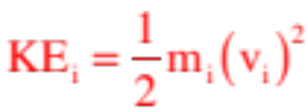
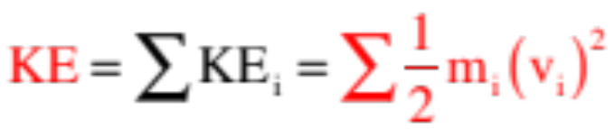
More Minutia: Rotational Inertia
and the Moment of Inertia
There is a rotational counterpart for every translational concept and para-meter out there. So what can we say about the energy content of a rotating disk?
Moved a distance units from the center of a disk rotating with angular velocity and you will find the mass moving with translational velocity . It’s kinetic energy calculates as:
To get the total kinetic energy for the entire mass, this process has to be done for all the masses with the results summed, or.
24.)

Slide 25


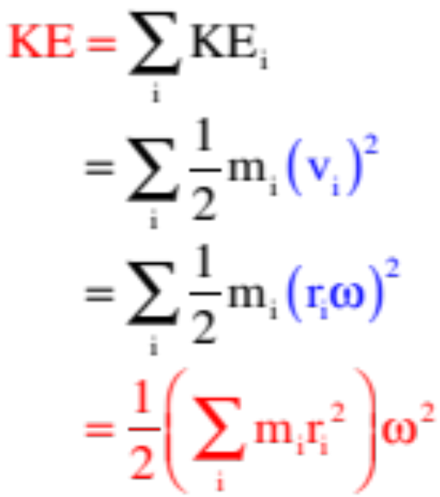


Noting that , we can rewrite that summation yielding:
Comparing this to leaves us with ½ and a velocity term squared, and a mass related term in parentheses.
This mass-related term is . It is called moment of inertia. It is always defined relative to an axis and it is the rotational counterpart to mass . . . which is to say, it is a relative measure of a body’s resistance to changing its rotational motion, or its rotational inertia.
25.)

Slide 26



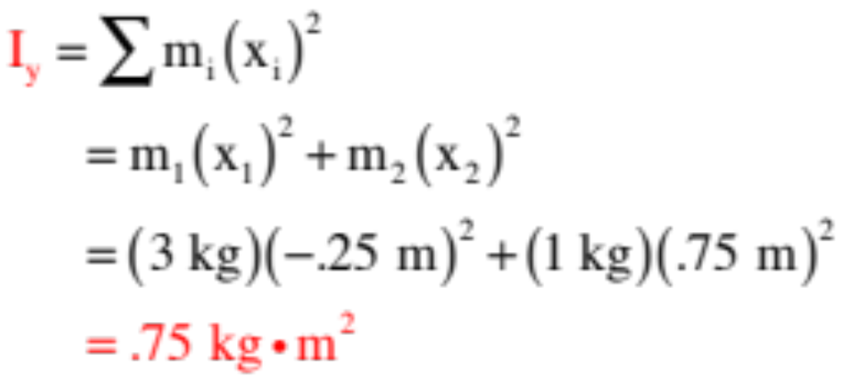



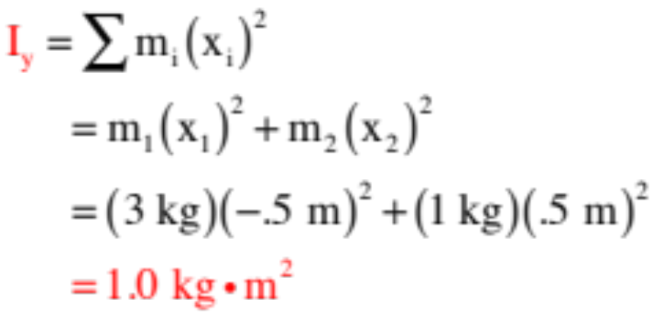


Example 2: Consider two masses m and 3m located a distance 1.0 meter apart. Relative to the coordinate axes shown:
a.) Determine the moment of inertia about the y-axis through the x-axis center of mass:
b.) Determine the moment of inertia about the y-axis as shown:
26.)

Slide 27




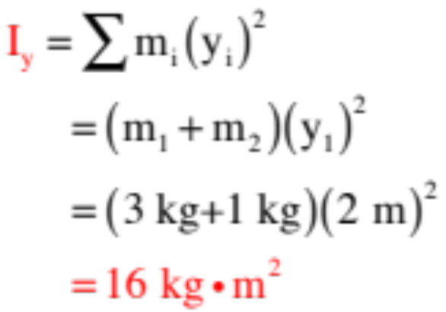



Notice the moment of inertia about the center of mass is smaller than about the other axes denoted. This is always true. is always a minimum.
c.) Determine the moment of inertia about the x-axis:
So what is this approach asking you to do? It is asking that you begin at the axis of interest, proceed outward until you run into some mass, multiply the mass by the distance-out-quantity-squared, and sum
all those quantities up. For this problem, that will look like:
Note: The closer a body is to an axis of rotation, the smaller its moment of inertia is about that axis.
27.)

Slide 28



Example 3: Keeping in mind what this approach is asking you to do, what is the moment of inertia of a thin cylindrical shell of mass M and radius R about its central axis?
This doesn’t really take any math. If you move out from the axis until you find some mass, you find all the mass a distance R units out (assuming the cylinder really is THIN). Multiplying that mass by that distance-squared yields:
In other words, although this won’t be the case in general, this was more of a conceptual exercise than anything else.
In general, when you need a moment of inertia expression for an object, you can either derive it or find it on page 287 of your text (or page 257 of Fletch’s text).
28.)

Slide 29
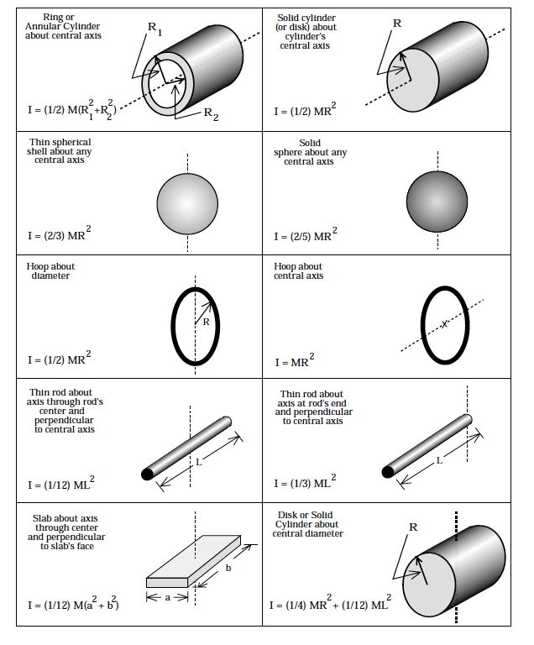
The table from Fletch’s book is shown to the right. Notice that the moment of inertia of a hoop (which is just a very short, thin cylinder) about its central axis is quote as:
just as we surmised. Still, you need to know generally how to do the derivations . . .
22b.)

Slide 30


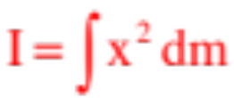


Example 4: Remembering what the approach is asking you to do, derive an expression for the moment of inertia of a homogeneous rod of length L about one end.
Although this is a continuous mass, the principle is the same. Move out along the x-axis until you find some mass, multiply by the distance-squared, then sum that quantity for all the masses found.
The problem? The system is not made up of discrete pieces of mass. That means that after moving an arbitrary distance “x” units down the axis, you need to create a differentially thin section of the rod of width “dx” to define a differentially small piece of mass “dm,” do the required multiplication, then sum all such pieces using integration. Doing this yields:
30.)

Slide 31
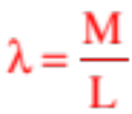
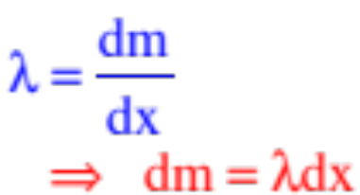
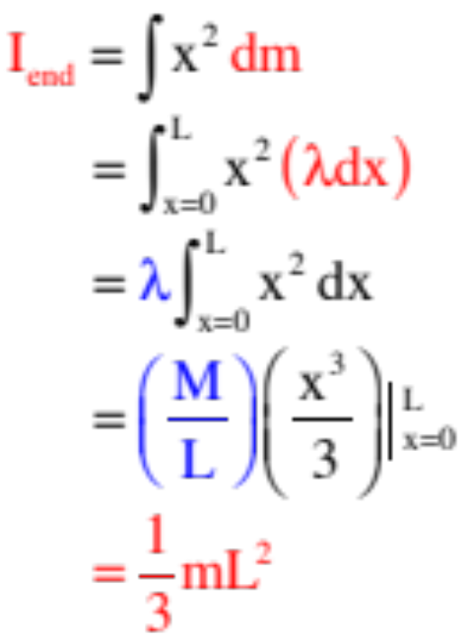
As we did with center of mass problems, we need to relate the position x of the bit of mass to the amount of mass dm that is there. To do that, we need to invoke a density function.
Due to the geometry, we will use a linear density function. With that in mind, we can write:
and
And with all that, we have:
31.)

Slide 32
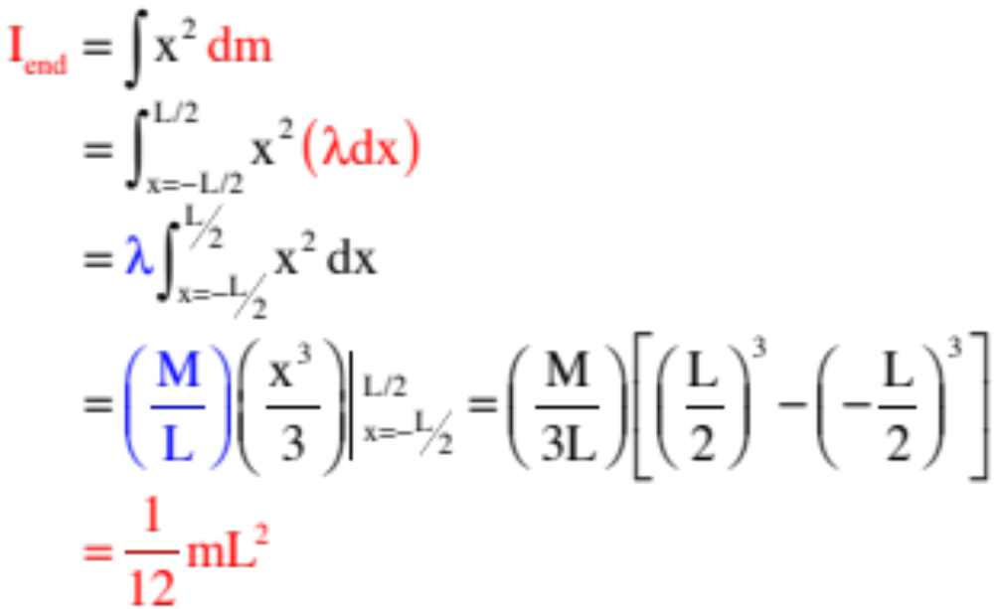
Example 5: Derive an expression for the moment of inertia of a homogeneous rod of length L about its central bisecting axis.
To define dx and dm:
32.)

Slide 33

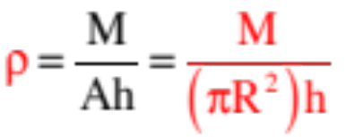



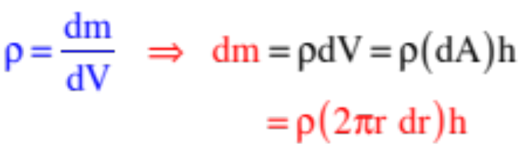
Example 6: Derive an expression for the moment of inertia of a cylinder of mass M and radius R about its central axis?
This requires a differentially thin cylindrical shell of radius r and thickness dr, which means we will need a volume density function. One way to write this is:
Noting that the differential volume of the differentially thin cylindrical shell will equal the shell’s differential area (it’s circum-ference times its thickness dr) times the cylinder’s height,
we can also write:
33.)

Slide 34
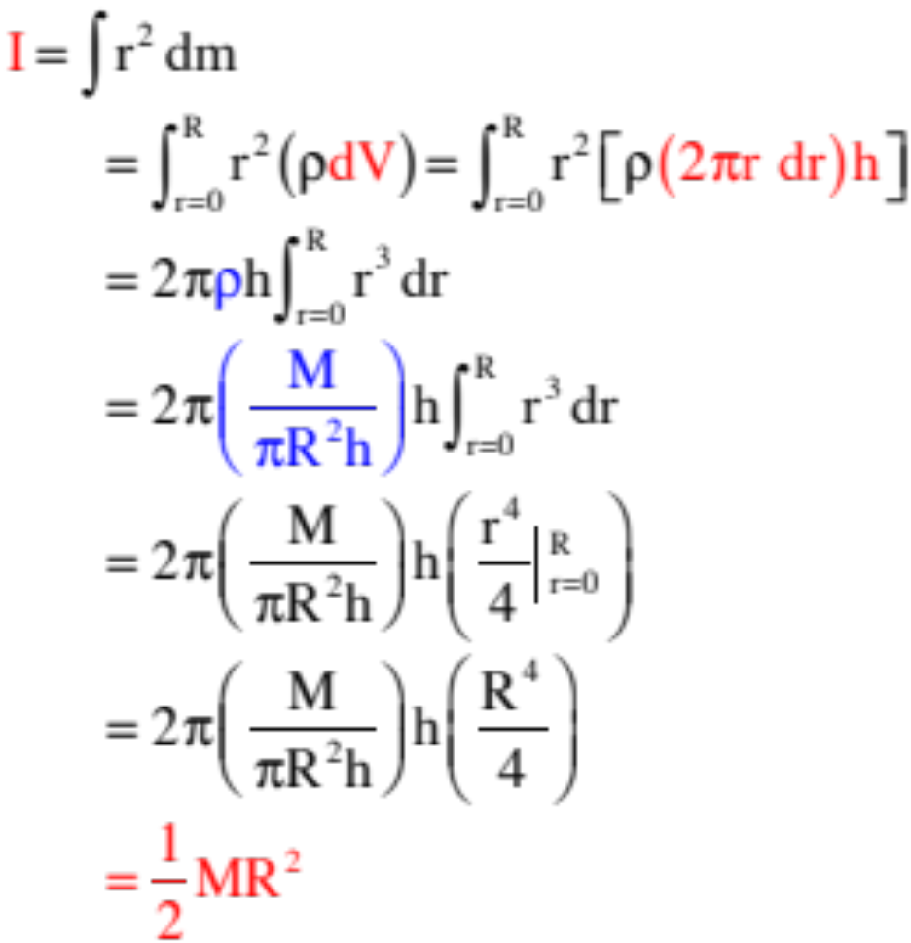
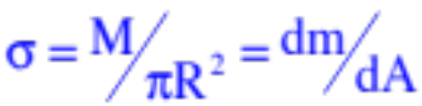

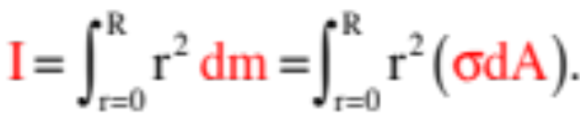
With that information, we can do our integral.
Note: We could as easily have used a surface density function , with and
34.)

Slide 35


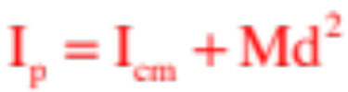




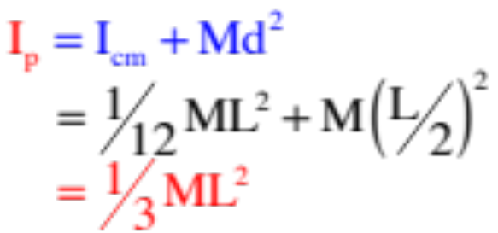

Parallel Axis Theorem
If you know the moment of inertia about an axis through the center of mass ( ), and want the moment of inertia about an axis parallel to that axis and a distance d units away ( ), the parallel axis theorem will allow you to determine that value. That expression is:
Example 7: Given that the moment of inertia of a beam about a central axis is , use the parallel axis theorem to determine the moment of inertia of the beam about one end.
. . . as calculated previously!
35.)

Slide 36








Torque
Consider the wrench shown below. Notice that the amount of rotational umph (this is a technical term) provided by the wrench on the bolt depends upon:
--how far out the force is applied ( ), and
--how big the force is ( ), and
--the component of the force ( ) perpendicular to .
The product of and generates the rotational counterpart to force, a vector called torque. When a net torque is applied to a stationary object that is free to rotate, the object will angularly accelerate.
36.)

Slide 37







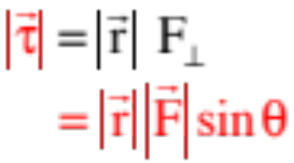
So formally defined, the MAGNITUDE of the torque generated by the force on the wrench is mathematically equal to:
As can be seen in the graphic, the perpendicular component of the force is equal to:
where is defined as the angle between the line of the force and the line of the position vector . (This definition is going to be important later.)
This means the torque can also be written as:
37.)

Slide 38



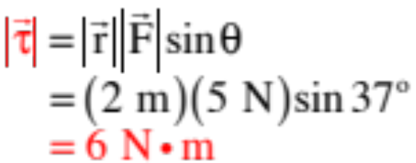


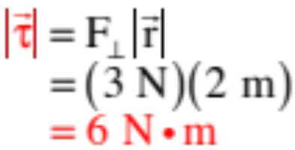
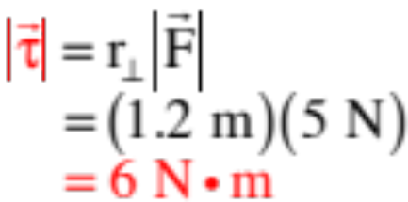
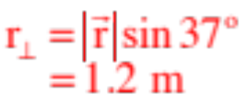
In fact, there are three ways to calculate a torque using polar information:
Definition approach:
F-perpendicular approach:
r-perpendicular approach:
38.)

Slide 39







Why is the r-perpendicular approach so powerful (and mostly preferred)?
Can you find the shortest distance between a point and a line? If so, you can find for any situation. Called the moment arm, that is what is, the shortest distance between the point about which you are taking the torque and the line of the force. With it,
Example 6: A ladder sits against a wall. Using the approach, determine the torque generated by the wall’s normal force N about the ladder’s contact with the floor.
line of the force
shortest
distance
1. Identify the position vector for the normal force.
2. Identify the line of N.
3. Identify shortest distance between floor contact and line of N, then express in terms of .
4. Determine the torque with
floor
39.)

Slide 40







Side point: Although we started by looking at a wrench, there are all sorts of instances in physics when we want to product of the magnitude of one vector and the perpendicular component of the second vector.
Because it pops up so often, this process is called a cross product. For two vectors and , the magnitude of is defined such that:
where is the angle between the line of and the line of .
The direction of a cross product will be perpendicular to the plane determined by and , and can be determined using the right hand rule.
Note that if and are in the x-y plane, the direction of the cross product will be in the + or – -direction.
40.)

Slide 41


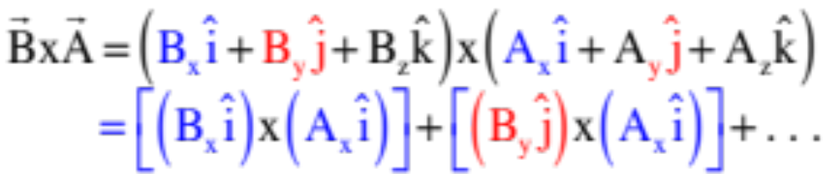
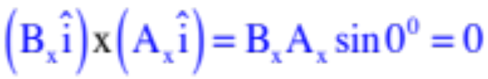
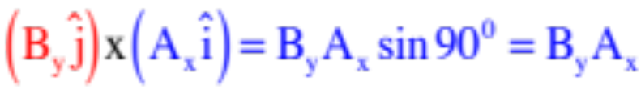
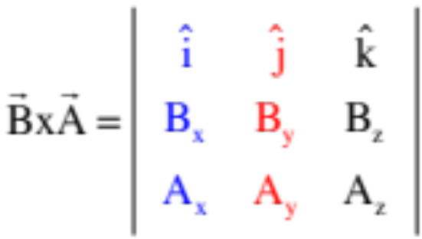
This is all fine and swell if you are dealing with polar notation, but what about vectors in unit vector notation? Specifically, if:
and
Then
But , so all the like-terms go to zero, and
in the -k direction, so we end up with 6 non-
zero parts.
What’s interesting is that those six parts fall out with the evaluation of the matrix:
Question is, how do you evaluate a matrix like this?
41)

Slide 42
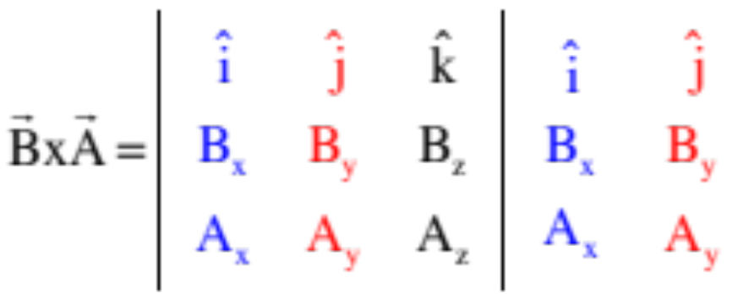
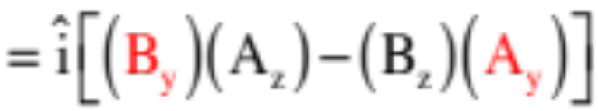

The operation is fairly simple (something you do over and over again).
Blank out the column and row in which exists the unit vector .
Evaluate the two-by-two matrix that is to the immediate right, and multiply it by .
42.)

Slide 43

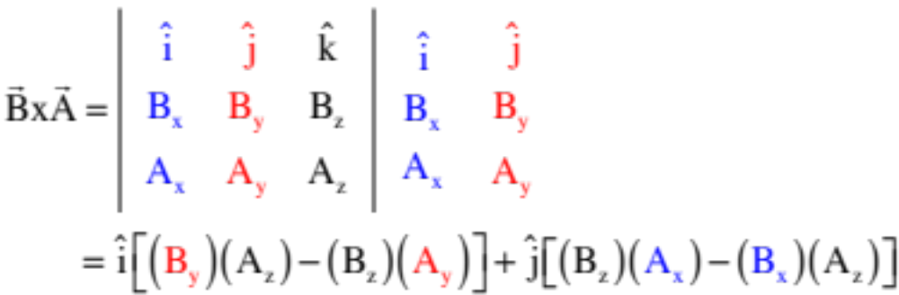

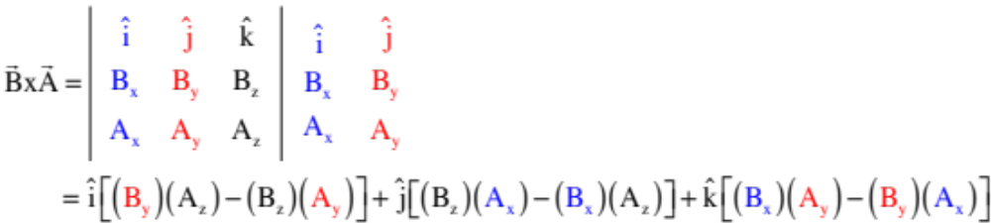
Adding in the term looks like:
Finishing off with the term gives us:
DON’T MEMORIZE the end result. Know the approach!
43.)

Slide 44



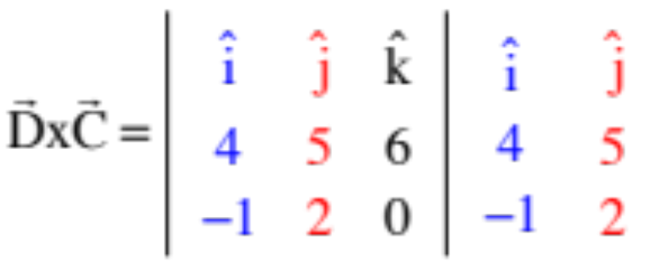
Example 8: Determine
44.)

Slide 45
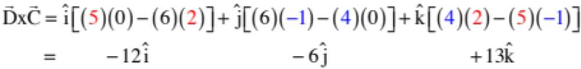
Example 8: (con’t) Determine
Solution:
+
+
445)

Slide 46




Newton’s Second Law Problems
Just as a net force acting on a mass is proportional to the acceleration of the body, with a proportionality constant being the mass of the body (i.e., a relative measure of the body’s resistance to change its motion), the net torque a body experiences about a point will be proportional to the angular acceleration of the body about that point, with the proportionality constant being the moment of inertia about that point (i.e., a relative measure of the body’s resistance to changing its rotational motion about that point). In other words, just as:
so also is:
Because all of our problems are going to have rotation in the plane of the page, they will all have rotational vector directions of . We will need to keep track of signs, but we won’t need the unit vector. As a consequence, the rotational version of N.S.L. can be written as:
46.)

Slide 47





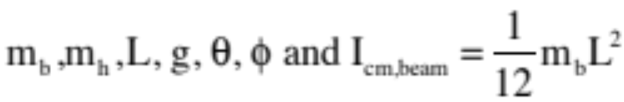






Example 9: A beam of mass and length L is pinned at an angle a quarter of the way up the beam (i.e., at L/4). A hanging mass is attached at the end. Tension in a rope three-quarters of the way from the end keeps it stationary. What is known is:
pin
a.) Draw a f.b.d. identifying all the forces acting on the beam.
47.)

Slide 48

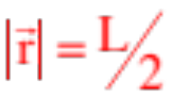

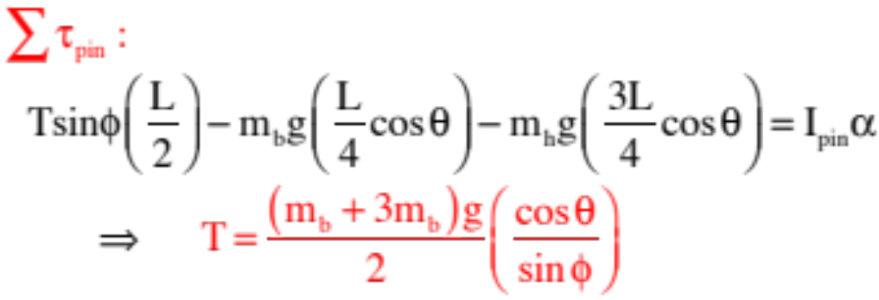


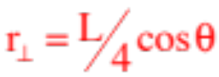
b.) Derive an expression for the tension in the line.
The clever thing to do here is to sum the torques about the pin. That will eliminate both H and V leaving you with only one unknown, T. What’s even more clever is to use the F-perpendicular approach on T as that component is REALLY easy to determine (given ).
For T:
For mg’s:
4le8)

Slide 49


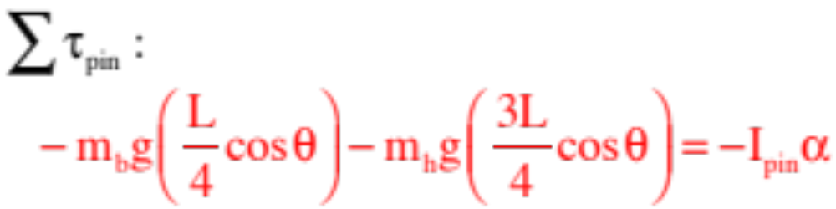

c.) Derive an expression for the angular acceleration of the beam about the pin just after the cable is cut.
This is the same problem you just did with one major difference. You don’t have to do a torque calculation for the tension because T is no more, and the term (where I is the moment of inertia about the pin) is no longer zero. With the non-zero torques about the pin being gravity and the hanging mass, and we can write:
Problem: We weren’t given , we were given . Enter the parallel axis theorem!
49.)

Slide 50

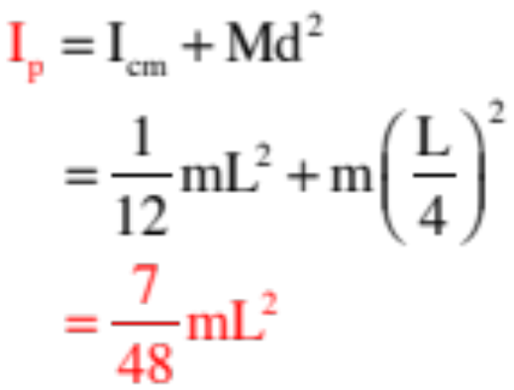
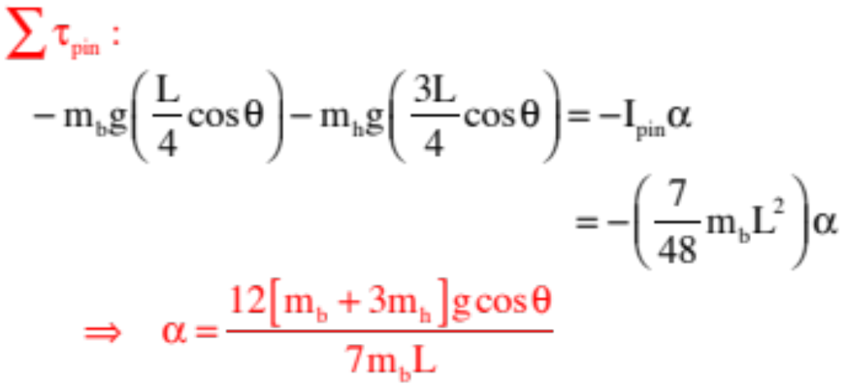

The parallel axis theorem states:
where d is the distance between the two parallel axes. In this case, that distance is L/4, so we can write:
and
50.)

Slide 51


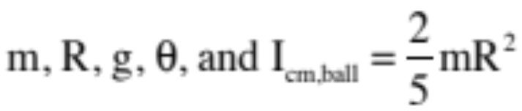
Example 10: A ball of radius R rolls without slipping down an incline of angle . a.) What is the acceleration of the center of mass, and b.) what is its speed after it has dropped a distance h?
Assume you know:
Before we can do this problem, there is something that needs to be noted about objects rolling up or down an incline. We need to talk about rolling friction and, more specifically, the direction of rolling friction.
Thinking back to what we said about static friction and its cause. The molecular structure of the bodies in contact meld into one another, and the electron-repulsion of their elements create a kind of bonding that needs to be released before motion can occur (the slide I used to animate this idea is shown on the next page). With sliding, that release takes the form of shearing and translates into what we call kinetic friction. With rolling, that release takes the form of pealing and is called rolling friction. What is important to note is that both have the underlying melding mechanism associated with static friction.
51.)

Slide 52










A little closer look is instructive. As the electrons of the upper object (in blue) nestle into the electron configuration of the lower object (in red), they apply a repulsive force to one another (see sketch).
The horizontal components add to zero. The vertical components producing the normal force that supports the upper object.
But try to move the upper body to the right and the horizontal components will no longer cancel.
This net horizontal force is known as the static frictional force between the two bodies. It is the force that has to be overcome before the upper body can actually accelerate to the right. Put a little differently, for the top body to accelerate, an external force to the right that is large enough to effectively shearing the repulsive bonds that exist between electrons has to be applied.
52.)

Slide 53
What changes if the one of the bodies is round and the second object, the underneath object, is an incline. The round body’s weight will motivate it to slough down against the repulsing (green) electrons of the incline (see sketch). That tendency to ease down the incline is what produces the static frictional force UP the incline (again, notice offset of electrons in sketch).
In fact, it doesn’t matter whether the round body is rolling up the incline or down it, that electron interaction will always produce a static friction force that is UP the incline.
rolling friction UP the incline
53.)

Slide 54





Example 10: A ball of radius R rolls without slipping down an incline of angle . a.) What is the acceleration of the center of mass, and b.) what is its speed after it has dropped a distance h?
Assume you know:
a.) What is the acceleration of the center of mass of the ball?
Because we are going to be taking torques, we need to place the forces on our f.b.d. where they actually act on the body.
There are two ways to do a problem like this. We’ll execute both.
The first approach looks at the motion from the perspective of the center of mass.
54.)

Slide 55




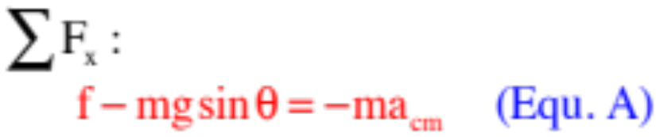
a.) con’t.
The center of mass both accelerates and has mass angularly accelerate about itself.
Dealing with the translational motion first:
According to Newton’s Second, summing the forces along the line of the acceleration will equal the mass times the acceleration of the center of mass along that line.
Our f.b.d. shows the forces and force components along the line (and perpendicular to the line) of acceleration. Doing the summation yields:
55.)

Slide 56



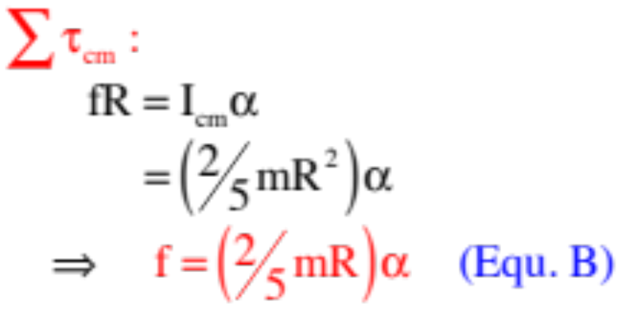
a.) con’t.
Dealing with the rotational motion:
According to the rotational version of Newton’s Second, the sum of the torques about the center of mass will equal the moment of inertia about the center of mass times the angular acceleration of the body about the center of mass.
A dressed down f.b.d. showing the forces without axes or components allowing us to identify any vectors and quantities. With those, the torque summation yields:
56.)

Slide 57



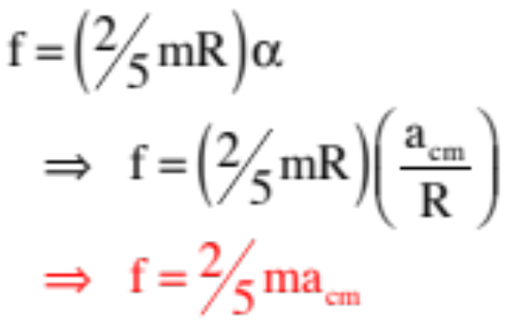

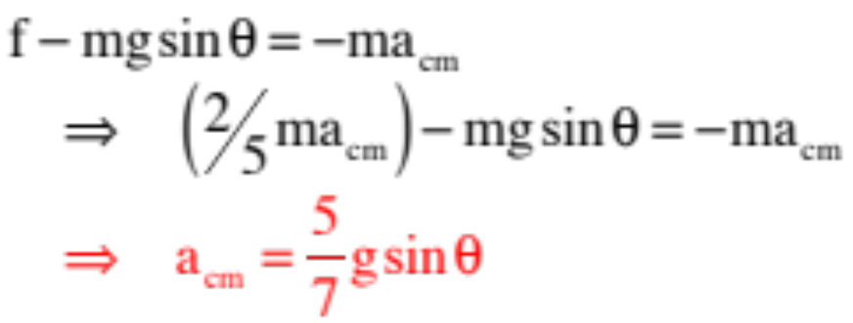
a.) con’t.
Remembering that for a rolling object, Equ. B becomes:
From Equ. A, then:
57.)

Slide 58



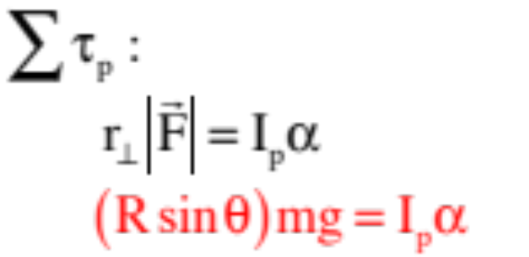
a.) con’t.
The second approach looks at the motion from an instantaneous fixed point at the point of contact perspective (remember, you can’t tell the difference between the motion of the two situations, instantaneously). From that perspective, summing the torques about the contact point eliminates the normal and friction leaving only a torque due to gravity, and we can write:
The torque is about the axis at P, so the moment of inertia must be about P. Enter (again) the parallel axis theorem.
58.)

Slide 59
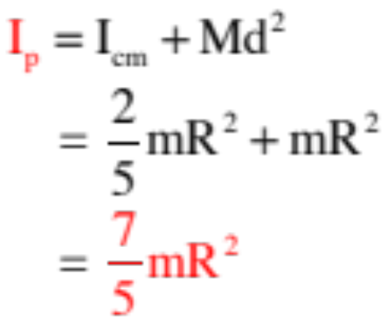
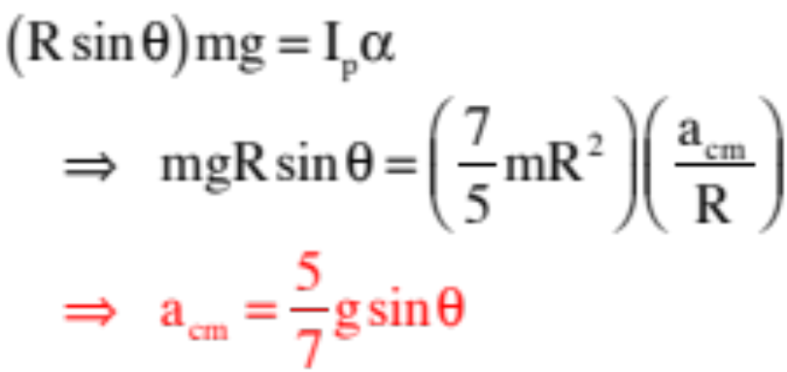
The parallel axis theorem maintains:
That means:
This is the same solution we got using the previous approach.
So which approach should you use in a given problem? Use the one that most naturally reflects the situation. In this case, the body’s center of mass was both accelerating and had mass angularly accelerating around it, so the c.of m. approach was the most reasonable. In the case of a pinned beam, the mass is angularly accelerating around a fixed pin, so the fixed point approach is best. Use the approach that best reflects what’s actually happening in the system.
59.)

Slide 60



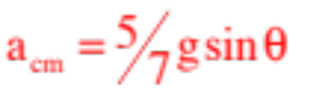


Example 10 continued: A ball of radius R rolls without slipping down an incline of angle . What is the speed of its center of mass after it has dropped a distance h? Assume you know:
b.) What is the velocity of the center of mass after the ball drops a distance h?
There are two ways to do this problem, one using kinematics and one using energy considerations. We’ll do the kinematics approach, first.
We’ve already determined the acceleration of the center of mass down the incline to be . We know the initial velocity is ZERO, and we know the body travels d, or:
60.)

Slide 61


With that information, we can write:
This is all fine and swell if you already know the ball’s acceleration (or angular acceleration), but if you don’t, doing the Newton’s Second Law evaluation just so you can use kinematics is kinda dumb . . . especially when you have an approach that is MADE to deal with velocities . . . conservation of energy!!!!!
61.)

Slide 62

Energy Considerations
When we derived the general expression for a rotating body’s moment of inertia, we introduced the idea of rotational kinetic energy. That expression was:
How might this play into a conservation of energy problem with rotational motion? In essence, we do NOT define potential energy functions for work being done by rotational agents, so the only terms that are generally affected in the conservation of energy relationship are the kinetic energy terms and, maybe, the extraneous work quantities.
But first . . .
62.)

Slide 63
A Preliminary Observation
Let’s say you have a block sliding down a frictionless ramp, and a ball rolling down an identical frictional ramp (same angle). If both are released from rest at the same time and same height, which object will get to the bottom of the incline first, and which will have the greatest speed?
The answer: The block will get to the bottom first and be moving fastest, though possibly not for the reason you might think.
Specifically, both objects start with the same amount of potential energy, so it might be a temptation to assume that friction does extraneous work on the ball and, hence, it’s velocity at the bottom will be less than that of the block moving over the frictionless surface. That isn’t the key, and you need to understand why.
63.)

Slide 64
Think back to our discussion of friction. Objects in contact with one another nestles into one another at the molecular structure. What stops the incursion is repulsion between the electrons of the two structures. Try to move one of the objects and that electron repulsion becomes imbalanced, producing a retarding force that on the macroscopic level is called static friction. To move one of the objects, you have to exert enough force to overcome this bonding-like situation. Doing so produces motion. During relative motion, the melding continues to exist, just not as much. The need to continually overcome the electron repulsion set up by this lesser melding is what we associate with kinetic friction. When a body ROLLS over a surface, there is no shearing. Instead, the surfaces peal back from one another. This removes VERY LITTLE energy from the system.
Bottom line: It isn’t friction that makes the ball move slower. It’s the fact that in the case of the block, all of the gravitational potential energy goes into changing the body’s translational kinetic energy. In the case of the ball, where not only the center of mass is accelerating but also there is angular acceleration around the center of mass, some of that initial gravitational potential energy goes into changing the body’s translational KE (and, hence, it’s translational velocity) but some also has to go into changing the body’s rotational KE. Having less energy for translational KE, the ball moves slower than the block at the bottom of the ramp.
64.)

Slide 65

Example 10 continued: A ball of radius R rolls without slipping down an incline of angle . Assume you know:
b.) What is the velocity of the center of mass after the ball drops a distance h.
Starting from scratch, energy consideration is the way to go here. Remem-bering that the ball started from rest, we can write:
65.)

Slide 66








Example 11: So let’s go back to the swinging beam of length L pinned at an angle a quarter of the way up the beam (i.e., at L/4). The cable is cut and the beam swings down. What is the velocity of it’s center of mass as it passes through its lowest point. We know:
pin
and we calculated earlier the moment of inertia about the pin as:
In this case, the object is rotating about the pin, so it makes sense to evaluate its motion relative to the fixed axis at the pin. Tracking the center of mass drop for potential energy positions (see sketch), we can write:
66.)

Slide 67



We could have looked at this from the perspective of the center of mass. That would look like:
Try the math. It will yields the same result.
67.)

Slide 68






Rotation, Translation and Pulleys
You have seen a problem in which a body has both translated and rotated (a ball rolling down an incline), but we haven’t yet dealt with pulleys and situations with multiple masses. With that in mind, consider:
Starting simple—Example 11: Consider a hung pulley with a rope around it and a mass attached to its end. If the pulley is massive, and WITHOUT using kinematics:
a.) Derive an expression for the system’s acceleration.
Starting with the translational version of N.S.L. on the hanging mass:
Two unknowns (a and T)—require another equation.
68.)

Slide 69



a.) con’t.
Assuming the pulley is a disk, so it’s moment of inertia can be approximated at:
we can write:
Combining our two relationships yields:
69.)

Slide 70



b.) How fast is the hanging mass moving after it has fallen a distance h?
Without using kinematics, this is a conservation of energy problem. Remembering that the disk will have rotational kinetic energy, we can write:
Interesting note: The calculated work tension did on the hanging mass as it fell was negative; the calculated work tension did on the pulley as it rotated was positive; and the two are equal summing to zero. That internal force did no net work on the system.
70.)

Slide 71








Example 12: something a little more complex: An Atwood Machine with a massive pulley of radius R (see sketch). Without using kinematics:
a.) Derive an expression for the system’s acceleration.
Note that we’ve done this problem before! So what’s different? The tension in the lines can no longer be equal. How so? If they were, the torques provided by the two tensions would be equal and opposite, so the net torque would be ZERO, hence no angular acceleration. But there is angular acceleration, so the tensions must be different. So . . .
71.)

Slide 72







a.) con’t.
There are three unknowns: Your third equation is coming from summing torques about the pulley.
With acceleration defined downward,
the pulley’s angular acceleration must be clockwise and negative, so:
Substituting tensions
and
and we get:
72.)

Slide 73


b.) How fast are the hanging masses moving after they have traversed a distance h?
Again, this is a conservation of energy problem. Defining the zero-potential energy levels, then writing out the governing equation for the system without solving yields:
So two morals here:
1.) The tension on either side of a massive pulley is different; and
2.) You can assign each mass its own zero potential energy level for gravity (near the surface of the earth), independent of any other mass in the system.
3.) Although it may not be obvious at first glance, the extraneous work done by the two tensions added to the work done by the torque produced by those tensions on the pulley will add to zero (that’s why is zero).
73.)

Slide 74








Example 13: Consider a string attached to a hanging mass at one end and to a block on an incline of angle at the other. The string is hung over a massive pulley of radius R and known I. What is given is:
a.) Derive an expression for the hanging mass’s acceleration when the system is released.
For hanging mass (assuming acceleration upward):
74.)

Slide 75









a.) con’t
For block (assuming acceleration down the incline):
For pulley (assuming angular acceleration clockwise):
75.)

Slide 76



a.) con’t
Remembering that:
and
we can write:
76.)

Slide 77


Example 13 (con’t): Consider a string attached to a hanging mass at one end and to a block on an incline of angle at the other. The string is hung over massive pulley of radius R and known I. What is given is:
b.) Derive an expression for the hanging mass’s velocity after it has risen a distance h.
This is a conservation of energy problem:
Note that when the hanging mass rises a distance h, the block slides down the incline a distance h but drops a distance d:
77.)

Slide 78


Where do we define the zero potential energy levels?
Assuming the zero level for the hanging mass is where it starts out, and the zero level for the block is where it ends up, we can write:
78.)

Slide 79



Problem: An arm of length “L” is welded to a pulley of radius R. The system is pinned at the pulley’s center of mass. A lump is glued to the pulley/arm’s end whose length is 2R. The system is initially stationary. Known:
a.) Draw a f.b.d. for the forces acting on the pulley/arm system. (Hint: Note that as there is only a vertical force initially acting at the pin, and there are 5 of these forces).
79.)

Slide 80
b.) Determine the moment of inertia of the system about the pulley’s pin.
parallel axis
theorem
80.)

Slide 81
c.) How would you determine how large a force the finger would have to be to keep the system in equilibrium?
Sum the torques about the pin . . .
d.) The finger is removed and the system released. Derive an expression for its initial angular acceleration?
81.)

Slide 82
e.) Is the angular acceleration constant? That is, if you wanted to determine, say, the angular velocity of the ensemble as it swung down through its lowest point, could you use rotational kinematics?
To see, we need to determine the angular acceleration expression for an arbitrary orientation. Consider:
Apparently the angular acceleration is a function of the angular displacement from the horizontal, which means the angular acceleration is not constant . . . which means you can’t use rotational kinematics to solve for anything . . .
82.)

Slide 83
f.) The entire system rotates down with the the arm passing through the vertical. At that point, what is the system’s angular velocity?
We need to identify the potential energy in the system to start with. As there are no rotational potential energy functions, all we need to worry about is gravitational PE for each piece of the system. From there, we can either approach this as a pure rotation of the entire system, or as individual pieces rotating with one another. We’ll do both, starting with the latter:
(treated like point mass)
(“I” from parallel axis theorem)
83.)

Slide 84
g.) (con’t.) Equating the right and left side, the beast yields an angular velocity of:
If we had treated this as a pure rotation of the entire ensemble, it would have looked like:
h.) Lastly, what would the nub’s velocity be at the bottom of the motion?
84.)

Slide 85
Example 14: Hinged beam and ball demo: plank hinged at one end rotating down with end achieving acceleration greater than g. (demo)
85.)

Slide 86
Ignore the mass of the catch, ball and tee. The moment arm for gravity if the torque is taken about the pin is:
so N.S.L. yields:
shortest distance between pin and line of force
Note: for when board horizontal, the acceleration of the end of the board is “1.5g”, which is greater than “g.”
and the end’s acceleration is:
86.)

Slide 87
Example 15: Lastly, a stinker: A hanging mass is attached to a string which is threaded over a massive pulley of radius R, and wound around a ball of radius R/2 sitting on an incline. The pulley is positioned so as to let the string always be parallel to the plane of the incline. We know:
a.) Derive an expression for the hanging mass’s acceleration when the system is released.
For hanging mass (assuming acceleration downward):
For reasons of clarity, I’m going to redefine this acceleration as the acceleration of the string and rewrite this N.S.L. equation as:
87.)

Slide 88
The ball is experiencing both an acceleration of its center of mass AND and angular acceleration about it’s center of mass. Noting that friction is up the incline (if the ball broke
traction, it would spin clockwise), we can take each type of motion, translational and rotational, as a separate entity.
For ball’s translational motion (assuming acceleration upward) with components:
88.)

Slide 89
The problem with this expression is that we have the hanging mass’s acceleration in terms of what the string is doing, and the ball’s acceleration in terms of what its center of mass is doing. To relate the two, notice that if the
contact point has zero instantaneous acceleration, we can write:
instantaneously
so
89.)

Slide 90
a.) con’t
For ball’s rotation (assuming angular acceleration clockwise and summing torques about the center of mass):
Problem? We need an expression for the angular acceleration of the ball in terms of the acceleration of the string.
90.)

Slide 91
a.) con’t
For the angular acceleration of the ball in terms of the acceleration of the string (which is to say, the acceleration of a point on the outer edge of the ball):
instantaneously
With that:
91.)

Slide 92
a.) con’t
For pulley (assuming angular acceleration clockwise):
So we have everything in terms of the string. It’s time to compile.
92.)

Slide 93
a.) con’t
93.)

Slide 94
a.) con’t
with
and
94.)

Slide 95
b.) Derive an expression for the hanging mass’s velocity after dropping a distance h.
This is very much like a standard conservation of energy problem with the exception that you have to keep track of subscripts and make the appropriate substitutions when it’s time to solve. I’ll not solve it, but writing it out looks like:
95.)

