Slide 1
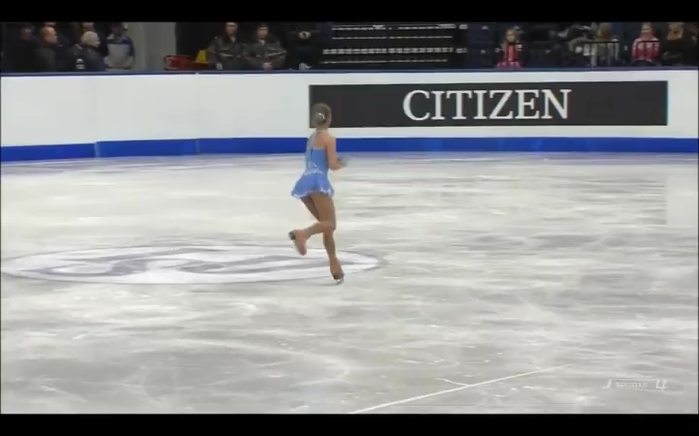
Change your orientation, you change your motion . . . (courtesy of Yulia Lipnitskaya
1.)

Slide 2
A Little Non-AP Tom-Foolery
A wheel suspended from the ceiling is held motionless in the position shown.
What happens when the wheel is released?
It flops down . . .
Now the same wheel is made to spin before it is released – will anything change?
It doesn’t flops down . . . rather, it stays upright and begins to precess about its hold-point . . .
2.)

Slide 3
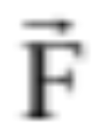

In the same vein:
As demonstrated in class, a force quickly applying a torque to the pinned axle of a rotating wheel will not motivate the wheel to follow the direction of the applied force. Instead, it will jerk the wheel to the right or left, depending upon the direction of the wheel’s rotation.
pinned
By the end of this unit, you will have the tools to predict that this should happen!
3.)

Slide 4
The Island Series:
You have been kidnapped by a crazed physics nerd and left on an island with twenty-four hours to solve the following problem. Solve the problem and you get to leave. Don’t solve the problem and you don’t.
The problem: You are on a street walking a bicycle toward a curb. You want to lift the bike by its seat up and over the curb without having the front tire flopping around as you do it. Your task is to divine a maneuver that will insure the wheel stays straight.
4.)

Slide 5

Solution to Island Problem
Just before you get to the curb, accelerate the bike so the front wheel is rotating as fast as possible. The front wheel’s large angular momentum vector, directed along the wheel’s axle, will keep the wheel orientated as set. That is, as long as there are no external torques acting, the wheel will keep its orientation just as a gyroscope keeps its.
angular momentum
5.)

Slide 6


CHAPTER 11:
Angular Momentum
We began the Momentum Chapter with an observation. If you want to stop an object in a given amount of time, the size of force required to make the stop will be governed by two parameters: the mass of the object (i.e., a relative measure of the body’s resistance to changing its motion) and its velocity. From that observation, the idea of MOMENTUM ( ) was born.
In the same sense, if you want to stop an object’s rotational motion in a given amount of time, the size of torque required to make the stop will be governed by two parameters: a relative measure of the body’s resistance to changing its rotational motion (i.e., it’s moment of inertia) and its angular velocity. From this we define ANGULAR MOMENTUM ( ).
And just as we developed theory that led us to relationships between momentum and force through impulse, and to the conservation of momentum, all of those avenues can be followed in an exact parallel in the world of rotation.
6.)

Slide 7









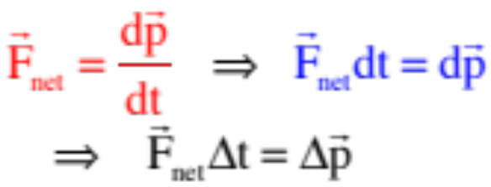
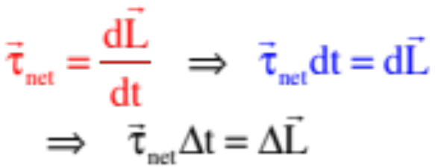



Summary (with new stuff in red)
translational world
rotational world
translational parameters:
rotational parameters:
force:
torque:
Newton’s Second Law:
Newton’s Second Law:
momentum:
angular momentum:
(or for a point mass about a point):
impulse:
angular
impulse:
conservation of energy
conservation of energy
conservation of momentum
conservation of angular momentum
7.)

Slide 8







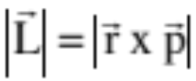

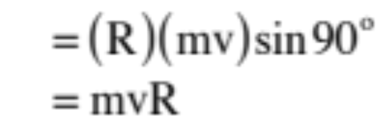

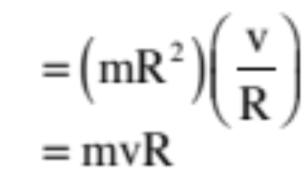

Angular Momentum: There’s a lot here. To make life easier, we are going to go after these ideas in pieces.
Example 1: A point mass m moves with velocity v in a circular path of radius R. Determine its angular momentum using:
a.) Translational parameters:
Note the direction of the cross product!
b.) Rotational parameters:
Note: the direction of the angular momentum is perpendicular to the plane of the motion ( direction), as would be expected of a counterclockwise rotation.
8.)

Slide 9
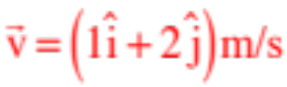
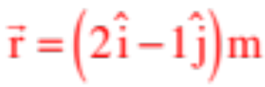
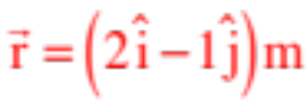

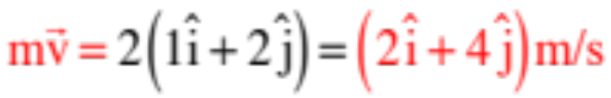
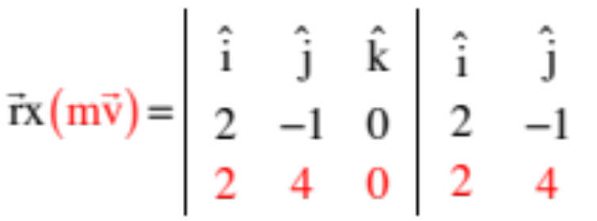
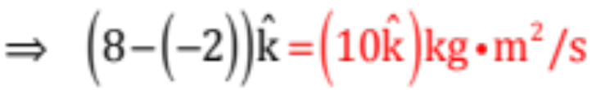
Example 2: What is the magnitude and direction of the angular momentum, relative to the origin, for a 2 kg particle moving at constant velocity at the instant it is at ?
Evaluating a cross product when given vectors in unit vector notation requires matrix manipulation (think back to torque calculations). Noting that the momentum is
We can write:
9.)

Slide 10

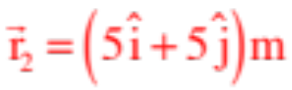

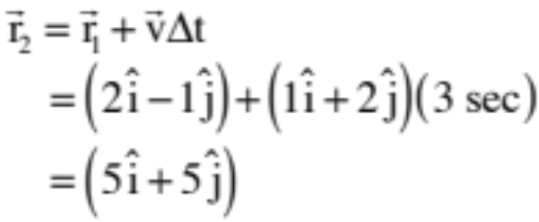
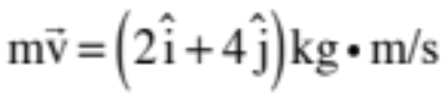
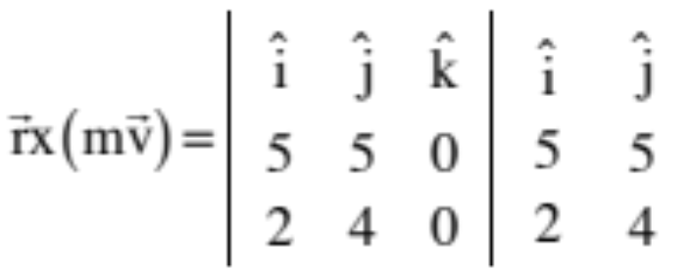
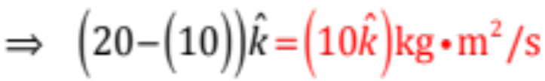
Example 3: Our 2 kg particle (the one moving at constant velocity when at at t = 0), what is its angular momentum at t = 3 seconds?
Using kinematics, at t = 3 seconds, the body’s position will be:
after 3 seconds of constant velocity
Momentum is still , so
10.)

Slide 11







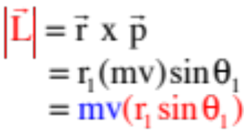
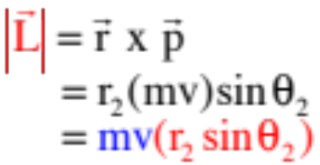


From this, a HUGE observation: Objects moving in a straight line HAVE angular momentum, and the angular momentum is CONSTANT!
This seemingly insane bit of amusement is actually grounded in intuitively sound reasoning. To see how, consider the simplest motion possible, a mass moving with constant velocity parallel to the x-axis. How does the angular momentum calculate out at several points in that case?
A little bit later . . .
Same angular momentum! But how can a body moving STRAIGHT have angular momentum?
11.)

Slide 12
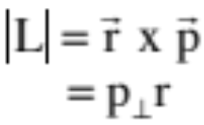








Consider a body moving in circular motion. Its angular momentum will equal:
where is the body’s momentum. This momentum will be perpendicular to the position vector and tangent to the path. Nobody would argue that this body’s motion was without angular momentum, as its motion is circular!
Now consider a particle moving parallel to the x-axis with momentum mv, as shown in the sketch.
It will have a momentum component that is radial and outward from the origin, and a tangential component ( ) that is perpendicular to the .
In other words, one of its components will be exactly like the momentum involved in the object that was executing a pure rotation, that had angular momentum. Conclusion, this body, moving in a straight line, will also have angular momentum (assuming its velocity vector doesn’t go thru the reference point).
12.)

Slide 13

Conservation of Angular Momentum
Remember how we proceeded through derivation of the conservation of momentum (start with the impulse relationship, apply it to two bodies that collide with one another where one has an external force via a jet pack applied to it, add the impulse relationships written for each body over the course of the collision, then leave the external impulse terms on the lefts side of the equation accompanied by the beginning of the interval variables with the end of the interval variables on the right side of the equation).
If we did a rotational analogue to that with two rotating objects interacting with an external torque acting in the mix, acknowledging that everything would be happening in “one dimension” (i.e., along the ), we could rearrange the impulse relationships likewise yielding:
This relationship essentially says that as long as there are not external torque-related impulses acting, the angular momentum of a system will not change over time. This is the conservation of angular momentum theorem.
13.)

Slide 14






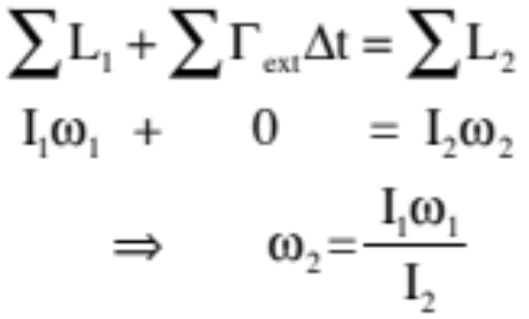

Example 4: An ice skater with arms out has an angular speed of and a moment of inertia . She pulls her arms in.
before
after
a.) What happens to her moment of inertia as she pulls her arms in?
(it decreases)
b.) What is her new angular momentum?
(no external torques, so it doesn’t change)
c.) What was her new angular speed?
There are no external torques acting on the woman, so conservation of angular momentum yields:
. . . And as , her angular velocity increases.
14.)

Slide 15
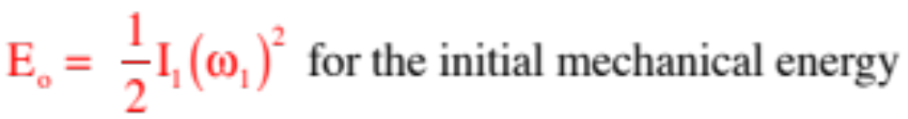
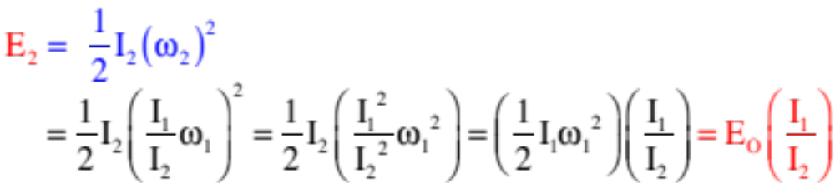
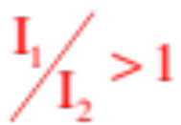

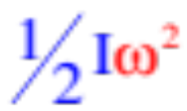
Example 4 (cont’) : An ice skater with arms out has an angular speed of and a moment of inertia . She pulls her arms in.
before
after
d.) Is mechanical energy conserved during this action? Justify and comment.
Just by using your head, chemical energy in your muscles must be burned to force your arms inward, so you might expect that the mechanical energy in the system would not be conserved. Looking at the math, though:
But , so and mechanical energy is NOT conserved. This should not be a surprise. When the moment of inertia diminishes and angular velocity gets proportionally LARGER due to conservation of angular momentum, KE must go UP as it is governed by velocity (remember, ).
15.)

Slide 16



Example 5: Another standard problem is the merry-go-round problem. A merry-go-round, assumed to be a disk, has mass M and radius R. It also has two kids who push the m.g.r.’s outer edge by running along side of it to get it up to an angular speed of . The kids, each of which have a mass of , then jump on and start to walk toward the center of the m.g.r. When they get to within units from the center, they stop. What is their speed at that point?
kid
walk
walk
kid
As they walk inward, each kid applies a force, hence torque, to the m.g.r., that changes the m.g.r.’s angular velocity. As a Newton’s Third Law action/action pair, the m.g.r. applies a force, hence torque, to the kids changing their angular velocity. As these are all internal impulses, conservation of angular momentum is applicable.
Interestingly, there are TWO ways we can go here with the kids:
16.)

Slide 17
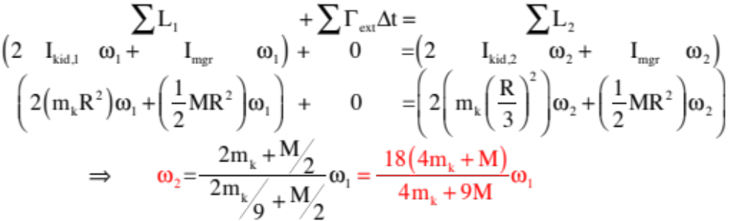
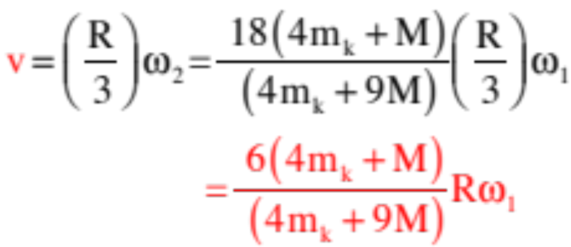
treating the two kids as rotating point masses:
the kid’s velocities:
17.)

Slide 18
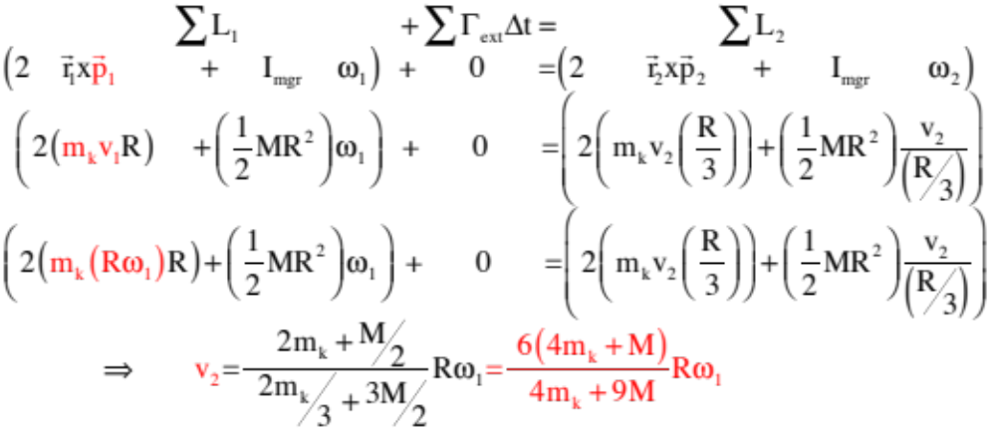
treating the kids as point masses:
Same solution either way. What’s important is the set-up, not all the nasty math.
18.)

Slide 19

Example 6: In 1967 as a graduate student, Jocelyn Bell (aka Dame Jocelyn Bell Burnett) observed, in the face of scant support from her advisor, Antony Hewish, the first pulsar. In 1974, in a classic “keep ‘em barefoot and pregnant” move, the all male, presumably all white Nobel committee gave Hewish the Nobel Prize in Physics for the discovery while ignoring Bell
altogether. With that monumental injustice in mind, consider the lowly pulsars:
When a star with a core between 1.4 and 1.8 solar masses dies, it explodes spectac-ularly in what is called a supernova. (Example: In 1054, a supernova occurred that was observed by the Chinese and was visible during the day for two weeks.) When a supernova happens, the outer part of the star blows outward creating what is called a nebulae (the supernova in 1054 created the Crab Nebulae) and the core is blown inward. The implosion is so violent that it forces electrons into the nuclei of their atoms (removing all the space in the atoms in the process) where they combine with the protons there to produce neutrons that stop the implosion by literally jamming up against one another. With all that space removed, the resulting structure is incredibly dense (think a thousand Nimitz class aircraft carriers compressed into the size of a marble) and small (think 10 to 15 kilometers across).
19.)

Slide 20



(con’t) The significance of all of this is that nature provides us with a WICKED example of conservation of angular momentum.
How so? There are no external torques acting during the supernova, so angular momentum is conserved. The enormously massive structure spread out over hundreds of thousands of kilometers starts out with a HUGE RADIUS and angular momentum even though its angular speed is low (the sun takes 25 days to rotate once about its axis). In other words, its angular momentum looks like:
20.)

Slide 21


After the supernova, the moment of inertial drops precipitously because the radius goes from several hundred thousand kilometers to, maybe, 15 kilometers during the explosion, BUT THE ANGULAR MOMENTUM STAYS THE SAME which means the angular velocity skyrockets. In other words, the final angular momentum relationship will look like:
In short, pulsars (neutron stars) are super dense structures that rotate anywhere from a few cycles per second all the way up the several hundred cycles per second, all as a consequence of conservation of angular momentum.
21.)

Slide 22
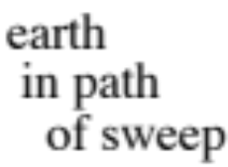
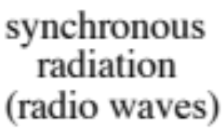

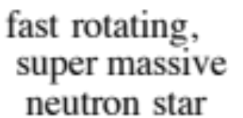
But what’s really cool is that they put out what is called synchronous radiation—radiation that is very directional and that is in the radio frequency range. So if the sweep of radiation of one of these fast rotating objects just happens to cross the
earth’s path, a blast of radio wave will hit the earth every time the star completes one rotation. In other words, we can hear them using a radio telescope. This is what you will experience on the next slide. Pretty amazing!
And as a small side-point, I’ve REALLY simplified what’s going on with these things. According to Sterl Phinney, Professor of Astrophysics at Caltech (and a Poly parent), the progenitor of the Crab Nebula lost 99% of its angular momentum during and since its supernova. More about this on the next slide (if I get the time to generate it).
22.)

Slide 23
Non-AP minutia about neutron stars: According to Dr. Phinney,
21.)

Slide 24
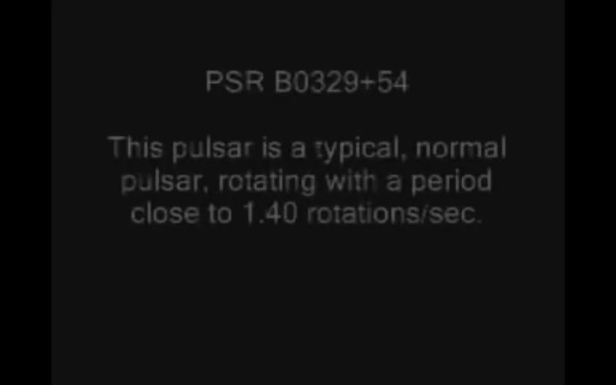
Remembering that these are super dense (density of 1000 Nimitz-class aircraft carriers compressed to the size of a marble) stars that are, maybe, 15 km across, and that each rotation produces one beat, here is what a pulsar sounds like as observed by a radio telescope.
AMAZING!!!
22.)

Slide 25





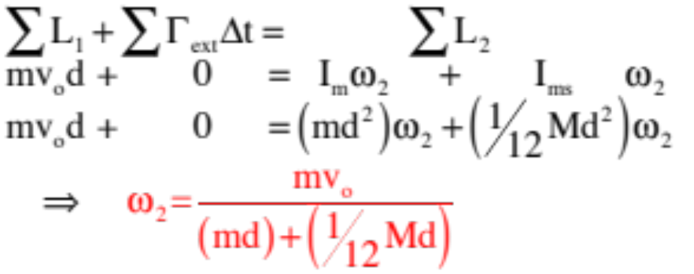
Example 7: Consider a meter stick of mass M pinned at its center. A puck of mass m moving with velocity strikes the meter stick a distance d units from the center and sticks to it.
a.) Is momentum conserved through the collision? If so, write out the conservation of momentum relationship thru the collision. If not, justify your response.
Momentum is NOT CONSERVED as the pin provides an external impulse.
b.) Is angular momentum conserved through the collision? If so, write out the conservation of angular momentum relationship. If not, justify.
Angular momentum IS conserved as all the torques about the pin are internal.
c.) Is energy conserved through the collision?
Nope! IT’S A COLLISION!!!!
23.)

Slide 26


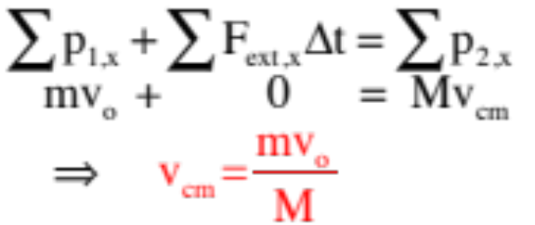
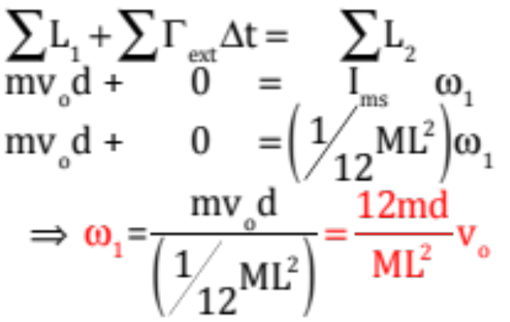

Example 8: Consider a stationary meter stick of mass M sitting freely on a frictionless surface. A puck of mass m moving with velocity strikes the meter stick a distance d units from the center and stops dead.
a.) Is momentum conserved through the collision?
Momentum IS conserved as there are no external impulses.
b.) Is angular momentum conserved through the collision?
Angular momentum IS conserved as all the torques are internal.
NOTICE: Momentum and angular momentum are both conserved but are INDE-PENDENT of one another, and the center of mass velocity and angular velocity about the center of mass are NOT related by
24.)

Slide 27
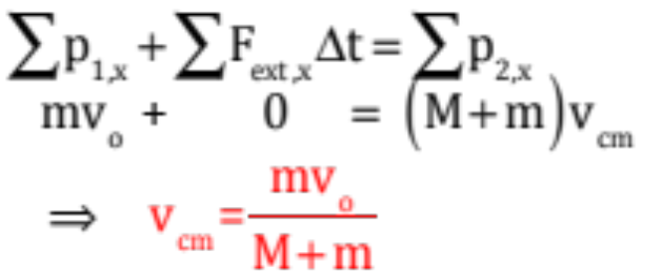
Example 9: A considerably more complex problem takes form if the mass sticks to the meter stick from the last problem. In that case: the meter stick of mass M sitting freely on a frictionless surface. A puck of mass m moving with velocity strikes the meter stick a distance d units from the center and sticks to it.
a.) What does conservation of momentum through the collision tell us?
Momentum IS STILL conserved as there are no external impulses, so.
b.) Is angular momentum conserved through the collision?
Angular momentum IS conserved as all the torques are internal, but this is where things get sticky. What we’ve done so far is to determine the angular momentum about the AXIS OF ROTATION of the system. Think about it:
25.)

Slide 28
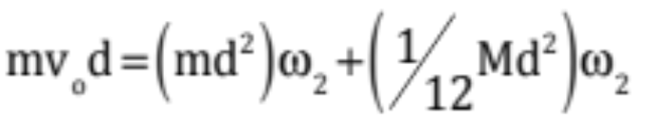
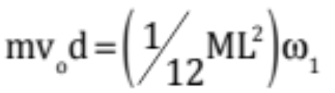


b.) (con’t.)
For the pinned beam situation, we calculated the angular momenta about the pin (i.e., at the center of mass of the meter stick).
For the unpinned situation in which the puck stopped and all the after-collision motion was around the meter stick’s center of mass, we calculated the angular momenta about the the center of mass of the meterstick (that was where the rotation was centered).
For the unpinned situation in which the puck STICKS, the rotation is NOT around the meter stick’s center of mass. It is around the center of mass of the two-body system. That means to do this problem, we have to find the system’s new center of mass, determine the meter stick’s “I” about that new axis (parallel axis theorem), calculate the puck’s initial angular momentum relative to that new center of mass, then put that equal to the angular momentum of the two bodies rotating around that new center of mass after the collision. Nasty . . .
26.)

Slide 29



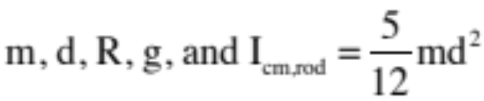
Example 10: A mass m sits at the top of a curved, frictionless incline of radius R. It slides down the incline and executes a perfectly inelastic collision with the end of a pinned rod of mass 5m and length d. The two rotate up to some angle before coming to rest. If R = .4d, derive an expression for . You know:
This is the rotational analogue to the problem shown to the right: A mass m sitting at the top of a curved incline of radius R slides down the incline,
executes a perfectly inelastic collision with a 5m mass, and proceeds up a ramp. How high up the ramp does it go?
So how would you do this problem?
(Energy up to the collision, momentum through the collision, energy after the collision!)
27.)

Slide 30

How are the problems different as far as solving goes? That is, why can’t we just use conservation of momentum when the two masses collide in the pinned beam problem?
To use conservation of momentum, we
need a system in which there are no external impulses. The pin provides an external impulse (it keeps the rod from accelerating en-mass to the left through the collision), so conservation of momentum won’t work for this collision. There are no external torques acting about the pin, though, so conservation of angular momentum IS applicable.
28.)

Slide 31

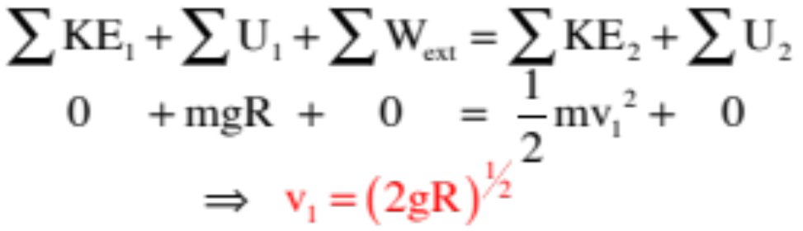
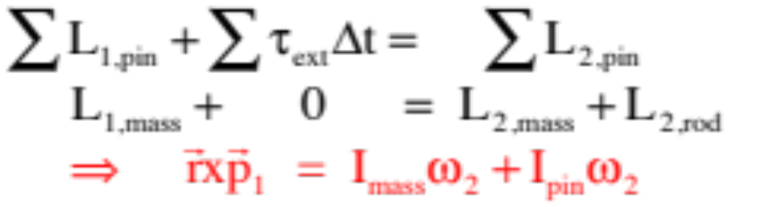
To begin, the velocity of the mass m just before the collision can be determine using conservation of energy:
Because there are no external torques acting about the pin, conservation of angular momentum is the key to the collision. Taking a time interval through the collision, and summing the angular momenta about the pin, we can write:
We need those angular momentum quantities.
29.)

Slide 32
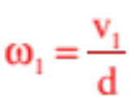




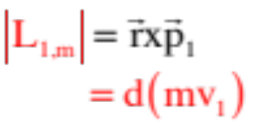
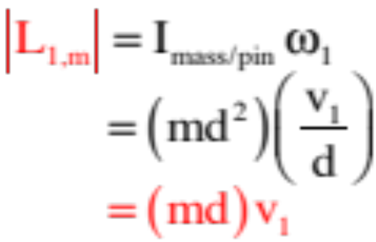
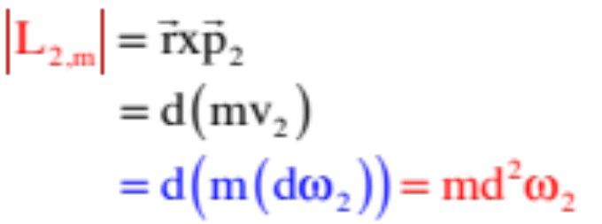
To determine the angular momentum of the mass about the pin, we can go two ways. We can either treat the mass as a translating point mass and using , or we can use rotational parameters. I’ll show both (assuming the velocity of the mass at the bottom of the incline is ):
translating point mass:
rotational parameters:
OR
Same either way.
After the collision, the mass’s angular momentum in terms of angular velocity:
30.)

Slide 33
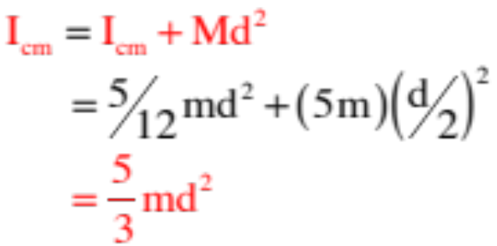
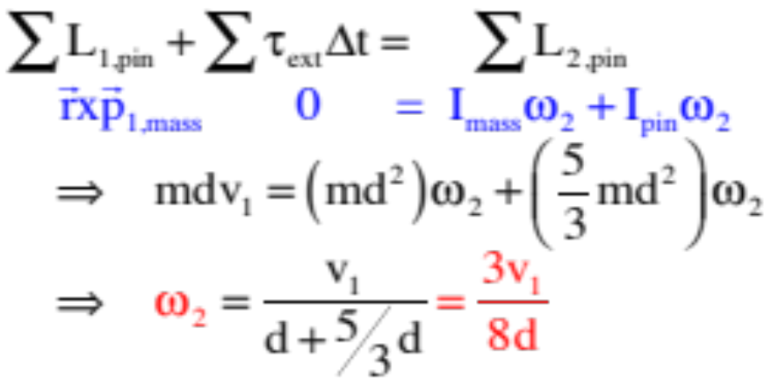
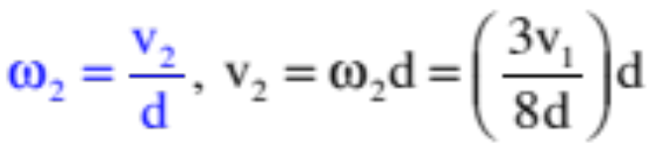
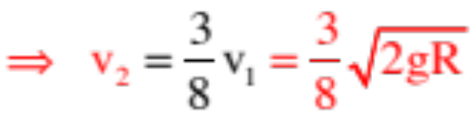
We need the moment of inertia of the rod about the pin. We’ll use the parallel axis theorem for that:
Putting everything together through the collision yields:
As
31.)

Slide 34




Knowing the after-collision velocities, we can use conservation of energy to determine how high the rod’s center of mass rises, and how high up the mass rises, before coming to a stop. Without doing the math to its conclusion, assuming the time interval is from just after the collision to the stop point and noting that the mass rises a distance (you should understand why by now) while the rod’s center of mass rises that equation looks like:
32.)

Slide 35
Back to the Non-AP Tom-Foolery
Remember the precessing wheel demonstration?
It was accompanied by a second demonstration in which a torque was quickly applied to the pinned axle of a rotating wheel, and instead of the wheel following the direction of the applied force, the wheel jerked to the right or left, depending upon the direction of the wheel’s rotation.
pinned
It’s time to make sense of both of these.

Slide 36

The mathematical key to these seemingly mysterious behaviors are wrapped up in the relationship between torque and angular momentum (or, Newton’s Second Law, rotation style). That is, the relationship:
This relationship suggests one of two things.
1.) If the direction of the net torque applied to a body matches the direction of the angular momentum vector of the body (translation: it matches the direction of the body’s angular velocity), an applied torque will change the magnitude of the angular momentum (that is, the body will angularly speed up or slow down). The translational parallel to this is a force along the line of motion making a body speed up or slow down.
But:
2.) If the direction of the net torque applied to a body does not match the direction of a body’s angular momentum vector, the body’s angular momentum will still change but the change will be in the angular momentum’s DIRECTION, not its magnitude. The translational parallel to this is a force that is perpendicular to the line of motion creating a centripetal situation. The precessing wheel circumstance falls into this latter category.

Slide 37






Starting with the hanging wheel rotating as shown:
The system is pinned where the chain attaches to the axle. The force being applied is due to gravity and happens at the center of mass of the wheel.
The torque produced by gravity is at right angles to the plane defined by and .
With the torque (i.e., ) at right angle to , the direction of the change of angular momentum demands that the body’s axle must precess!

Slide 38



--What about the jerking wheel? Assume a clockwise rotation. The angular velocity (and, hence, angular momentum) vector is shown below in the sketch with the view from above shown to the right (I’ve put a nub at point A for reference).
eye looking down
looking from above

Slide 39



--Let’s try to rotate the wheel about point A by applying a quick downward force F to point A.
eye looking down
looking from above
(pinned at point A)
(quick impulse into page)

Slide 40


--Note that the direction of the torque applied by is NOT in the direction of the angular momentum vector, which is along the axle.

Slide 41



--If the torque is in the direction of the CHANGE OF angular momentum, then the NEW angular momentum direction must be as shown below . . . and hence we predict precession!

