Slide 1
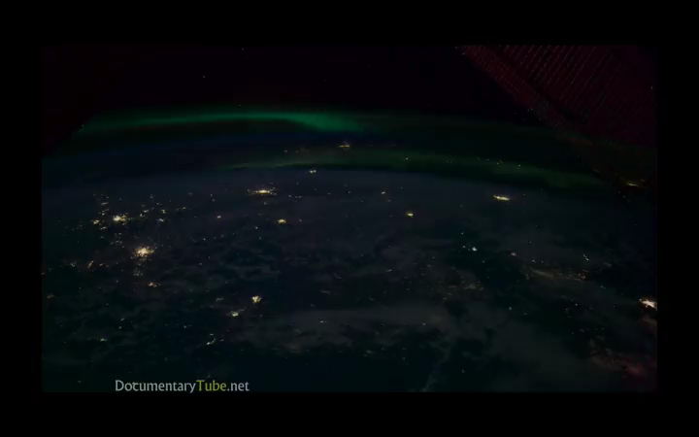
Earth from space . . .
1.)

Slide 2
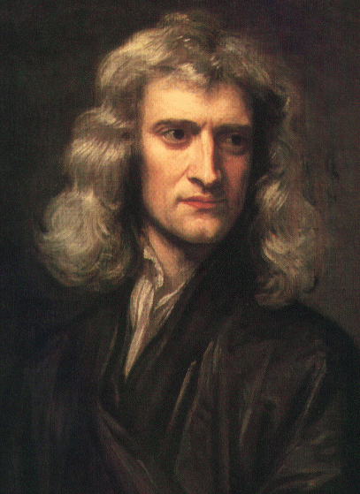
CHAPTER 13:
Universal Gravitation
“Why do celestial objects move the way they do?”
• Kepler (1561-1630) Tycho Brahe’s assistant, analyzed celestial motion mathematically
• Galileo (1564-1642) Made celestial observations by telescope
• Newton (1642-1727) Developed Law of Universal Gravitation
courtesy of Richard White
2.)

Slide 3



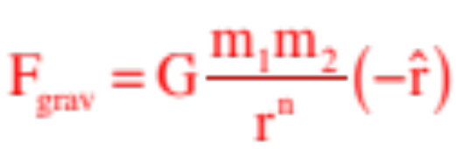
Newton observed that there exists a force between any two masses that is proportional to the product of the masses and inversely proportional in some way to the distance between the center of masses of the bodies (he didn’t originally know if it was or or or what). The proportionality constant was/is called the universal gravitational constant G. In polar-spherical notation, this attractive, radial force is denoted as:
To determine the power n, he made another interesting observation. The same force that accelerates an object like an apple close to the surface of the earth accelerates the moon in its path around the earth. Taking that path to be circular, and noting that it takes 27.3 days for the moon to orbit the earth once, he wrote:
3.)

Slide 4
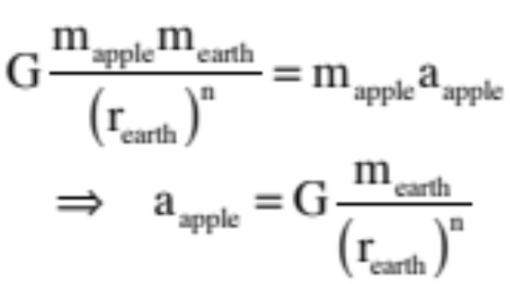
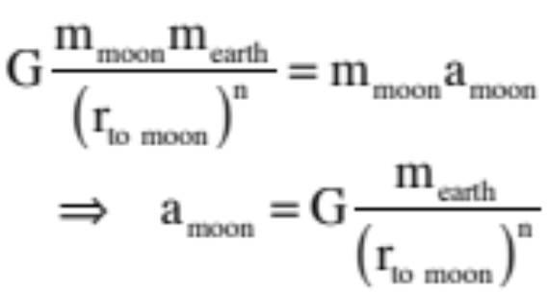
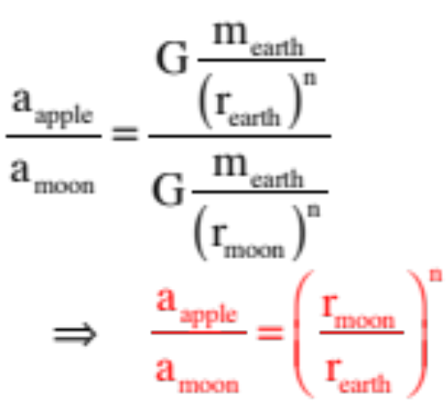
acceleration of apple using the theory:
acceleration of moon using the theory:
ratio of two accelerations yields:
4.)

Slide 5

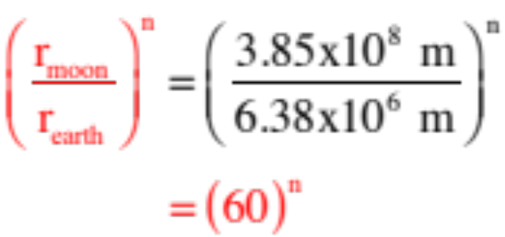
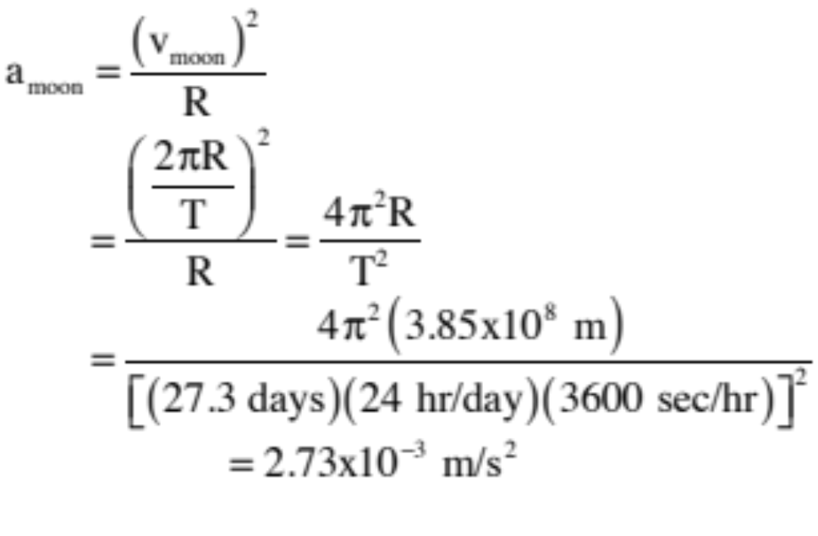
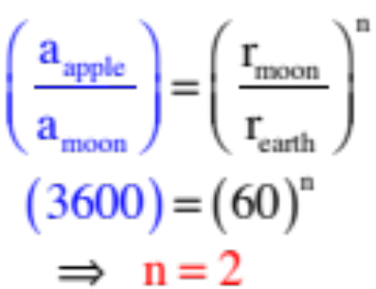
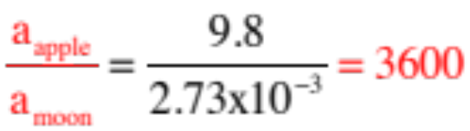
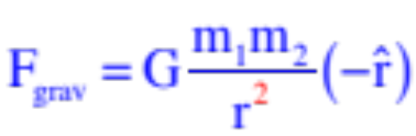
acceleration at earth:
using the radii:
centripetal acceleration at moon:
putting everything together:
using calculated accelerations:
In other words:
Note: Newton shelved this theory for several years because the accepted distance to the moon was off and the exponent he originally calculated was something like 1.7—not something he thought nature would do.
5.)

Slide 6
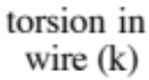




After initial experiments were done by Charles Coulomb, Henry Cavendish used a torsion balance in a vacuum to measure the attraction between two masses m and M to one another. The calculated value of G was:
6.)

Slide 7
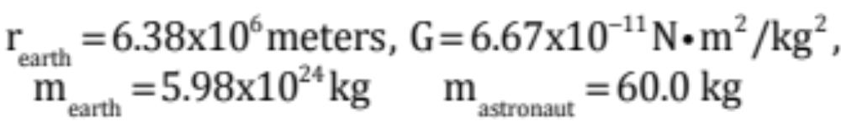

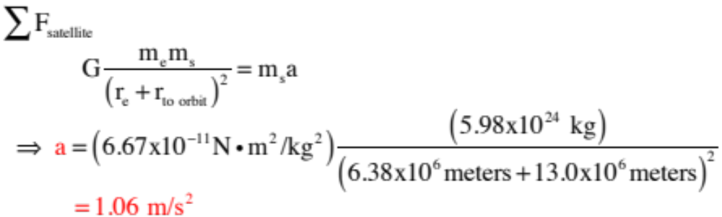
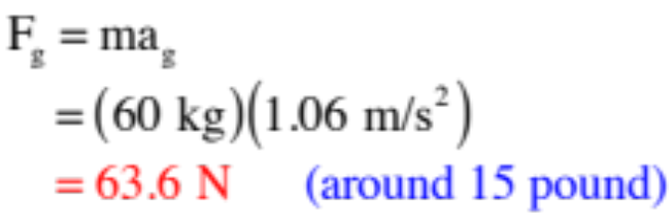

Example 1: A 2000 kg space shuttle orbits the earth at a distance of 13,000 km above the earth’s surface. You know:
a.) Derive an expression for, then determine the acceleration of the satellite in its orbit.
b.) What is the acceleration of an astronaut inside the orbiting satellite?
c.) What is her weight?
It will be the same!
7.)

Slide 8
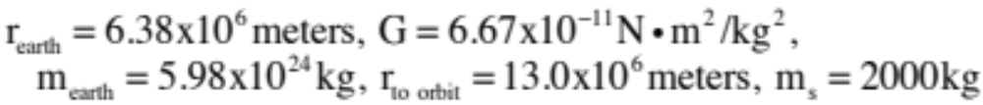
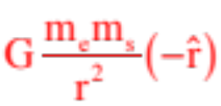
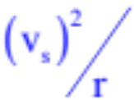
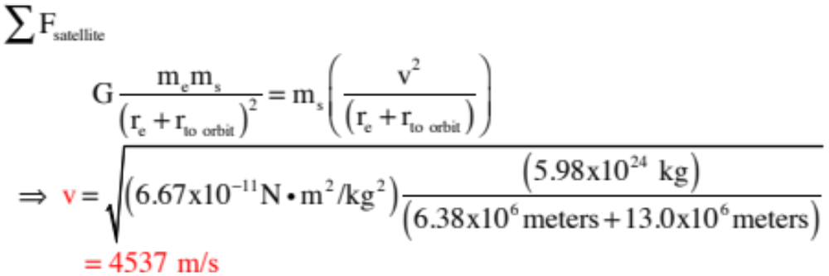
d.) Derive an expression for, then determine the velocity the satellite must maintain to keep its orbit.
Important point: Orbital motion has two masters. There is Newton’s general gravitational force , and there is the centripetal acceleration required to
keep the body from plummeting into the celestial body it is traveling around. What that means is that for a circular orbit with a given orbital radius, there is only ONE speed that will hold the body in orbit!
8.)

Slide 9
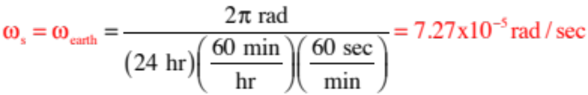

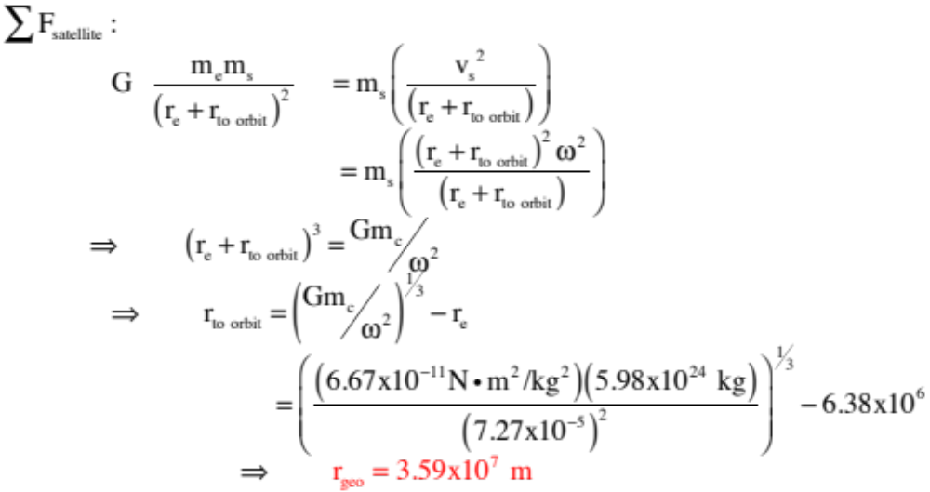
e.) What is the radius of a geosynchronous orbit?
A geosynchronous orbit is a circular orbit in which the satellite is always over the same point on the earth. In other words, the satellite’s angular velocity is the same as the earth’s angular velocity.
We know:
and
9.)

Slide 10
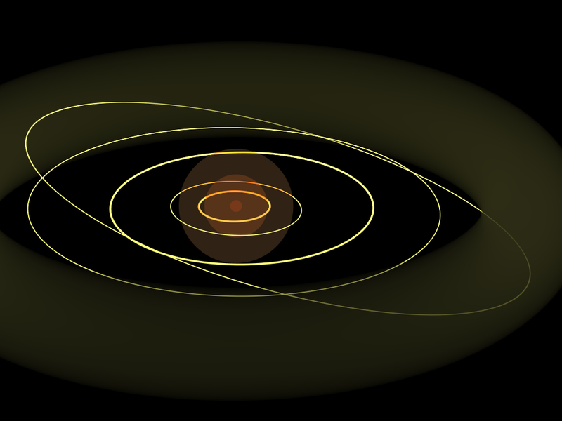
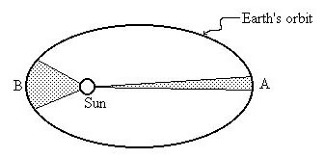
Kepler’s Laws
As a consequence of data taken by Tycho Brahe, a Danish astronomer (last of the naked-eye celestial observers), Kepler was able to deduce three “laws” about planetary motion. They are:
Kepler’s First (called the Law of orbits): Planets move in elliptical orbits with the Sun at one focal point.
Kepler’s Second (called the Law of areas): A radius drawn from the Sun to any planet sweeps out equal areas in equal time intervals.
Kepler’s Third (called the Law of periods): The square of a planet’s period is proportional to the cube of its semi-major axis.
10.)

Slide 11

Kepler generated his Laws by using observational data from Brahe. Each of the laws do, though, have a theoretical justification. To wit:
Kepler’s First (called the Law of orbits): Planets move in elliptical orbits with the Sun at one focal point.
Using conservation of angular momentum and conservation of energy, it is possible to derive an expression for the radial position of a planet as a function of its angular position in the orbit (i.e., ). The derived expression is that of an ellipse.
Kepler’s Second (called the Law of areas): A radius drawn from the Sun to any planet sweeps out equal areas in equal time intervals.
The derivable expression for a planet’s area-sweep with time (i.e., dA/dt) looks just like the derived expression for a planet’s angular momentum (give or take a constant). As the angular momentum of a torque-free body is constant, dA/dt must also be constant.
11.)

Slide 12






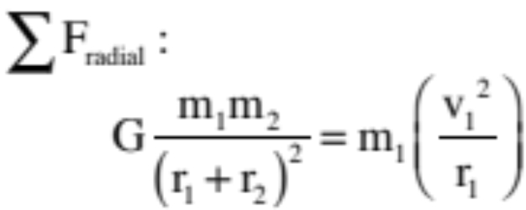
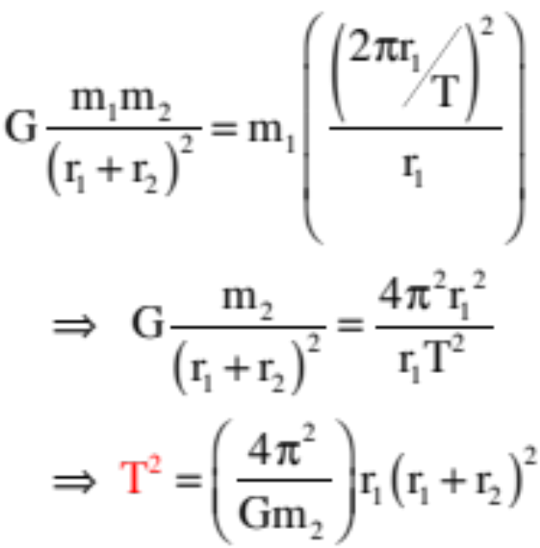
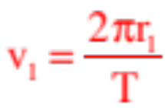
Example 2: Derive an expression for the period of motion of a planet of mass as it orbits the center of mass of a two-planet system, where the mass of the second planet is (see sketch).
This is a Newton’s Second Law problem. Summing the forces on :
The velocity in terms of the period is:
Substituting this into our relationship yields:
12.)

Slide 13




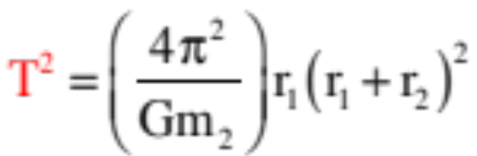


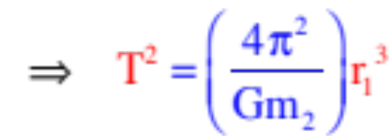

Notice: If we let the planet become very small so that , then , the system’s center of mass migrates toward the center of
and we can write:
This is Kepler’s Third Law, which is to say, the square of the period is proportional to the cube of the radius (or semi-major axis).
Note that of Kepler’s three laws, this is the only one that is an approximation.
13.)

Slide 14
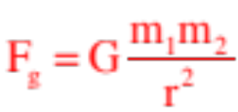





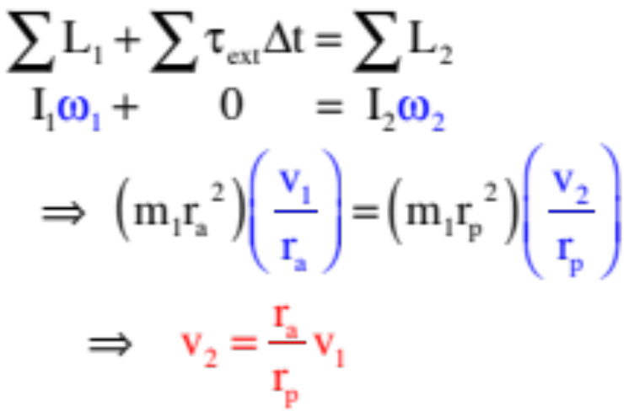
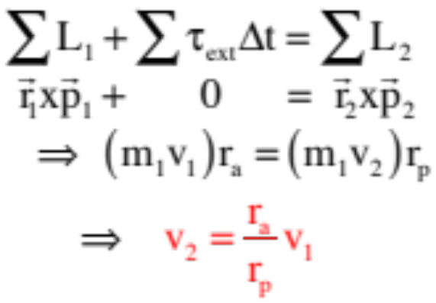
Conservation of Angular Momentum
Because gravitational forces are RADIAL, they don’t produce torques. With no external torques acting, planetary motion adheres to conservation of angular momentum. With that in mind:
Example 3: If a planet moving in an elliptical orbit has a velocity at its farthest point (its aphelion) of , what is its velocity at its closest point (its perihelion)? Assume you know the distances identified on the sketch.)
This is a conservation of angular momentum problem:
OR
URL http://galileoandeinstein.phys.virginia.edu/more_stuff/Applets/Kepler/kepler.html
14.)

Slide 15
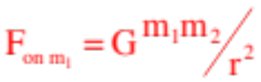
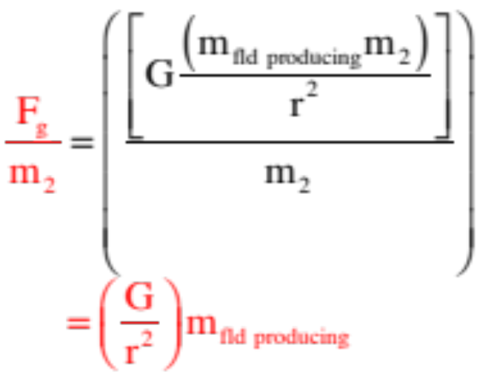
Point of Order about FIELDS
For all sorts of reasons, Newton didn’t really like his theory of gravity. . . even though it does do a great job of predicting how the real world acts (we put a man on the moon using it). First, why should two objects be attracted to one another simply by virtue of each having mass (that’s what his universal gravitational force equation suggests). And second, contact forces makes sense (push on something, it pushes back), but forces acting at a distance . . . how does that work?
An alternate view is to think of a mass as creating a disturbance in the region around it (called it a gravitational field) and define it as the amount of force per unit
AVAILABLE at a point due to the presence of that field-producing mass. Such quantities would be field-producing, force-related, but would be independent of any mass feeling the affect. That is, they would exist whether a mass resided at a point of interest or not.
The math for the gravitational field due to any mass would look like the relationship shown to the right:
Not so important here, but the idea will become more important in E&M.
15.)

Slide 16

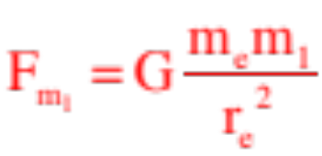
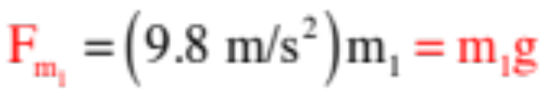

Gravity Near and Far
Close to the surface of the earth, the magnitude of the force on a mass due to the presence of the earth’s mass is
where denominator is the square of the distance between the center of mass of the two objects or, in this case, the radius of the earth.
Putting numbers into this expression for G, the mass and radius of the earth, that relationship becomes:
with a potential energy function that we’ve derived as:
16.)

Slide 17


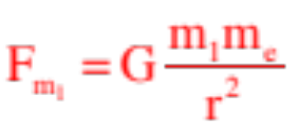

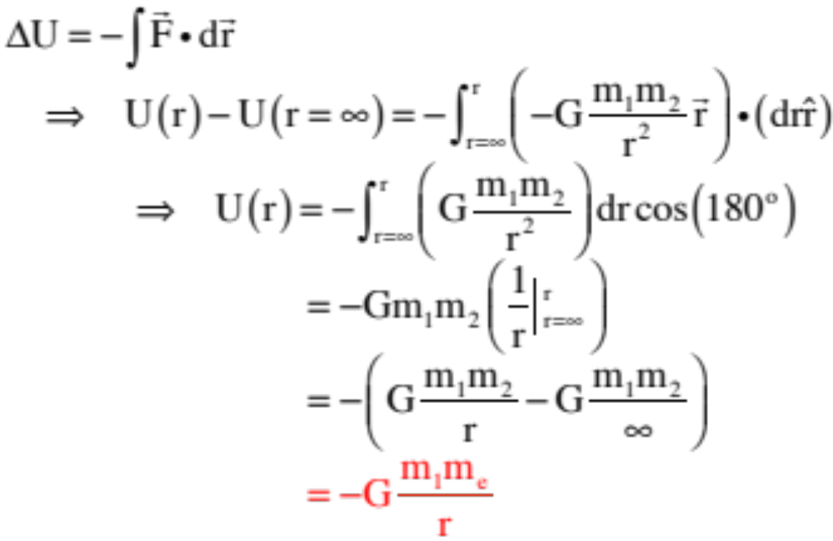



Far from the earth (or any celestial body), the magnitude of the force on a mass due to the presence of the earth’s mass is
where denominator is the square of the distance between the center of mass of the two objects which, in this case, is NOT the radius of the planet.
Noting that there is a preferred F = 0 point at infinity, which will be our zero potential energy point, the potential energy function for this far-field gravitational force derives as:
17.)

Slide 18


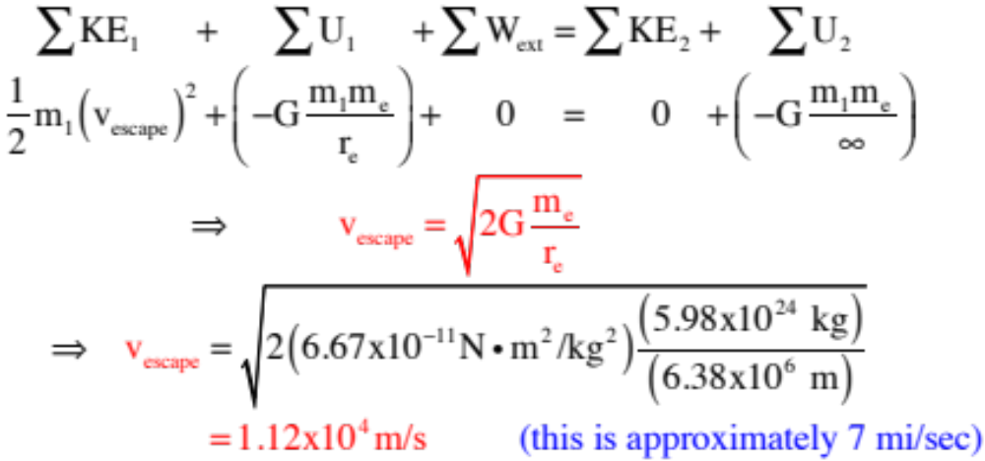
Example 4: Derive an expression for the escape velocity required for a mass to free itself from the earth’s gravitational field.
This is an energy problem. Realizing that for an object to become completely free of the earth, it must move to infinity, and remembering that the gravitational potential energy for far-field situations is not zero at the earth’s surface, conservation of energy yields:
18.)

Slide 19

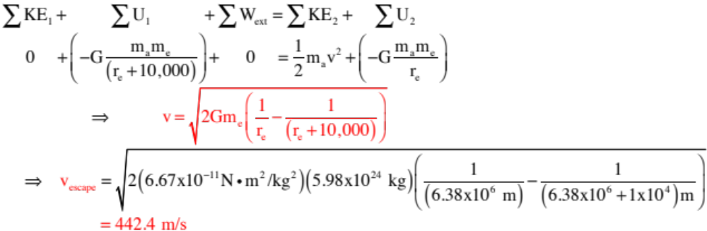
Example 5: An apple is released from a height of 10,000 meters above the earth’s surface. How fast is it moving just before it hits the earth, assuming no air friction.
Again, a classic conservation of energy problem.
Note that using mgy as your potential energy function, the velocity comes out to be 442.7 m/s, so even at 10,000 meters up, the mgy approximation is a fairly good one.
19.)

Slide 20







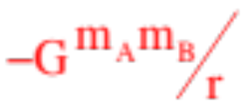

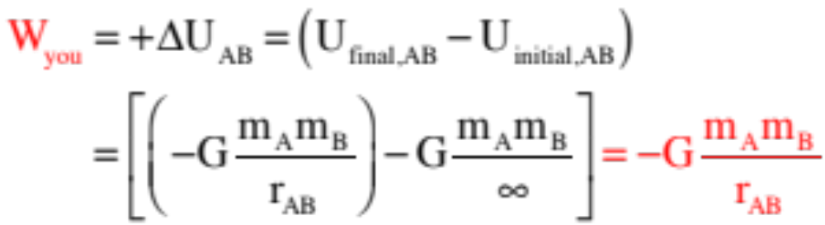
Potential Energy of Multiple Mass Systems
It takes no energy to draw a mass from infinity to some position in space. Once there, that mass will produce a potential energy field around that point.
The amount of energy required to draw a second mass in from infinity to a distance units for the first mass is equal to the amount of work you need to put into the system to effect the deed. This will be minus the amount of energy the field does (assuming you come in with constant velocity). As the amount of work the field does is equal to , where U is the fields potential energy function equal to , the amount of work you must do will be . That is:
(That’s right, you need to apply a force opposite the direction of motion, hence the negative work, to keep the body from accelerating as it comes in.)
20.)

Slide 21






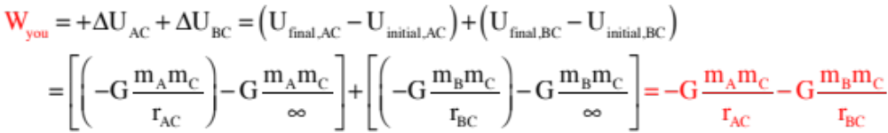
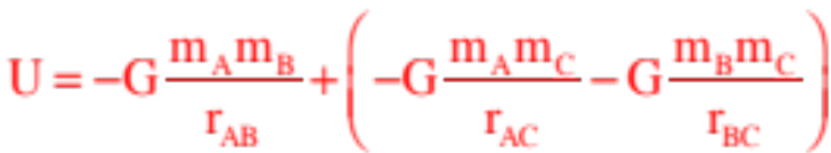
The amount of energy required to draw a third mass in to a distance from and from will equal the amount of work you have to do to bring the mass in from infinity. That will be:
Adding this to the original bit of work done to bring in the second piece, and we get the potential energy wrapped up in the system as:
Bottom line: Each added mass must interact with all the masses already present.
21.)

Slide 22



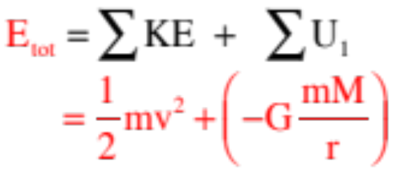
Total Energy in an Orbiting System Where the Orbit is Eliptical
Example 6: Assuming an eliptical orbit, what is the total mechanical energy wrapped up in an orbiting satellite.
22.)

Slide 23
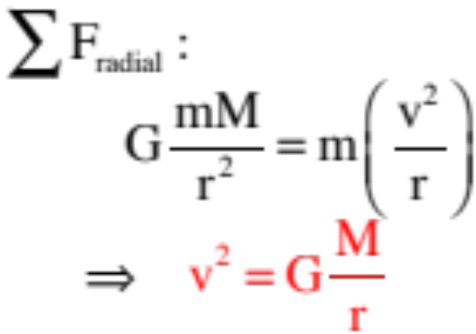
Total Energy in an Orbiting System Where the Orbit is Circular
Example 7: Assuming an eliptical orbit, what is the total mechanical energy wrapped up in an orbiting satellite.
To relate the velocity, look at what Newton’s Second has to say about the system:
23.)

Slide 24
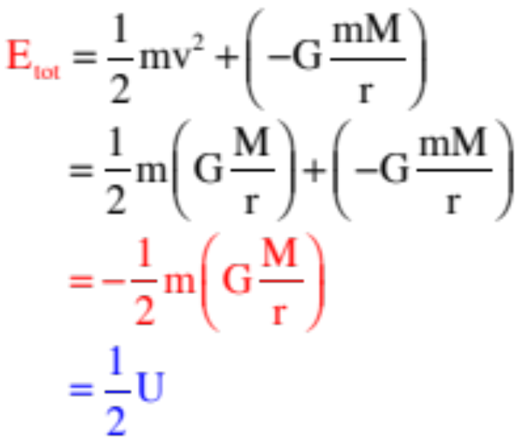
Combining:
Bottom line: The total amount of mechanical energy wrapped up in CIRCULAR ORBITAL MOTION is equal to half the potential energy in the system. This relationship is still good with elliptical orbits if you make the r term into the semi-major axis.
24.)

Slide 25




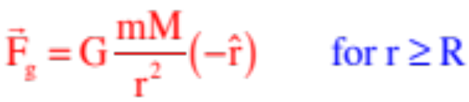

A Particle’s Interaction with a Larger Mass
Case 1 (spherical shell with particle outside):
The net force on m is due to all the bits of mass inside the sphere of radius R. Newton created Calculus to justify the claim that there is no difference between
this situation and the situation in which all of the mass is located at the system’s center of mass. (as the math yields the same relationship). For the ring of mass M shown, this is:
Case 2 (spherical shell with particle inside):
Inside the ring, the net force on the mass m due to all the bits of mass encompassed in the ring will, because gravity is an inverse square function, vectorially add to zero, so:
25.)

Slide 26
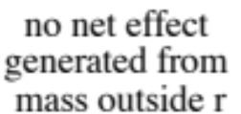

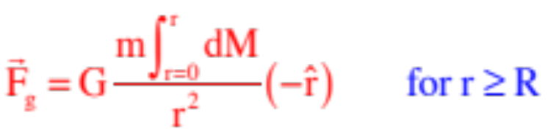
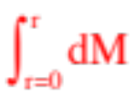
Case 3 (spherical solid with particle outside):
The net force on the mass m is, again, due to all the bits of mass encompassed in the ring of radius R. And just as before, this will equal:
Case 4 (spherical solid with particle inside):
This is a little trickier. Think of the mass as sitting on a sphere of radius r. From Case 2, all the mass outside that radius provides no net gravitational force, whereas from Cases 1 and 3, the gravitational force from the mass inside that radius will be as though all of that mass was located at the sphere’s center of mass. In other words:
where is the fraction of the sphere’s mass inside the sphere of radius r.
26.)

Slide 27





The mass inside r can be determine in two ways. One only works if the mass if homogeneous. The other uses differentially thin spherical shells and works whether the mass distribution is uniform or not. We’ll do the easy way first, then I’ll show you the more complex approach.
Assuming the mass is uniformly distributed, the volume mass density function (mass per unit volume) can be written in two ways:
and
Equating:
So:
27.)

Slide 28







It shouldn’t be terribly surprising that the force would be a function of r. You would expect the force to be zero at the sphere’s center (i.e., at r = 0), which this function satisfies (whereas a function wouldn’t).
In any case, the more exotic way to do this would be to create a differentially thin spherical shell, determine the mass in it, then integrate to determine the total mass inside.
The differential volume is the surface area ( ) of a spherical shell times the differential thickness da, which means:
So:
28.)

Slide 29





Graphs
Magnitude of force on particle due to a spherical shell:
Magnitude of force on particle due to a solid shell:
29.)

Slide 30


AP Example 7: Two satellites of masses m and 3m, respectively, are in the same circular orbit about the Earth's center, as shown in the diagram above. The Earth has mass M_{e} and radius R_{e}. In this orbit, which has a radius of 2R_{e}, the satellites initially move with the same orbital speed v_{o} but in opposite directions.
a.) Derive an expression for the orbital speed v_{o} of the satellites in terms of G, M_{e}, and R_{e}.
30.)
Notes:
1984M2.

Slide 31



b.) Assume that the satellites collide head‑on and stick together. In terms of v_{o,} determine the speed v of the combination immediately after the collision.
You should be able to use either conservation of momentum (no external impulses acting) or conservation of angular momentum (no external torque-related impulses). We’ll start with conservation of angular momentum, and because these are both point masses (and to be a little exotic), we’ll calculate the angular momentum using both and the cross product :
Noting that:
31.)
Notes:
1984M2.

Slide 32


We can write:
where the negative sign suggests the final angular velocity that is clockwise, as expected.
32.)
Notes:
1984M2.

Slide 33

Using conservation of momentum:
where again, the negative sign suggests the final velocity is in the same direction as the original direction-of-motion of the 3m mass.
Clearly, the conservation of momentum is the easier way to go here, but both are educational.
33.)
Notes:
1984M2.

Slide 34



c.) Calculate the total mechanical energy of the system immediately after the collision in terms of G, m, M_{e}, and R_{e}.
As the gravitational potential energy is
apparently:
34.)
Notes:
1984M2.

Slide 35

Note: For this new combo-satellite to carry the new velocity in a circular orbit, its new radius would have to be:
This wouldn’t happen, though, as the new motion would become elliptical looking something like:
35.)
Notes:
1984M2.

Slide 36

And with the new radius, the total mechanical energy for the circular orbit would becomes:
36.)
Notes:
1984M2.

Slide 37
Weird stuff to think about...
Courtesy of Mr. White
It’s the different escape speeds required for different planets that explains why some planets have atmospheres and others don’t. Gas molecules have speeds that depend on their temperatures: the greater the temperature, the greater the average speed of the molecules, and the greater the chance is that they’ll have a velocity that allows them to escape the planet.
Mercury? No atmosphere
Earth? Light molecules gone, heavier molecules remain
Jupiter? Even hydrogen can’t escape!
37.)

