Slide 1
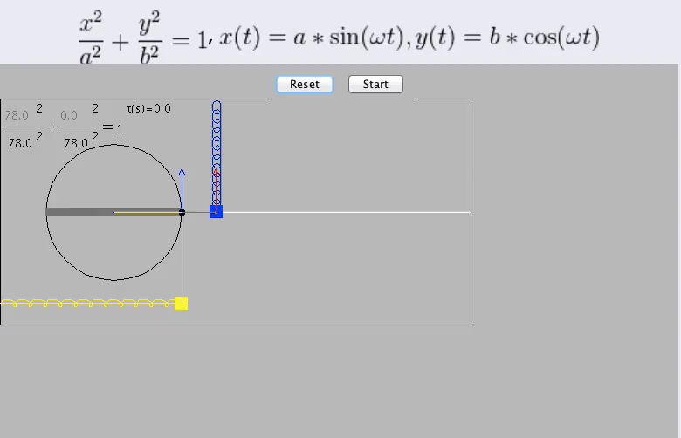
CHAPTER 15:
Vibratory Motion
courtesy of Richard White
courtesy of Richard White
2.)
1.)

Slide 2
The Island Series:
You have been kidnapped by a crazed physics nerd and left on an island with twenty-four hours to solve the following problem. Solve the problem and you get to leave. Don’t solve the problem and you don’t.
The problem: Your demented host has a precocious child who wants to dig a hole through the center of the earth and jump into it. Thinking the kid is a genius who can do anything he puts his mind to, the parent assumes the kid will succeed, periodically re-emerging at the mouth of the hole after the jump (he’ll accelerate down through the earth to the other side, then come back). To get a picture of the kid every time he shows himself at the original hole site, the parent wants to hire a satellite that will orbit at just the right altitude so that every time the kid’s head pops out of the ground, the satellite will be overhead to take a picture. To get off the island, you must determine the appropriate orbital altitude the satellite needs to maintain to be able to do this?
2.)

Slide 3
Solution to Island Problem
You’ll see!
3.)

Slide 4





Two glaring observations can be made from the graphic on the previous slide:
1.) The PROJECTION of a point on a circle moving with constant angular velocity follows the same path as a mass attached to an ideal hanging spring as the spring oscillates up and down. And:
2.) If you track the oscillation in time, it traces out a sinusoidal path.
Both of these observations fall out from the math if we start with Newton’s Second Law applied to a mass m attached to an ideal spring oscillating over a frictionless, horizontal surface.
That analysis follows:
4.)

Slide 5

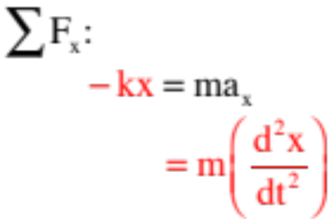
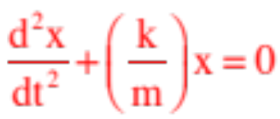
Keeping the sign of the acceleration embedded (it will be either positive or negative, depending upon the point in time, so we’ll leave it implicit), and noting that the spring force in the x-direction on a mass attached to the
spring will be (Hooke’s Law), Newton Second Law yields:
Pulling the –kx to the right side and dividing by m yields the relationship:
This is the characteristic equation of SIMPLE HARMONIC MOTION.
5.)

Slide 6


This relationship:
essentially asks us to find a function x such that when you take its second derivative and add it to a constant times itself, the sum will always add to zero.
The function that does this is either a cosine or a sine (I usually use a sine, but your book for no particularly good reason uses a cosine, so we’ll use that).
There are restrictions on the cosine function we need. In fact, we want the most general form possible. Specifically:
1.) We need the cosine’s angle to be time dependent, so instead of using an angle , we will use a constant times t, where the constants units have to be radians/second. As we have already run into a variable with those units ( ), we will use that symbol. (Interesting note: If the angular velocity of the rotating point-on-the-circle shown in the first slide had been , the constant in question for the vibratory motion’s cosine function would have been that same number .)
6.)

Slide 7

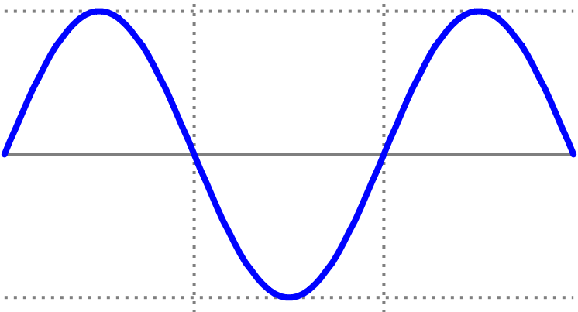


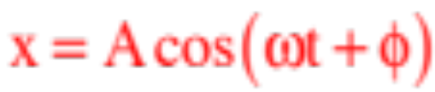
2.) We need the ability to start the clock when we want. A simple cosine function sets the position to be at a positive maximum at t = 0 (see sketch).
at t=0, x=max pos. displ.
new axis
We need to be able to shift the axis by some phase shift amount , essentially starting the clock (i.e., setting t = 0) when the body is at any chosen x-coordinate.
at t=0, x-coord. shifted
3.) Lastly, we need to be able to accommodate motion whose maximum displacement is other than one.
The function that does all of this for us is:
7.)

Slide 8
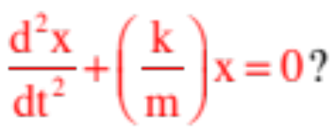
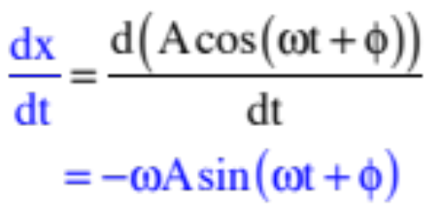

So back to the problem at hand. Does
satisfy
The only way to tell is to try it out:
This, by the way, is the velocity function. And as a sine function can never be larger than one, this means the magnitude of the maximum velocity for this oscillatory motion will be:
This will happen when the force is completely spent, or at equilibrium.
8.)

Slide 9
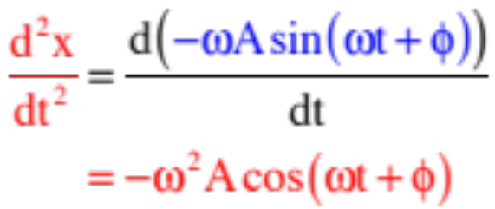

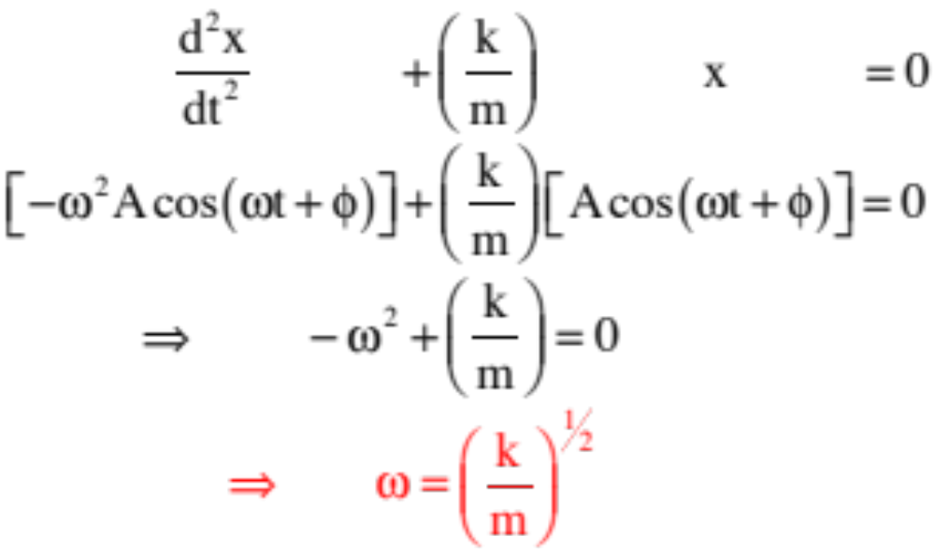
Continuing:
Another side point: This means the magnitude of the maximum acceleration, which happens at the extremes where the spring force is maximum, will be:
Plugging everything in:
9.)

Slide 10
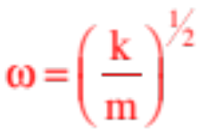
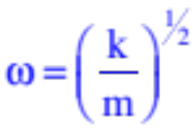

In other words, the differential equation
is satisfied by the position function
as long as the angular frequency satisfies:
Big Note: Notice that in concluding that , we are saying that the angular frequency of our oscillating system is equal to the square root of the constant that sits in front of the position term in the Newton’s Second Law equation! Put a little differently, if you can get a N.S.L. evaluation into the form:
you will know the oscillation is simple harmonic in nature AND you will know that the angular frequency of the system is .
10.)

Slide 11



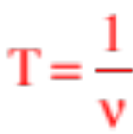
Minor point: So what is the angular frequency really doing for us? It is simply another way to identify how quickly the system is oscillating back and forth. But instead of telling us the frequency in cycles per second, it is telling us how many radians being swept through per cycle. Noting that there are radians per cycle, the relationship between frequency and angular frequency is:
And as the frequency in cycles per second is the inverse of the number of seconds required to traverse one cycle (or the period T in seconds per cycle), we can also write:
In short, if we can derive an expression for for a system, we also know and T.
11.)

Slide 12


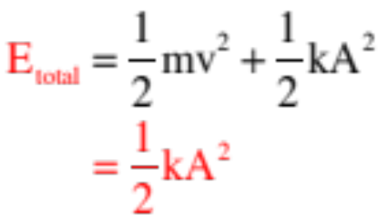
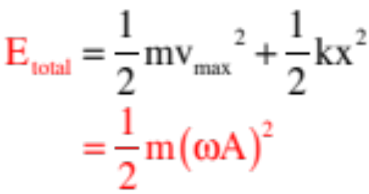
Energy in a Spring System
At the extremes where the velocity is zero and acceleration a maximum:
, where A is the maximum displacement (the amplitude), so:
At the equilibrium where the acceleration is zero and velocity a maximum:
12.)

Slide 13
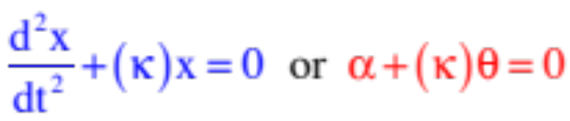


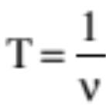

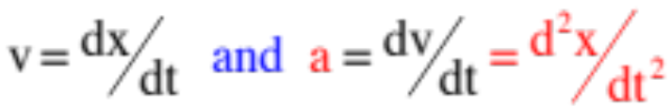
Summary of Relationships
Relationships always true:
characteristic equation for simple harmonic motion
angular frequency from characteristic equation
angular frequency and frequency related
period inversely related to frequency
position function for s.h.m.
velocity and acceleration functions
maximum velocity (happens at equilibrium)
maximum acceleration (happens at extremes)
13.)

Slide 14
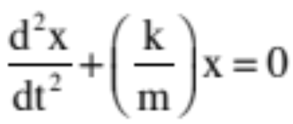
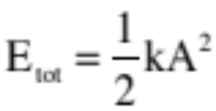
Summary of Relationships
For a spring:
characteristic equation for simple harmonic motion
angular frequency from characteristic equation
total mechanical energy in system
The period of oscillation for a spring is constant no matter what the spring’s amplitude. How so? A larger displacement will require more distance traveled to execute a single cycle, but because force is a function of displacement, it will also generate a larger maximum force, so the period will stay the same no matter what!
14.)

Slide 15

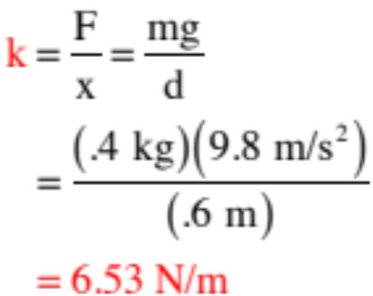
REALLY SIMPLE Example 1: A spring with spring constant k is hung from the ceiling. A mass m = .4 kg is attached and allowed to gently elongate the spring until it comes to rest at a point .6 meters below its free-hanging position. The mass is then pulled an additional .2 meters down and released.
a.) What is the spring’s spring constant?
The spring constant identifies how much force is required to displacement the spring one meter (units: N/m). It measures, essentially, stiffness. We’ve been told that a mass m, whose weight is mg, displaced the spring a distance d = .6 meters, so we know:
15.)

Slide 16
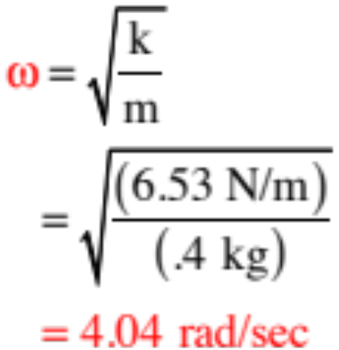
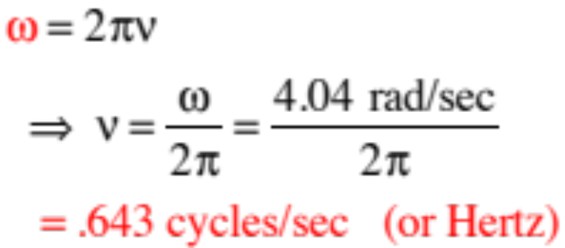
b.) What is the amplitude of the resulting oscillation?
Being elongated an additional .2 meters from equilibrium means m will oscillate about the equilibrium point .2 meters above and below, which means the motion’s amplitude is .2 meters.
c.) What is the motion’s angular frequency?
Knowing m and k, we can write:
d.) What is the motion’s frequency?
16.)

Slide 17
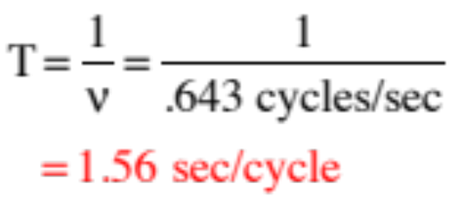
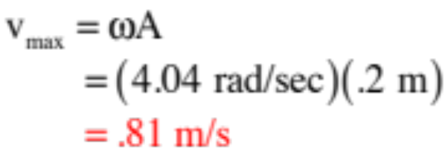
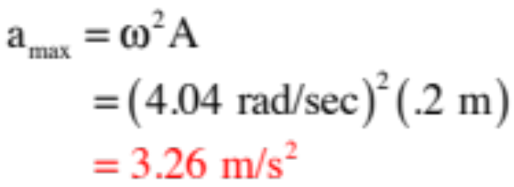
e.) What is the period of the motion?
f.) What is the maximum velocity?
g.) Where is the velocity a maximum?
at equilibrium
f.) What is the maximum acceleration?
g.) Where is the acceleration a maximum?
at the extremes
17.)

Slide 18
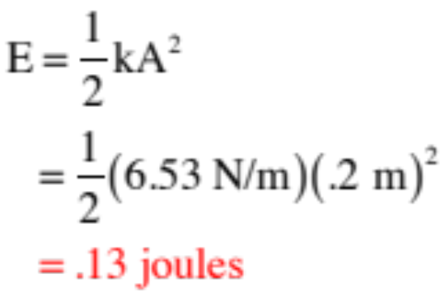
h.) How much mechanical energy is in the system?
i.) How would this problem have changed if the spring had been inverted?
it wouldn’t
18.)

Slide 19






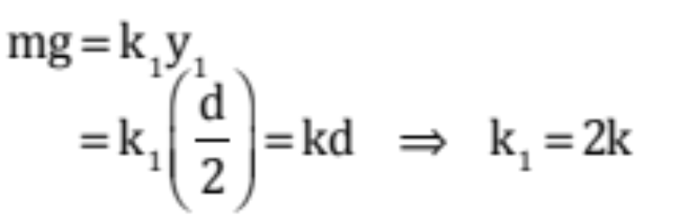
Physical Characteristics of Springs
Consider a spring of spring constant k that has a mass m attached to it. What happens to the spring constant if:
a.) You cut the spring in half?
It doubles for each new spring, but how so?
Assume the mass m elongates the spring a distance d down to its equilibrium position. In that case,
If we put a mark halfway down the spring and think of it as two springs, one on top of the other, with each having its own new spring constant , and if we notice that the force on the upper spring has to be the same as the force on the lower spring (note that this is called a series combination and is associated with situations in which the stress is the same for all parts involved) we can write:
19.)

Slide 20
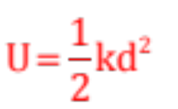
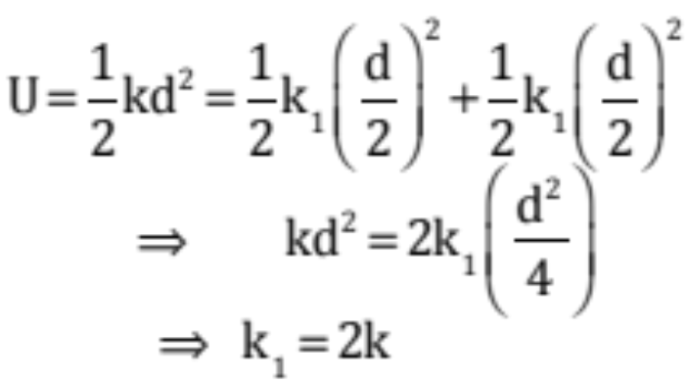
a.) What happens if you cut the spring in half? (con’t.)
Another way to look at it is through energy. The spring potential energy for an elongated spring stretched from its equilibrium position is:
If we think of the spring as two springs attached one on top of the other, the energy content won’t change and we can write:
Still another way to look at it: Elongating the original spring to the 1.0 meter mark is relatively easy because there is a lot of spring to unfurl (so k, the force/unit length required to hold the spring at a particular length, is relatively small). But cut the spring in half and you are physically stretching a lot less spring to that 1.0 meter point, which means more force/length will be required to hold at that point (so bigger k).
20.)

Slide 21

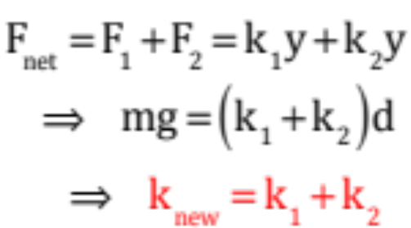
b.) What happens if you double the spring’s length?
Playing off the reasoning from above, the spring constant would halve.
c.) What happens if you put two springs side by side?
This is a parallel combination where the stress is distributed between the members, and in it the effective spring constant is the sum of the individual spring constants involved. How so?
21.)

Slide 22



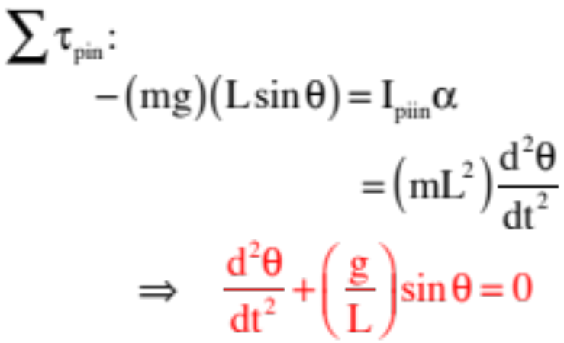





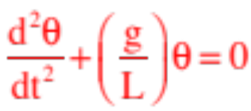
Example 2: A simple pendulum of length L is observed as shown to the right. What is its period of motion?
If we can show that this system’s N.S.L. expression conforms to simple harmonic motion, we have it. As the motion is rotational, we need to sum torques about the pivot point. The torque due to the tension is zero. Noting that r-perpendicular for gravity is , we can write:
This isn’t quite the right form, but if we take a small angle approximation, we find that for and we can write:
22.)

Slide 23

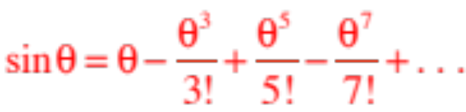

Minor Note: How do we know that the ?
The Taylor expansion for a sine function is:
which suggests that for small angles,
23b.)

Slide 24
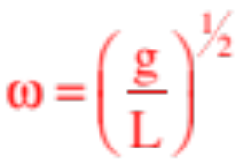
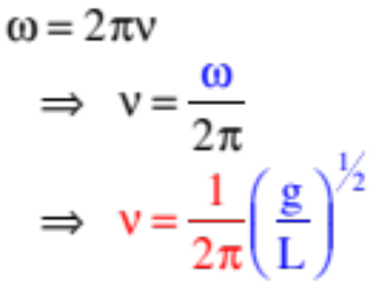
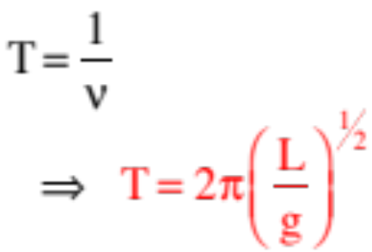
With
We can see we are dealing with simple harmonic motion, which means:
and
and
And wasn’t that fun . . .
24.)

Slide 25
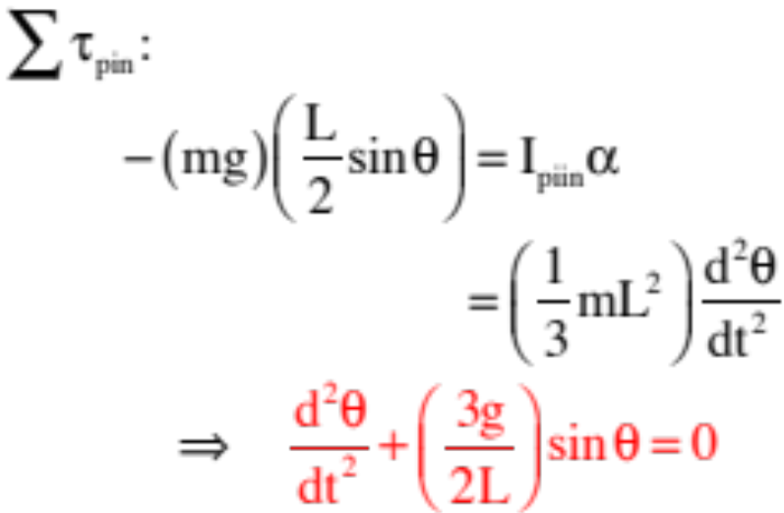

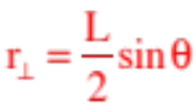

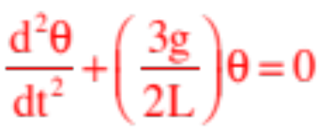
Example 3: A physical pendulum of length L takes the form of a beam pinned at one end as shown to the right. What is its period of motion?
Again, starting with N.S.L.:
Again, this isn’t quite the right form, but if we take a small angle approximation, we find that for and we can write:
25.)

Slide 26
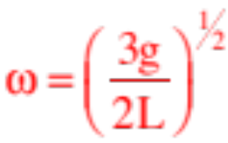
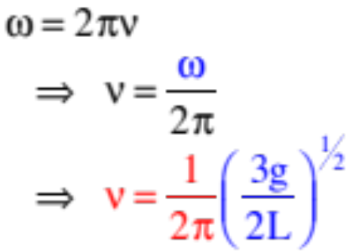
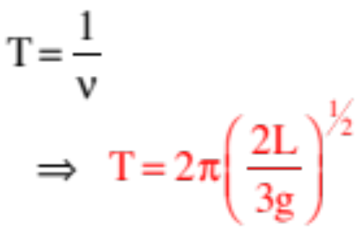
With
We can see we are dealing with simple harmonic motion, which means:
and
and
And wasn’t THAT fun . . .
26.)

Slide 27



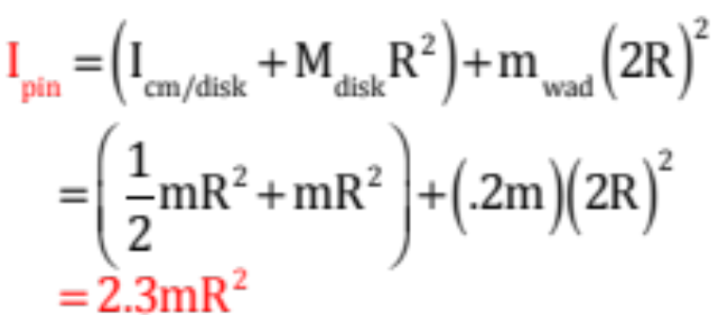
Example 4: An oddball physical pendulum consists of a disk of mass m and radius R with a wad of mass .2m attached at its edge as shown. What is its period of motion?
Using the parallel axis theorem on the disk and the definition of moment of inertia for a point mass on the wad, we can determine the net moment of inertia about the pin as:
27.)

Slide 28
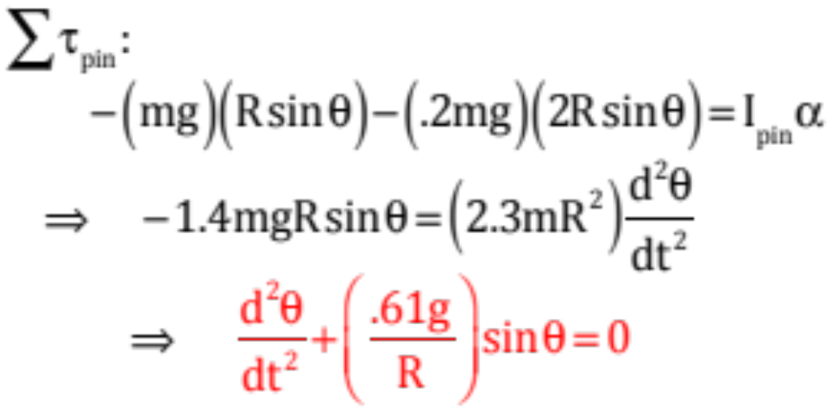


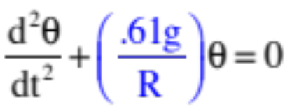
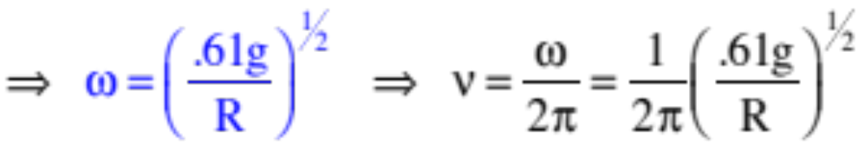
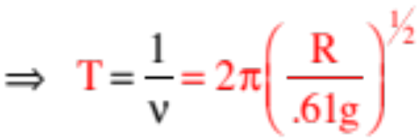
Taking the torque about the pin, yields:
With and
28.)

Slide 29


Example 5--an old AP question: A spring whose force magnitude is equal to is displaced a distance A and released whereupon its period is determined to be T. If it is then displaced a distance 2A, will its period go up, go down or stay the same?
This is a very cool problem because it makes you think about what you know, then extrapolate to this new situation.
What you know is that for a “normal,” Hooke’s Law spring where the force magnitude is , the period will be constant. That is, if the displacement is small, the force will be small and it will take some amount of time to cover one cycle. And if the displacement is large, the proportionally larger force will allow the additional distance to be covered in the same time . . . hence a constant period.
In this scenario, increasing the displacement means that the force will be larger, but not proportionally larger—it will be GREATER than proportionally larger. With the larger than expected force, the mass should cover the ground in less time than “usual,” meaning the period should diminish. Bizarre, but that the case.
29.)

Slide 30

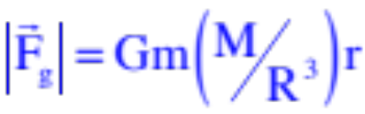
Example 6: A great problem! A kid jumps into a tunnel drilled through the earth from pole to pole. He accelerates toward the center of the earth, reaches that point whereupon he begins to negatively accelerate as he travels back toward the surface on the other side of the planet. Once at the surface on the other side, he stops, then start back toward the center of the earth again. In other words, the kid oscillates back and forth. His father, wanting to see his kid occasionally, commi-sions a satellite to orbit in just the right circular path so
as to be overhead every other time the kid’s head emerges from the hole. Remembering that the force due to gravity inside a solid sphere is (this was derived in the last chapter), what altitude above the earth’s surface must the satellite be to effect this feat?
The key to this problem is in finding the frequency (or period) of motion of the kid’s oscillation between the poles. This will be the same as the period of the satellite’s motion. So how do you determine that period?
If we could show that the kid was executing simple harmonic motion, complete with its characteristic equation, we’d be set. So let’s try that!
30.)

Slide 31
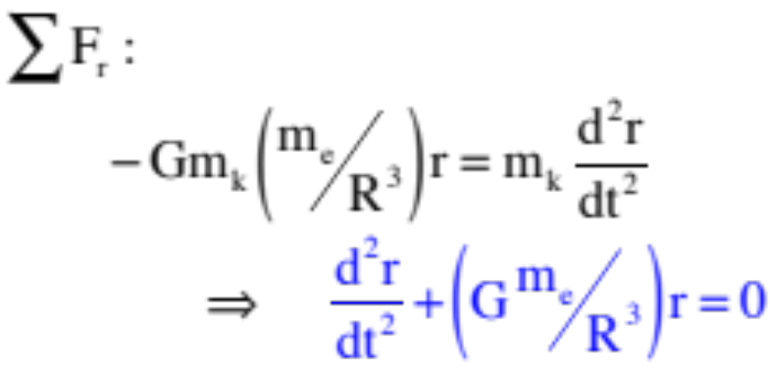
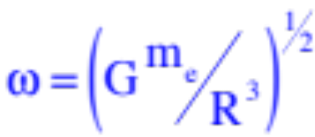

Writing out Newton’s Second Law on the kid yields:
This is the characteristic equation of S.H.M. (an acceleration plus a constant times a position equals zero). That means the angular frequency of the oscillation is:
But:
31.)

Slide 32


Knowing that:
the satellite’s velocity will be:
32.)

Slide 33


We can use Newton’s Second Law on the satellite:
33.)

