Slide 1

CHAPTER 23:
Electrostatics n Static Electricity
1.)

Slide 2
Charge
What do you know about the atom?
1.) Its nucleus is made up of electrically neutral neutrons and electrically positive protons.
2.) On its outskirts in “orbitals” associated with states of energy reside electrically negative electrons.
3.) Outer shell electrons, called valence electrons, determine how atoms will combine with one another to make molecules. Bonding types are:
a.) Covalent bonding happens when valence electrons are shared between adjacent atoms. Covalent bonding does not allow electrons to migrate throughout a structure. It is characteristic of insulators.
b.) Metallic bonding happens when valence electrons can migrate freely throughout a structure. It is characteristic of conductors.
c.) Ionic bonding happens when atoms have an unbalanced number of protons and electrons, hence are electrically charged. This kind of bonding is not going to be a player in the materials we will be considering here.
2.)

Slide 3


In an electrically neutral atom:
electron here as much as it is here!
The average position of its protons is where?
(In the nucleus at the center of the atom!)
The average position of its electrons is where?
electron’s average position at center
(Even though the electrons are “moving” around the nucleus at speeds up to 14,000 miles/second, their AVERAGE position is at the center of the atom where reside the protons.)
Bohr atom
This is why normal atoms are electrically neutral. Essentially covering every positive charge in an electrically neutral atom there sits a negative charge to null the positive out.
Although there will be time when we talk about the movement of positive charge, in reality, protons are fixed stationary in the nucleus with electrons ALWAYS being the entities that move onto or off of an object. A positively charge object is just an object that has had electrons removed; a negatively charged object an object upon which free electrons have been added.
3.)

Slide 4




A glass rod, which easily releases electrons, is rubbed vigorously by a silk clothe, which easily accepts electrons. This leaves the rod electrically positive.
Consider an electrically neutral conducting sphere (notice that for each proton, there is an electron covering it)?
What happens when the two are brought together?
The ball’s electrons, which are free to move because the bonding is metallic, will migrate toward the positive charge on the rod leaving the far side of the ball electrically positive and the near side electrically negative (I’ve omitted all the neutral combinations).
Charge separation like this is called polarization.
With this, the electrical repulsion between the rod and ball’s far-side positive charge will be overcome by the electrical attraction between the rod and the ball’s near-side negative charge, and a net force of attraction will exist.
4.)

Slide 5
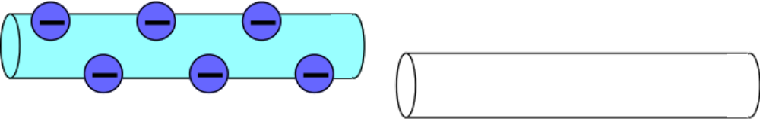
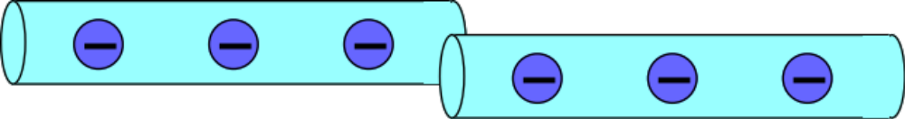
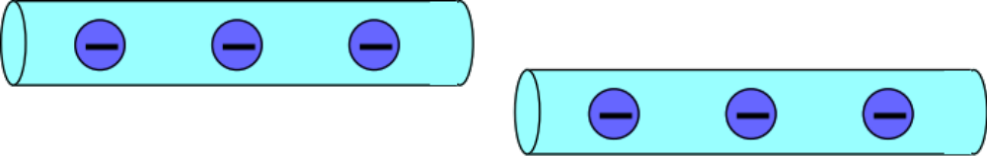
Mr. White’s Charging by Conduction Slide 1
“Charging by conduction” occurs when a charged conductor (metal) touches a neutral conductor: some free electrons pass from one object to the other.
5.)

Slide 6
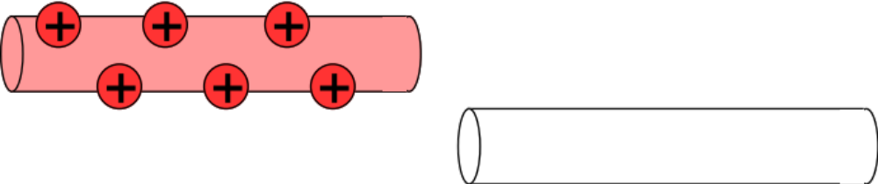
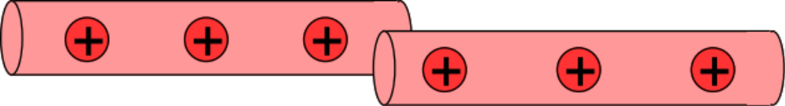
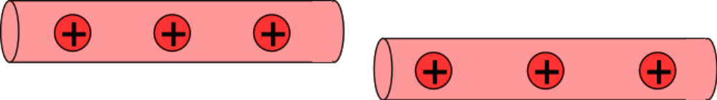
Mr. White’s Charging by Conduction Slide 2
Note from Fletch: If both rods are conductors and they are identical, the charge will distribute evenly (as shown) between the two.
6.)

Slide 7
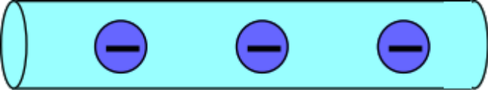
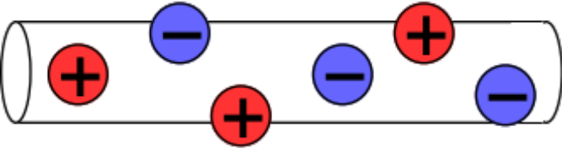
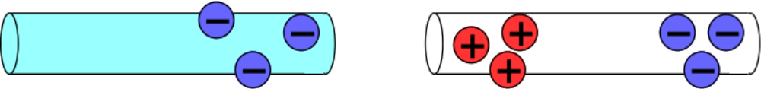
Mr. White’s Charging by Induction Slide 1
“Charging by induction” occurs when a charged object is brought near a neutral conductor.
7.)

Slide 8
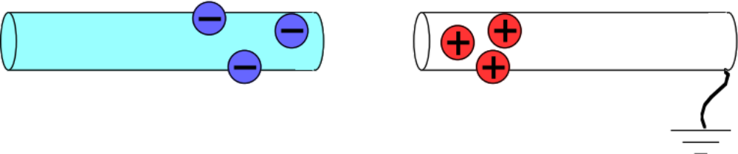
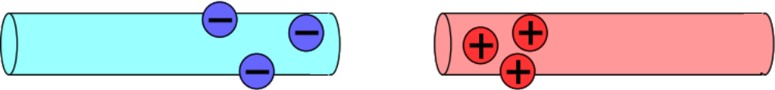
Mr. White’s Grounding Slide
The term grounding refers to connecting a conductor to the literal ground, ie. the earth. The earth readily accepts or gives up electrons—it has plenty to spare—so grounding a conductor allows for the flow of charges. What effect this has depends on the situation.
8.)

Slide 9
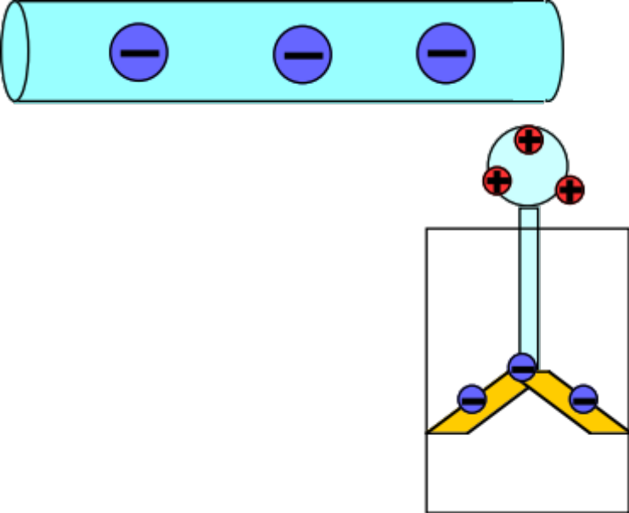
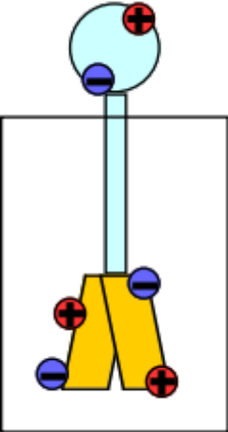
Mr. White’s Electroscope
The electroscope is a simple device designed to detect the presence of electric charges. Movable leaves (of gold?!) connected to a metal ball separate when a charged object is brought near, or touched to the ball. But why?
9.)

Slide 10
Shielding
When free charge is placed on a conductor, electrical repulsion will motivate electrons to move as far away from other electrons as possible. Consequence:
Force electrons onto a flat conducting surface. At some point, the free electron population already on the surface will provide such a large repulsive force that no additionally placed electrons will make it onto the surface. When that happens, the electrons will be evenly distributed over the surface.
surface charge density
evenly distributed
Bend the surface and you can force MORE electrons on, increas-ing the surface charge density. Why? Because there is now material between the electrons, diminishing their repulsive effect on distance electrons. This phenomenon is called SHIELDING.
surface charge
density increased
Oddly shaped conductors will have different charge densities, depending upon the severity of their curvature.
charge density
really high
The extreme: the lightning rod, a pointed piece of metal insulated from a house. It accumulates HUGES amount of charge at its end point, attracting potential lightning strikes away from the house.
charge density
relatively low
10)

Slide 11


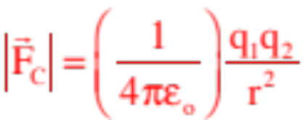
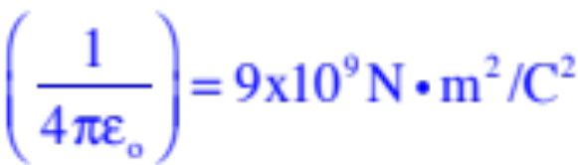
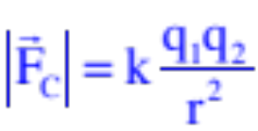
Coulomb’s Law
When two point charges are in the vicinity of one another, they will feel a Newton’s Third Law, action/reaction electrical force that will be attractive if the charges are unlike and repulsive if the charges are like.
According to Coulomb, the magnitude of that force will be proportional to the product of the magnitude of the two charges (the symbol for charge is q) and inversely proportional to the square of the distance between the two charges.
The proportionality constant is usually defined in terms of another constant called the permittivity of free space (this is a measure of a vacuum’s resistance to forming an electric field—something we’ll talk about later). Numerically,
So mathematically, Coulomb’s Law is written as:
As , this is sometimes defined as k and Coulomb’s Law
is written in some books as:
11.)

Slide 12


Important Points
Coulomb’s Law only works between two POINT CHARGES. If you want to deal with more than two charges, you need to execute a vector sum of all the Coulomb forces acting on a charge due to all the point charges in the system.
Coulomb’s Law is only useful in static situations. Charge in motion is a whole other kettle of fish.
The unit for charge in the MKS system is the COULOMB. In that unit:
There is Coulombs worth of charge on an electron;
There is Coulombs worth of charge on a proton;
12.)

Slide 13





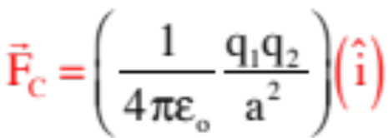

NEVER include a charge’s sign when using Coulomb’s Law. The direction of force generated by a point charge on another point charge, is determined by attraction or repulsion between the charges (i.e., whether they are like or unlike charges) and how the coordinate axis is set up. Beyond determine likeness or unlikeness, the sign of the charges has nothing to do with direction in a coordinate axis setting! To wit:
Example 1: A positive charge is located at the origin. A negative charge is located a distance -a units along the x-axis. What is the force on due to the presence of ?
According to Coulomb’s Law:
Why in the +x-direction? Because opposites attract, and the direction of attraction on in this case is to the right! If it had been located at x = a, the magnitude would have been the same but the direction would have been in the –x-direction!
REGISTER! If you’d included sign in the Coulomb expression, you’d have ended up with a force value that was NEGATIVE, which would have made NO SENSE given the coordinate set-up. USE COULOMB ONLY FOR MAGNITUDES!
13.)

Slide 14




Example 2: Consider the charge configuration shown. Where could you put a positive charge q if it is to feel no net electric force?
As a small side point, it doesn’t matter whether q is positive or negative—zero force is zero force!
Observation: The point must be along the x-axis. But where?
It can’t be between the two charges because the positive charge will push q to the left while the negative charge will also pull q to the left . . . hence no place in between where the net force can be zero.
It can’t be in the positive region to the right of the origin because the 2C charge will be both larger and closer to q than will be the case for the -.5C charge . . . hence no place in that region where the net force can be zero.
Apparently, the coordinate must be in the -x-region to the left of the origin.
14.)

Slide 15
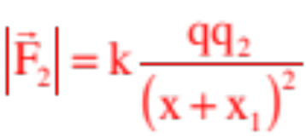
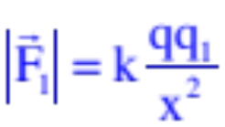




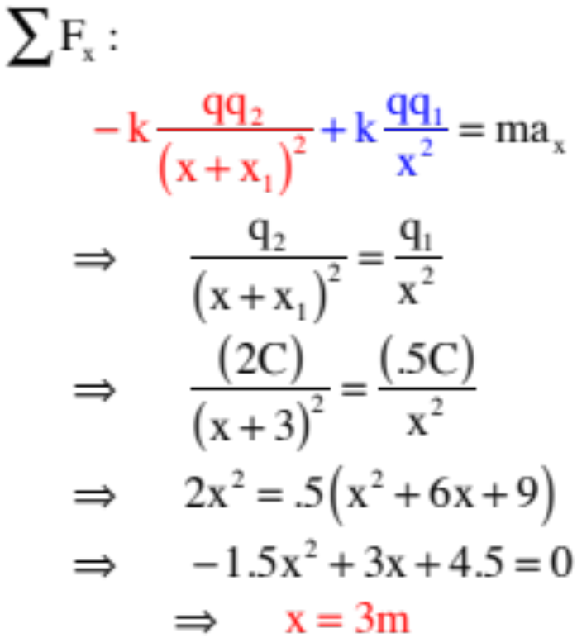

Defining x to be the no-force position of q, we can write Coulomb’s Law between q and each of the charges:
Noticing that the positive charge is producing a negative force (it’s repulsing q), and the negative charge a positive force, signs need to be added after the fact. Summing these forces vectorially, we get:
15.)

Slide 16












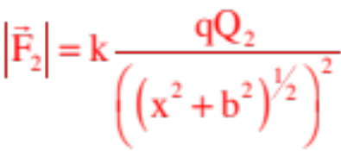

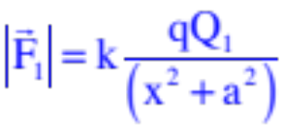
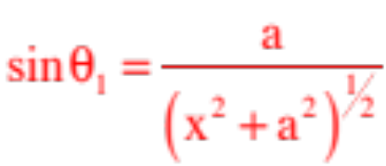
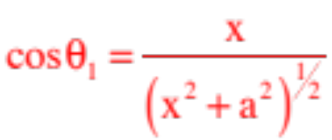
Example 3: Determine the force on q.
Begin by determining the direction and magnitude of the force on q due to the presence of each of the charges in the system.
To add the forces vectorially, we need to break the forces into components.
At this point, we need a little trickery. Looking at the shaded triangle, the sine and cosine can be written as:
and
16.)

Slide 17
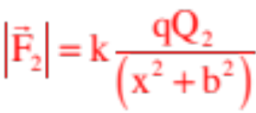
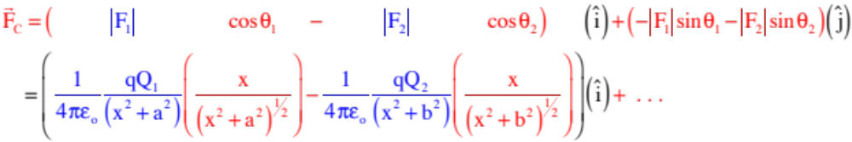
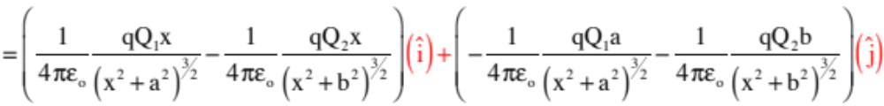
Putting it all together:
17.)

Slide 18




Electric Fields
Place a “field producing” point-charge out in space.
That charge will produce an electrical disturbance in the region around it.
To detect that disturbance, place a test charge in the region. As long as the disturbance is there, the test charge will feel a force on it.
If you measure the force on the test charge q, THEN DIVIDE BY THE MAGNITUDE OF THE TEST CHARGE, you end up with a force-related quantity that is dependent upon:
The size of the field producing charge Q, and
The distance from the field producing charge Q.
It will have NOTHING TO DO with the size of the test charge.
18.)

Slide 19


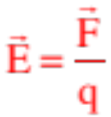

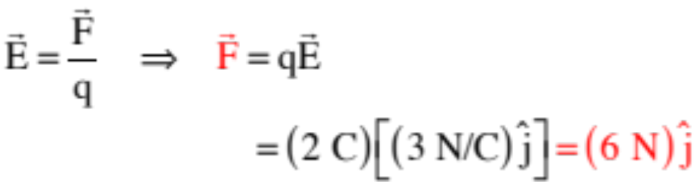
electrical
disturbance
Called an ELECTRIC FIELD, this idea of measuring the amount of force per unit charge AVAILABLE at a point due to the presence of field-producing charge can be (and is) associated with any charge configuration.
exists
An ELECTRIC FIELDs exist wherever there is charge. For the electric field to exist, there doesn’t need to be present a secondary charge to feel the effect of the field-producing charge. And because E-flds tell us how much force is available PER UNIT CHARGE at a point, the electric field is defined as:
Example 3: What force does a 2 C charge feel in an electric field ?
19.)

Slide 20



Subtleties Concerning Electric Fields
An electric field, being a modified force field, is a vector. So how is its direction defined?
The direction of an electric field is defined as the direction a POSITIVE TEST CHARGE will accelerate if released in the field at the point of interest.
DON’T GET AHEAD OF YOURSELF on this. You will see how it all plays out shortly. For now, just take in the definition.
Example 4: At point a designated in each of the scenarios below, draw the direction of the electric field generated by the field-producing charge configuration.
surface charge on outside
edge of hollow, insulating
sphere
direction
of E.fld
direction
of E.fld
direction
of E.fld
no E.fld
20.)

Slide 21



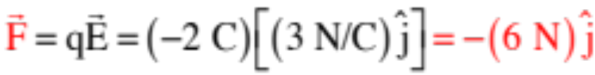
Continuing with Subtleties
By definition, positive charges freely accelerate in the direction of electric fields. As such, negative charges must freely accelerate OPPOSITE the direction of electric fields.
So whereas we DIDN’T use a charge’s sign when using , leaving the force’s sign determination to attraction/repulsion characteristics coupled with where the charge was in the coordinate system, we NEED to include charge sign in using
. To see why, reconsider Example 3.
Example 5: So back to Example 3, but with a twist. What force does a -2 C charge feel in an electric field ?
When the charge was positive, the calculation yielded , so we’d expect the solution to this problem to be negative that value. But how to get that negative. Although this is REALLY NOT KOSHER, IF we use the sign of the charge in our relationship, we get the right answer (not Kosher because the sign of a charge has nothing to do with the sign of a force). Using that, we can write:
Point taken?
21.)

Slide 22
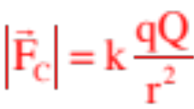
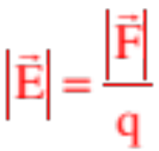
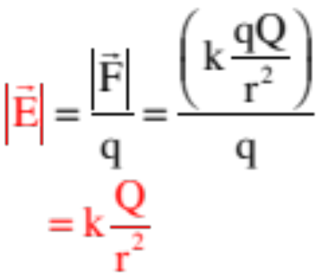
A Specific Case--The Electric Field Generated by a POINT CHARGE
Example 6: Derive a general expression for the electric field generated by a point charge Q?
If we placed a positive test charge q a distance r units from Q, the magnitude of the force on q (according to Coulomb’s Law) would be:
By definition, the magnitude of the electric field is , so:
22.)

Slide 23
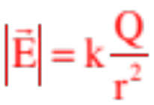

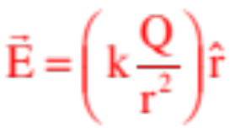
Observations:
If you are ever working with a field-producing charge that is a POINT CHARGE, you now know its electric field will equal:
When talking theoretically, the direction of this field will be radially outward if the field-producing charge is positive (a positive test charge will accelerate away from a positive field-producing charge—that’s how electric fields are defined . . . the direction a positive test charge will accelerate if put in the field and released) and radially inward if the field-producing charge is negative. As such, with the sign of the charge included (again, not kosher, but it gives the correct sign for the vector), the E-fld as a vector is often presented as:
For most problem solving, though, we work in Cartesian coordinates. In that setting, use the relationship to determine the magnitude of the E-fld and determine the direction using the “acceleration of positive test charge” question.
23.)

Slide 24




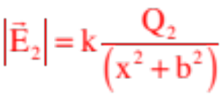
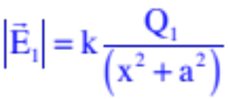
Example 7: Derive an expres-sion for the electric field at (x,0).
notice, no charge here,
just a point in space
This is very similar to Example 3 (and because the charge q was positive in that problem, the forces on it and the direction of the electric fields will even be the same). The difference? No need to include the test charge q, just work with E:
Defining the field directions and magnitudes,
then break into components:
You’d use the same trickery ( ) and finish the problem just like before.
24.)

Slide 25
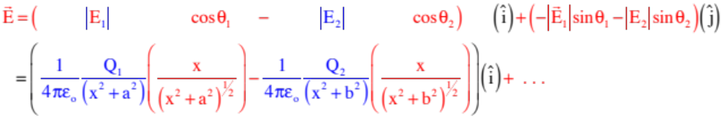
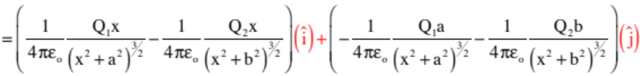
Putting it all together:
25.)

Slide 26
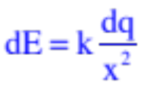





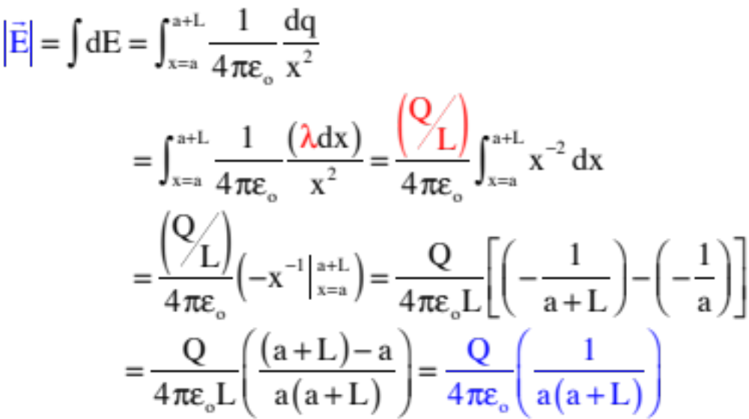

Example 8: Derive an expression for the electric field at the origin due to a rod with charge -Q uniformly distributed over its length L.
Being an extended charge distribution, we need to break the rod into a differenti ally small bit of charge,
determine the electric field magnitude and direction as it exist exists at the origin due to that bit of charge,
then sum that differential electric field over the entire rod. To do this, we will need to define a linear charge density function
(yes, this looks just like
the linear mass density function . . . that’s OK, we can use the same symbol to do the more than one thing):
As always, the density function can be written in differential terms as . With that, we have:
26.)

Slide 27
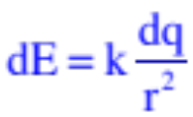

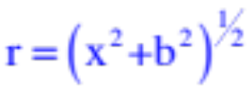





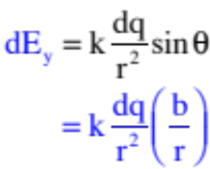
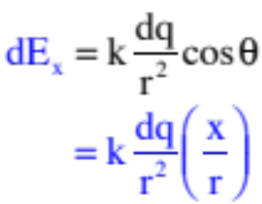
Example 9 (a non-AP question): Derive an expression for the electric field at an arbitrary point y = b on the y-axis due to a rod with charge Q uniformly distributed over its length L.
As usual, define the direction and magnitude of the differential E-fld due to an arbitrary differential charge dq on the rod.
Once done, break it into component parts using the sine and cosine trick:
27.)

Slide 28
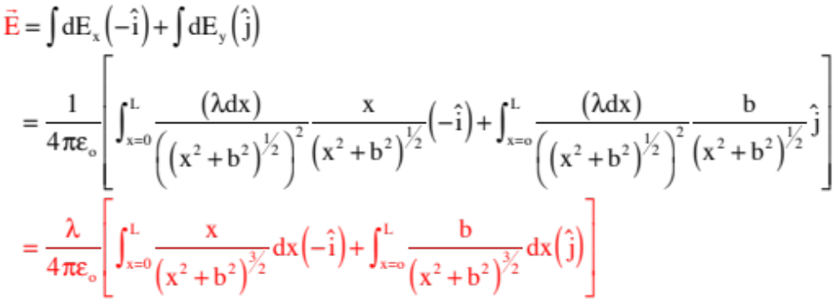
Without doing the integrals (the set-up is what is important, and something like this isn’t something the AP folks are going to throw at you), the electric field is:
28.)

Slide 29

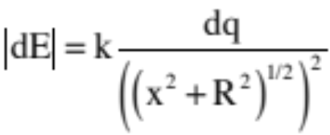





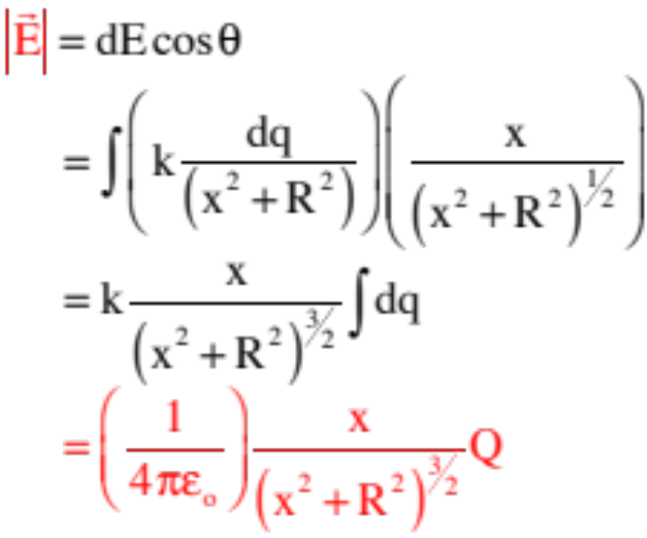
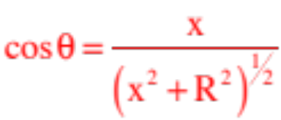

Example 10: A ring situated in the y-z plane (as shown) has –Q’s worth of charge on it. Derive an expression for the E-fld at (x,0).
As usual, begin with a differential bit of charge -dq and determine the direction and magnitude of the differential electric field at (x,0) due to that bit.
these components are the same.
these components cancel out.
Use any symmetry that exist to simplify the summing task.
Noting that x and R are constants, and that the cosine is:
where the direction, by inspection, is
we can write:
29.)

Slide 30
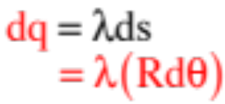











Example 11: Derive an expression for the electric field at the center of a half-hoop of radius R with Q uniformly distributed over its surface.
This is a little bit tricky as the differential bit of charge dq is located on an arc
So magnitude, direction and components of dE due to dq become:
What needs to be noticed is that the arclength ds subtended by an angle is:
Using a linear charge density function, then, we can write:
30.)

Slide 31






An additional bit of trickery is involved in exploiting the symmetry of the set-up. Notice there is a second dq on the right side at an angle that will produce a mirror-image differential electric field to our original bit of charge. The x-components of the two fields will add to zero, so all we really have to deal with is the y-component.
With the linear charge density as:
and dE as:
we can write:
31.)

Slide 32






Example 12: A solid disk of radius R situated in the x-z plane (as shown) has Q’s worth of charge on it. Derive an expression for the E-fld at (x,0).
We already know the E-fld function along the x-axis for a charged hoop.
So taking the hoop’s charge to be dq and its radius to be r, we can write the magnitude of the differential E-fld (in the x-direction) due to a differentially thin hoop on the face of the disk to be:
As always, a surface density function can be defined as both:
and, with the area of a hoop equaling the circumference of the hoop times its thickness:
32.)

Slide 33



Summing over all of the differential hoops yields:
rewriting
33.)

Slide 34
If you have been observant, you will have noticed that every single electric field function you have derived for an extended charge configuration has been for the electric field at the origin of the coordinate system you have been given. The extended bar to the right is a good example.
So what would you have done if the coordinate system hadn’t been provided—if the above problem had, instead, been presented as shown and the question was “What is E at Point p?”
p
If you had seen a bar problem done with the axis in the middle, you may have been tempted to mimic what you had seen before and try to parallel the two problems. That would suggest memory work, not thinking work.
p
The intelligent way to do the problem, and the way that suggests you actually understand the process, would be to put the axis at the point of interest, define your x accordingly, and go from there. In other words, to set it up in exactly the same way it was presented to you in the actual problem.
Additionally, if you would like to look at more exotic, most-probably non-AP electric field problems, look at the Where r You Going PowerPoint on the class Web site.
34.)

Slide 35
Electric Fields Lines
A method to visualize what an electric field looks like is wrapped up in what are called electric field lines. You saw an example of field lines when I introduced the idea of an electrical disturbance around a charge (see figure to the right). The lines are designed to tell you very specific information about the charge configuration:
electric field lines for positive point charge
As electric field lines move away from positive charge and toward negative charge (remember, the direction of an electric field is defined as the direction a positive test charge would accelerate if released at the point of interest), electric field lines always leave positive charges and enter negative charges.
The number of line that leave a charge is proportional to the size of the charge.
The distance between lines gives you a relative feel for the strength of the field at a particular point—the closer the lines, the stronger the force. That means a constant E-fld will have field lines that are parallel and equidistant apart.
The lines gives you a relative feel for the direction of the field at a given point, and skirt areas where an E.fld is zero.
constant E-fld
35.)

Slide 36

(next five pictures courtesy of Mr. White)
36.)

Slide 37

(courtesy of Mr. White)
37)

Slide 38

38.)

Slide 39


39.)

Slide 40

(courtesy of Mr. White)
40.)

Slide 41
(next five pictures courtesy of Mr. White)
41.)

Slide 42

42.)

Slide 43

(courtesy of Mr. White)
43.)

Slide 44

44.)

Slide 45

(courtesy of Mr. White)
45.)

Slide 46

(courtesy of Mr. White)
46.)

Slide 47

(cover of Physics Teacher magazine)
47)

Slide 48

Electric Fields - concept check
From Fletch’s book
it’s a vector, which tells you the direction a positive test charge will accelerate if placed in the field (a negative charge would go the other way).
Its magnitude is the available force per unit charge (like “g”). If you place a charge “q” at any location where you know E, you can calculate the force on the charge to be F = qE (like F_{g} = mg)
This is how all our electrical devices work! When you flip a switch, plug something in, whatever, an electric field is the thing that makes electrical devices function.
An electron would accelerate to the left because the field indicates how a positive charge would accelerate.
A proton would accelerate to the right. It would feel the same electrical force as the electron (just in the opposite direction) but would accelerate differently due to its larger mass.
48.)

Slide 49











Example 13: A charge –Q and mass m is fired into a cavity bounded by two metallic plates of length L. The plates are d units apart. The charge initially moves along the cavity’s central x-axis with velocity (see sketch). Assuming gravity acts downward:
a.) The hope is that Q will move straight along the x-axis even though gravity is acting upon the mass. An E-fld is placed between the plates to counteract gravity. In what direction must that field be? Also, what kind of charge must exist on the top and bottom plate to effect that field?
If the electric FORCE must be upward to counteract the downward force of gravity, and if the force on a negative charge is opposite the direction of an electric field (think about how the direction of an electric field is defined), the E-fld must be downward (hence producing an electrical force upward). (NOTE: The easiest way to think through this is to assume the charge is positive, determine the E-fld for that particle, then reverse you solution.)
The charge configuration needed to generate a downward electric field, given that field lines leave positive charges, is positive charge on the top plate and negative charge on the bottom plate.
49.)

Slide 50










b.) What must be the electric field magnitude to effect this straight-line motion?
This is a Newton’s Second Law problem. Noting that the magnitude of the electric force is , where q does not carry its sign, we can write:
c.) Given this E-fld, if this experiment had been carried out in space:
i.) What path would the charge take after the firing?
(see sketch)
ii.) Given the electric field as calculated, what velocity would the charge require to just barely clear the cavity without crashing into its wall?
3
1
2
50.)
Notes:
----- Meeting Notes (1/29/18 13:35) -----

Slide 51







Example 14—courtesy of Mr White:
Secret Agent 008 is in a rather sticky situation. A climbing rope of negligible mass suspends our hero over a pool of hungry sharks. The space above the pool is permeated by a uniform electric field of 100 N/C. Luckily, Agent 008 is wearing a special Adjustable Electric Charge Body Suit prepared for him by the ingenious minds at the Imperial Research and Development Lab.
a) In order to stay alive long enough to devise
an escape plan, 008 must select a charge for his suit that will enable him to keep the rope at a minimum angle of 20° to the left of vertical, as shown in the drawing above. If he weighs 75 kg, what is the magnitude and polarity of the charge Agent 008 should set the suit for?
He is going to need an electric force opposite the direction of the E-fld, so it will need to be a negative charge. With the f.b.d.:
and
51.)

Slide 52
b) Agent 008 accidentally selects a charge of +10.0 Coulombs for his body suit. To what angle (relative to the vertical) does his body swing now?
A positive charge will swing him in the direction of the E-fld, so the sketch will be a mirror image of what is seen and you’ll just have to do the math (it’s the same math) to figure out the angle.
c) Unfortunately, Agent 008’s rope has been weakened--when the rope reaches this new angle, it snaps. What was the tension in the rope just before it broke?
Go back to either of the equations used to solve Part b and solve for T.
52.)

