Slide 1
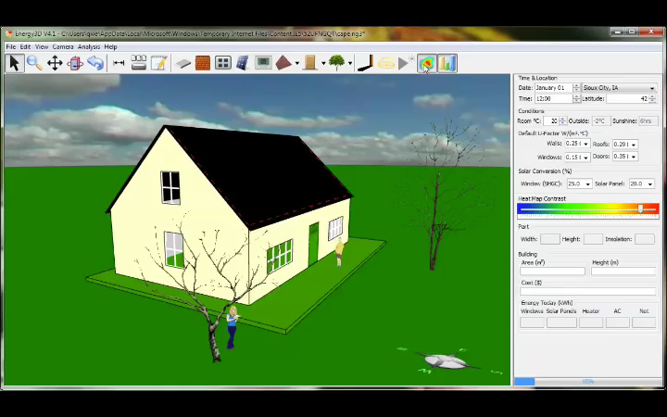
Heat flux
Energy radiating through a surface
1.)

Slide 2
CHAPTER 24:
Gauss’s Law
Consider a heat source
asymmetrically placed inside an irregularly shaped, closed surface. Assume the amount of heat per unit area per unit time passing through the surface is defined by a position function h (that is, you give me a coordinate and I give you the goods). How much heat per unit time passes through the entire surface?
If we could identify a differential surface area through which heat was passing, we could multiply the heat per unit area per unit time function h by that surface area dA to produce the heat per unit time through that area. Summing (integrating) over all the areas for the entire surface would generate the amount of heat that passes through the entire surface per unit time.
So how does the math work on this?
2.)

Slide 3









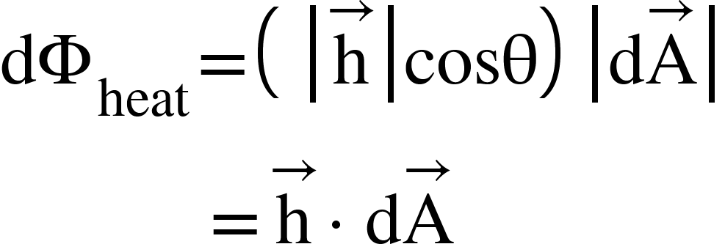
We start by defining on the surface a differential surface area vector whose magnitude dA is equal to the surface area of the differentially small patch and whose direction is perpendicularly out from the surface. That vector, along with , is shown to the right.
What we are interested in is the component of along the line of times the magnitude of . In other words, we want the differential heat flux through the patch, which will equal:
component will
not produce heat
through the patch
component will
produce heat
through the patch
This is the mathematical definition of flux. Any vector field can have a flux through a surface, whether it be an open surface or a closed surface.
3.)

Slide 4


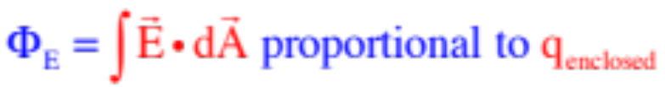
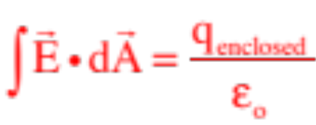
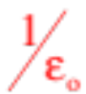
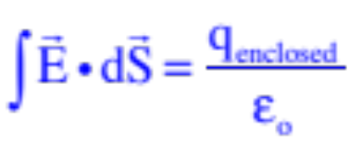
Gaussian surface
So let’s assume our hot object is actually a point charge q. What can we do with that situation?
Gauss made the simple but powerful observation that there would be an electric flux through the closed surface, called a
Gaussian Surface, as long as there was charge enclosed inside the surface.
What’s more, he surmised that the amount of flux would have to be proportional to the amount of charge enclosed inside the Gaussian surface. In other words, mathematically:
The proportionality constant that made the relationship into an equality was the inverse of our old friend, the permittivity of free space (i.e., ), so Gauss’s Law is written as:
(Tiny note: Some books use dS as the surface area vector, so .)
4.)

Slide 5



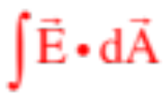


Some Observations About Flux:
1.) Remember back to the impulse relationship and the instances when you were asked to determine the impulse on an object. You had the choice of determining the namesake of the operation ( ) OR, you could determine , depending upon what you knew.
You have a similar situation when asked to determine the electric flux through a closed surface. You can determine over the surface, OR you could just determine the total net charge enclosed inside the surface and use to determine the flux. The two will be the same.
2.) The units for electric flux are .
3.) The area vector dA used in electric flux calculations is ALWAYS defined perpendicularly outward from the Gaussian surface.
4.) Charge outside a Gaussian surface will generate no net flux through the closed surface. (Think about it, charge outside the surface will produce electric field lines that first pass into the surface, but then will pass out of the surface on the other side generating no net flux through the surface).
5.)

Slide 6
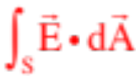



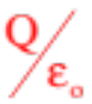
Back to Gauss’s Law
Gauss’s Law is ALWAYS TRUE, no matter how the geometry shakes out, but it is pretty useless unless you can exploit symmetry in a problem.
Example 1: Use Gauss’s Law on the spherical surface of radius R and charge Q as shown.
What the integral is apparently asking us to do is to define an arbitrary, differential surface area dA (remember, dA has a magnitude equal to the area of the enclosed surface and is directed perpendicularly outward from the surface), evaluate both the direction and magnitude of the electric field at that surface, dot the
Gaussian surface
and into one another, then do that for all the differential surfaces over the entire structure and sum them by integrating.
Gauss was right. That flux WOULD equal . But because no two points on the surface are the same distance from the charge Q, and no two dot products are going to be the same (angles different), doing that integral would be a NIGHTMARE. In short, this is an impossible problem to do!!!!!!!
6.)

Slide 7
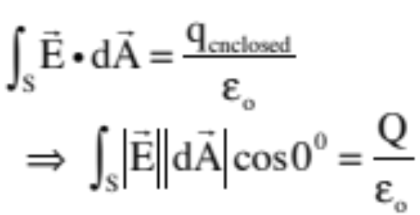
Example 2: This is Example 1 done more reasonable: Derive an expression for the electric field function for a point charge Q.
imaginary Gaussian surface
Important observation: There is no given Gaussian surface to begin with in this problem, just a hanging charge. We need to create an imaginary Gaussian
surface around the charge, one that exploits the symmetry of the charge’s electric field. That is, we need to create a surface such that ever point on the surface is equidistant from the charge.
With the imaginary Gaussian surface centered on the charge, ANY differential area vector dA will be radially outward, which is to say, in the direction of E, and the angle between the electric field vector and the differential area vector will be zero (so the cosine in the dot product will equal 1). With that, we can draw (see sketch), then write:
7.)

Slide 8
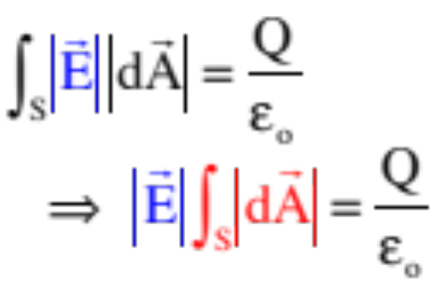

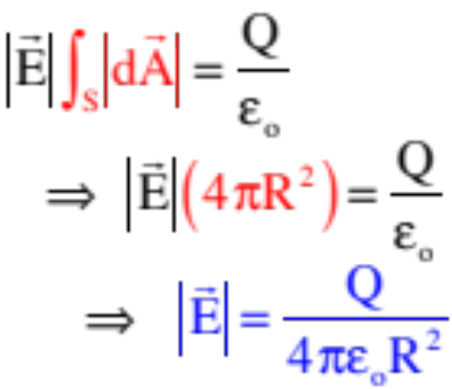
imaginary Gaussian surface
Herein lies the beauty of the method. Because every point on the surface is equidistant from the charge, the evaluation of the magnitude of E at every differential surface dA WILL BE THE SAME, which is to say, IS A CONSTANT VALUE, and because it is a constant, we can pull it out of the integral. (Note that we couldn’t do that with the original Example 1 because each point was a different distance from Q.) With that, we can write:
That makes life wonderful, as now the only thing inside the integral is the differential surface area dA, and summing that over the surface simply yields the total surface area of the sphere ( ) . . . So we can further write
Look familiar? It should. It’s the same as the electric field function we derived for a point charge using Coulomb’s Law!
8.)

Slide 9


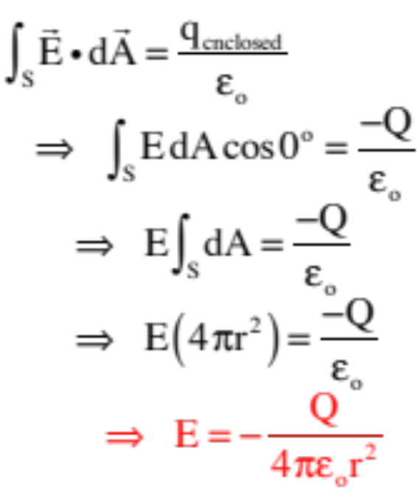
Insulators and Gauss’s Law
What is characteristic of insulators is that free charge stays put in an insulator, it doesn’t migrate around in response to an electric field. With that in mind:
Example 3: Derive the electric field function, both inside and outside, for a spherical insulator of radius R, that has charge -Q evenly distributed throughout its volume.
Start with an imaginary Gaussian sphere of radius r, where r > R, and write out Gauss’s Law for the situation (there are notes on the process on the next page):
a.) for r>R:
Gaussian surface
And yes, this looks like a point charge!
9.)

Slide 10



Subtleties:
1.) The LEFT SIDE of Gauss’s Law is always the EASY PART of the equation. Assuming you’ve picked the appropriate geometry, the magnitude of , which is what the dot product is interested in, should be the same everywhere. That means will be a constant and you will ALWAYS pull it out of the integral which, in turn, means you will ALWAYS end up integrating over dA. So for spherical symmetry, the left side will ALWAYS end up equaling:
2.) The dot product deals with magnitudes, so the E being determined by Gauss’s Law should be the magnitude of the electric field as evaluated at (or on) the Gaussian surface. So what’s the deal with the negative sign?
To make the math easy, always assume that is outward in the same direction as . That will make the dot product positive. If you are clever, though, and include the sign of the charge in , a negative sign showing up in the final expression for E will tell you that you’ve assumed the wrong direction for
(i.e., it’s inward, not outward). In other words, the negative sign doesn’t technically mean a negative electric field direction, but it sorta does . . . This will be a lot more important when you get to complicated charge configurations.
10.)

Slide 11
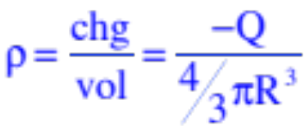

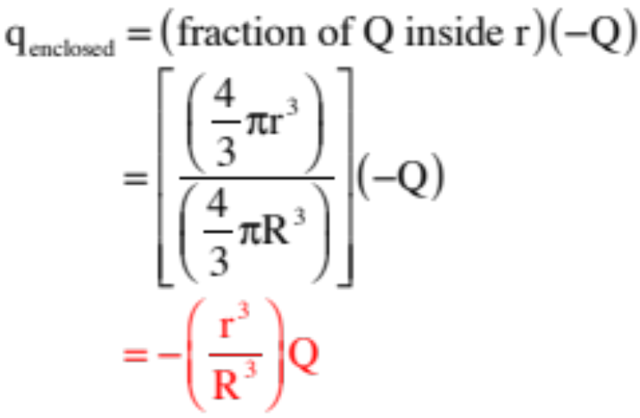
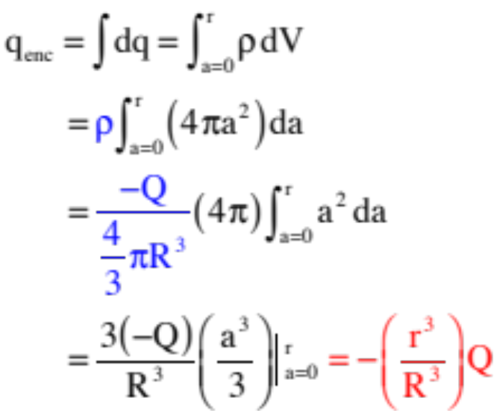



Again, start with an imaginary Gaussian sphere of radius r, this time with r < R, and write out Gauss’s Law for the situation.
b.) for r<R:
Note that we to need to figure out how much charge is inside r. We can do this two way. I’ll show both.
Gaussian surface
Using density function (works for all situations)
Straight ratio (works only for constant density)
Noting that:
and
surface
area
11.)

Slide 12
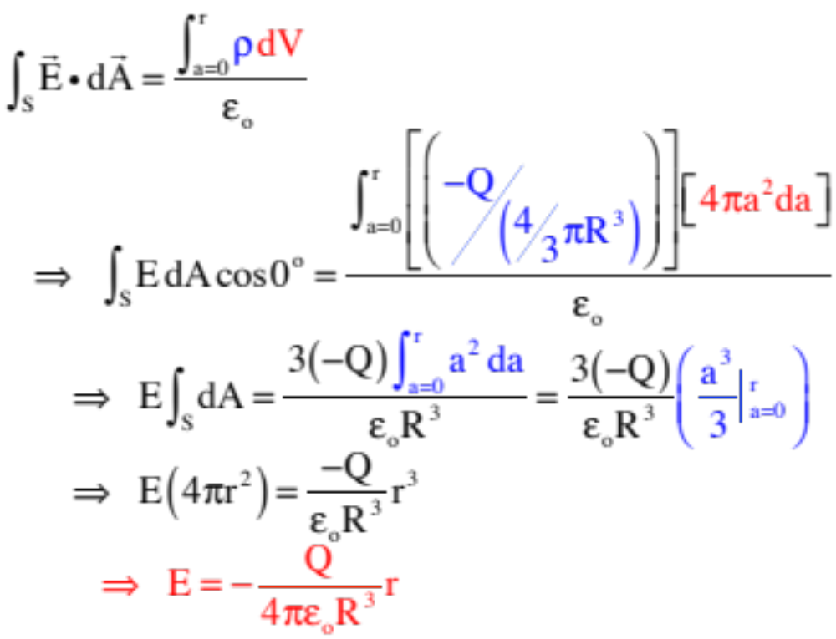
(con’t.—doing this with the density function . . . though either way would do here)
b.) for r<R:
Gaussian surface
Note that this is a linear E-field inside the sphere!
12.)

Slide 13

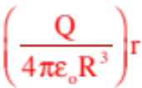
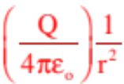


c.) What does the graph look like for electric field magnitude versus position?
13.)

Slide 14
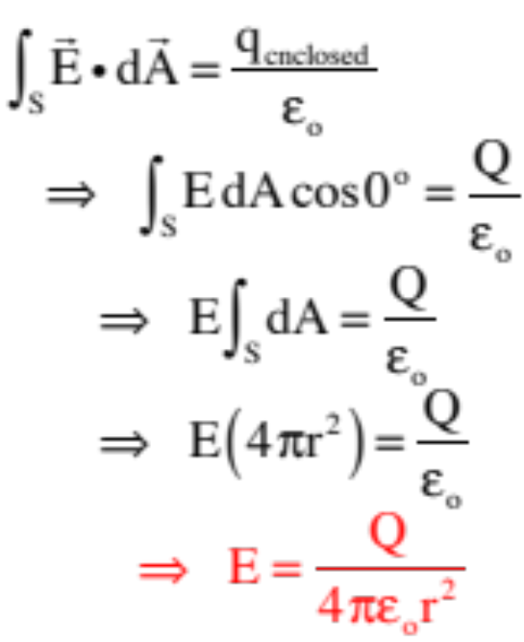
Conductors and Gauss’s Law
What is characteristic of conductors is that free charge can move around freely within the conductor, migrating in response to an electric field. With that in mind:
Example 4: Derive the electric field function, both inside and outside, for a spherical conductor of radius R, that has charge Q placed on it.
The imaginary Gaussian sphere of radius r, where r > R, looks just like it did for the insulator, except the charge is not shot through the volume but resides on the volume’s surface (like-charge attempts to get as far away from like charge as possible). So . . .
a.) for r>R:
Gaussian surface
Still looks like a point charge!
14.)

Slide 15
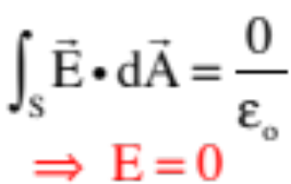
This is easy. With all the charge on the surface, the charge enclosed inside the Gaussian surface is zero and:
b.) for r<R:
Gaussian surface
c.) What does the graph look like for E-field magnitude versus position?
Note that this suggests that E-fld functions are discontinuous . . .
15.)

Slide 16





Now for the Real Fun
Example 5: A thick skinned, conducting, spherical shell with inside radius b and outside radius c has a net charge 3Q on it. At its center is a solid conducting sphere of radius a that has a net charge of –Q on it.
a.) How will charge distribute itself on these structure?
OBSERVATIONS:
1.) The electric field inside a conductor in a static situation will always be ZERO. Why? Because if
an electric field existed, electrons would respond to it and move until the field was nullified.
2.) For the E-field to be zero inside the conducting sphere, the net charge inside a Gaussian surface in that region must be zero. How can this be? Free charge in the amount –Q (i.e., electrons) must migrate to the outside surface of the conductor (hence the total charge inside the Gaussian surface inside the shell will sum to zero).
16.)

Slide 17





a.) (con’t)
OBSERVATIONS (con’t)
3.) Being a conductor, the electric field inside the shell must also be zero. As there is –Q’s worth of charge on the solid sphere at the center, electrons in the shell will be repulsed and migrate out from the inside to outside wall leaving the inside surface with +Q’s worth of charge on it and no charge enclosed for a Gaussian surface inside the shell.
4.) IF the shell had been electrically neutral, the migration of electrons in the shell due to the –Q at the center would have left the inside surface at +Q and the outside surface at –Q.
5.) IF the charge at the center didn’t exist, on the other hand, the +3Q net charge on the shell (meaning 3Q’s worth of electrons had been removed) would reside on the outside surface.
6.) Combining observations 4 and 5 leaves us with a net charge on the outside surface of +2Q and a net charge on the shell of +3Q (look at sketch).
17.)

Slide 18

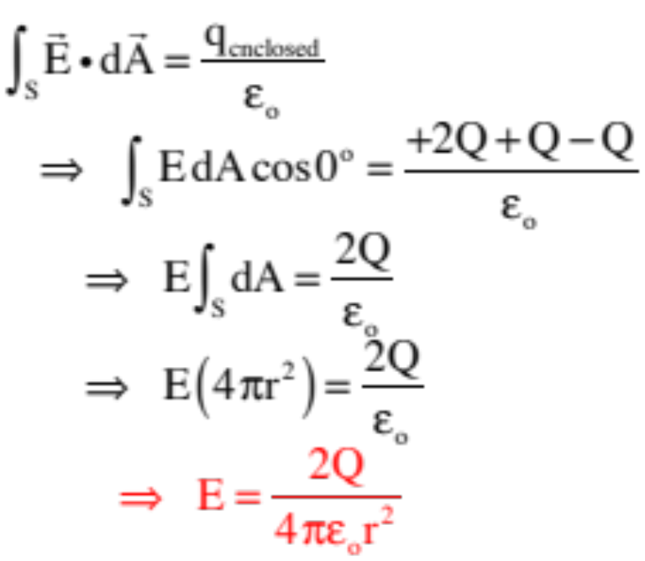

b.) Derive an expression for the E-fld for .
Using an imaginary Gaussian sphere of radius r, where r > c, and including ALL the charge enclosed, we can write:
Gaussian surface
18.)

Slide 19

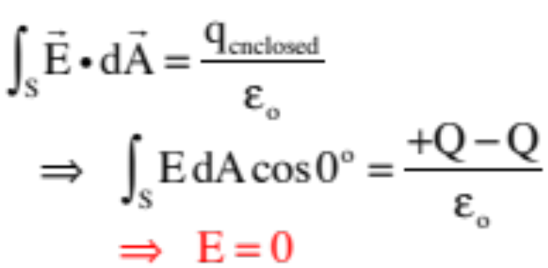
c.) Derive an expression for the E-fld for .
Using an imaginary Gaussian sphere of radius r, where r is inside the shell, we can write:
Gaussian surface
19.)

Slide 20

d.) Derive an expression for the E-fld for .
Using an imaginary Gaussian sphere of radius r, where r is between the shell and the sphere, we can write:
Gaussian surface
where the negative sign tells us the E-fld is not outward as assumed but, instead, opposite the assumed direction and inward (you’d expect this with net negative charge on the inside of the region and net positive charge on the outside).
20.)

Slide 21

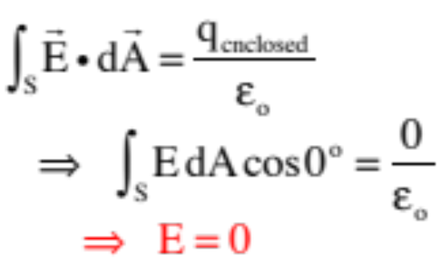
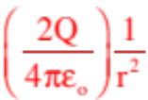



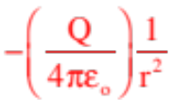
e.) Derive an expression for the E-fld for .
Using an imaginary Gaussian sphere of radius r, where r is inside the sphere:
f.) What does the graph look like for E-field as a vector versus position?
Gaussian surface
21.)

Slide 22


Real Fun With a Twist
Example 6: Let’s assume that someone touches an insulator to the inside of the conducting shell, and in doing so transfers Q’s worth of charge to the shell. What is going to happen in that case?
1.) An important point, which I haven’t men-tioned yet, is that physicist have no qualms about looking at situations like this from the perspective of the motion of POSITIVE
added
(which migrates)
charge ends up here
CHARGE. That is not what is really happening, but you can view theoretical situations as though it was happening, and come out with reasonable conclusion.
Doing that in this case suggests the following will happen: The bits of positive charge making up the transferred Q will migrate to the outside edge of the shell leaving it with a net charge of Q on that surface.
2.) In reality, electrons are drawn from the shell’s outside edge, leaving it with a net charge of Q, migrating through the shell to the inside edge where they jump to the insulator (that’s how the shell becomes more positive).
22.)

Slide 23



And Even More Fun
Example 7: A thick skinned, insulating spherical shell with inside radius b and outside radius c has a volume charge density , where the constant . At its center is a solid conducting sphere of radius a that has a net charge of Q on it.
a.) Derive an expression for the magnitude of the electric field for r > c.
We need the total charge inside a Gaussian surface that engulfs the entire charge configuration. The Q on the center sphere is easy, but the charge shot through the shell is not so easy as it is slight at the inside and gets heavier as one moves outward (that is, it isn’t uniform). To do this, we need to be clever.
Gaussian surface
23.)

Slide 24






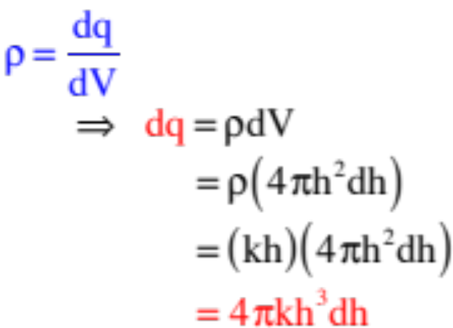

Define a differential volume dV as a differentially thin shell of radius h and thickness dh. Its magnitude will be its surface area ( ) times its differential thickness dh, or . With a given volume charge density of , where has been evaluated at h, we can write:
With this, we can determine the charge shot through the entire shell, or through just part of the shell.
Gaussian surface
24.)

Slide 25

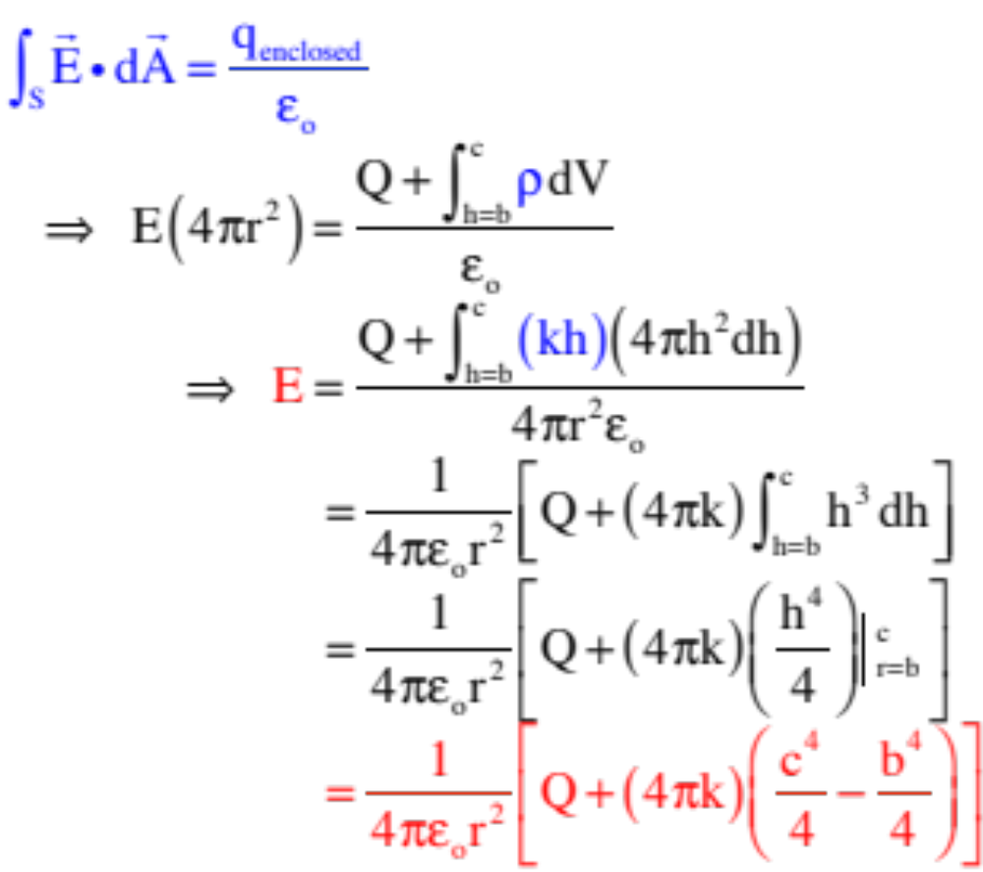
With
and figuring out the charge between b and c inside the Gaussian radius r, we can write:
Gaussian surface
25.)

Slide 26
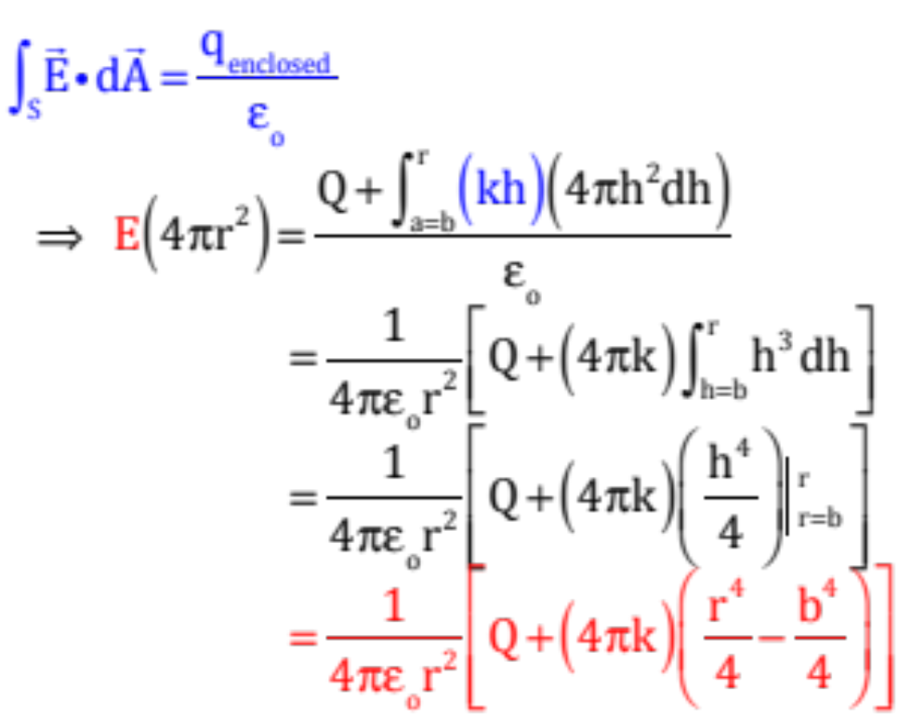
b.) Derive an expression for the magnitude of the electric field for c > r > b.
This is easy as it’s the same as Part a except the shell’s contribution to the charge is only the charge out to the Gaussian radius r. That is:
Gaussian surface
26.)

Slide 27
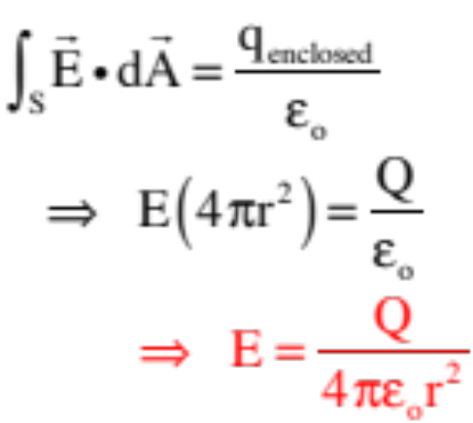

c.) Derive an expression for the magnitude of the electric field for b > r > R.
The only charge inside the Gaussian surface for this section is that on the inner conductor, which is Q, so:
Gaussian surface
d.) Derive an expression for the magnitude of the electric field for r < R.
No charge enclosed inside the Gaussian surface, so E = 0.
27.)

Slide 28


Cylindrical Symmetry and Gauss’s Law
cylindrical
Gaussian
surface
Example 8: Derive an expression for the electric field function for an “infinitely long” insulating rod whose linear charge density is a constant .
What you are looking for in a Gaussian surface is a surface upon which the magnitude of E is constant AND
L
the dot product is either the same everywhere, or zero. With a linear charge distribution, a sphere clearly won’t do. What will work, if you are clever, is a cylinder. How so? If the charge configuration is infinitely long (or in a pinch, very, very long), the electric field will be radially outward (or inward, depending upon the charge). A Gaussian cylinder will have ends whose dA’s will be perpendicular to the electric field (hence producing no electric flux and a zero dot product) and a curved surface whose dA’s are along the line of E. In short, a cylindrical Gaussian surface will do the job.
28.)

Slide 29

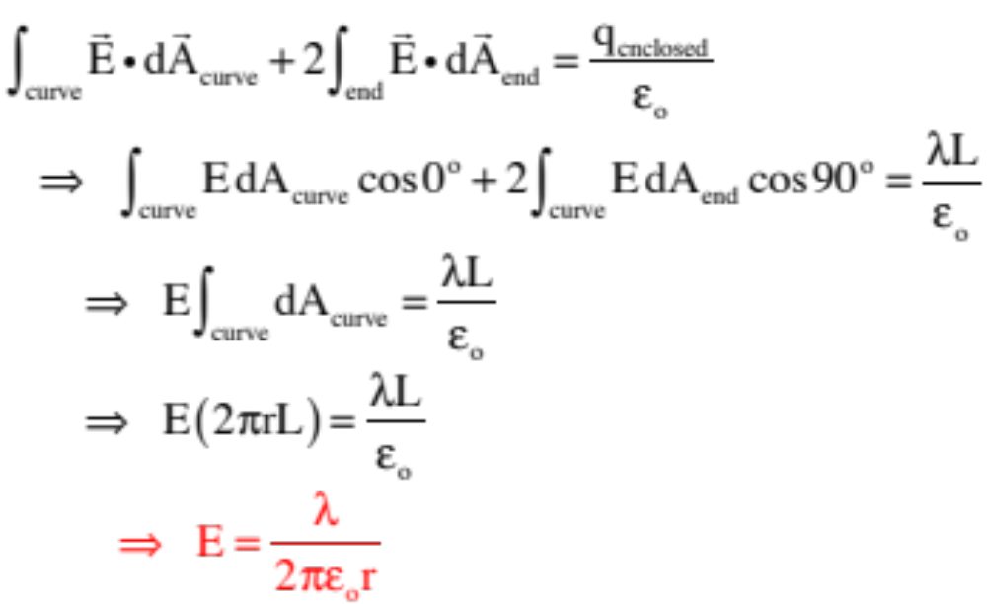

Noting that the amount of charge inside an imaginary, cylindrical, Gaussian surface will be the linear charge density times the length of the surface, and the surface area of a cylinder is the circumference times the length L, we can write:
cylindrical
Gaussian
surface
L
29.)

Slide 30






Example 9: A cylinder of inside radius a and outside radius b has a volume charge density that varies as r (i.e., , where k is a constant).
a.) Derive the electric field function for a < r < b:
The set-up is shown below:
top view
end view
3-d view
Gaussian
surface
central axis
Gaussian
surface
30.)

Slide 31









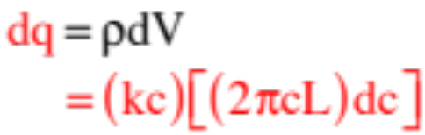
end view
We need the total charge inside a Gaussian cylinder, but as the density varies, we need to determine the charge in a differentially thin cylindrical shell inside the Gaussian surface, then integrate over all the shells.
The differential volume of a differentially thin cylindrical shell of radius c is the circumference of the shell ( ) times the differential thickness of the shell dc times the length of the Gaussian cylinder L. That is:
Gaussian
surface
Knowing that , we can write dq evaluated at c as:
31.)

Slide 32
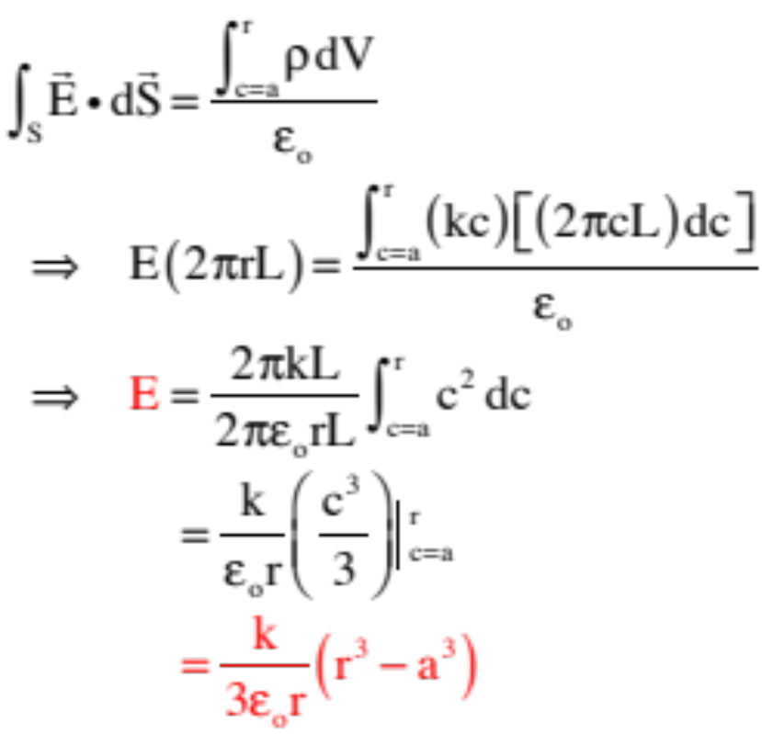
With that, Gauss’s Law becomes:
3-d view
Gaussian
surface
central axis
b.) Derive an electric field for r < a:
(It’s zero as no charge inside Gaussian surface.)
c.) Derive an electric field for r > b:
Same problem as Part a exception of the limits of the integration are different (you are now adding up ALL the charge inside the cylinder, so the limits go from c = a to c = b instead of c = a to c = the Gaussian radius r.)
32.)

Slide 33




Flat Sheets of Charge and Gauss’s Law
There is a subtlety we need to look at before we can make sense out of sheets of charge.
thin sheet
3-D view
thin sheet
insulator
from side
thin sheet
conductor
from side
--An insulator typically has free charge infused throughout its volume. For insulators, an area charge density function say, “Multiply me by a surface area and you get how much charge is behind that surface shot through the structure.”
--A conductor has charge on its surface with NO free charge in its interior. For conductors, an area charge density function say, “Multiply me by a surface area and you get how much charge is on the surface of the area in question.”
These are two very different critters!
33.)

Slide 34


With that in mind:
thin sheet
3-D view
Example 10: Derive an expression for the electric field function for an “infinite” sheet of insulating material whose area charge density is a constant .
thin sheet
insulator
from side
We need a Gaussian surface whose faces either yield zero flux or a flux whose electric field evaluation is a constant. It turns out that a plug
whose end-faces are symmetrically placed on either side of the slab will do the job. The flux through the curved section will be zero as E and dA will be at right-angles with one another, and with dA defined as outward on both outside faces, E will both have the same evaluation and will provide the same dot product. That is:
34.)

Slide 35
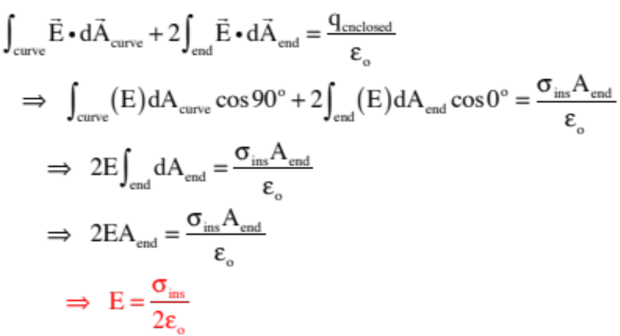
thin sheet
insulator
from side
35.)

Slide 36
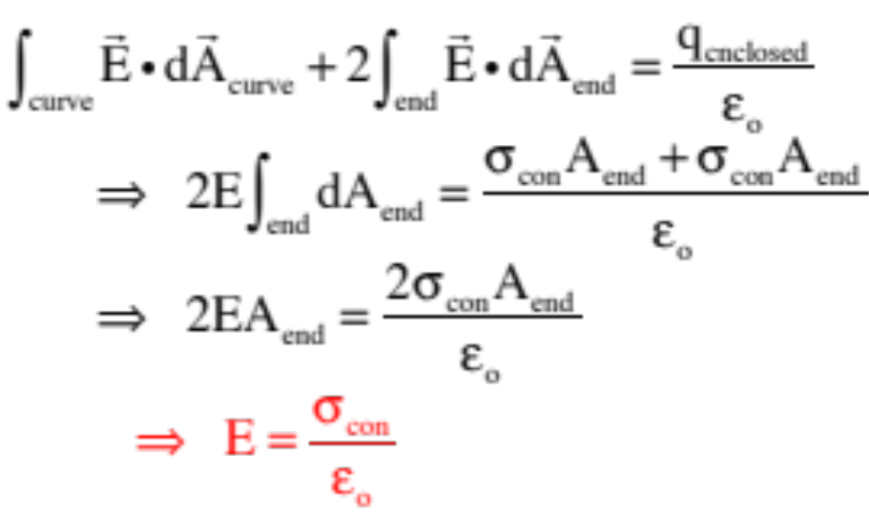
Example 11: Derive an expression for the electric field function for an “infinite” sheet of conducting material whose area charge density is a constant .
thin sheet
3-D view
thin sheet
conductor
from side
Here is where the difference in the charge configurations comes into play. We could use the same plug we used with the insulator, but there would be two surfaces upon which there was charge placed, each of which would have a charge density of . That means:
36.)

Slide 37

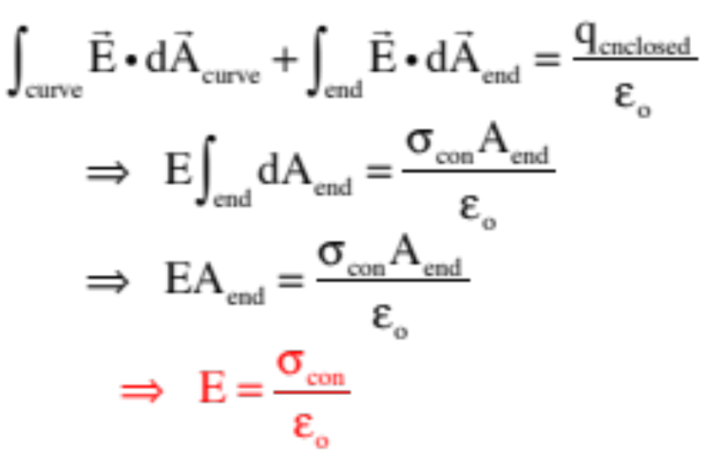
As a side point, another possibility would be to utilize the fact that inside the conductor, the electric field is zero. That means the Gaussian surface could have looked like:
thin sheet
3-D view
thin sheet
conductor
from side
and:
Same result either way!
37.)

Slide 38









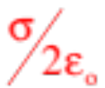
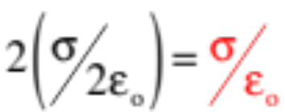
Parallel Sheets of Charge
Example 12: Two infinite, parallel sheets of opposite charge sit side by side and have a charge density of on each. What is the electric field intensity on either side, and in-between the configurations?
viewed from side
The Gaussian surfaces for both the positive and negative charge configuration is shown for region A. Each is identical to the configuration associated with an insulator. As such, each electric field magnitude will be equal to . As the fields will be in opposite directions, though, they will add to zero. The same will be true in region C.
Between the sheets in region B, the fields are in the same direction with the same magnitude, so we have a net field of
38.)

Slide 39

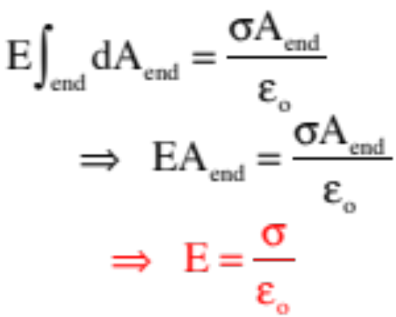
Parallel Plates and a Bit of Trickery
Example 13: Two infinite conducting plates with equal but opposite charge densities on them sit side by side. What is the electric field intensity between the plates?
Assuming the plates are very close together (in comparison to their plate area), we can approximate them as infinite conducting sheets. If we do that, Gauss’s Law yields:
from side
But an intrepid observer will undoubtedly notice that THIS IS THE SAME FUNCTION we got for a SINGLE infinite sheet . . . so how can that be (‘cause there’s two sheets here!)?
39.)

Slide 40




The trickiness is, again, in the definition of .
If you start with a sheet that has charge density on it, then bring a similar but oppositely charged plate in parallel to it, what’s going to happen to the original plate?
Electrons in the original plate will migrate away from the negative charge on the encroaching plate, leaving the original plate’s inside surface MORE ELECTRICALLY POSITIVE than it had been (and as that happens, more negative charge will be drawn to the inside surface of the encroaching plate keeping the charge distributions equal and opposite). In other words, it’s plate charge density will have changed to a new value .
In other words, Gauss’s Law will still worked, but the charge density function will be altered from the original situation.
40.)

Slide 41

A Disk
Example 14: Can you use Gauss’s Law to determine the electric field function for a flat, finite, positively charged disk?
Technically, there is no Gaussian surface that will accommodate the symmetry (or lack of symmetry) associated with a disk. However, you could use a plug and the technique used with the infinite sheet of charge as long as your point of interest was close to the central axis and r was small in comparison to the radius R of the disk.
411.)

Slide 42
Example 15
Physlet E.24.3
42.)

Slide 43
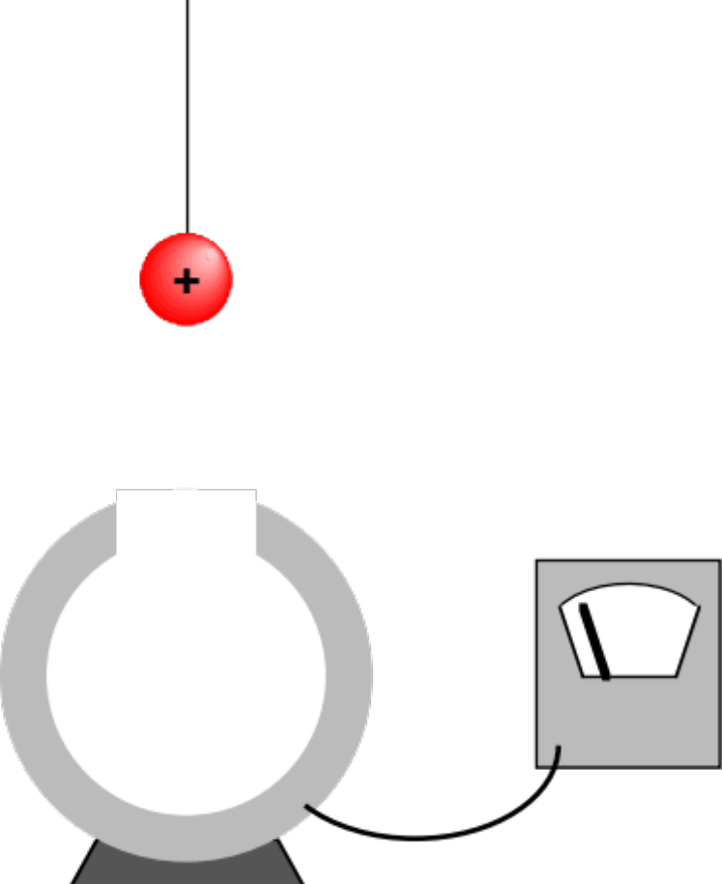
Example 16 - Faraday’s Ice Pail Experiment
Courtesy of Mr. White:
43.)

Slide 44
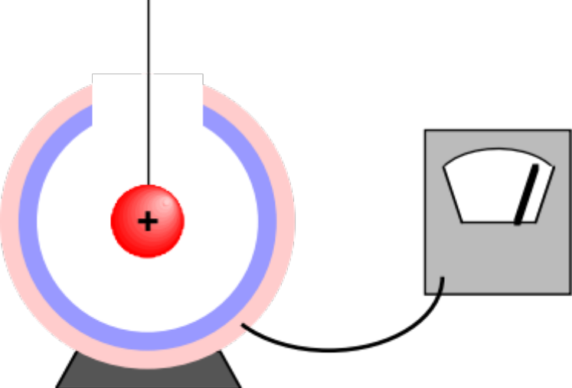
Example 16 - Faraday’s Ice Pail Experiment
Courtesy of Mr. White:
44.)

Slide 45
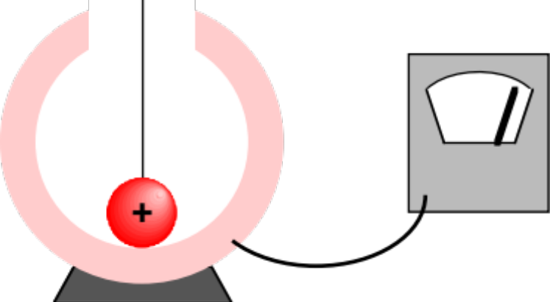
Example 16 - Faraday’s Ice Pail Experiment
Courtesy of Mr. White:
45.)

Slide 46
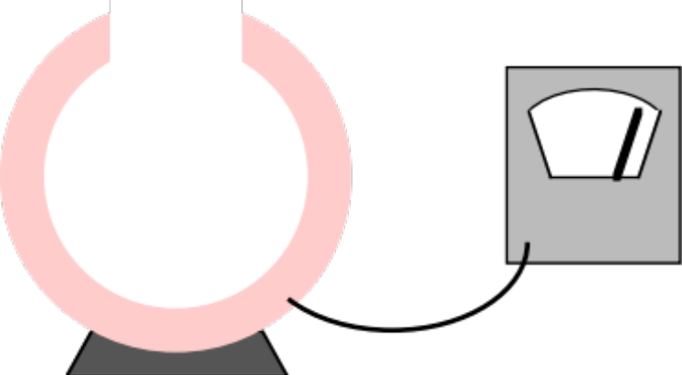
Example 16 - Faraday’s Ice Pail Experiment
Courtesy of Mr. White:
46.)

Slide 47
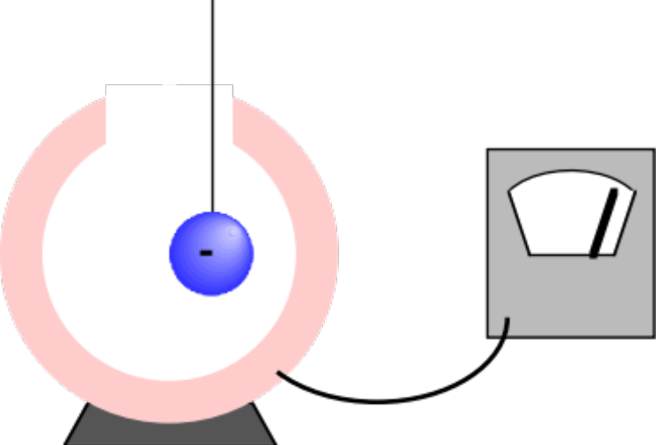
Example 16 - Faraday’s Ice Pail Experiment
Courtesy of Mr. White:
47.)

