Slide 1
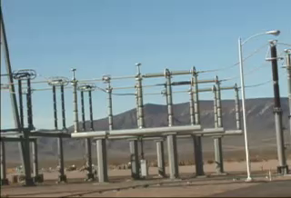
CHAPTER 25:
Electric Potentials and Energy Considerations
courtesy of
Mr. White
1.)

Slide 2



Electric Potential Fields
You should now be comfortable with the idea that a charge configuration will produce an electrical disturbance in its vicinity, and that knowing how much force per unit charge is provided to the region
around the field-producing charge (whether there be a secondary charge is in the region experiencing the force or not) in the form of an electric field is a useful idea to entertain.
It’s time to consider another related field, one associated with energy.
If we release a test charge q (or any charge, for that matter) in the electrical disturbance generated by our field-producing charge, the test charge WILL ACCELERATE.
will
accelerate,
has energy
2.)

Slide 3
Why will the test charge accelerate?
Because there is POTENTIAL ENERGY available to the test charge as it sits in the field.
will
accelerate,
has energy
We could measure the amount of potential energy the test charge has, but that would be quite limiting (the
information would be applicable only to that particular test charge).
The clever thing to do would be to mimic what we did with electric fields. We could measure the test charge’s potential energy while in the field at a particular point, then divide by the size of the test charge to determine how much POTENTIAL ENERGY PER UNIT CHARGE is AVAILABLE at the point (whether the test charge is there to feel the effect or not).
This quantity, with units of joules per coulomb (or volts), is called the ABSOLUTE ELECTRIC POTENTIAL at the point of interest.
3.)

Slide 4

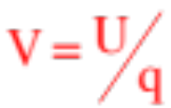
An ELECTRIC POTENTIAL FIELD, measuring the amount of potential energy per unit charge AVAILABLE at all points in the region of a field-producing charge, can be (and is) associated with any charge configuration.
electrical
disturbance
potential
field exists
An ELECTRIC POTENTIAL FIELD exists wherever there is charge (and, for that matter, wherever there is an electric field). For the potential fields to exist, there doesn’t need to be present a secondary charge to feel the effect. And because voltage-flds tell us how much energy is available PER UNIT CHARGE at a point, the electric potential field V is defined as:
Important note: As an absolute electric potential is a function of the charge q that generates the field, a negative charge will produce a NEGATIVE absolute electric potential and a positive charge will produce a POSITIVE absolute electric potential!
4.)

Slide 5
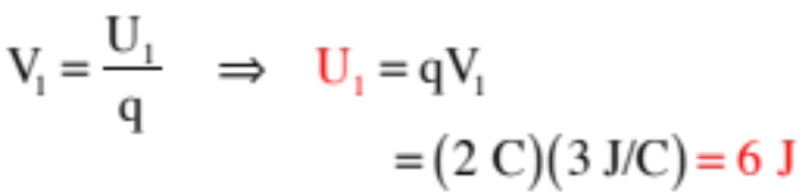

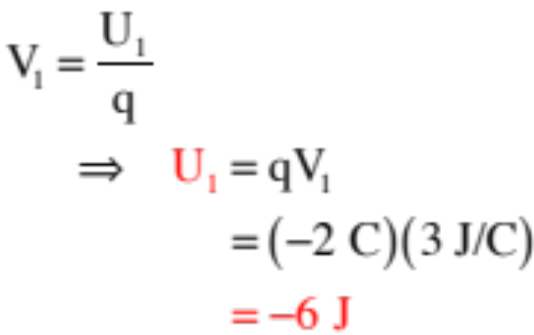
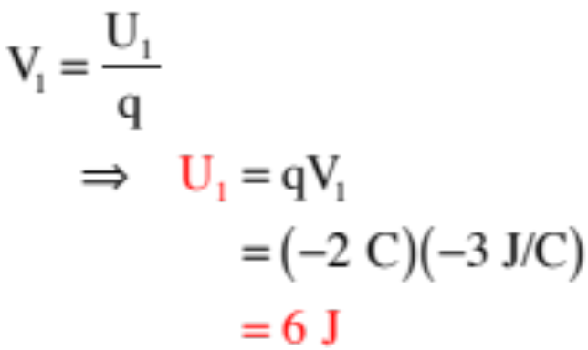

Example 1: How much potential energy does a 2 C charge have at a point where the absolute electric potential is
?
Example 2: How much potential energy does a -2 C charge have at a point where the absolute electric potential is ?
Example 3: How much potential energy does a -2 C charge have at a point where the absolute electric potential is
?
5.)

Slide 6
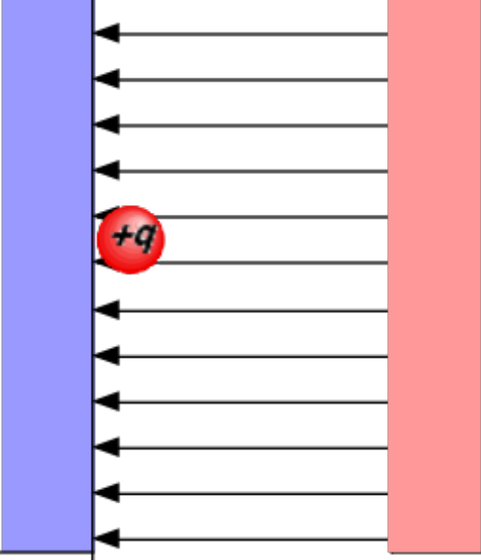
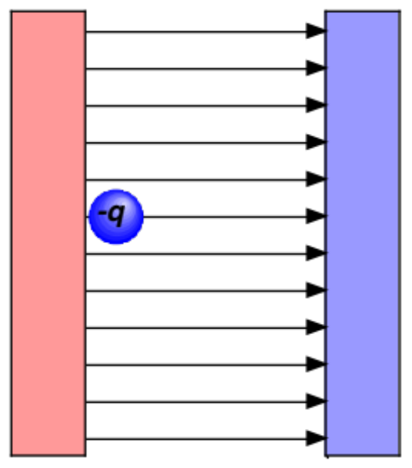
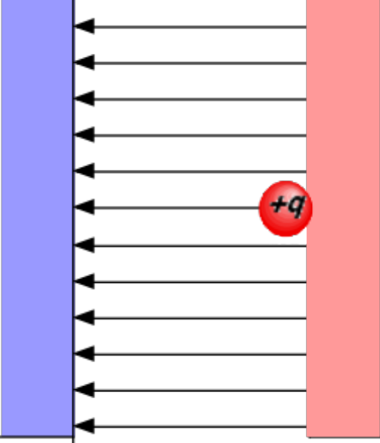
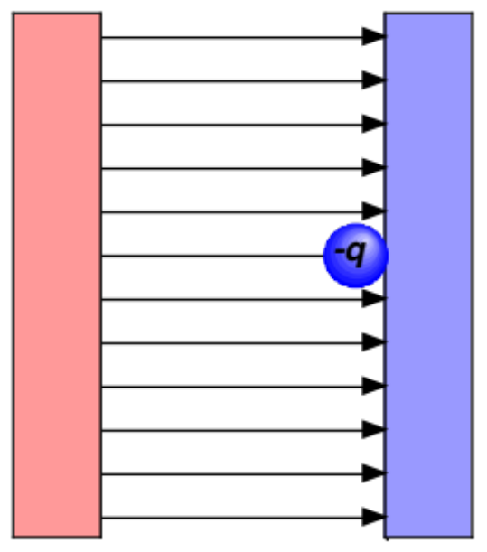
Example 4 (courtesy of Mr. White)
Is the electric charge in each of these situations in a position of high U_{e} or low U_{e}?
6.)

Slide 7
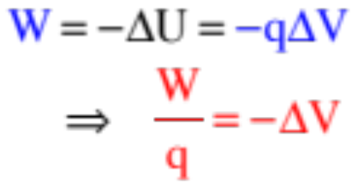

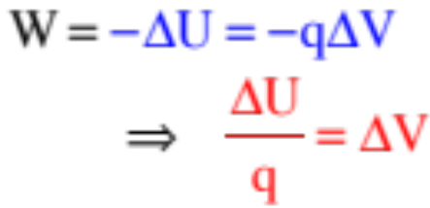
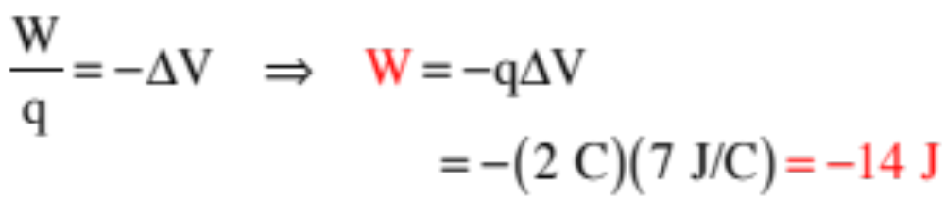
Work and Electric-Potential (Voltage) Fields
Note: An absolute electric potential field is a modified potential energy field.
Everything you can do with energy considerations, you can do with electric potential functions:
Just as the work done on a body moving from one point to another in a conservative force field equals , we can use the definition of absolute electric potential to write:
and
Apparently, if you know the voltage difference between two points, you know how much work per unit charge AND potential energy per unit charge the field has available between the two points.
Example 5: How much work does a field do on a moving 2 C charge if the potential difference between its beginning and end points is 7 volts?
7.)

Slide 8
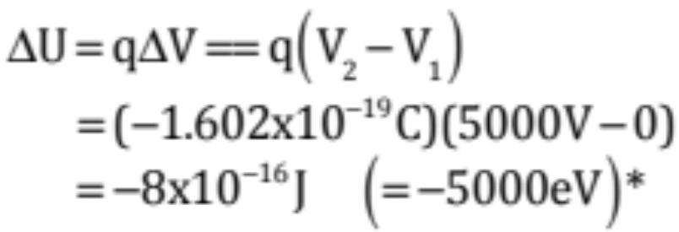
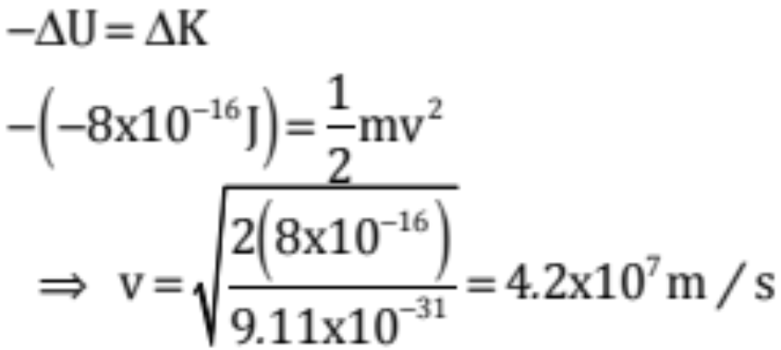
Example 6: (courtesy of Mr. White)
An electron (e⁻) in a TV picture tube is accelerated from rest through a potential difference of 5000 V.
a.) What is the change in the U of the electron?
b. What is the final speed of the electron?
*Fletch’s note: An electron-volt (eV) is defined as the amount of energy an electron picks up when accelerated through a 1 volt electrical potential difference.
8.)

Slide 9





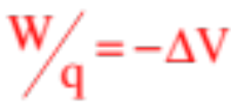
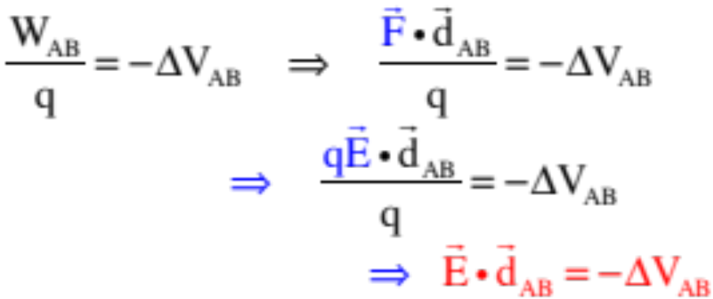
Electric Potential Difference and E-flds
Assuming we are dealing with a constant electric field and a straight-line path between two points in the field, we can use the definition of work ( ) with the manipulated definition of the electric field ( ) to extend out potential difference relationship ( ) into a very interesting proposition. Specifically:
two points in a
constant E-fld
And what might we glean from this bit of amusement?
9.)

Slide 10



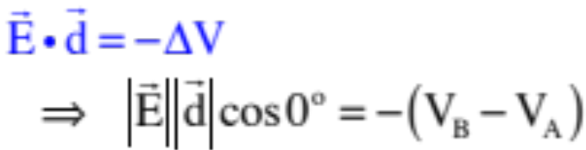


Observations
Example 7: Points A, B and C are identified in a constant electric field as shown in the sketch.
a.) Which point has the GREATER absolute electric potential? (That is, do electric fields run from higher voltage to lower, or vice versa?)
three points in a
constant E-fld
the dot product in our relationship falls out as:
Traversing from A to B, so points along the line of ,
By observation, the left-side of the equation is positive (two magnitudes multiplied together), so the right-side must also be positive. For this to be true, must be larger than .
IMPORTANT OBSERVATION: This means that ELECTRIC FIELDS migrate from HIGHER ELECTRIC POTENTIAL to LOWER.
10.)

Slide 11



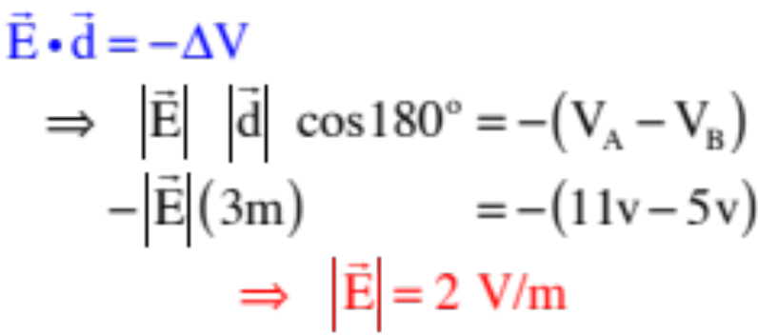

b.) Assume the electric potential at A is and the electric potential at B is . If the distance between the two points is 2 meters, derive an expression for the magnitude of the electric field.
three points in a
constant E-fld
This time, to point out how the angle works, we will traverse from B to A. Noticing that now the angle between and is , we can write:
IMPORTANT SIDE POINT: The unit for ELECTRIC FIELDS is newtons per coulomb, but it is also, apparently, volts per meter.
11.)

Slide 12


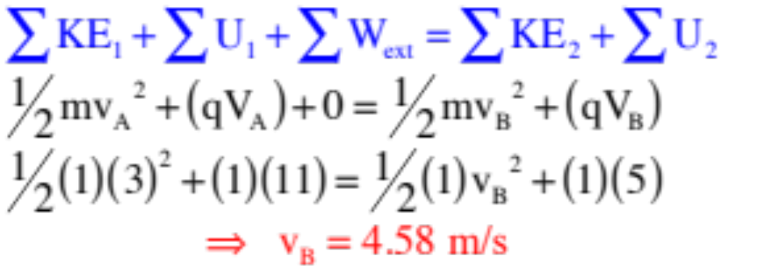

c.) A positive charge Q=1C and mass m=1 kg moves naturally along the E-fld lines.
i.) Is the charge moving from higher electrical potential to lower, or lower electric potential to higher?
This has nothing to do with the charge. Electric fields proceed from higher voltage to lower, so it’s doing the former.
ii.) Is the charge moving from higher potential energy to lower, or lower potential energy to higher?
This has EVERYTHING to do with the charge. POSITIVE CHARGES naturally move from higher to lower voltage along E-fld lines (being by definition the direction a positive charge would naturally accelerate), so it is moving from higher to lower potential energy.
iii.) If Q’s initial velocity was
at A, what is its velocity at B? (Note that the voltages have been put on the sketch.)
12.)

Slide 13


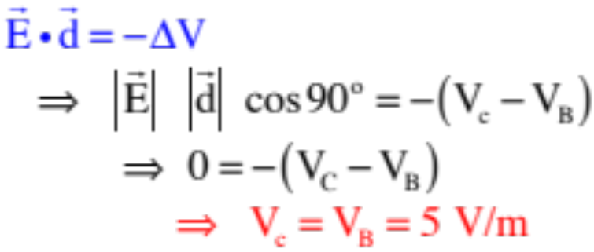

d.) Given the electric potential at B is and the electric field, as calculated in the previous part, is , what is the voltage (i.e., the electric potential) at C, assuming the distance between B and C is .5 meters?
This is slightly tricky. Define on your sketch as shown. Notice that the angle between and is . With that, we write:
IMPORTANT POINT: An EQUIPOTENTIAL LINE is a line upon which every point has the same electrical potential. Points B and C are on the 5-volt equipotential line.
IMPORTANT POINT: Equipotential lines are ALWAYS perpendicular to electric field lines.
13.)

Slide 14
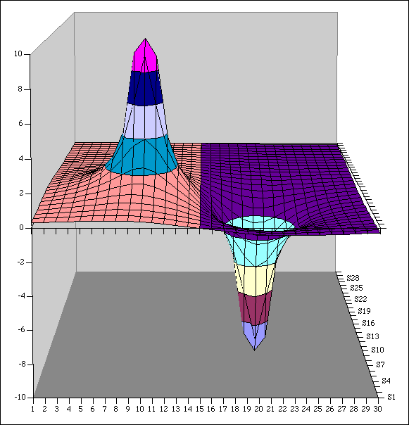
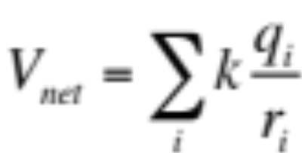
Electric Potential contours (courtesy of Mr. White)
What are the potentials of each of the charges shown here? What do these potential values represent?
14.)

Slide 15
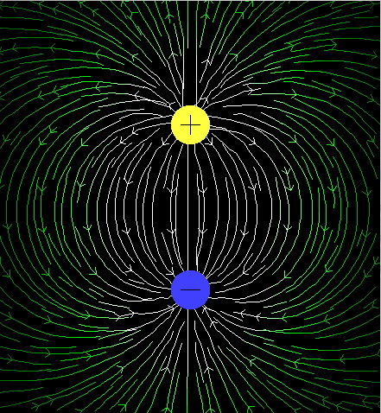
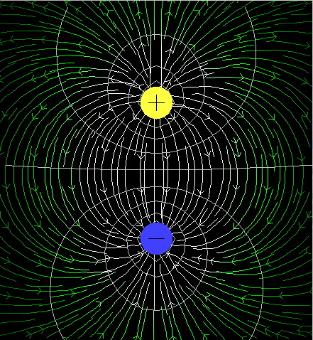
Equipotential Lines
(courtesy of Mr. White)
... are related to Electric Field lines. How?
15.)

Slide 16
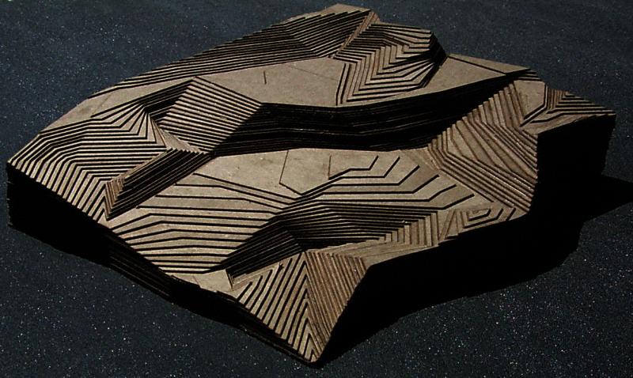
Equipotential Lines
(courtesy of Mr. White)
... can be visualized as a topographic map.
16.)

Slide 17
Equipotential Lines
(courtesy of Mr. White)
... reveal areas of higher vs. lower electric potential.
17.)

Slide 18
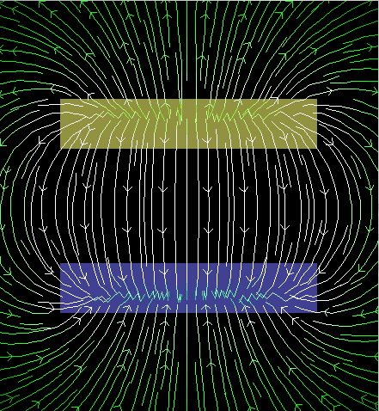
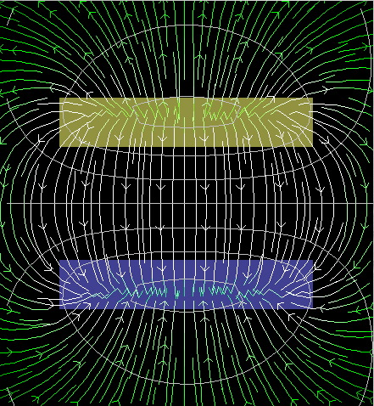
Example 8: (courtesy of Mr. White)
Draw appropriate equipotentials for this electric field.
18.)

Slide 19
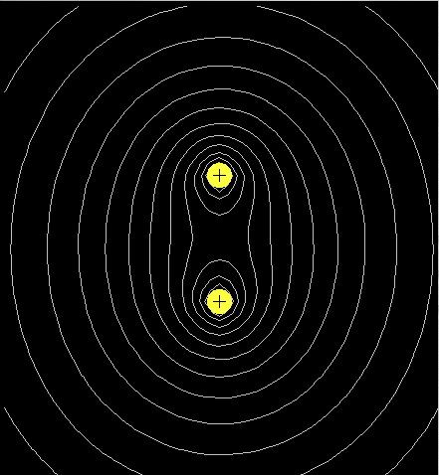
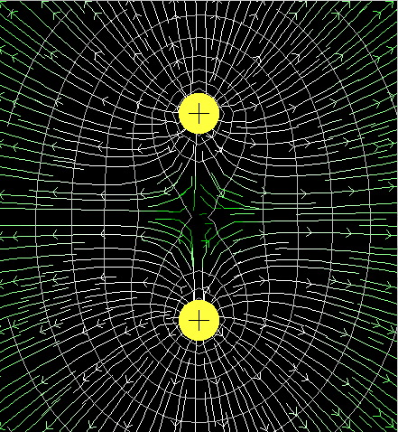
Example 9: (courtesy of Mr. White)
Draw appropriate field lines for these equipotentials.
19.)

Slide 20




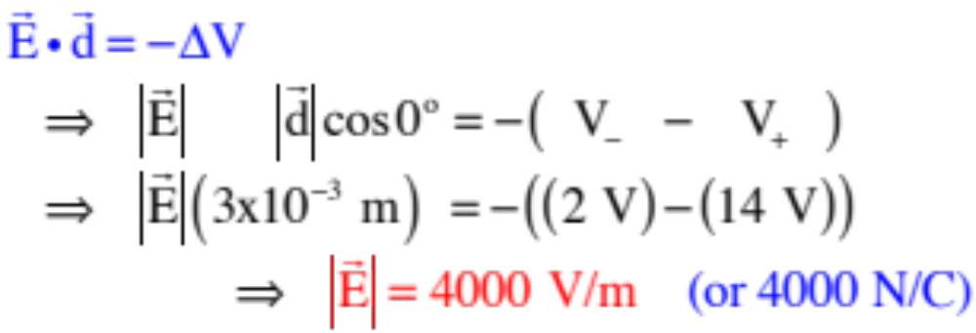
plates viewed
from side
Example 10: A battery has an electric potential of 14 volts at its positive terminal and 2 volts at it’s negative terminal. It is connected to parallel metal plates that are 3 millimeters apart and insulated from one another.
a.) From what you know about the voltages, draw in the electric field lines between the plates.
low voltage
(negative)
terminal
hi voltage
(positive)
terminal
b.) How big is the electric field between the plates?
Traversing from the upper plate to the lower plate (i.e., from the higher voltage to the lower voltage plate ALONG THE E-FLD LINES, we can write:
20.)

Slide 21




plates viewed
from side
c.) Points A, B and C are identified between the plates. A positive charge is placed successively at each point:
i.) At which point will the charge experience the greatest electric field?
(The E-fld is constant between the plates—all points are the same.)
ii.) At which point will the charge experience the greatest electric potential?
low voltage
terminal
hi voltage
terminal
(The voltage closest the positive plate will be highest, which is C.)
iii.) At which point will the charge experience the greatest potential energy?
(A charge’s potential energy at a point is related to voltage as , so for a positive charge, that will be greatest at C . . . or as close to the 14 volt plate as possible.)
d.) Now, a negative charge is placed at each point:
i.) At which point will the charge experience the greatest electric potential?
(Electrical potential has NOTHING TO DO with the charge feeling the effect: it’s still C.)
ii.) At which point will the charge experience the greatest potential energy?
(Using , sign included, the greatest potential energy point for a negative charge is A. This makes sense if you think about it. A -1C charge on the negative plate (pt A)would be -2 joules whereas on the positive plate (pt C) it would be -14 joules. A is bigger (closer to zero)! Also, where, if you let a negative charge go, would it pick up the most kinetic energy? Certainly not if it was next to the positive plate. Definitely next to the negative plate at A!).
21.)

Slide 22


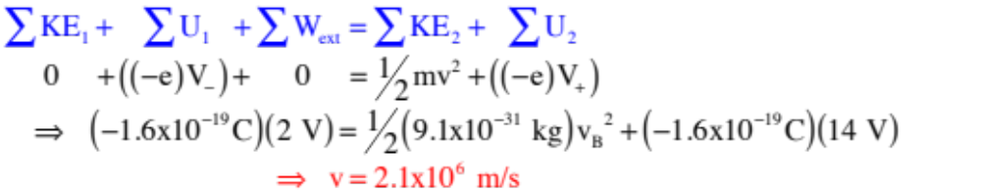
plates viewed
from side
e.) An electron accelerates between the plates. How fast is it moving if it started from rest?
Note that the electron (charge –e) would accelerate from the negative the positive plate, and that the potential energy of a charge sitting at a point whose potential is V is with the charge’s sign included, we can write:
low voltage
terminal
hi voltage
terminal
22.)

Slide 23
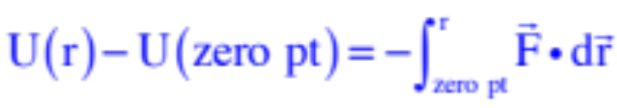
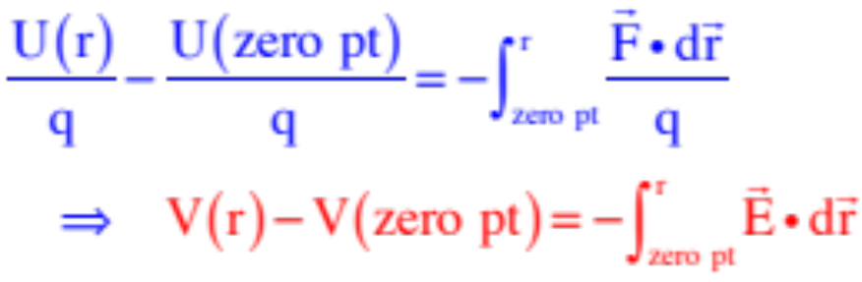

Deriving an Electric Potential
From an Electric Field
We know from our experience with energy considerations that if we want the potential energy function that goes with a conservative force field, we can derive it using:
If the force is the consequence of a charge in an electric field, we could divide everything by the size of the charge q feeling the effect, and have:
23.)

Slide 24
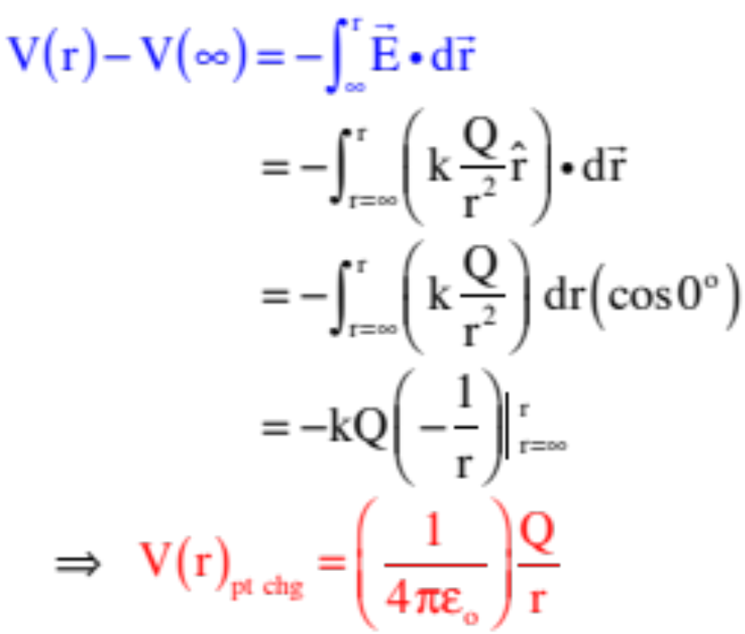
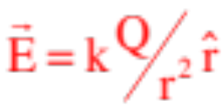
A Specific Case--The Electric Potential Generated by a POINT CHARGE
Example 11: Derive a general expression for the electric potential generated by a point charge Q?
Setting the zero point for the electric potential to be where the electric field is zero (i.e., at infinity), and using the electric field function for a point charge as , we can write:
24.)

Slide 25
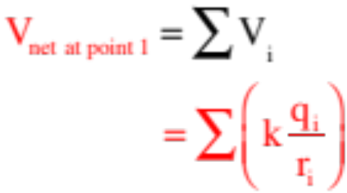
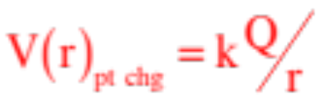
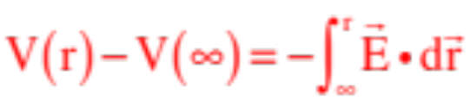
Things to notice:
This function is good ONLY for point charges.
This is a SCALAR quantity (‘cause electric potentials are NOT vectors).
Being a scale, a group of point charges will produce a net electric potential at a point that is simply the sum of the individual electric potentials. There is NO NEED to do anything with components . . . because again, voltages aren’t vectors! Mathematically, this can be stated as:
Positive charges generate positive electric potentials while negative charges generate negative electric potentials, so the SIGN of the charge needs to be included in the use of .
Any electric field generated by a static charge configuration will be conservative in nature, and can have an electric potential function derived for it using:
25.)

Slide 26
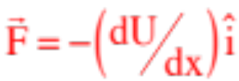
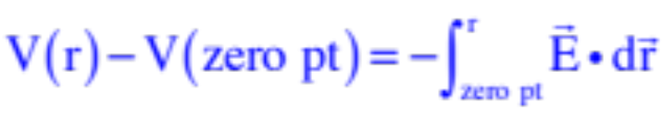

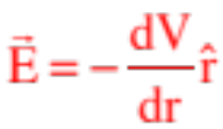
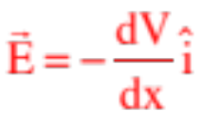
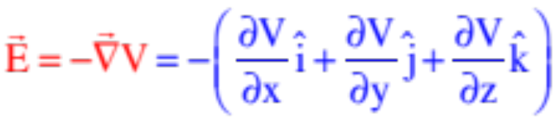
So How Are Electric Fields and
Electric Potentials Related?
Remember back to the Energy chapter when we related a conservative force function to its potential energy function. We found that the spatial rate of change of potential energy equals the force associated with the potential energy field, or . There is an electrical analogue to this.
That is, the differential consequence of:
is
But if that is true, it must also be true that:
Except in Cartesian coordinates (assuming E is in the x-direction),
which can be expanded into multiple dimensions using the del operator as:
26.)

Slide 27
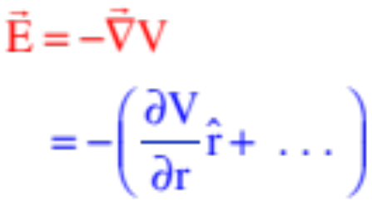
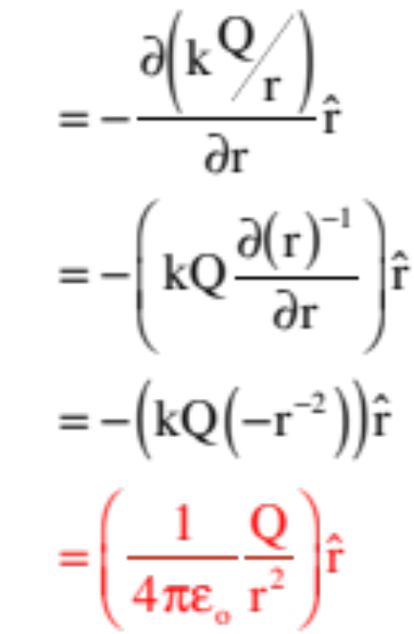
The Electric Field Generated by a POINT CHARGE as calculated from
the Electric Potential
Using the del operator in polar spherical coordinates . . .
We’ll come back to this shortly. . .
27.)

Slide 28

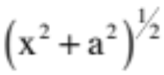



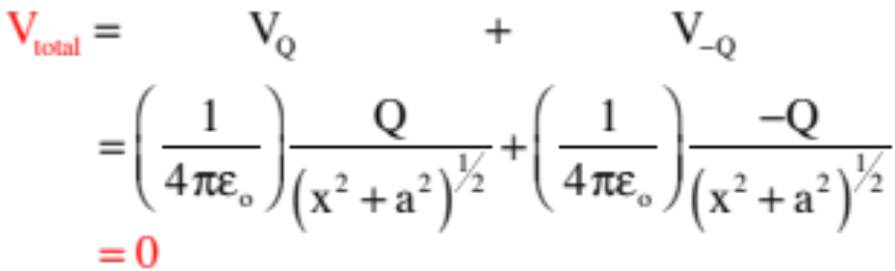
Example 12: Assume the charges are equal and opposite, and are placed symmetrically as shown.
a.) Is there an electric field at (x,0). If so, in what direction is it?
There will be an E-fld at (x,0). By inspection, its x-components will add to zero leaving it with only y-components.
b.) Is there an absolute electric potential at (x,0). If so, in what direction is it?
TRICK QUESTION—electric potentials don’t have directions as they are scalars. As for magnitude:
c.) Does this make sense?
Yes, if you understand how E-flds and voltage flds are related to one another.
28.)

Slide 29

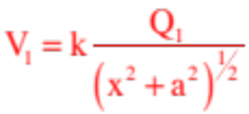
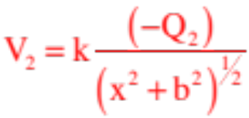



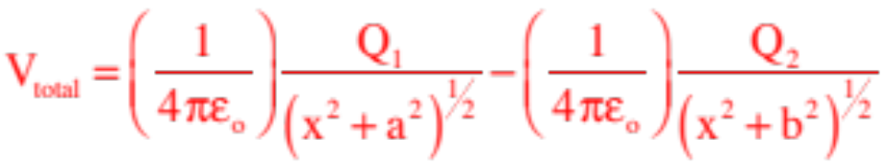
c.) How would the problem change if the charges were no longer the same and their positions no longer symmetric?
The math shows it all.
29.)

Slide 30








Example 13 (A non-AP problem): Derive an expression for the electric potential at the origin due to a rod with charge -Q uniformly distributed over its length L.
This extended charge distribution is something you’ve already seen. The solving technique is exactly as was before.
Define the differential electric potential at the origin due to a differential bit of charge,
then sum that differential electrical potential over the entire rod. You’ll again need to define a linear charge density function
and note that . With that, we can write:
30.)

Slide 31






Example 14 (a non-AP question): Derive an expression for the electric potential at an arbitrary point y = b on the y-axis due to a rod with charge Q uniformly distributed over its length L.
SO NICE, no components!
31.)

Slide 32







Example 15: A ring situated in the x-z plane (as shown) has –Q’s worth of charge on it.
a.) What is the direction of the E-fld at (x,0)?
From observation, it’s .
b.) Derive an expression or V at (x,0)?
these components are the same.
these components cancel out.
c.) Do the results from Parts a and b make sense together?
sure
32.)

Slide 33


Example 17 (not): Consider yourself lucky. A lab I had my students do for years (minus the data part) follows: Given a charged copper disk:
a.) Use Gauss’s Law to derive an expression for the electric field due to the disk very, very close to the disk’s central axis (i.e., at a coordinate (x,0) such that x << R).
b.) Use the differential-charges-dq-approach to derive an expression for the electric field generated by the disk at some point down the x-axis (x,0).
c.) Using the relationship derived in Part b, assume that x<<R in that relationship and see if that E matches up with the Gauss’s Law expression.
d.) Using dq , derive an expression for the electric potential at (x,0).
e.) Though not completely kosher, due to the vagaries of the symmetry, you could use the del operator on the electric potential function you derived in Part d to derive an expression for the electric field at (x,0). Do so and see if it matches your expression from Part a.
Called THE LAB FROM HELL, students lost a lot of sleep but learned a LOT.
33.)

Slide 34






Example 18: In the previous “lab” example identified as Example 17, it was stated in Part e that “although it is not kosher, you could use the del operator to derive an expression for the electric field at (x,0).” What was up with that?
The question is asking us to use
(or the del operator equivalent) to determine E. Why is this spooky?
Consider a hoop. What would happen if the upper half of the hoop was negatively charged while the lower half had an equal amount of positive charge?
There would be a net electric field at (x,0) in the y-direction, but the electric potential V at (x,0) would be ZERO. So how could you use ?
To make things work, you need a general expression for V(r), an expression for the electric potential at an arbitrary point, to use with .
34.)

Slide 35


Due to the symmetry, a single-charge hoop has an electric field that is down the x-axis, and it has a V-function that is a function of x. As such, using
yields
which matches the derived E-fld expression from before.
35.)

Slide 36
The point here is that you can use
even if we don’t have a general expression for V(r). The key is in whether the charge involved is all the same kind (i.e., either all positive or all negative). If that be the case, you can fudge some (not kosher, but it gives you the right answer).
36.)

Slide 37



Example 19: A solid, charged, conducting sphere of radius R and Q’s worth of charge on it.
a.) Derive a general algebraic expression for the electric potential field for r > R.
If we are going to use we need to know the E-fld function for r>R. Gauss’s Law was born to dispatch that problem.
Starting with a Gauss’s surface,
Gaussian surface
we can write:
37.)

Slide 38





Although it isn’t stated, problems like assume the electric potential will be zero where the electric field is zero, which in this case is at infinity. So identifying :
38.)

Slide 39








b.) Derive a general algebraic expression for the electric potential field for r < R.
This is where it gets a bit tricky. Why? Because the electric field inside the sphere and outside the sphere are different, so we can’t use one giant in
Also, because electric potentials AREN’T inverse square functions, you can’t ignore the charge interior to the point of interest like you did with Gauss’s Law!
How to deal with this?
For each discrete region, derive using each region’s known electric field function, then add them all up. That is:
To execute these changes, we need electric fields (as each over its limits), so normally we’d be back to Gauss’s Law.
39.)

Slide 40

In this problem, though, we have the electric field for the outside region, and because the sphere is a conductor, we know the electric field inside is zero, so we can write:
Note: If the inner sphere had been an insulator, we would have had to use Gauss’s Law to determine the electric field function in that region, and that second integral would not have been zero. We’ll try this in the next problem. In the meantime . . .
40.)

Slide 41







c.) Sketch the graph for: E-fld vs position AND the electric potential field vs. position.
Notice that whereas the E-fld functions is discontinuous, the V-fld function is CONTINUOUS!
41.)

Slide 42


Example 20: A solid insulating sphere of radius R has Q’s worth of charge shot uniformly throughout.
a.) Derive a general algebraic expression for the electric potential field for r > R.
As before, Gauss’s Law yields:
Gaussian surface
and the electric potential function yields:
just as before . . .
42.)

Slide 43






b.) for r<R:
We know the E-fld outside. For the E-fld inside:
Gaussian surface
where the volume charge density is:
and the spherical shell’s differential volume , so:
43.)

Slide 44

So the electric potential is:
44.)

Slide 45








Example 20: A point charge at the center of a thick, uncharged conducting spherical shell of inside radius and outside radius . Determine the electrical potential for:
The first thing to note is that when you are asked to “determine” a value, that is not the same as “derive” a value. As long as you justify what you do, you can be as clever as you want. In this case, the observation to be made is that outside (especially from a distance), this charge configuration just looks like a point charge (even with the charge redistributing itself on the conductor). We know the electric potential function for a point charge. It’s
Again, being clever: You know the electric field inside a conductor is zero, so the electric potential difference between any two points must be zero. You also know that electric potential functions are continuous. Evaluating the field for right at , we get the electric potential at the outside edge of the conductor, which must be the electric potential throughout the conductor. That evaluation is:
45.)

Slide 46





This is where things get tricky.
The temptation is to look at hollow region in which Q resides, think, “That’s a point charge with an electric field equal to:
And conclude that because the electric field is that of a point charge, the electric potential must be that of a point charge, or
The problem with this is that this function, evaluated at yields
But this is part of the conductor, and we’ve already concluded that the electric potential has to be inside the conductor.
So what gives?
46.)

Slide 47

We know that for spherical symmetry, Gauss’s Law states that an electric field is generated only by the charge inside the sphere upon which the point of interest resides. That is because the electric field generated by each individual points charges is an inverse square function in distance (i.e., )
Electric potentials aren’t like that. They are simply inverse distance functions , or
To get the electric potential function for a charge geometry that is spherical in nature, we not only have to consider the charge inside the sphere upon which the point of interest resides, we also have to consider the charge outside that sphere, also. That means:
47.)

Slide 48


That is:
Note that for
this becomes:
48.)

Slide 49

SUMMARY—Conductors . . .
Electric Fields:
a.) Free charge on a conductor in a static setting stays on the conductor’s surface.
b.) Close to the surface of a conductor, the E-fld is perpendicular to the surface and has a magnitude .
c.) Inside a conductor, the E-fld is zero in a static charge situation (otherwise, electrons would migrate).
Electric Potentials:
a.) Free charge on a conductor will distribute itself so as to create a equipotential surface (the voltage will be the same at every point on the surface)..
b.) As the electric field inside a conductor is zero, the voltage field (the electric potential field) inside a conductor will be CONSTANT.
49.)

Slide 50





How do you determine the total energy in a systems of particles? (We did a problem like this back in the Gravitation section). The idea is simple:
1.) It takes no energy to bring a charge in from infinity. Once in, though, it will generate an electric potential field whose point-magnitude will (because it is a point-charge) equal to with V = 0 at infinity.
2.) Bringing a second charge in from infinity will require work in the amount of . That work will go into the total energy wrapped up in the system. That new charge will produce it’s own voltage field with a similar function defining it.
3.) Bringing a third charge in from infinity will require work as it deals with the fields generated by both and , the the total amount of work done (and the total energy in the system) will become:
50.)

Slide 51







Example 5: A long wire of radius R has a linear charge density on it. What can we say about the electric potential function for:
For r>R
1.) We need the electric field function for this region so we can use the approach to determine the electric potential outside the wire. Starting with a Gaussian surface whose outside surface area dS will be its circumference times its length L, and noting that the charge inside
its length L, and noting that the charge inside the Gaussian surface will be equal to
times the length of the Gaussian surface L, we can write:
51.)

Slide 52

2.) With the electric field, we run into a problem if we try to assume the electric potential is zero at infinity. Following the math will show why:
Bottom line: Although you could be asked to use Gauss’s Law to determine the electric field generated by an insulator or conductor whose geometry is cylindrical, you will not be asked to determine the electric potential relative to infinity.
Having said that, you COULD be asked to determine the electric potential DIFFERENCE between two points in the region around or inside a cylindrically symmetric charge configuration. That is:
52.)

Slide 53









Let’s say you have a coaxial cable in which the inside wire has a linear charge density of on it while the outside sheath has a charge density of on it. What is the voltage difference between the two cables?
1.) We need the E-fld between the structures. Gauss’s Law to the rescue:
2.) With the E-fld, and assuming we are traversing from the inside-out (i.e., with the electric field), we can write:
. . . Which makes sense as electric potential drops as you go from positive to negative plates.
53.)

Slide 54

Review slides/your notes (courtesy of Mr. White)
54.)

Slide 55







a.) Note that the positive charge is in blue and the negative charge is in redish:
i.)
The charge inside the Gaussian surface is the fraction of charge inside r, or:
For a Gaussian surface inside a:
55.)

Slide 56


a.) Use Gauss’s Law to derive the electric field for:
ii.)
For a Gaussian surface between a and 2a:
56.)

Slide 57



a.) Use Gauss’s Law to derive the electric field for:
iii.)
For a Gaussian surface between 2a and 3a:
We need the volume density function (this is the easiest way to go):
With the volume of a differential spherical shell of radius c and thickness dc inside the outer insulator being:
57.)

Slide 58

With the density function:
58.)

Slide 59



Note: As a check, if we went all the way out to , the E-field should be zero as there would be NO net charge enclosed in the Gaussian surface at that radius (+Q on the inside sphere and –Q on the outside sphere). Trying it, we get:
a. continued) Use Gauss’s Law to derive the electric field for:
iv.)
For a Gaussian surface outside of 3a, the enclosed charge will be zero and E = 0.
59.)

Slide 60

b.) What is the electric potential at the outside edge of the outer shell (i.e., at )? Explain your response.
The electric potential at the outer edge is ZERO.
This bit of trickery is based on the fact that the electric field is zero in the outer region, which means between any two points in the region must be zero. If the electric potential is zero at infinity, it must be zero at the sphere’s edge.
c.) Derive an expression for the electric potential difference between points X and Y as shown in the sketch.
To do this, we need the electric potential function for the volume between a and 2a.
60.)

Slide 61

This is tricky. Because we’ve already used Gauss’s Law to determine the electric fields in the system, the temptation might be to use the extended approach to determine electrical potential differences from infinity (assuming that V = 0 at infinity) by setting up the integrals as shown below.
This horror clearly can’t be the expected approach as this is an AP problems, and doing all of this would take an eternity, relatively speaking.
So how to proceed?
61.)

Slide 62






With the voltage at infinity zero, let’s define as the voltage on the inside surface of the outer shell due to the charge shot through the outside shell. The inside sphere will look like a point charge from the outside, so the net voltage at “r,” where “r” is between “a” and “2a,” will be the superposition of the voltage due to a point charge and . That is
Evaluating this relationship at X (where r = a) and Y (where r = 2a), then subtracting the two to get the voltage difference between the two points, yields:
62.)

Slide 63

63.)

Slide 64

E&M 1: Consider the E-fld lines:
a-i.) Between A, B and C, where is the E-fld the greatest?
The E-fld is greatest at Point C as the field lines are the closest together at that point.
a-ii.) Between A, B and C, where is the electric potential the greatest?
The electric potential is greatest at Point A as electric potentials are always greatest upstream in E-flds (positive charges move along E-fld lines, and E-fld lines move from higher to lower voltages)
b-i.) Describe the motion of an electron released at Point B.
Electrons accelerate opposite the direction of E-flds, so an electron will accelerate toward the left. The acceleration will be a function of the magnitude of the field. From observation, the field lines get farther apart as one moves toward the left, so the E-fld gets smaller in that direction. That means the electric force and, hence, acceleration, will diminish as the electron proceeds, though the velocity will continually increase (just not at a steady pace).
64.)

Slide 65

b-ii.) The electron’s speed after accelerating through a 10 volt potential difference?
Assuming the electron accelerates, for the sake of argument, from 2 volts to 12 volts, conservation of energy yields:
65.)

Slide 66






c.) If the voltage between B and C is 20 volts, estimate the magnitude of the E-fld halfway between them. State assumptions made:
Assuming the electric field is constant, or nearly constant in that region, assume (for the sake of the math) that and (thereby generating the 20 volt potential difference between the two), and noticing from the graph that the distance between the two points is approximately .01 m, we can write:
If we take to be a vector between Points B and C in the direction of the E-fld, then the angle between and will be zero and that relationship becomes:
66.)

Slide 67
d.) Equipotential line through Point D:
Equipotential line perpendicular to E-fld lines
67.)

Slide 68

Millikan’s Oil Drop Experiments (courtesy of Mr. White)
Conducted from 1909-1913
Determined the magnitude of electron charge
Earned Millikan the Nobel Prize in 1923
F_{e}=qE
E
q
F_{g}=mg
68.)

Slide 69

Millikan’s Oil Drop Experiments
(courtesy of Mr. White)
Assume charged sphere with mass m, charge q. It should be possible to set up a specific electric field E, based on a specific potential V, that will cause mass to levitate.
F_{e}=qE
E
q
F_{g}=mg
69.)

Slide 70

Millikan’s Oil Drop Experiments
(courtesy of Mr. White)
By statistically grouping the results, it’s possible to determine the fundamental unit of charge.
70.)

