Slide 1
The Island Series:
You have been kidnapped by a crazed physics nerd and left on an island with twenty-four hours to solve the following problem. Solve the problem and you get to leave. Don’t solve the problem and you don’t.
The problem: You are given a small spotlight, the outline of a bat that can go over the lamp’s face, two copper serving platters, some wire and a car battery. You find that if you hook the battery to the lamp, it doesn’t shine very brightly. You need it to shine brightly, but only for a second (you want to project the bat-signal onto a cloud so Batman will come rescue you). What clever thing might you do to light up the lamp for just a moment?
Solution: Set the two plates close without touching and parallel to one another (they have to be rigidly separated). Hook one lead from the battery to one of the plates and the second lead to the other plate. This will allow the plates to charge up, acting like a capacitor. Disconnect the lead. Hook one lamp lead to one of the plates. When you hook the other lead to the other plate, the cap will discharge very quickly through the lamp, providing a burst of energy that should light it up nicely.
1.)

Slide 2
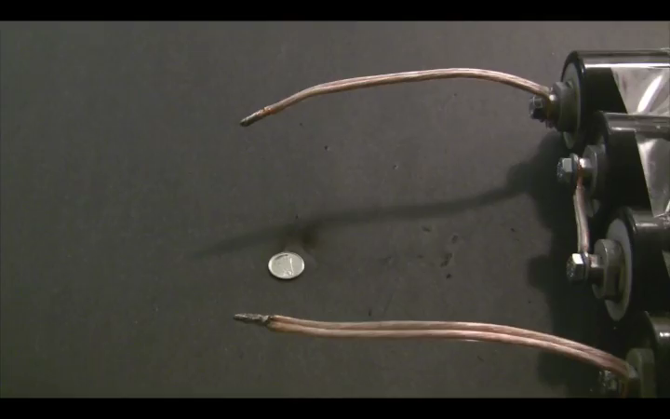
CHAPTER 26:
Capacitors
discharging capacitor:
2.)

Slide 3
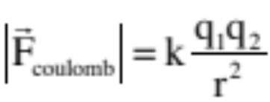
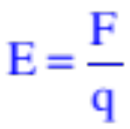
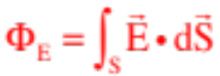
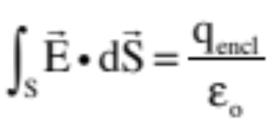
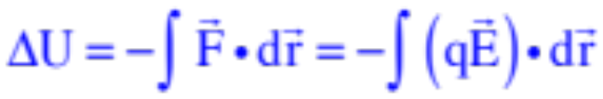
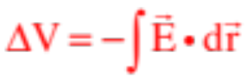
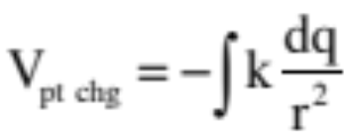
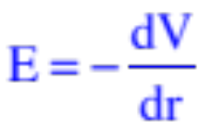
General Review
Electric fields: exist in presence of charge configurations; are modified force-fields
Gauss’s Law: used to generate electric field functions for symmetric charge configurations
Electrical potentials: voltage fields that exist in the presence of charge configurations; are modified potential energy functions; the potential difference between two points equals work-per-unit-charge available to a secondary charge due to presence of field-producing charge
3.)

Slide 4




Capacitors
initially
at zero
voltage
A physical capacitor is quite literally two metal, parallel plates sitting next to one another, completely insulated from one another.
A battery generates an artificially created electrical potential difference between it’s terminals. The + terminal is at higher voltage (the + terminal is the longer, red line in the sketch). The “voltage” of the battery is the electrical potential difference between the terminals.
Connecting a battery across an uncharged capacitor will effect an interesting situation.
Initially, there will be a voltage difference between the battery’s + terminal and the capacitor’s uncharged green plate, motivating charge to move between the two plates. If we assume it is positive charge that is moving (controversial, but we’ll talk about that later), the green plate will begin to charge up positively.
4.)

Slide 5
As the green (left) plate charges up, two things happen:
Electrostatic repulsion will motivate a like-amount of positive charge off the yellow plate, leaving it electrically negative; and
The voltage build-up on the green plate will diminish the voltage difference between it and the battery’s + terminal, and the current will decrease (ultimately to zero once the cap is fully charged).
What we end up with in our charged capacitor is an electrical device that has charge stored on it, that has an electric field between its plates, and that has energy stored in that electric field.
In other words, in an DC (direct current) electrical circuit, capacitors store electrical energy.
5.)

Slide 6




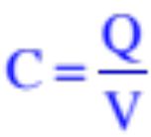






Furthermore, the charge Q on ONE PLATE will always be proportional to the magnitude of the voltage difference across the plates, with the proportionality constant being the cap’s capacitance. Mathematically, then:
Usually written in truncated form as:
this also means that the capacitance is defined as:
This, in turn, means the capacitance of a capacitor is a constant that tells you how much charge per volt the capacitor has the capacity to hold.
Its unit of coulombs per volt is given a special name—the farad.
It’s not uncommon to find capacitors in the range of: millifarad (mf = ), or microfarad (Mf or = ), or nanofarad (nf = ), or picofarad (pf = ).
6.)

Slide 7











Picky but Important Points
1.) A 1 farad capacitor is a HUGE capacitor. It is much more common to run into capacitors in the:
--millifarad (mf) range: this is
--microfarad (Mf or ) range: this is
--nanofarad (nf) range: this is
--picofarad (pf) range: this is
2.) When traversing between capacitor plates along the electric field lines, the voltage goes from high to low. That is why the negative sign is needed in .
But in is the POSITIVE voltage-change across the plates, meaning:
This observation is going to be important shortly!
7.)

Slide 8
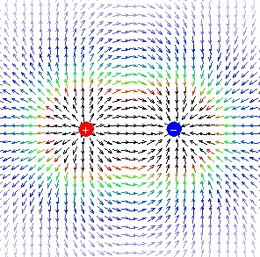
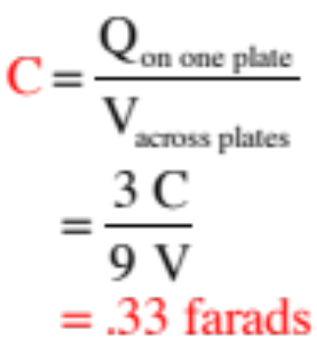
Example 1 (courtesy of Mr. White)
What is the capacitance of this system, where each conductor has a charge of +/- 3 Coulombs, and a 9-volt potential exists between the two conductors?
8.)

Slide 9
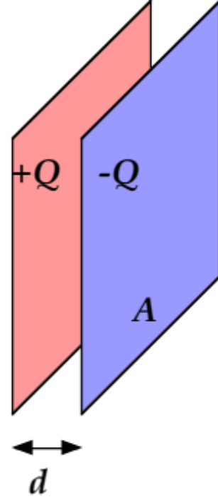
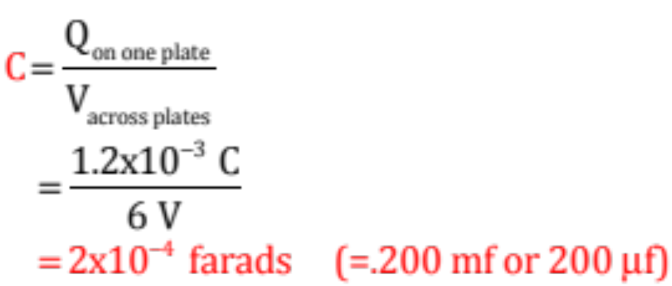
Example 2 (courtesy of Mr. White)
Two conducting plates have a charge of 1.2 mC on each, with a 6.00-V potential difference between the two of them. What is the capacitance of this system?
The only thing tricky about this problem is that everything has to be in MKS—electrical potential in volts and charge in coulombs. Sooo . . .
Note: Clearly you need to become familiar with the prefixes (and symbols) for milli, micro, nano and picofarads.
9.)

Slide 10
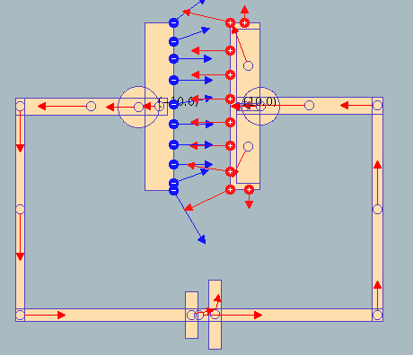
Demo :Parallel Plate Capacitor
Physlet I.26.1
10.)

Slide 11




In a series combination of circuit elements, each element is attached to its neighbor on one side only. What is common to all series combinations is current (i.e., the amount of charge that passes through the element per unit time).
Series Combinations
Think back to how uncharged capacitors work in electrical
circuits. A battery provides a voltage difference across its terminals which generates a voltage difference between its + terminal and the left plate (in the circuit above) of . As such, charge begins to accumulate on that plate electrostatically repulsing like charge off its right plate.
In a series combination, the repulsed charge from the right plate moved to the next capacitor, depositing itself on that cap’s left plate, electrostatically repulsing like charge off its right plate . . . which proceeds back to the battery (hence a complete circuit).
What’s common in the series combo of caps, then, is “the charge” on each cap.
11.)

Slide 12



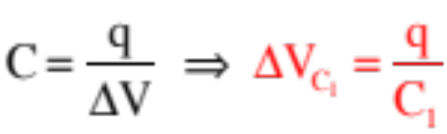

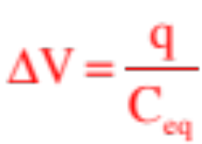
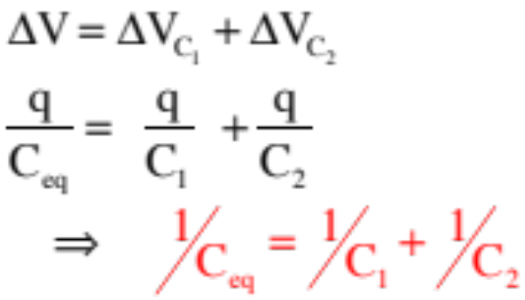
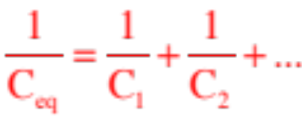
We know the total voltage-change across the battery, and hence across the capacitors, is . Logic additionally dictates that:
Capacitors in Series
We know, though, that:
If we had a single, equivalent capacitance that could take the place of the series combination (i.e., a cap that would draw the same charge q for the same battery voltage ), we could write:
In other words for a series combination of capacitors:
Bottom line:
12.)

Slide 13


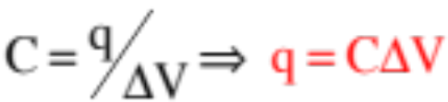
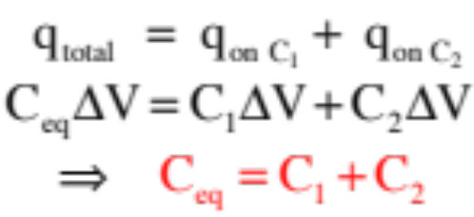

Capacitors in Parallel
Unlike series combinations, each element in a parallel combination attaches to its neighbors in two places.
What is common in a parallel combination is the voltage drop across each element.
So in the parallel combination of capacitors shown, charge will leave the battery and distribute itself between the two initially uncharged capacitors in such a way that the voltage across each cap is the same. If is the total charge drawn from the battery over a period of time:
Using and our equivalent capacitance circuit, we can write:
Bottom line:
13.)

Slide 14


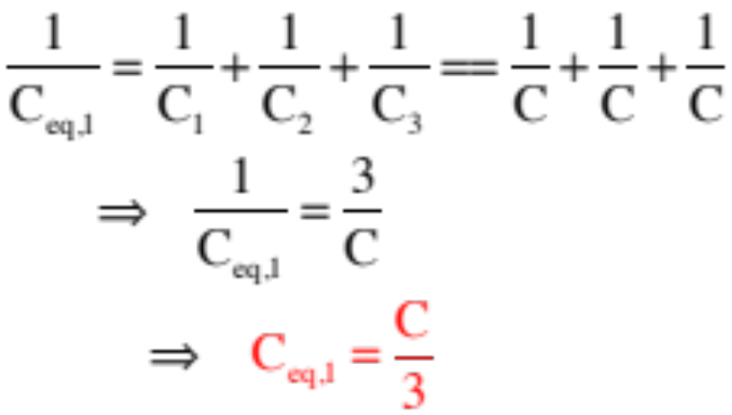
Example 7: Derive an expression for, then determine the equivalent capacitance of the capacitor combination shown to the right. Assume all the capacitors are
--This is essentially a series combination—three caps in series with a parallel combination (remember, what makes a series combo—each element is connected to its neighbor at one place).
--For the three series caps: Technically, we should write:
BIG NOTE: When you have equal-sized caps C in series, the equivalent capacitance equals C divided by the number of caps in the combination (look at our problem for confirmation!).
14.)

Slide 15

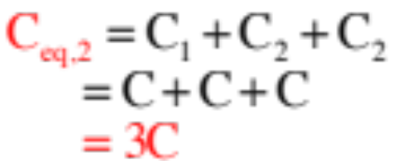

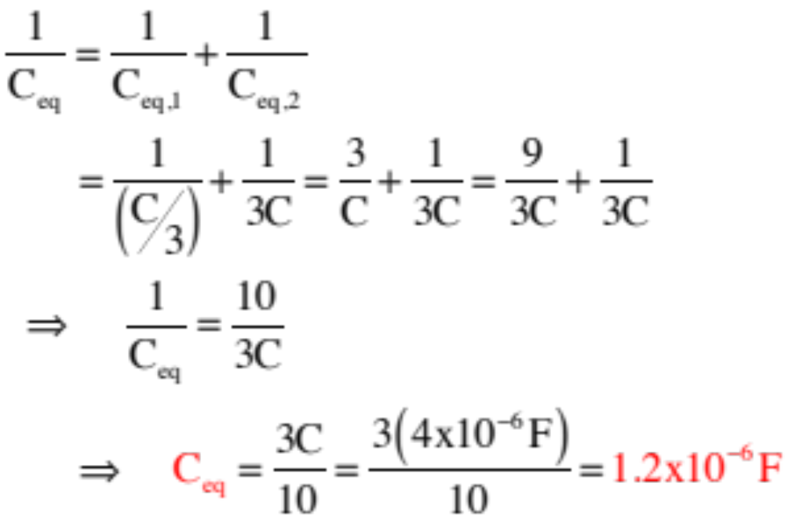
--Redrawing:
--To continue, we need the equivalent capacitance for the parallel combination. As parallels just add, we get:
--Redrawing:
--For the final series combination:
15.)

Slide 16


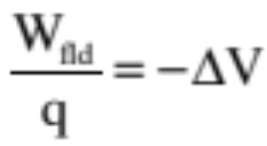

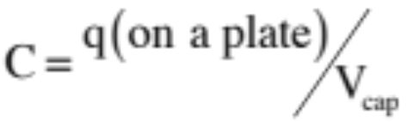

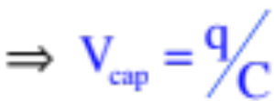
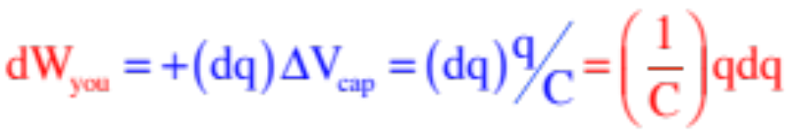
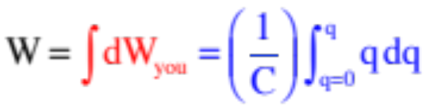
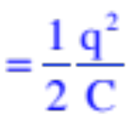
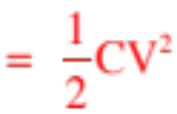

Deriving a Capacitor’s Energy Content
Consider a partially charged capacitor. How much work would be required to move a differential bit of charge +dq from the – plate to the + plate?
Noting that the work you do will be minus the work the field does, and writing everything in differential form, we can write:
Noting that the definition of capacitance yields:
We can re-write that first differential equation as:
Summing (integrating) to get the total work to assemble all the charge on the plates yields:
This is the energy stored in a capacitor.
16.)

Slide 17
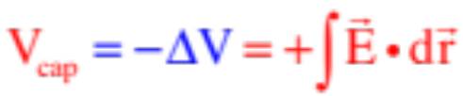
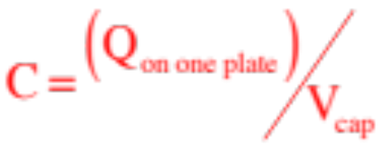
Example 3: Derive an expression for the capacitance of a conducting sphere of radius a. (I’ve never understood why textbooks think this obscure problem is interesting enough to do, but ours does so I’m covering it.)
Deriving a Capacitor’s Capacitance Using Physical Parameters
The assumption: the sphere is the inner plate of a capacitor whose outer spherical plate is located at infinity (obscure enough for you?). With that:
1.) Start by assuming there is Q’s worth of positive charge on one plate and –Q’s worth of charge on the other plate (the one at infinity). (In some cases, you might need to define a charge density, depending upon the geometry).
2.) Derive an expression for the electrical potential difference between the plates. This will often require you to use Gauss’s Law between the plates to determine the E-fld function, then use .
3.) Then use the definition of capacitance to determine the capacitance C for the geometry.
17.)

Slide 18


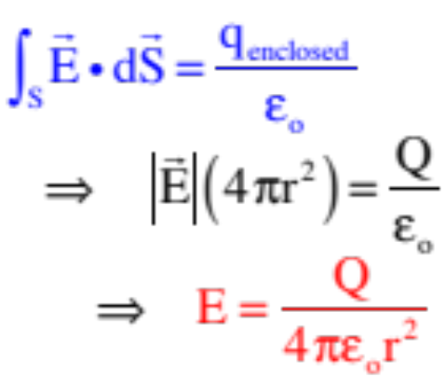
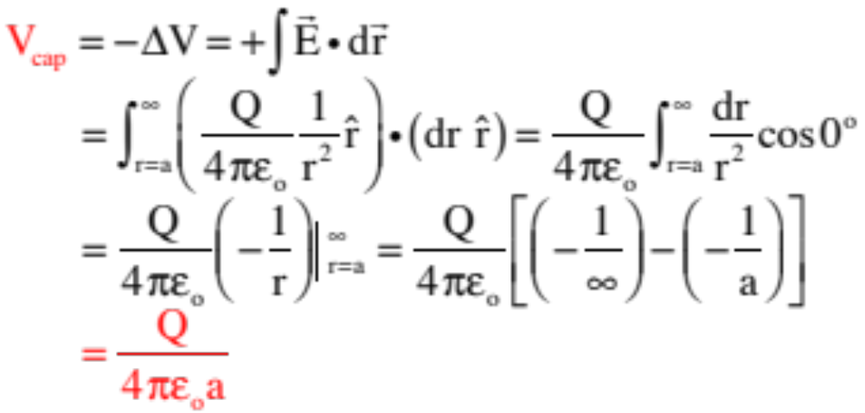
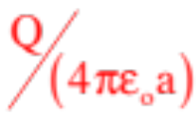
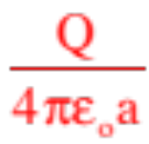
Executing all that, we have:
1.) Assume Q’s on plates:
2.) Gauss’s Law to determine E-fld between plates:
Gaussian surface
3.) Derive an expression for the electrical potential difference ( ) between the plates:
(Or you could have just noticed that V at infinity would be zero, and V at a would be , and that the difference would just be
18.)

Slide 19
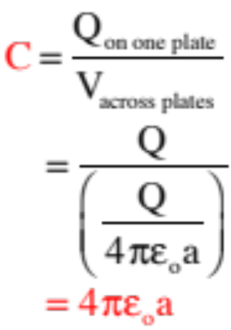
4.) Using the definition of capacitance:
Learn the approach. You will be using it!
19.)

Slide 20



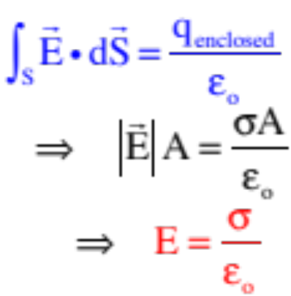

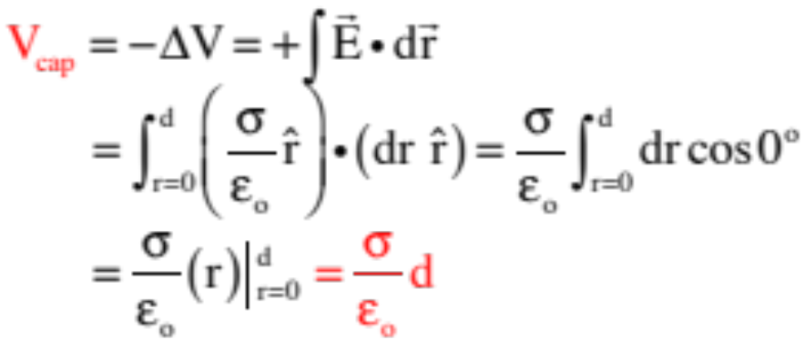
Example 4: Derive an expression for the capacitance of a parallel plate capacitor of plate area A whose distance between its plates is d.
1.) Assume charges (in this case, in the form of an area charge densities ):
2.) Noting that all the charge will migrate to the inside surfaces, use a Gaussian plug and Gauss’s Law to derive an expression for the E-fld between plates.
3.) Derive an expression for the electrical potential difference ( ) between the plates:
20.)

Slide 21
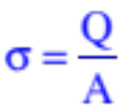
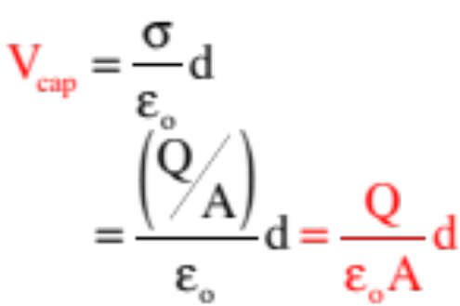
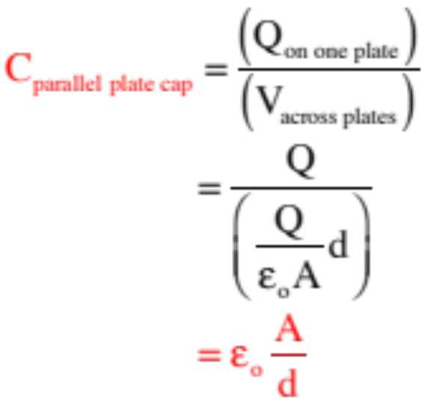
Except
so
4.) Using the definition of capacitance:
(This general expression for the capacitance of a parallel plate capacitor is actually something you will be expected to know.)
21.)

Slide 22







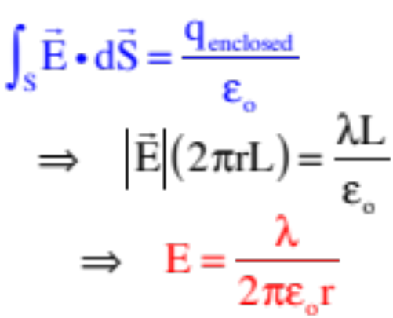
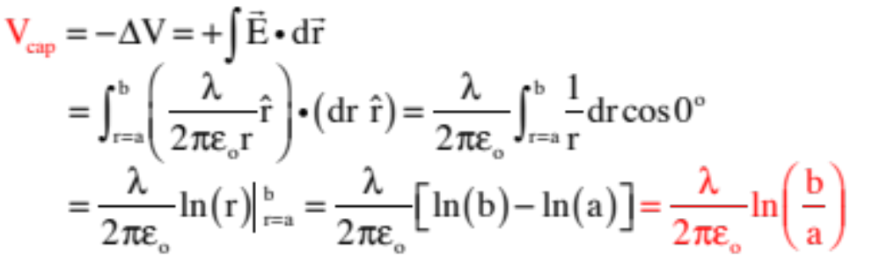
Example 5: Derive an expression for the capacitance-per-unit-length of a coaxial cable of inside radius a and outside radius b.
1.) Assume charges (in this case, a linear charge density ) on the inside rod:
2.) Noting that all the charge will migrate to the inside surfaces, use a Gaussian cylinder of length L and Gauss’s Law to derive an expression for the E-fld between plates.
3.) Derive an expression for the electrical potential difference ( ) between the plates:
22.)

Slide 23
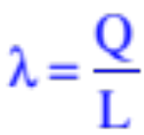
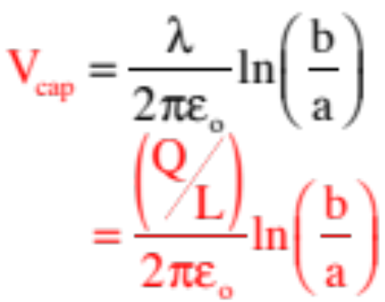
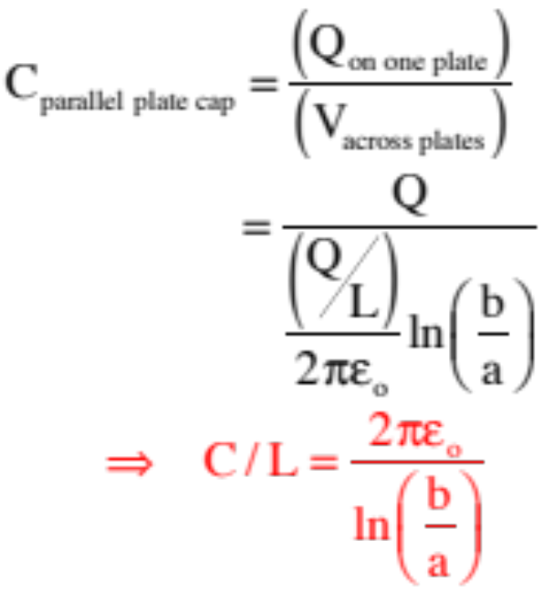
Except
so
4.) Using the definition of capacitance:
23.)

Slide 24



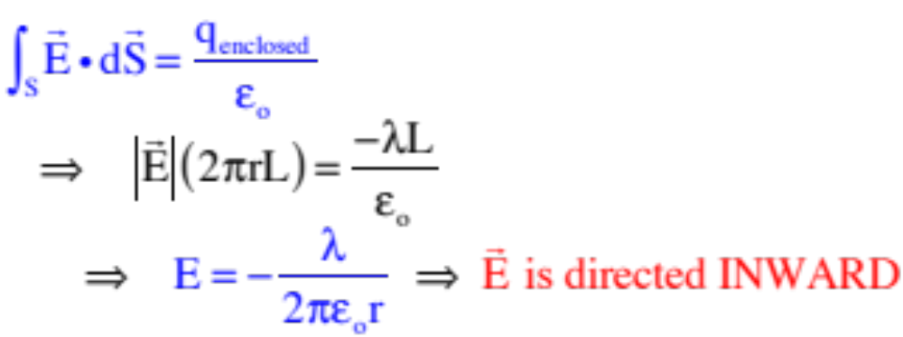

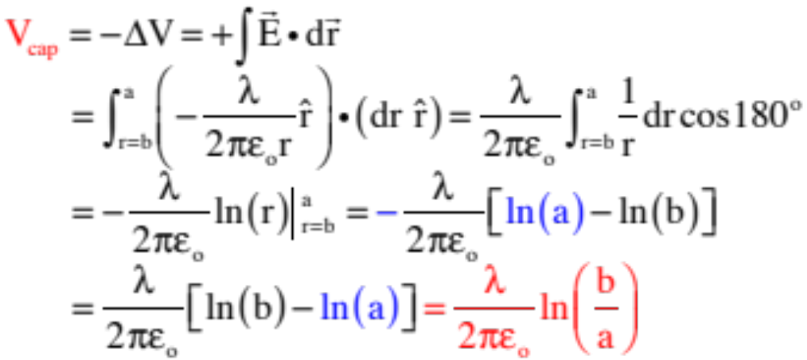

Point of order: what would have happened if we had defined the inner section a charge density and the outer shell a charge density of ?
Gauss’s Law would have yielded:
Remembering that dr is defined outward, if we track WITH the electric field to determine the electrical potential difference and, hence, , we’d have to track from the outside shell to inside, so:
SAME RESULT!
24.)

Slide 25



Example 6: Derive an expression for the capacitance of concentric spherical shells of inside radius a and outside radius b.
1.) Assume charges (in this case, Q’s):
2.) Noting that all the charge will migrate to the inside surfaces, we don’t really need Gauss’s Law as we know from experience that the E-fld for a charged sphere is:
3.) Derive an expression for the electrical potential difference ( ) between the plates:
25.)

Slide 26

4.) Using the definition of capacitance:
It should go without saying, but I’ll say it anyway. These derivations are not here to memorize. UNDERSTAND THE APPROACH so you can handle whatever comes down the pike!
26.)

Slide 27


Lab this week (courtesy of Mr. White)
Measuring voltage Measuring current
27.)

Slide 28

The Electric Battery (courtesy of Mr. White)
1780s - Galvani vs. Volta
28.)
Notes:
1780s -- Luigi Galvani --experiments w/ frogs, and contraction of leg muscles in the presence of static electric charges. One day, while cutting a frog leg with a steel scalpel, the scalpel accidentally touched a slime covered brass hook that was holding the frog’s leg in place, and it started twitching. He suspect that the twitching was due somehow to the metal conducting the “animal electricity,” which he took to be evidence of the animal’s “life force.”
Alessandro Volta, a friend of Galvani’s who lived about 200 km (120 miles) away, respectfully disagreed. Volta thought that the source of electricity wasn’t the animal, but the brass and steel metals themselves.
Volta conducted a series of experiments with various metals, and various types of moist conductors between the metals, in order to determine which combinations of materials would cause the frogs’ legs to twitch the most.
Volta couldn’t convince Galvani that the metals produced the electricity, because the frog legs were the only “electroscope” at the time capable of detecting such small amounts of charge.
Galvani--static charges produce twitching
twitching was evidence of “animal electricity”, or “life force”
Volta--twitching was evidence of electric charges in metals
Volta’s experiments lead him to develop the first Electric Pile, or Battery. Less potential, but ability to deliver current over a long period of time

Slide 29


The Electric Battery (courtesy of Mr. White)
1780s - Galvani vs. Volta
29.)
Notes:
1780s -- Luigi Galvani --experiments w/ frogs, and contraction of leg muscles in the presence of static electric charges. One day, while cutting a frog leg with a steel scalpel, the scalpel accidentally touched a slime covered brass hook that was holding the frog’s leg in place, and it started twitching. He suspect that the twitching was due somehow to the metal conducting the “animal electricity,” which he took to be evidence of the animal’s “life force.”
Alessandro Volta, a friend of Galvani’s who lived about 200 km (120 miles) away, respectfully disagreed. Volta thought that the source of electricity wasn’t the animal, but the brass and steel metals themselves.
Volta conducted a series of experiments with various metals, and various types of moist conductors between the metals, in order to determine which combinations of materials would cause the frogs’ legs to twitch the most.
Volta couldn’t convince Galvani that the metals produced the electricity, because the frog legs were the only “electroscope” at the time capable of detecting such small amounts of charge.
Galvani--static charges produce twitching
twitching was evidence of “animal electricity”, or “life force”
Volta--twitching was evidence of electric charges in metals
Volta’s experiments lead him to develop the first Electric Pile, or Battery. Less potential, but ability to deliver current over a long period of time

Slide 30


How It Works (courtesy of Mr. White)
Two electrodes (carbon and zinc) are immersed in a dilute acid (the electrolyte).
C
As the acid dissolves the Zn, ions are drawn into the electrolytic solution leaving
in the zinc.
C⁴⁺
2e–
Zn²⁺
2e–
Zn²⁺
C⁴⁺
Extra are pulled from the carbon rod to neutralize the now positively charged electrolyte, leaving positive charges (electron holes) on the carbon.
2e–
2e–
Zn²⁺
Zn²⁺
e–
e–
e–
Zn
e–
e–
e–
e–
In this way, an electrical potential difference is created between the rod and the bottom plate of the battery.
e–
30.)
Notes:
As acid eats into Zn, Zn²⁺ ions are drawn into electrolyte, leaving e⁻ in the zinc. Extra e⁻ are pulled from the carbon rod to neutralize the now positively charged electrolyte, leaving “positive charges” (electron holes) on the carbon.

Slide 31
reverse electric-field due to van der Waal effect in insulating dielectric
Dielectrics
Consider the charged, parallel-plate capacitor shown to the right (complete with its E-fld).
Placing an insulating material (called a dielectric) between the plates does a number of things.
1.) The dielectric experiences a van der Waal effect due to its presence in the electric field between the
plates. This creates a reverse electric field that diminishes the net electric field across the plates (see sketch on next page).
net electric field, hence net voltage across the plates, decreases with dielectric
2.) With the net electric field diminishing, the net electrical potential across the plates goes DOWN.
As C=q/V, a diminishing of V means the capacitance goes UP.
3.) Conceptually, placing a dielectric between the plates effectively allows the plates to hold more charge per unit volt. This is why the capacitance increases when a dielectric is placed internal to the cap.
31.)

Slide 32



reverse electric-field due to van der Waal effect in insulating dielectric
Net effect: For the charged, parallel-plate capacitor shown to the right.
1.) The capacitance of a capacitor with a dielectric between its plates will equal:
where , sometimes characterized as , is the proportionality constant called the dielectric constant.
Note 1: This means there are three ways to increase a capacitor’s value:
net electric field, hence net voltage across the plates, decreases with dielectric
1.) increase the plate area.
2.) bring the plates closer together.
3.) place an insulating dielectric between the plates.
32.)

Slide 33






Example 8: Genesis of dielectric constant: Derive an expression for the capacitance of a parallel plate capacitor of plate area A and distance between the plates d if it has between its plates an insulator.
Gaussian plug
1.) The approach is similar to the one used originally. Assume an area charge densities for the plates.
2.) All the plate charge will still migrate to the inside surfaces, so a Gaussian plug will have one side in the region between the plates (in the dielectric) and one face inside the conductor where the E-fld is zero.
3.) Gauss’s Law is still , but there’s a problem. The charge enclosed isn’t solely the charge on the plates due to (inside the Gaussian plug, I’ll call this plate charge ). There is also charge induced on the dielectric’s surface (a negative --call the charge inside the Gaussian plug due to this ) due to the van der Waal effect. In other words,
33.)

Slide 34




Gaussian plug
Problem is, we don’t want Gauss’s charge enclosed to be in terms of some nebulous, induced charge quantity associated with the insulating dielectric. So what to do?
If we take the fraction of “charge in the plug to the charge on the plate” as the constant , we can write
and Gauss’s Law can be written in
terms of the charge on the plates q as:
That is where the dielectric constant comes from.
Bottom line: When dealing with a dielectric, you can assume the “charge enclosed” part of Gauss’s Law is equal to the charge on the cap plates (ignoring the induced charge on the dielectric) if you include the insulator’s dielectric constant in the Gauss’s Law expression as:
34.)

Slide 35




So the parallel-plate capacitor derivation would look like:
with ,
That means:
and
35.)

Slide 36











Example 9: How would you deal with:
a.) A capacitor in which the dielectric extended only partially into the region between the plates?
If asked to derive it, you’d use Gauss’s Law to determine the E-fld in each region (the expressions will look identical with the exception of the terms with for air), then determine the voltage change between the plates by summing the changes across the two regions:
If you were asked to just determine the net capacitance, you could just be clever. How so? What you are really looking at are two caps in series.
So we could write:
36.)

Slide 37




b.) A capacitor in which the dielectric only partially fills in the region but does it from plate to plate?
In this case, you have two different electric fields across in different regions which makes it look like two different capacitor side by side, connected at both ends. By definition, this is a parallel combination.
As parallel caps add, a derivation would required you to determine the capacitance for each using standard means, then add the two. That is, execute:
Back to being clever, though, you could use what you know about parallel cap:
And write:
37.)

Slide 38

Example 10: Consider a charged capacitor of capacitance C with a voltage across its plates.
a.) Energy is stored within the capacitor. How so? That is, WHERE is the stored energy stored?
The energy is stored in the electric field between the capacitor’s plates.
b.) How much energy is stored?
The real question is, how much work was required to assemble the charges currently residing on the capacitor’s plates?
Think about it. If there is already charge on the plates creating a voltage of , a differentially charge +dq will need work done on it, and will experience a change of potential energy, as it is forced from the low voltage plate to the high voltage plate. Knowing the relationship between that differential bit of work, potential energy and electrical potential difference, so we can write:
38.)

Slide 39




But according to our definition of capacitance:
so substituting that into our relationship yields:
The total work due to all the charge transferred in this way, then, is:
39.)

Slide 40



c.) So if an capacitor is charged to 250 volts:
i.) How much energy is stored in the capacitor?
i.) How much charge is stored in the capacitor?
This is slightly tricky. The net charge is zero. The charge on one plate is:
40.)

Slide 41

Demo 2
Parallel-Plate Capacitor (courtesy of Mr. White)
Physlet I.26.2
41.)

Slide 42



Dielectric Values
Material Dielectric Dielectric
Constant ( ) Strength (V/m)
Vacuum 1.00000 ------
Air (dry) 1.00059 3e6
Paper 3.7 16e6
Water 80 ------
Advantages to using dielectrics in capacitors include:
increasing capacitance (!)
increasing the maximum operating voltage of the capacitor (most dielectrics have a greater breakdown strength than air does).
the dielectric itself provides a mechanical support between the plates.
allows the plates to be closer than would otherwise be the case.
42.)
Notes:
In order to try to increase Capacitance in a parallel-plate capacitor, you can’t just decrease d forever. The minimum value of d is limited by the breakdown strength of the material.

Slide 43




Example 7 (courtesy of Mr. White)
A parallel-plate capacitor has plates 2.0cm x 3.0 cm, separated only by a 1.00mm thickness of paper.
a.) Find the device’s capacitance (note that the dielectric constant for paper from the chart on the previous slide is 3.7).
b.) What is the maximum charge that can be placed on the capacitor?
Note that the dielectric strength identifies the dielectric’s breakdown voltage per meter of material. For paper, that is:
At .001 meters, the breakdown voltage is:
So:
43.)

Slide 44

c.) What is the maximum energy that can be stored in this capacitor?
44)

