Slide 1

CHAPTER 28:
Complex DC Electrical Circuits
1.)

Slide 2









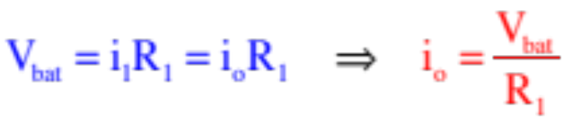





EMF and Terminal Voltage
Example 1: Consider the circuit to the right. If the resistors represent light bulbs:
a.) What does the ammeter read when the switch is open?
(step 1—redraw without the meters)
All the battery’s voltage drop happens across the resistor , and the current through the ammeter is just , so:
b.) In an ideal world, what should happen to the current through when the switch is thrown?
Nothing, and this is tricky. If you think of the current from the battery as fixed, you’ll conclude current will drop as some current will now be needed for . But au, contraire. Current through is governed by the voltage across it and its resistance, neither of which changes when you throw the switch. So what happens?
The battery outputs MORE CURRENT so and , in theory, should remain unaffected.
2.)

Slide 3







c.) Here’s the rub: if you carry this experiment out in the real world, the light bulb associated with will actually dim suggesting that the current through has diminished. So what’s going on?
The problem lies in the internal workings of power supplies. There are actually two parts to a p.s.:
1.) There is the part of the battery that creates the electric field that motivates charge to move through the wires. This part has the units of volts and is called the electromotive force, or EMF (symbol );
2.) Although it is possible to “rectify” a power supply to compensate for this, a power supply in its natural state also has internal resistance .
Including the voltage drop due to , this means a VOLTMETER will read what is called the terminal voltage (i.e., the voltage as measured at the terminals of the p.s.) equal to:
Soooo, if you increase by throwing the switch, does DOWN across the resistors and the bulbs will dim!
3.)

Slide 4







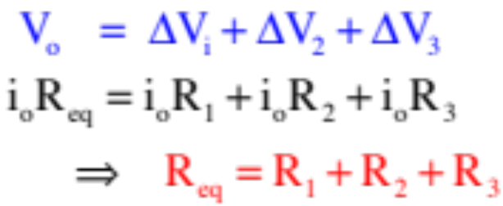
Series Resistor Combinations
Example 2: Derive an expression for the equivalent resistance (the single resistor that can take the place of the resistor combination) for the series combination shown to the right. Assume an ideal power supply with no internal resistance.
The idea behind is to find the single resistor that can take the place of all the resistors in the system. In other words, the single resistor that, when put across will draw .
Using the idea that the sum of the voltage drops across all the resistors will equal the voltage drop across the power supply, and including Ohm’s Law in the mix, we can write:
4.)

Slide 5






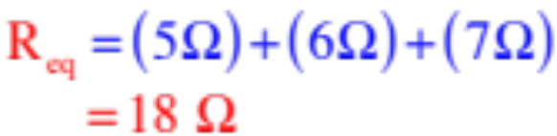
Characteristics of a Series Combinations
--Each element in a series combination is attached to its neighbor in one place only.
--Current is common to each element in a series combination.
--There are no nodes (junctions—places where current can slit up) internal to series combinations.
--The equivalent resistance for a series combination is:
--This means the equivalent resistance is larger than the largest resistor in the combination;
--This means that if you add a resistor to the combination, will increase and the current through the combination (for a given voltage) will decrease.
Example 3: What’s the equivalent resistance of a resistor in series?
5.)

Slide 6


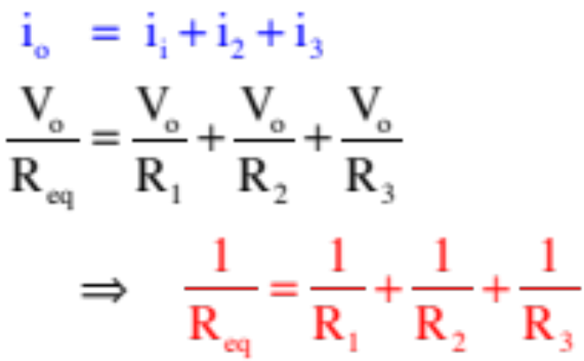
Parallel Resistor Combinations
Example 3: Derive an expression for the equivalent resistance (the single resistor that can take the place of the resistor combination) for the parallel combination shown to the right. Assume an ideal power supply with no internal resistance.
What’s common in a parallel combination is the voltage drop across each element.
Also, in this case, the sum of the currents through the parallel combination must equal the current drawn from the power supply. Using that and Ohm’s Law, we can write:
6.)

Slide 7



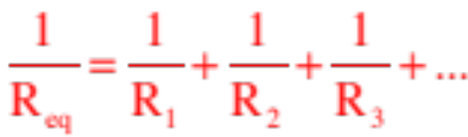
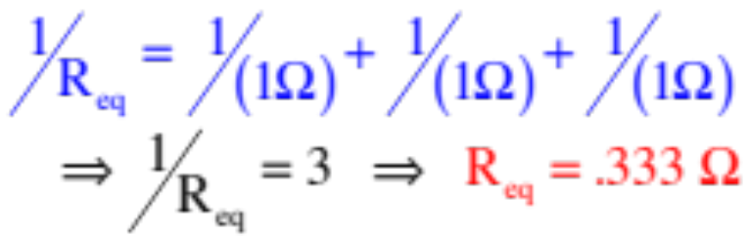
Characteristics of a Parallel Combinations
--Each element in a series combination is attached to its neighbor in two place.
--Voltage is common to each element in a parallel combination.
--There are nodes (junctions—places where current can slit up) internal to parallel combinations.
--The equivalent resistance for a parallel combination is:
--This means the equivalent resistance is SMALLER than the smallest resistor in the combination;
--And, if you add a resistor to the combination, will decrease and the current through the combination (for a given voltage) will increase.
Example 3: What’s the equivalent resistance of three one-ohm resistors in parallel?
7.)

Slide 8




Run and Shoot Problems
Example 4: An ideal power supply has EMF powering it. Any blue letters that show up designate points on the circuit. Assume the low voltage terminal of the p.s. is at zero volts. Assume the resistor values are the same as the resistor subscripts.
a.) What is the first thing you would do if asked to work with this circuit?
Redraw the circuit without the meters. They aren’t doing anything in the circuit except identifying a branch or resistor for which you want a current.
b.) What is the absolute electrical potential at Point a?
There is essentially no resistance between Point a and the high voltage terminal of the p.s., so their voltages are the same point being .
c.) What will the ammeter read?
Some amount of current is being drawn from the power supply. Being in the same branch as Points a, b and g, it will be the same for all three points. It will also be the current through the ammeter. So how do we get that?
8.)

Slide 9
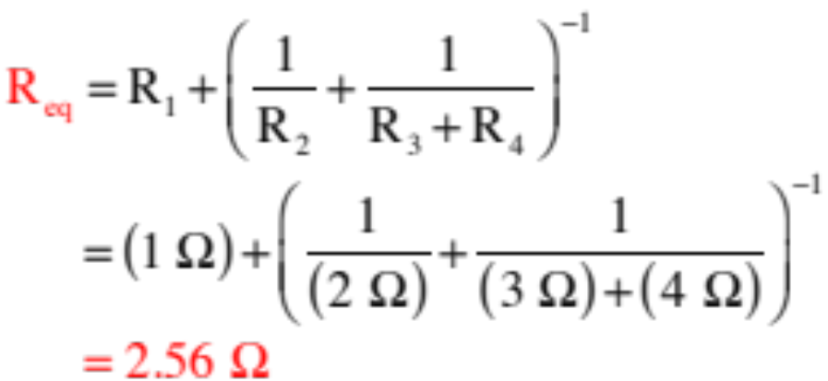
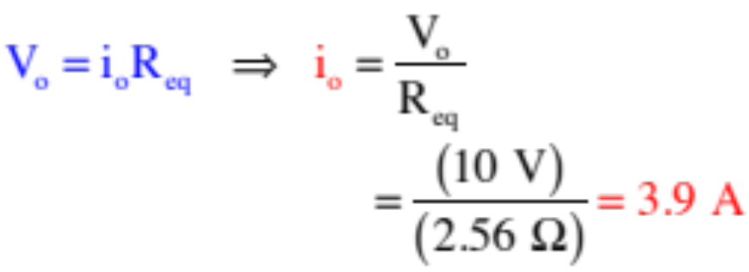
c.) ammeter?
Here is the circuit with the meters removed. The trick here is to find the equivalent resistance for the circuit, then use Ohm’s Law.
This circuit is in series with in parallel with and in series. That is:
Using the circuit:
The ammeter will read 3.9 amps.
9.)

Slide 10
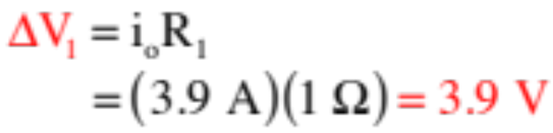
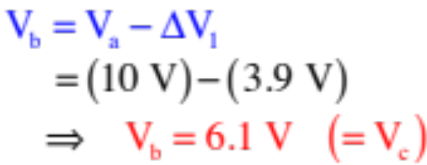

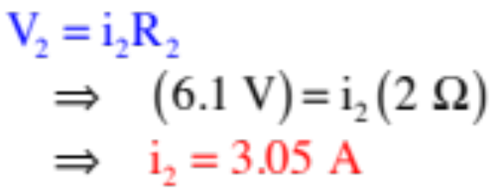
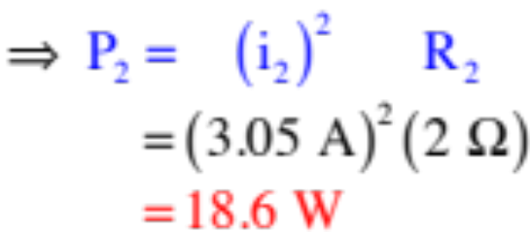
d.) How much power does dissipate?
We know the absolute electrical potential (the voltage) at Point a is 10 volts.
We know current goes from high voltage to low voltage, so the voltage change across must be a voltage DROP equal to:
Logic dictates that the absolute electrical potential at Point b is:
Because the absolute electrical potential at Point d is zero, the voltage across equals and:
The power dissipated by is, then:
10.)

Slide 11



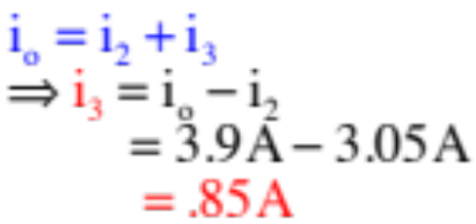
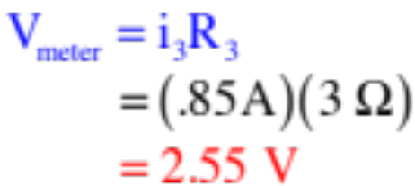
e.) What does the voltmeter read?
You should begin to see a pattern here. Every question, whether it be asking for an ammeter reading or voltmeter reading or power calculation or current through an element or voltage cross an element, they all require you to determine the CURRENT
through the branch in which the element exists. That, in general, is what you will always be doing—trying to derive expressions for current values.
In this case, you could determine the current through the far-right branch (so you could use Ohm’s Law on to get what the voltmeter would read) by using the same approach we used to get the current in the central branch in Part c (you’d just be using Points e and f instead of Points c and d in the process).
Or . . .
Look at node h
So
11.)

Slide 12













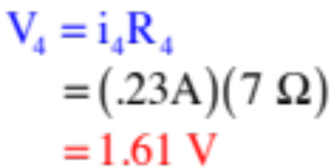
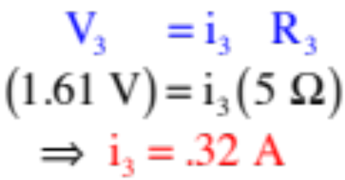
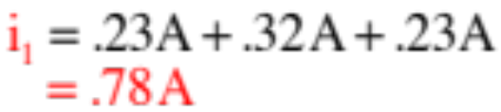
Example 5: A power supply with of internal resistance is used to power a circuit. If the current through is .23 amps, what is the current through ?
Start with what is obvious.
The current through in the bottom branch will equal all the currents in the parallel combination put together, or
We know the current through (given) and (same size resistance with same voltage across it), so all we need is the current through .
The voltage across each of the parallel resistors is the same, and equal to:
The the current through is:
So:
12.)

Slide 13







Example 6: The current from the battery is 3 amps. How much current goes through the upper branch of the parallel combination?
This is another use-your-head question.
If the upper branch has half the resistance of the lower branch, it should draw twice the current.
With 3 amps coming in, that means 2.0 amps should pass through the upper branch.
Note: AP questions often have easy, non-mathematical, use-your-head solutions like this. That is why I’m showing you screwball problems like this. We will get into a more formal approach for analyzing circuit problems shortly.
13.)

Slide 14



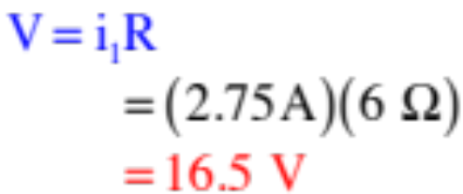









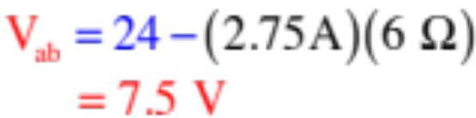
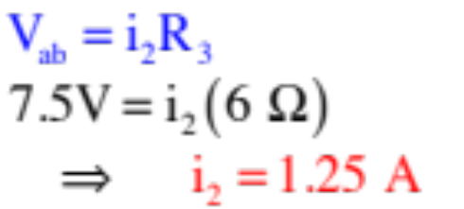
Example 7: Consider:
a.) What does the voltmeter read?
b.) What is the voltage difference between Points a and b?
Assuming the voltage at Points a is zero (this is tricky as you don’t know what is—you can define it anyway you want, though), the voltage changes will be due to the increase due to the battery in the right branch and the drop due to the 6 ohm resistor. That is:
c.) What does the ammeter read?
This is just the current through the 3 ohm resistor, or:
d.) How is generated?
Each battery produces an E-fld,
which permeates the entire circuit. The fields superimpose on one another, creating a net field. That net field is what motivates charge to move in each branch.
14.)

Slide 15


Some Definitions
A branch: A section of a circuit in which the current is the same everywhere.
Loop 3
branch
branch
--elements in series are a part of a single branch (look at sketch).
branch
Loop 1
Loop 2
--in the circuit to the right, there are three branches.
A node: A junction where current can split up or be added to.
--elements in parallel have nodes internal to the combination.
--in the circuit above, there are two nodes.
A loop: Any closed path inside a circuit.
--in a circuit, loops can be traverse in a clockwise or counterclockwise direction.
--in the circuit above, there are three loops.
15.)

Slide 16



For Your Amusement
For the circuit to the right:
a.) How many branches are there?
six
b.) How many nodes are there?
four
c.) How many loops are there?
seven
And that last little nubbin is supposed to be a tooth, cause this looks like a face to me!
16.)

Slide 17







Kirchoff’s Laws—the Formal Approach
With the definitions under your belt, Kirchoff’s Laws are simple (and you’ve been inadvertently using them in the seat-of-the-pants evaluations). They are:
Node A
Kirchoff’s First Law: The sum of the currents into a node equals the sum of the currents out of a node. Mathematically, this is written as:
Loop 1
Loop 2
Example from the circuit’s Node A:
Kirchoff’s Second Law: The sum of the voltage changes around a closed path (a loop) equals ZERO. Mathematically, this is written as:
Examples: starting at Node A:
Loop 1 traversing counterclockwise:
Loop 2 traversing clockwise:
Note: Current moves from hi to lo voltage, so traversing against the current through a resistor produces a that is positive; traversing with current makes it negative.
17.)

Slide 18

Kirchoff’s Laws—Using the Approach
Example 8: Determine the meter reading in the circuit to the right using Kirchoff’s Laws. Assume the power supply is ideal with an EMF of 10 volts, and assume the resistor values are the same as their subscripts (this is essentially Example 4).
Node A
Step 0: Remove the meters.
Step 1: Define one current for each branch.
Step 2. Write out node equations for as
many nodes as you can (see note below). Be sure to identify which node you are working with. For this problem:
Node A:
Important note: If you had written out the node equation for the node at the bottom, you would have gotten . This is the same equation as above. There will always be fewer independent node equations than actual nodes in a circuit. In this case, there were two nodes and only one independent node equation.
18.)

Slide 19


Additional note: You have three branches and three unknown currents, which means you will need three equations to solve. You have one node equation, which means you will need two more equations, presumably from your loops. Kindly note: there are three loops in this circuit, but you can only get TWO INDEPENDENT LOOP EQUATIONS
Node A
Loop 1
Loop 2
from them. Any two of those equations will do, and any two will produce the third, which means that if you try to do this problem using nothing but loop equations, you’ll end up with mush. (Try it if you don’t believe me!)
Step 3. Identify and label the loops you will use. Use an arrow in each to show the direction you intend to traverse that loop.
Note 1: If there is a power supply in the loop, I prefer to start at the low voltage terminal and proceed through the supply. That way, the voltage change through the supply will be positive. With that in mind:
Loop 1:
Loop 2:
Note 2: Put resistance terms first as they’ll usually be assumed known whereas currents will not be.
19.)

Slide 20



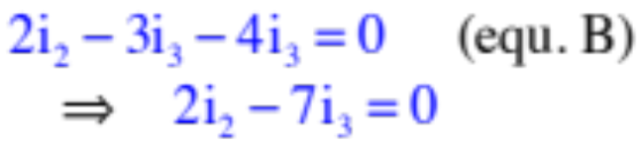
Solving 3 Equations with 3 Unknowns
We have three equations and three unknowns. The ammeter is in the branch whose current is . So how to solve for ? There are three approaches.
Our equations:
Putting in the numbers to make life easier:
Approach 1—Brute force algebra:
I’ll lay this out on the next page, just to convince you it’s not the way to go.
20.)

Slide 21

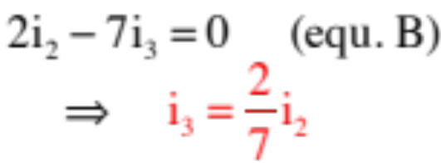
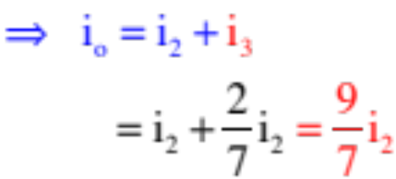
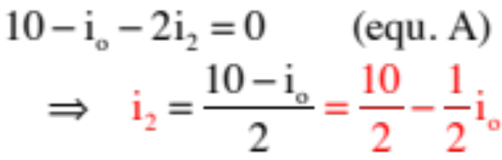
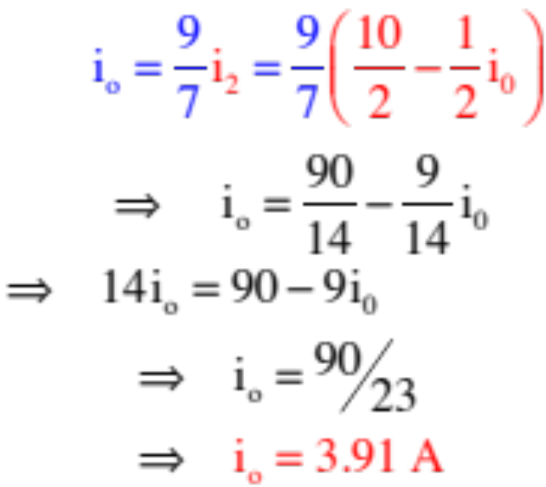
Like I said, NASTY!
as
but
so
21.)

Slide 22




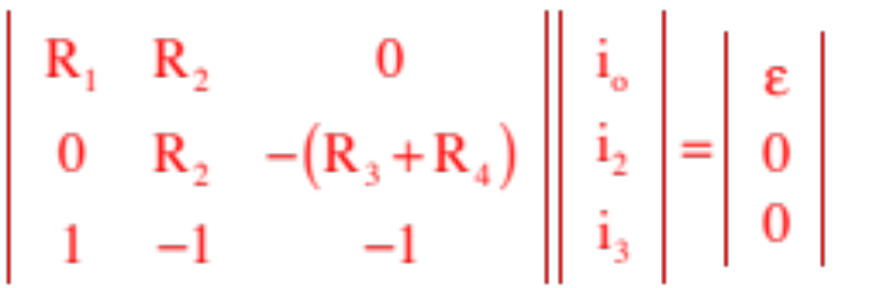
Approaches 2 and 3: Matrices:
--Begin by rewriting each equation so their term is in the first column, its term is in the second column, etc., and its voltage term (if there is one) is on the right side of the equal sign.
Our equations become:
--Put the information into a matrix:
voltage
column
column
column
column
22.)

Slide 23
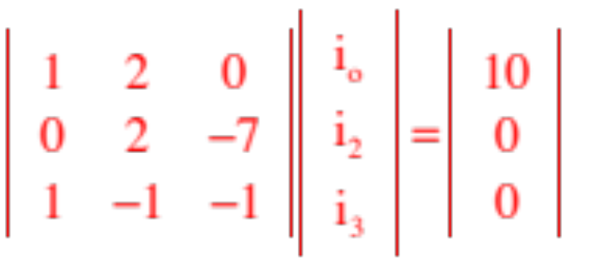
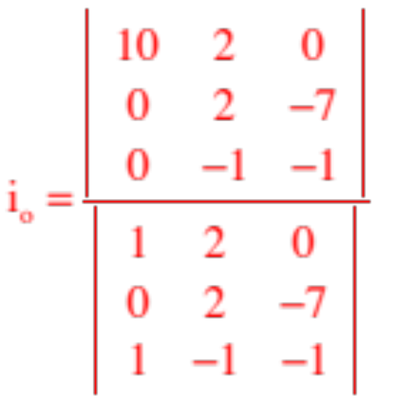
--Using numbers:
becomes
--You have two options at this point, depending upon your abilities with a calculator and whether there are any variables in your relationship. The first approach is a manual evaluation of the matrices and will always work.
Noting that the left-hand 3x3 matrix is called the determinate, solving for, say, , requires the evaluation of two matrices, one divided into the other. Specifically, the determinate divided into the determinate with the column replaced by the voltage column (the far column to the right). That is:
23.)

Slide 24
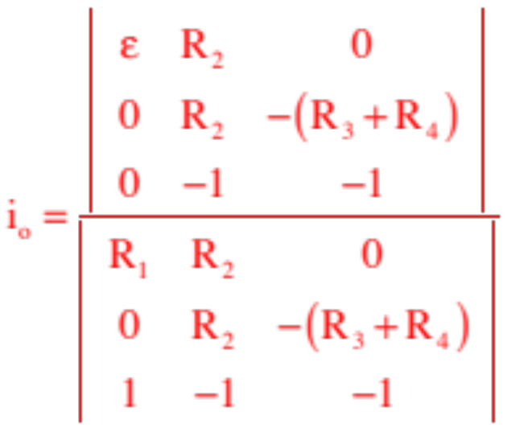
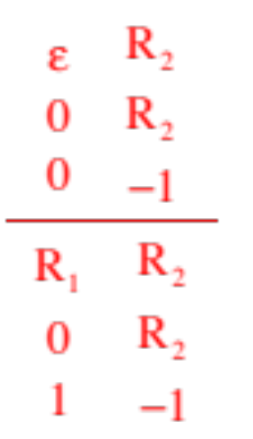
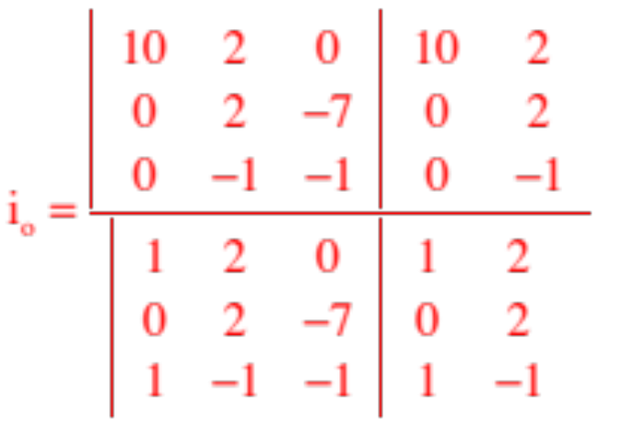
--How to evaluate a matrix? Start by reproducing the first two columns at the end of the matrix.
--With numbers:
24.)

Slide 25
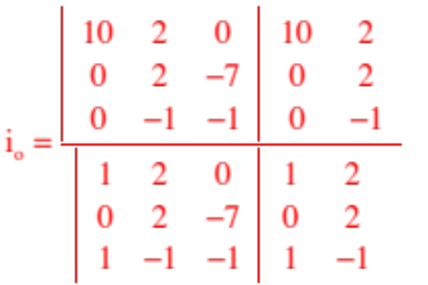
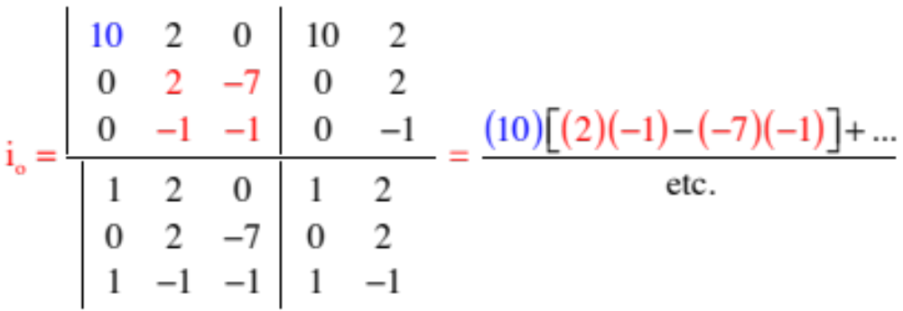
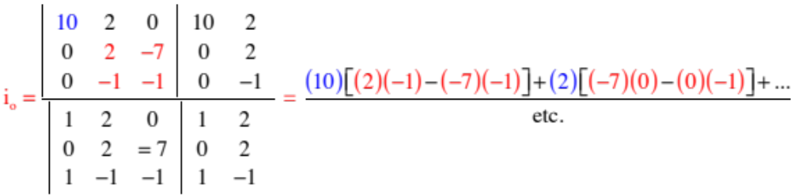
--The first part of the execution is shown below:
--The second part:
25.)

Slide 26
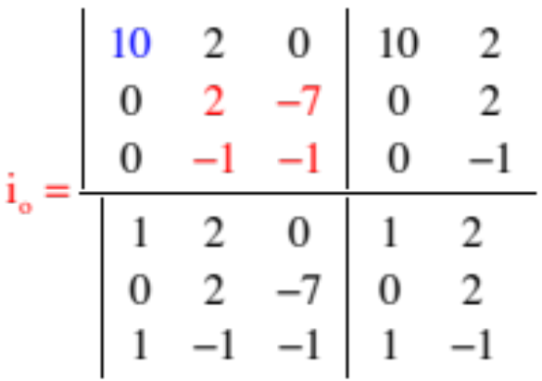
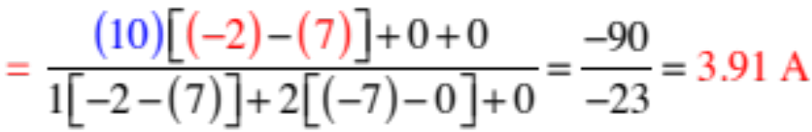
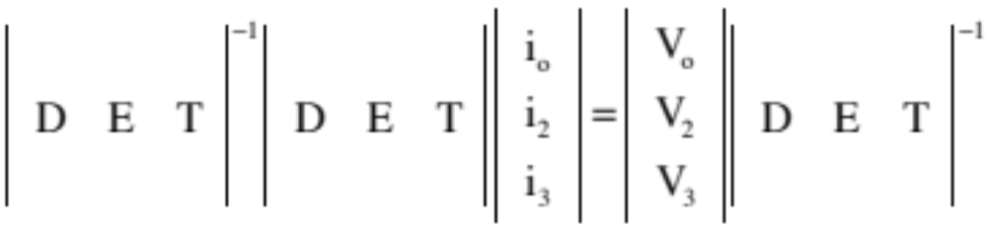

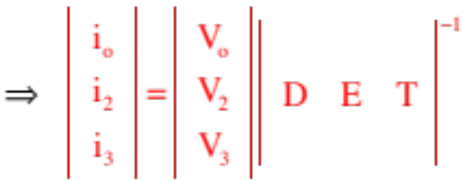
--Once you get the hang of the pattern, you can do these in your head without writing much of anything down:
--The other alternative has to do with matrix manipulation on a calculator. Specifically, if you multiply everything by the inverse determinate, you end up with a 1x3 matrix whose elements are the solution for the three unknowns.
26.)

Slide 27







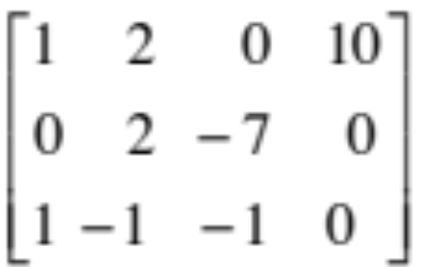
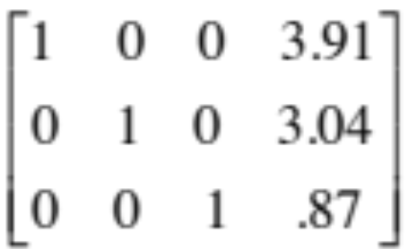



--the alternate alternate is to have your calculator execute an rref (reduce row echalon format) operation. The following is courtesy of Mr. White.
Using your calculator:
Math -> Matrix -> Edit -> A (for name of matrix) . . . note that some calculators just have a “matrix” key you can use (versus starting with “math”)
3 [Enter] 4 [Enter] (this gives you a 3x4 matrix)
Enter coefficients and values into Matrix; exit, then go back to “matrix” and:
In “math,” use “rref” A (reduced row echelon form)
You’ll end up with 1’s and the last row will give you the current values.
27.)

Slide 28

Example 9: Using a clever shortcut (this is a huge hint for dealing with these type problems quickly). Again the power supply is ideal with an EMF of 10 volts, and assume the resistor values are the same as their subscripts.
Node A
Step 0: Remove the meters.
Step 1: Define one current for each branch.
And here is the clever move.
Think about it. If current comes into
node A,
how much current must go through ? Must be . So why not just call it that (instead of )? Doing so eliminates one unknown, which makes the solving a lot easier.
and current goes out of node A and through ,
Consequence: You only need to write two loop equations (you’ve already used the node information in defining the currents). THIS IS HUGELY HELPFUL. You’ll see!
28.)

Slide 29
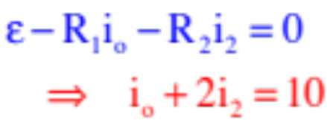
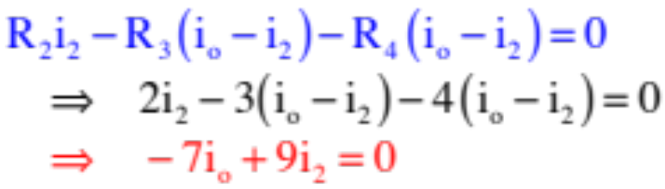
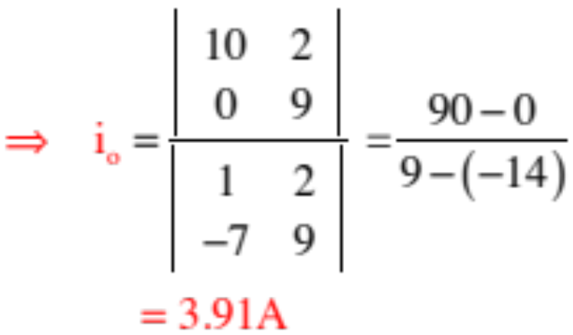
Loop 1:
Node A
Loop 2:
Loop 1
Loop 2
Solving:
29.)

Slide 30












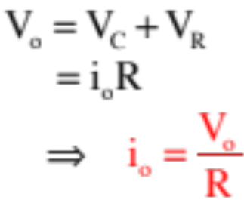

Capacitors—Charging Characteristics
Example 10: Consider a resistor, an uncharged capacitor, a switch and a power supply all hooked in series. Note also that when the switch is thrown, the voltage across “a” and “b” is equal to both the battery voltage and the sum of voltages across the resistor and capacitor. That is:
a.) At t = 0, the switch is closed. What initially happens in the circuit?
As the cap initially has no charge on its plates, it will provide no resistance to charge flow. That means no voltage drop
across the capacitor with all the voltage drop happen across the resistor . . . which means:
30.)

Slide 31



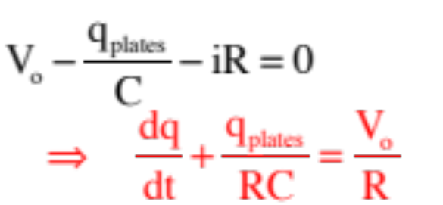
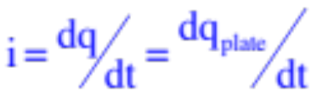
b.) What happens as time proceeds?
As the cap begins to charge, some of the voltage drop happens across the resistor and some across the capacitor leaving us with a Kirchoff expression of:
The problem? There are two different types of q in this expression. One refers to the amount of charge on one capacitor plate. The other refers to charge flowing through the circuit (current is defined as the time rate of charge flow).
Although this won’t always be the case, in this instance the rate at which charge accumulates on the cap plates will equal the rate at which charge passes by per unit time, and we can write:
31.)

Slide 32
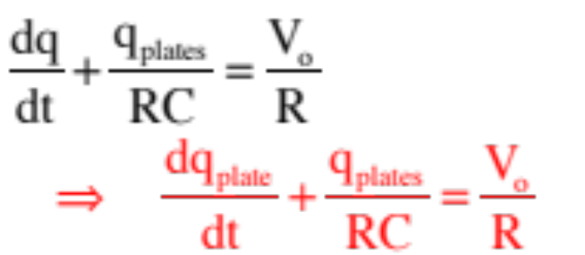

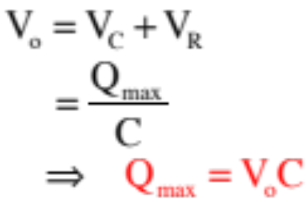
This means Kirchoff’s Law can be written as:
Note that as time proceeds toward infinity, the charge on the capacitor plates reaches maximum, all the voltage drop happens across the capacitor, current in the circuit drops to zero and there is no voltage drop across the resistor. In that case:
32.)

Slide 33
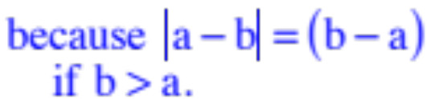
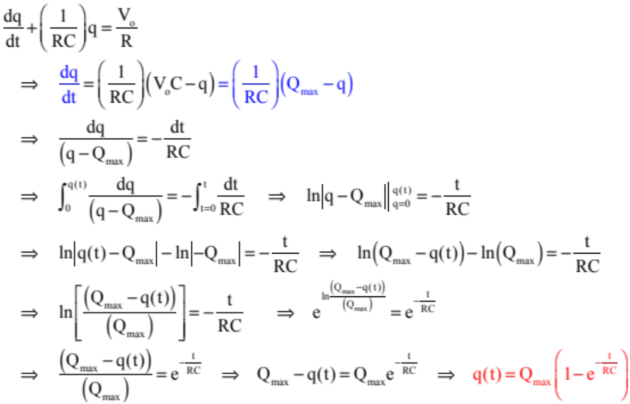
Solving:
33.)

Slide 34






Time Constant for a Capacitor
A graph of the charging characteristic of a charging capacitor is shown below.
In theory, capacitor fully charged at t =
no charge on capacitor initially
34.)

Slide 35






It would be nice to get a feel for how fast a capacitor/resistor combination will charge or discharge.
To that end, how much charge would the cap have accumulated after a time equal to RC?
This time is defined as one time constant . It is the amount of time it takes the capacitor to charge to 63% of its maximum. Two time constants will charge it to 87% of its maximum (try the calculation if you don’t believe me).
35.)

Slide 36



c.) What is the current as a function of time?
36.)

Slide 37






A graph of the current characteristics for a charging capacitor/resistor combination:
Note that after one time constant, the current is:
After one time constant, the capacitor’s current will have dropped 63% and will be at 37% of its maximum. After two time constants, it will be at 13% of its maximum.
37.)

Slide 38






Capacitors—Discharging Characteristics
Example 11: At t = 0, the switch is thrown and a charged capacitor begins to discharge.
switch closed at t = 0
a.) How are current through the circuit and charge on the capacitor plates related?
When a capacitor is discharging, the rate of change of charge on the plate is negative (charge is leaving) and:
Using this with Kirchoff’s Law (tracking along the direction of current flow) yields:
38.)

Slide 39

Solving:
switch closed at t = 0
39.)

Slide 40






A graph of the charge on plate characteristics for a discharging capacitor/resistor combination:
Note that after one time constant, the charge is:
After one time constant, the capacitor’s charge will have dropped 67% and will be at 37% of its maximum. After two time constants, it will be at 13% of its maximum.
40.)

Slide 41

c.) What is the current as a function of time?
switch closed at t = 0
41.)

Slide 42
A graph of the current characteristics for a discharging capacitor/resistor combination:
Note that after one time constant, the current is:
After one time constant, the capacitor’s current will have dropped 67% and will be at 37% of its maximum. After two time constants, it will be at 13% of its maximum.
And yes, it’s the same as for a charging circuit.
42.)

Slide 43





Summary of Graphs
Graphs of capacitor charging and discharging characteristics.
charge vs. time
(discharging)
charge vs. time
(charging)
current vs. time
(both charging and discharging)
43.)

Slide 44



Example 11: A one microfarad cap is in series with a 10 k-ohm resistor, a battery whose voltage is 100 volts and a switch.
a.) The capacitance value tells you something that is always true no matter what the voltage across the cap happens to be. What does it tell you?
The capacitance tells you the amount of charge one plate can hold per volt across the plates.
b.) What is the initial current in the circuit?
With no charge initial on the cap (and, hence, no voltage across the cap), we can write:
c.) What is the circuit’s current after a long time?
It will go to zero.
d.) How much charge will the cap hold when fully charged?
When fully charged, all the voltage drop will be across the cap (no current in the circuit, so no drop across the resistor), and
44.)
Notes:
Potential = V = Q/C = Q1/C1
Q1 > Q2, so excess Q1 flows to Q2. V1=V2.
Consider capactiors as parallel: Q=Q1+Q2 = VC1 + -VC2. V’=Q’/C’ = V(C1-C2)/(C1+C2)
Before: Ui=C1V^2/2+C2V^2/2. After: Uf=[(C1-C2)/(C1+C2)]^2 Ui Some energy went into heating wire!

Slide 45


e.) How much energy does the cap hold when fully charged?
f.) Where is the energy stored?
In the electric field between the plates.
g.) You are told the system’s time constant is seconds. What does that tell you?
It tells you how long it will take for the cap to charge up to or discharge by 63%.
h.) Where is the charge alluded to found?
On one plate of the cap.
45.)
Notes:
Potential = V = Q/C = Q1/C1
Q1 > Q2, so excess Q1 flows to Q2. V1=V2.
Consider capactiors as parallel: Q=Q1+Q2 = VC1 + -VC2. V’=Q’/C’ = V(C1-C2)/(C1+C2)
Before: Ui=C1V^2/2+C2V^2/2. After: Uf=[(C1-C2)/(C1+C2)]^2 Ui Some energy went into heating wire!

Slide 46

THINGS TO NOTICE ABOUT CAPACITORS
1.) Caps in series have common charge on their plates.
2.) Caps in parallel have common voltage across their plates.
3.) Close S₁ with S₂ open and C₁ charges to Q_{max,1}. At that point there is no current and V_{R} = 0.
Keep S₁ closed and close S₂. C₁ is still across the battery so it keeps Q_{max,1} on it, but C₂ is now also across the battery so more charge is drawn from the battery until it reaches Q _{max,2}. In other words, because the battery is still connected, the total charge in the system is not fixed.
4.) Different scenario: Close S₁ with S₂ open and C₁ is all that is across the battery, so it charges to Q_{max,1}.
Open S₁ and C₁ is now isolated (disconnected from the battery). Close S₂ so that C₁ and C₂ are now in parallel. Because the battery is no longer in the circuit, the charge in the system is fixed. That means the charge on C₁ has to redistribute itself which it will do until the voltage across each cap is the same (and if the charge that flows from C₁ to C₂ is q, then the charge left on C₁ is (Q – q)).
46.)
Notes:
Potential = V = Q/C = Q1/C1
Q1 > Q2, so excess Q1 flows to Q2. V1=V2.
Consider capactiors as parallel: Q=Q1+Q2 = VC1 + -VC2. V’=Q’/C’ = V(C1-C2)/(C1+C2)
Before: Ui=C1V^2/2+C2V^2/2. After: Uf=[(C1-C2)/(C1+C2)]^2 Ui Some energy went into heating wire!

Slide 47

Alternate View of Previous Page
1.) Caps in series have common charge on their plates.
2.) Caps in parallel have common voltage across their plates.
3.) Close S₁ with S₂ open and C₁ charges to Q. Keep S₁ closed and close S₂. C₁ is still across the battery so it keeps Q on it, but C₂ is now also across the battery so more charge is drawn from the battery. Because the battery is still connected, the total charge in the system is not fixed.
4.) Different scenario: Close S₁ with S₂ open and C₁ charges to Q. Open S₁ and C₁ is now isolated (disconnected from the battery). Close S₂ so that C₁ and C₂ are now in parallel. Because the battery is no longer in the circuit, the charge in the system is fixed. That means the charge on C₁ has to redistribute itself which it will do until the voltage across each cap is the same (and if the charge that flows from C₁ to C₂ is q, then the charge left on C₁ is (Q – q)).
5.) Second circuit: S starts out closed so C₁ charges to Q. S is opened so the caps are now in series. What changes? Because the battery voltage is now distributed between the two caps, C₁‘s voltage goes down but the charge on the two caps has to be the same.
47.)
Notes:
Potential = V = Q/C = Q1/C1
Q1 > Q2, so excess Q1 flows to Q2. V1=V2.
Consider capactiors as parallel: Q=Q1+Q2 = VC1 + -VC2. V’=Q’/C’ = V(C1-C2)/(C1+C2)
Before: Ui=C1V^2/2+C2V^2/2. After: Uf=[(C1-C2)/(C1+C2)]^2 Ui Some energy went into heating wire!

Slide 48



Example 12: You charge up two unequal capacitors that are in series. You disconnect the battery by opening , then reconnect the two caps by closing .
a.) What is initially common to the two caps?
Caps in series have the same amount of charge on their plates.
b.) When you throw both switches, how are the caps related (series or parallel)?
They are now connected in two places, which is characteristic of a parallel combination.
c.) So what should happen when both switches are thrown?
The the caps now in parallel, their voltages have to be the same so charge will have to rearrange itself necessitating current to momentarily flow.
48.)
Notes:
Potential = V = Q/C = Q1/C1
Q1 > Q2, so excess Q1 flows to Q2. V1=V2.
Consider capactiors as parallel: Q=Q1+Q2 = VC1 + -VC2. V’=Q’/C’ = V(C1-C2)/(C1+C2)
Before: Ui=C1V^2/2+C2V^2/2. After: Uf=[(C1-C2)/(C1+C2)]^2 Ui Some energy went into heating wire!

Slide 49

Example 11: (courtesy of Mr. White): Examine the circuit here, where C₁ > C₂ and both have been charged to the same potential V.
a.) What is the potential between points a across b before the switches are closed?
Q1/C1
b.) What happens to the charges after the switches are thrown?
This is a screwball problem in the sense that the voltages initially have the same magnitude, but their polarities are reversed. That means that when the switches are thrown, charge will flow between the caps. Specifically:
c.) What is the potential across a and b a long time after the switches have been closed?
This is going to take some room:
49.)
Notes:
Potential = V = Q/C = Q1/C1
Q1 > Q2, so excess Q1 flows to Q2. V1=V2.
Consider capactiors as parallel: Q=Q1+Q2 = VC1 + -VC2. V’=Q’/C’ = V(C1-C2)/(C1+C2)
Before: Ui=C1V^2/2+C2V^2/2. After: Uf=[(C1-C2)/(C1+C2)]^2 Ui Some energy went into heating wire!

Slide 50






c.) What is the potential across a and b a long time after the switches have been closed?
The total charge in the system is:
Letting the new charge on be q, the new charge on will be:
With the new voltages the same, we can write:
Knowing q, we can write:
50.)
Notes:
Potential = V = Q/C = Q1/C1
Q1 > Q2, so excess Q1 flows to Q2. V1=V2.
Consider capactiors as parallel: Q=Q1+Q2 = VC1 + -VC2. V’=Q’/C’ = V(C1-C2)/(C1+C2)
Before: Ui=C1V^2/2+C2V^2/2. After: Uf=[(C1-C2)/(C1+C2)]^2 Ui Some energy went into heating wire!

Slide 51

d.) What is the energy stored in the system before and after the closing of the switches?
51.)
Notes:
Potential = V = Q/C = Q1/C1
Q1 > Q2, so excess Q1 flows to Q2. V1=V2.
Consider capactiors as parallel: Q=Q1+Q2 = VC1 + -VC2. V’=Q’/C’ = V(C1-C2)/(C1+C2)
Before: Ui=C1V^2/2+C2V^2/2. After: Uf=[(C1-C2)/(C1+C2)]^2 Ui Some energy went into heating wire!

Slide 52




The Galvanometer
A galvanometer is an ammeter built to a very specific specification. All galvanometers swing maximum deflection when amps flow through them. Although they are usually discussed in the chapter on magnetism (they are built using a coil in a magnetic field), it is possible to use a galvanometer to build an ammeter designed to handle larger currents, and to build voltmeters.
52.)

Slide 53







Example 12: Design a 2-amp ammeter assuming the galvanometer’s resistance is .
For the galvanometer to go full deflection--something you want it to do when 2 amps flow into it--you need to shunt some of the current away from the galvanometer. The current that does not flow into the galvanometer flows through the shunt resistor. In this case, that will be:
2 - .0005 = 1.9995 amps.
With the shunt resistor in parallel with the galvanometer and the voltage across each being the same, we can write:
53.)

Slide 54






Example 13: Design a 12-volt voltmeter assuming the galvanometer’s resistance is .
You want the galvanometer to go full deflec-tion when 12 volts is across its terminals. Unfortunately, 12 volts will produce a HUGE current, so you need to cut the down current. You can do that by adding a resistor in series. As the current in a series combination is the same everywhere, we can write:
54.)

Slide 55


Observations:
--The galvanometer-engineered ammeter consists of a galvanometer in parallel with (in this case) a resistor (that is, essentially a wire). As the equivalent resistance of a parallel combination is smaller than the smallest resistor in the combination, that means that the equivalent resistance of the ammeter is REALLY SMALL—exactly as expect.
--The galvanometer-engineered voltmeter consists of galvanometer and, in this case, an additional resistor in series. As the equivalent resistance of a series combination is larger than the largest resistor in the combination, that means that the equivalent resistance of the voltmeter is REALLY Big—again, exactly as expect.
55.)

