Slide 1
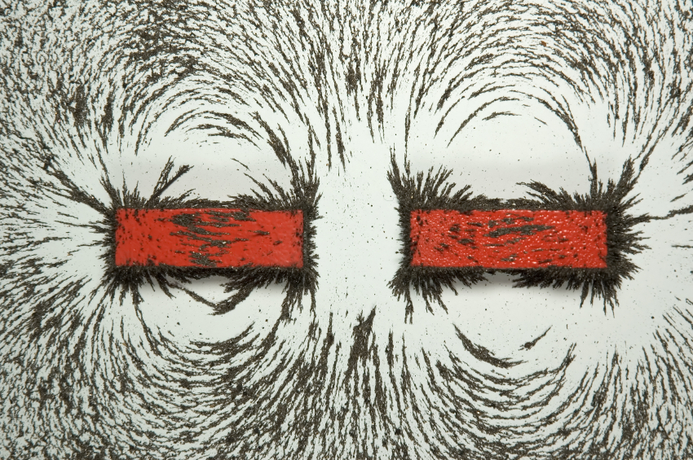
CHAPTER 29:
Magnetic Fields and Sources
photo courtesy of Mr. White
1.)

Slide 2

Relativity and Magnetism
--Newton’s Classical Mechanics demands that the speed of light depend upon the relative motion between the frame of reference of the light source and the observer’s frame (think of about a passing car’s speed on the freeway—how fast it passes you depends upon how fast you are going).
--Yet because alternating magnetic fields (B-flds) induce electric fields (E-flds), and alternating E-flds induce B-flds, the only way an alternating E-fld can coupled with an alternating B-fld to produce an electromagnetic wave (i.e., a wave in which the alternating E-fld feeds the B-fld and the alternating B-fld feeds the E-fld), is if, according to Maxwell’s equations, the wave’s velocity is , the speed of light.
--You can’t have it both ways. The speed of light is either frame-of-reference dependent alla Newton, or it’s a fixed value independent of frame-of-reference alla Maxwell.
--This conundrum is what motivated Einstein to develop his Theory of Special Relativity, a form of Mechanics that assume that the speed of light is the same in all frames of reference.
2.)

Slide 3



--One of the stranger characteristics of Special Relativity is that if you have an object that is approaching at relativistic speeds, it will length contract. And, in fact, this length contraction phenomenon will occur even at classical speeds (though observing it at classical speeds is difficult).
--With this in mind, consider a wire with conventional current flowing through it (i.e., assume positive charge flow). If you fire a positive charge opposite the direction of current flow, an interesting thing is observed.
The charge will feel a force that motivates it to veer away from the wire. So what’s going on?
path taken
3.)

Slide 4



As positive charge carriers move onto the wire (with electrons assumed stationary), an equal number of positive charge carriers move off the wire. That means the number of positive and negative charge stays even throughout time, the wire stays electrically neutral, and there’s no good reason for the moving test charge to feel a force. But it does. This led early theorists to conclude that there must be a force, a magnetic force, affecting the moving charge . . . except that isn’t what’s really happening here. To see this, we have to look at the situation through the perspective of the moving charge .
-
-
-
-
-
-
-
-
-
-
e
e
e
e
e
e
e
e
e
e
+
+
+
+
+
+
+
+
+
+
p
p
p
p
p
p
p
p
p
p
assume velocity of positive charge is
4.)

Slide 5





In the frame of reference attached to , is not moving. What’s more, as far as
is concerned, both the electrons and the wire are seen to be moving to the left with velocity , and the protons are seen to be moving to the left with velocity
The sketch below show all of this.
electron and wire velocity:
(stationary)
-
e
+
p
proton velocity:
5.)

Slide 6
What’s important to notice here is that because the protons are moving faster than the electrons, they will length contract more than will the electrons. When they do so, from the moving charge’s perspective, there appears to be more protons on the wire than electrons.
-
-
-
-
-
-
-
-
-
-
-
-
e
e
e
e
e
e
e
e
e
e
e
e
+
+
+
+
+
+
+
+
+
+
+
+
+
+
p
p
p
p
p
p
p
p
p
p
p
p
p
p
Protons length contract more than electrons. More protons means the wire looks electrically positive and an electric field is set up pointing outward from the wire.
6.)

Slide 7

With more protons apparently on the wire, there is an electric field generated emanating outward from the wire. It is that electric field that the responds to.
E-field due to preponderance of positive charge
-
-
-
-
-
-
-
-
-
-
-
-
e
e
e
e
e
e
e
e
e
e
e
e
+
+
+
+
+
+
+
+
+
+
+
+
+
+
p
p
p
p
p
p
p
p
p
p
p
p
p
p
E-field due to preponderance of positive charge
6.)

Slide 8
In short, what was described by early researchers as a MAGNETIC EFFECT was (and is) really a RELATIVISTIC EFFECT.
Still, the Classical Theory of Magnetism is a good theory in the everyday world (just as is the case with Newtonian Mechanics), so that’s what you will be spending the next several weeks learning.
7.)

Slide 9

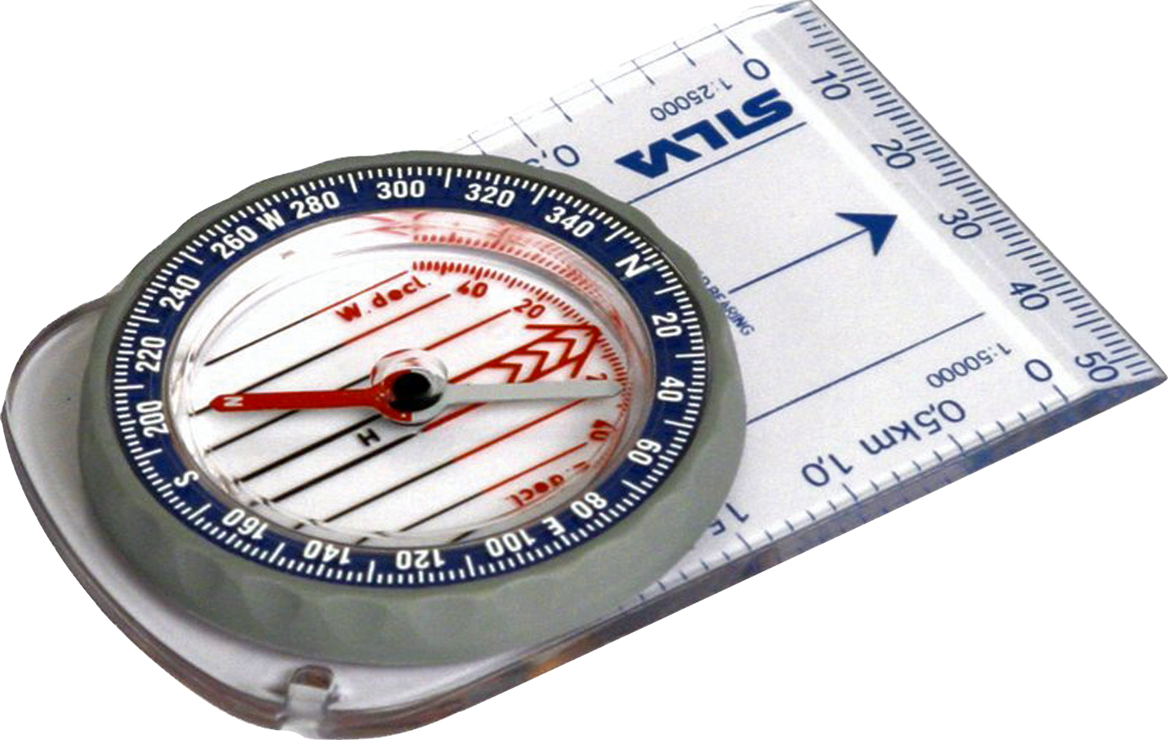
General Information
Electric Fields
Magnetic Fields
--magnetic fields (abbreviated as B-flds), with units of teslas in the MKS system, are NOT modified force fields (release a charge in a B-fld and it will just sit there);
--electric fields (abbreviated as E-flds), with units of newtons per coulomb or volt per meter, are modified force fields (release a charge in an E-fld and it will accelerate);
--magnetic forces do exist when a charge moves through a B-fld—they are centripetal and are governed by the relationship:
--electric fields are generated with the presence of charge;
--B-fields are generated by charge in motion;
--an electric field’s direction is defined as the direction a positive charge will accelerate if released in the field;
--a B-field’s direction is defined as the direction a compass points when placed in the field;
--electric field lines:
--magnetic field lines:
--go from positive to negative charge;
--go from north to south pole, or circle around current carrying wire;
--identify the E-fld’s direction in a region;
--are closer together where E-flds are more intense;
--identify the B-fld’s direction in a region;
--are closer together where B-flds are more intense;
9.)

Slide 10
Terminology and the Compass
Place a compass in the earth’s magnetic field.
south magnetic pole
north geographic pole
The compass end that originally pointed toward the north geographic hemisphere was called the north geographic seeking magnetic pole.
earth
compass
With time, the word geographic was dropped leaving the north seeking magnetic pole, and with even more time, the seeking and magnetic was dropped leaving us with north pole.
north geographic seeking pole
south geographic pole
north magnetic pole
Problem is, north poles are attracted to south poles, which means that given the definition, there must be a south magnetic pole in the north geographic hemisphere. Not very esthetically pleasing, but that’s life (and it’ll switch directions in another 200,000 or so years due to slow oscillatory patterns in the earth’s magma).
10.)

Slide 11
Bar Magnets
electron spin about an axis producing a B-fld
If magnetic fields are generated by charge in motion, where is the motion associated with a bar magnet?
An atom’s spin quantum number highlights the fact that electrons spin up or down, depending.
electron
In most atoms, approximately the same number of electrons spin in one direction as the other, but in certain atoms (the ferromagnetic ones), they spin considerably more in one direction than the other.
The most prominent example of a ferromagnetic material is iron, with six more electrons spinning in one direction than the other. As such, EACH IRON ATOM IS A MINI-MAGNET UNTO ITSELF.
11.)

Slide 12
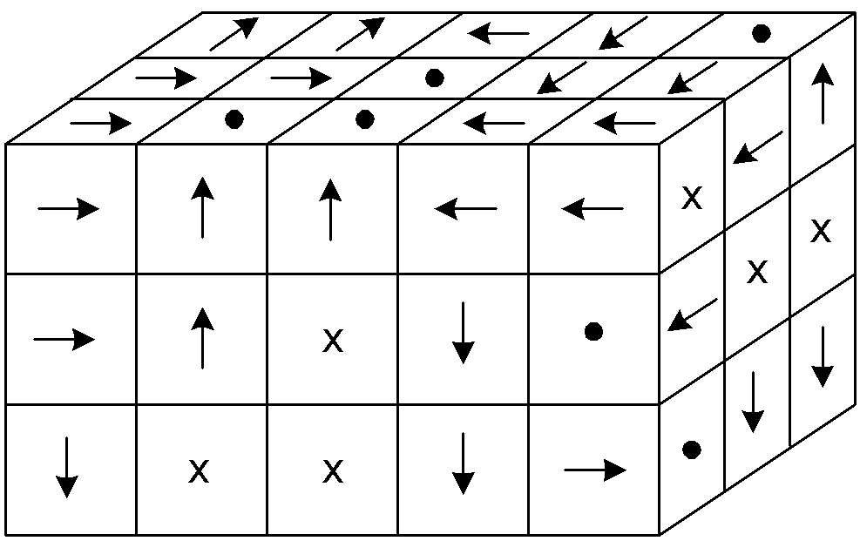
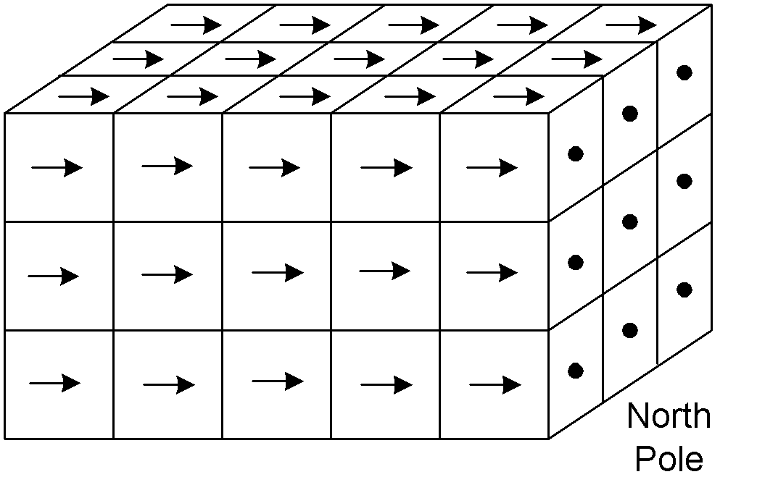
So how can a piece of iron be magnetic under some conditions and not under other conditions (there are, after all, iron nails that do not exhibit magnetic characteristics at all). (The explanation is called Ampere’s Theory of Magnetism.)
Enter the magnetic domain. What happens is this: Atoms within irregular, microscopic regions, called domains, align themselves so that all of their magnetic fields are in the same direction.
When the domains are themselves aligned, the material acts like a magnet. When the domains are NOT aligned, the net magnetic effect is lost (in some cases, all that is needed to de-magnetize a magnetic is to have thermal agitation shake the domains out of alignment). In any case, the first sketch below is without alignment, the second with alignment.
sketches courtesy of Mr. White
domains aligned
domains unaligned (not realistic rendering)
12.)
Notes:
Microscopic examination reveals that a magnet is made up of tiny (up to 1mm wide or long) regions called domains. The domain behaves as its own tiny magnet, with a specific size and a specific north-south pole orientation.
In an unmagnetized piece of iron, the domains don’t have any preferential alignment. In a magnetized piece of iron, the domains are aligned, giving the piece of iron a preferential magnetic orientation.
To make a magnet, take a piece of ferromagnetic material, and subject it to a strong magnetic field, which will cause the domains to shift (somewhat temporarily) into alignment with that field.
A magnet can be demagnetized by striking it repeatedly, which jars the magnetic domains out of alignment. (Dropping magnets is bad for them.)

Slide 13
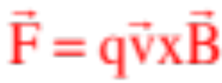
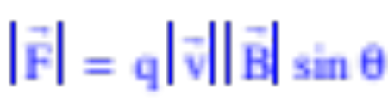



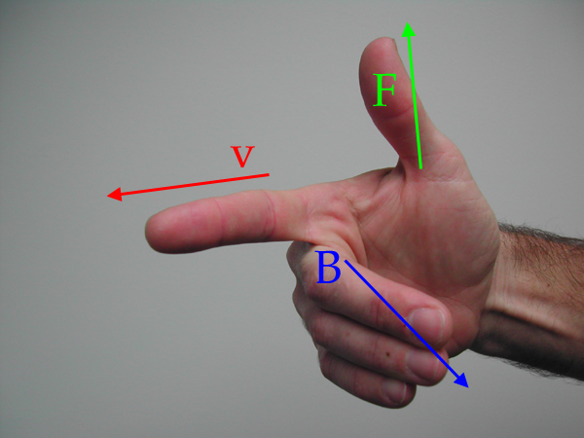
Magnetic Force
When charge moves through a magnetic field, it may or may not feel a force, depending upon its motion. If present, that force will be:
The magnitude is , where q is the size of the charge,
is the magnitude of the velocity vector, is the magnitude of the magnetic field and is the angle between the line of the two vectors.
The direction is determined using the right-hand rule.
sketch courtesy of Mr. White
13.)

Slide 14
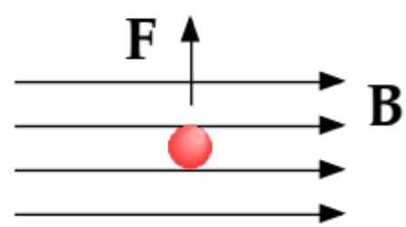
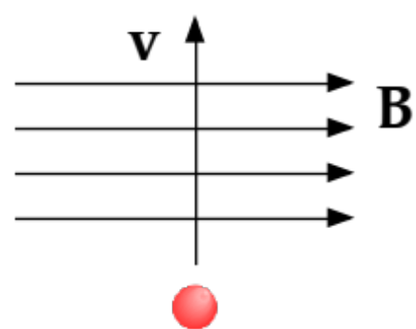
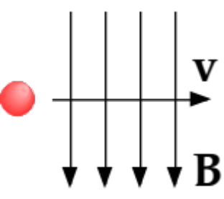
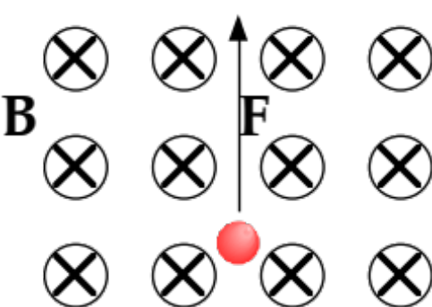
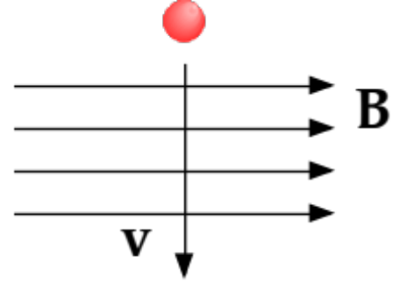
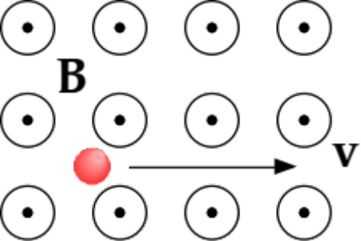
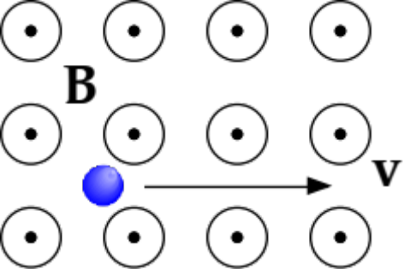
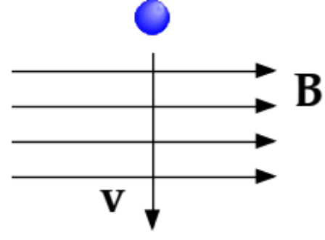
Example 1: (courtesy of Mr. White)
Identify the missing vector in these diagrams. Assume red signifies negative charges, blue positive charges. The responses are in green
B
F
v
zip
v
F
F
v
F
F
F
14.)

Slide 15

Fine Print for
The right-hand-rule determine the direction of force for a positive charge.
Magnetic forces are centripetal forces acting perpendicular to magnetic fields (whereas electric forces act along electric fields). That means magnetic forces DO NO WORK on charges that feel their effect.
Magnetic forces are experience only by charges in motion.
15.)

Slide 16




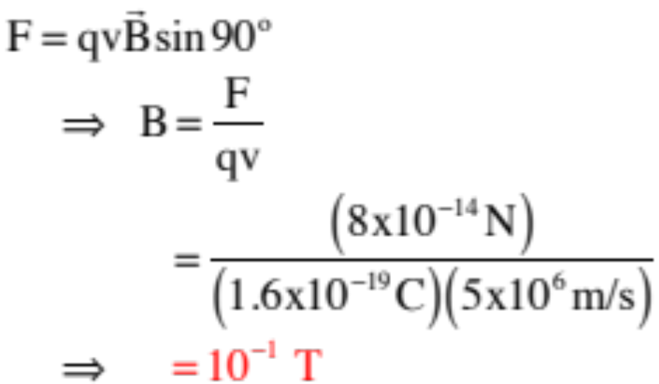
Example 2: A proton moving upward with speed in a magnetic field feels a force of to the west. When moving horizontally to the north, it feels no force. Find the magnitude and direction of the magnetic field in this region. (courtesy of Mr. White)
Because no force is felt when the proton is moving northward, the magnetic field must either be toward the north or the south.
Reverse engineering the right-hand-rule suggests if the field is to the north*, the velocity vector would have to be out of the page to generate a force to the west, with a magnitude of:
*Note that if the field was to the south, the velocity vector would be into the page.
16.)

Slide 17
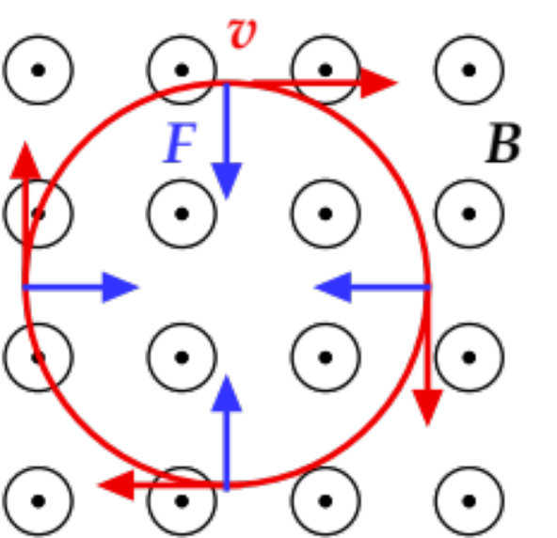
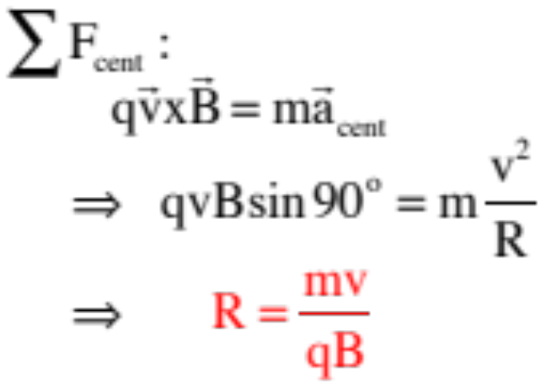
Example 3: A charge q of mass m is moving with constant velocity v at right angles to a magnetic field B. (idea courtesy of Mr. White)
a.) What kind of motion will it execute?
Because magnetic forces are centripetal, the mass will follow a circular path.
b.) What is the radius of the motion’s path?
17.)

Slide 18
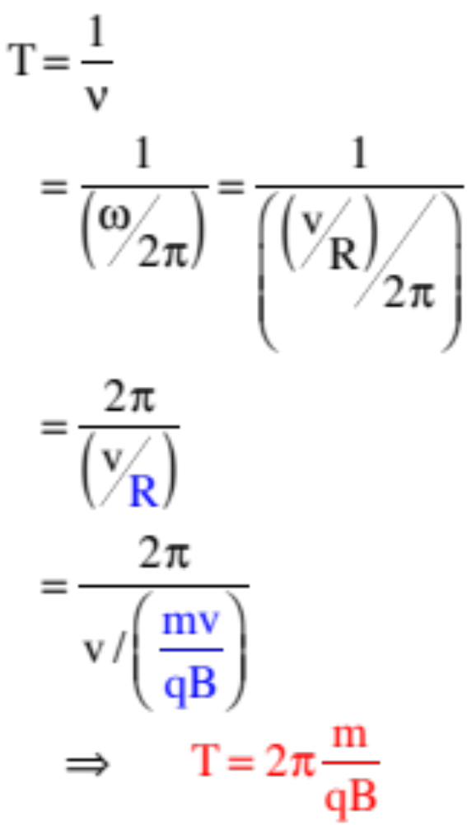
c.) What is the period of the motion?
18.)

Slide 19
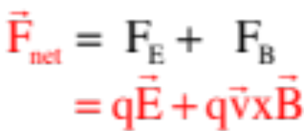
Lorentz Relationship
When both magnetic and electric forces act, the relationship looks like:
19.)

Slide 20




Example 4 (the velocity trap): A velocity trap (or velocity selector) is an electric field and magnetic field at right angles to one another that selectively allow charged particles with one velocity only to proceed down its axis. It is made up of parallel plates bathed in a B-fld (see sketch).
a.) Assuming the B-fld is into the page as shown, what path will a negative charge take if nothing additional is added to the system (i.e., no E-fld is present).
According to the right-hand-rule, a positive charge would feel a force upward, so a negative charge will feel a force downward.
b.) Insert the E-fld required to make the charge travel along a straight line.
The force exerted by the B-fld is downward, so the force exerted by the E-fld must be upward. To create an upward force on a negative charge, you need an E-fld that is downward.
20.)

Slide 21
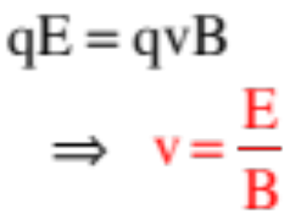
c.) What velocity will make it through the trap?
This is a Lorentz relationship problem. The net force must be zero for this to work, which means:
21.)

Slide 22

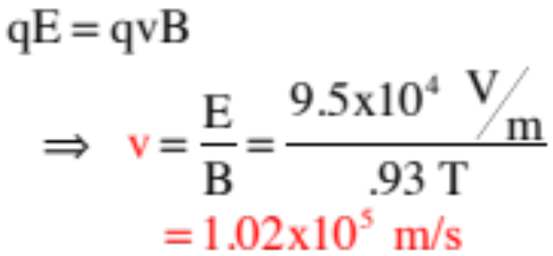
Example 5 (mass spectrometer): An unknown mass is volatalizes (made into a gas), had its molecules singly ionized (had one electron stripped away), accelerated through a
potential difference to give them velocity, and sent through a velocity trap made up of a 95,000 V/m E-fld and a .93 teslas B-fld. The molecules that make it through the trap move into a region in which there is only the B-fld.
a.) What is the velocity of the molecules that make it through the trap?
22.)

Slide 23

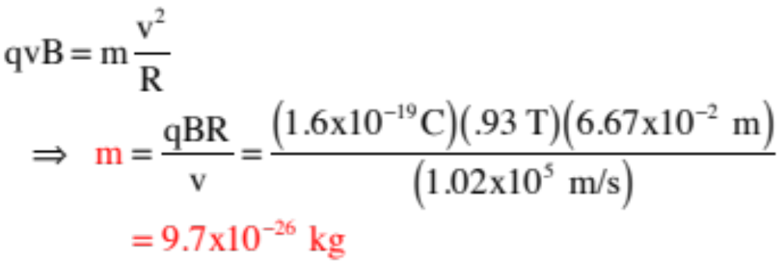
b.) Draw in the path of the molecules in the far right chamber.
They will circle upward.
c.) If the radius of the arc is observed to be .0667 meters, what was the mass of the particle (that’s what these devices are designed to do—determine the mass of an unknown material from which the identification of
the material can be had). In the region in which there exists only a B-fld:
(This is the molecular weight of table salt.)
23.)

Slide 24



Point of Order
Magnetic forces exist on charges moving through magnetic fields ONLY when the charges cut across magnetic field lines. Until now, the only examples we’ve viewed have been situations in which the charges have cut across at right-angles to the field lines. What happens when they cut across at an angle?
--The velocity component perpendicular to the B-fld will generate a magnetic force that will motivate the charge to circle (magnetic forces are centripetal in nature);
--The parallel component will simply provide momentum for the charge to continue to move in that parallel direction.
--The net effect is that the charge will helix along the B-fld lines.
24.)

Slide 25



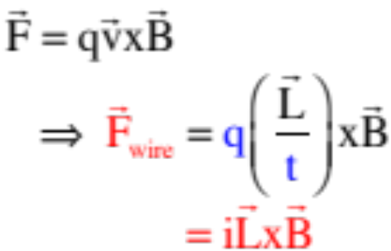
B-flds and Current Carrying Wires
Consider a current moving into the page that is positioned between the poles of a horseshoe magnet. What effect will the wire feel due to being in the B-fld.
--According to the right-hand-rule, conventional current is the motion of positive charge. Positive charge into the page in a magnetic field to the left produces a magnetic force upward.
--Mathematically: Noticing that a charge’s velocity v is the distance it travels L per unit time, and current (q/t) is the charge q that passes by per unit time, we can write:
25.)

Slide 26
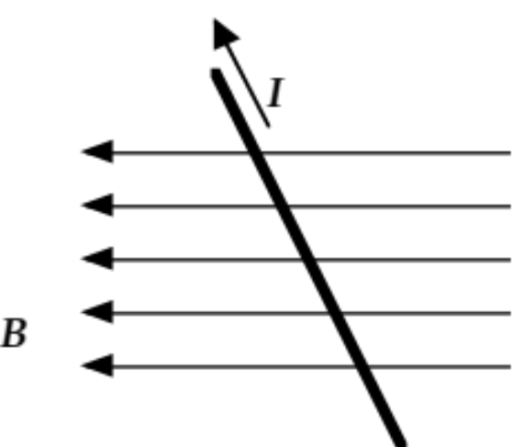

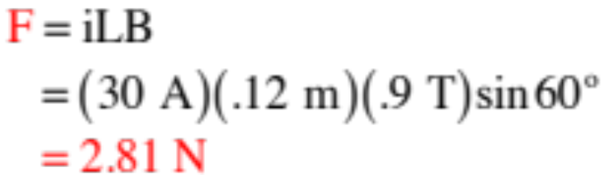
Example 6: (courtesy of Mr. White): A 12 cm length of wire carrying a 30-Amp current is placed in a magnet field at an angle of 60° relative to the field’s direction (as shown). If the field is 0.90 T, what force does the wire feel, and in which direction?
a.) On the sketch, show the direction of the force on the wire.
According to the r.h.r., it’s out of the page.
b.) Determine the magnitude of the force.
26.)

Slide 27
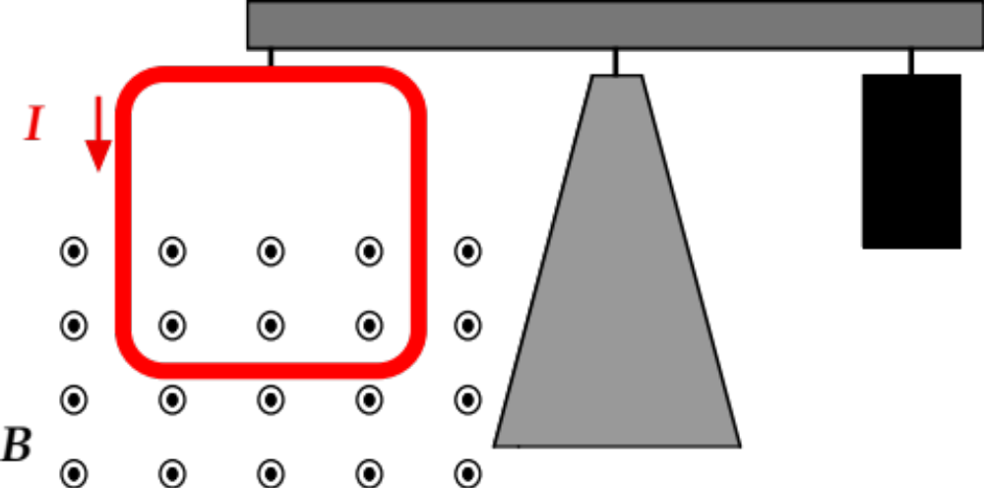

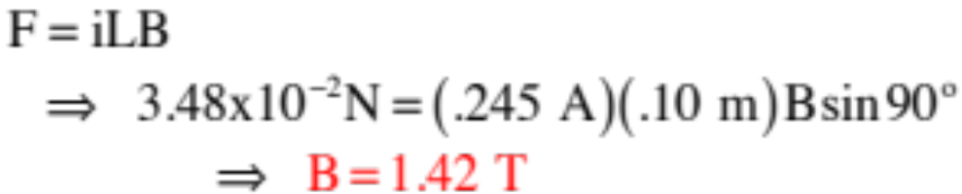
Example 7: (courtesy of Mr. White): A 10 cm 10 cm square loop of wire hangs vertically, as shown here. When the current in the wire is 0.245 A counterclockwise, a scale supporting the wire measures a downward force of . Find the magnitude of the magnetic field.
According to the r-h-r, the force will be downward. Its magnitude will be:
Note: This could easily have been turned into a torque problem . . . just sayin . . .
27.)

Slide 28








Example 8: Two metal ramps (in red) at an angle are d units apart and are bathed in a downward B-fld. A battery wire is connected to each ramp making a circuit. A metal rod would slide frictionless down the ramp if it were not for the magnetic force provided by the B-fld. In fact, in this case the rod is motionless. Assuming the net resistance of the system is R:
3-d view:
a.) What must the polarity of the battery be if the rod is to stay stationary on the ramp (again, assume the rod is frictionless).
side view:
For equilibrium, you can see from observation that you need a component of the magnetic force to the left to counter the component of gravity to the right. Reverse engineering
yields the need for a current into the page to generate a magnetic force in that direction . . . So the polarity of the battery must be high-side on left.
28.)

Slide 29



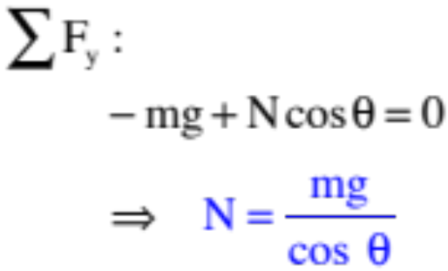

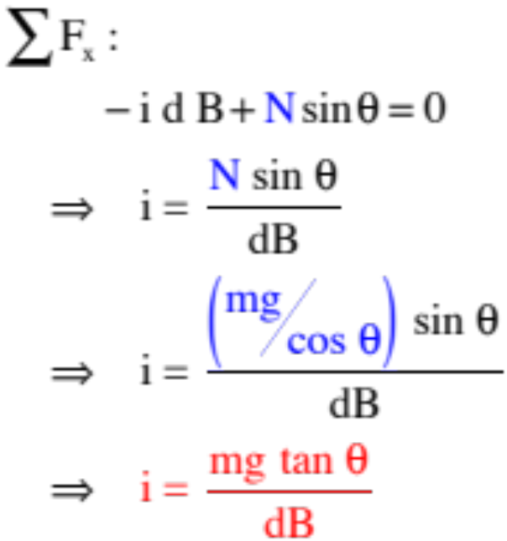
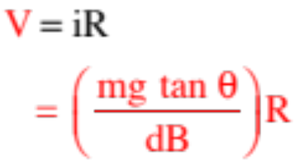
b.) How big must the battery voltage be to effect this situation?
Doing a f.d.b. and breaking the forces into components, we can determine i:
From Ohm’s Law:
29.)

Slide 30





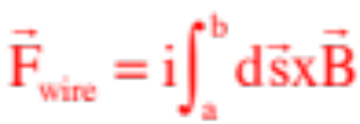
Another Point of Order
The relationship for the force on a wire in a B-fld looks like:
but this only works when L is a straight wire, B is constant and the angle between the two vectors remains the same throughout.
If any of those parameters vary, you need to use an integral. Specifically:
--define a differential displacement ds along the wire;
--cross ds into the magnetic field evaluated at ds;
--execute the integral:
30.)

Slide 31












Galvanometer and
Torque on a Current-Carrying Loop
Consider a current-carrying loop of width a and height c, pinned at the top and bottom, bathed in a magnetic field.
How will the current i respond to the B-fld?
Look down from the top and ignore the billowing of magnetic field generated by the bar magnets. In that view, the current moves across the upper section of wire as shown, moves down into the page in the section on
Look down
the right, and moves out of the page in the section on the lower left.
The r.h.r. suggests the direction of the magnetic forces on those sections are as shown.
31.)

Slide 32
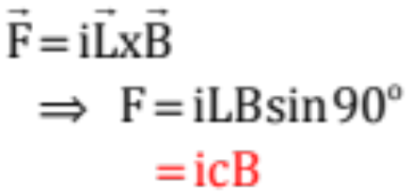


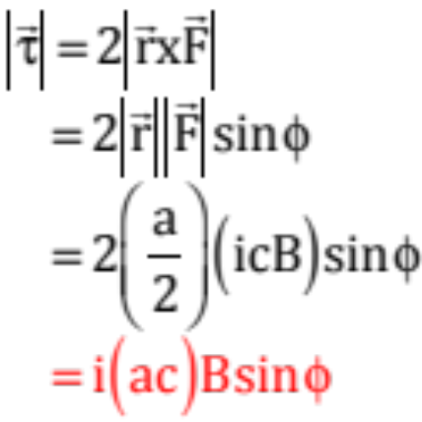




The magnitude of the
magnetic force will be:
The total torque due to the current in the wires into and out of the page is:
where is the angle between the line of the force and the line of the position vector .
32.)

Slide 33
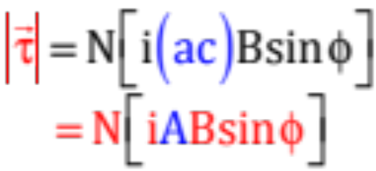







Two observations:
1.) There could be N loops in our coil, so the most general torque expression should be the torque expression we’ve already derived multiplied by N.
2.) Notice that ac is the area A of the loop.
With this, we can write the torque calculation as:
--Although this is not something I think the AP folks are likely to ever test on, consider:
Lay your right-hand on the loop in the direction of the current. The direction your outstretched thumb points will define a direction perpendicular to the face of the coil.
Define a vector, called the magnetic moment , whose direction is in that perpendicular direction and whose magnitude is equal to .
Crossing that magnetic moment vector into the B-fld yields a magnitude:
which is the torque on the coil . . .
33.)

Slide 34

Aside from giving physics teachers an excuse for having students do torque calculations in an E&M section, the real usefulness of all of this quite cool.
0
5
5
If you put a pinned coil in a magnetic field, attach a spring to it to provide a restoring torque, then attach a pointer hung over a scale, you have the makings of a meter.
N
i
S
And, in fact, that is exactly how a GALVANOMETER is made—it’s a coil suspended in a magnetic field with a spring attached to it to provide a restoring torque, so that when you put through it, the torque provided by the moving current in the B-fld coupled with the restoring torque sees the pointer swing “full deflection” over the scale . . . and that is very cool . . .
34.)

Slide 35

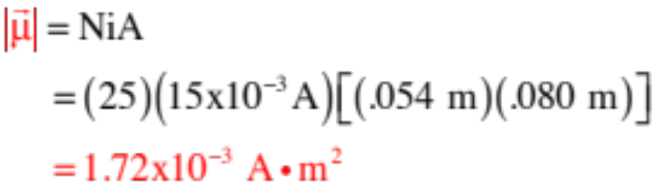
Example 8: (courtesy of Mr. White): A rectangular coil of dimensions 5.40 cm x 8.50 cm consists of 25 turns of wire and carries a current of 15.0 mA.
a.) Calculate the magnetic moment of the coil, putting the direction onto the sketch.
Circling the right hand in the direction of the current yields a thumb-point leftward (the direction should be perpendicular to the face of the coil)
35.)
Notes:
a. µ=IA = 6.885e-5 Am² x 25 = 1.72e-3 Am²
b. Torque = µxB = 6.02e-4 Nm (Notice that A•m²•T = (C/S)•m²•(N/C•m/s) = N•m)
c. AT 0° there is no Torque. At 60°, 5.21e-4 Nm

Slide 36
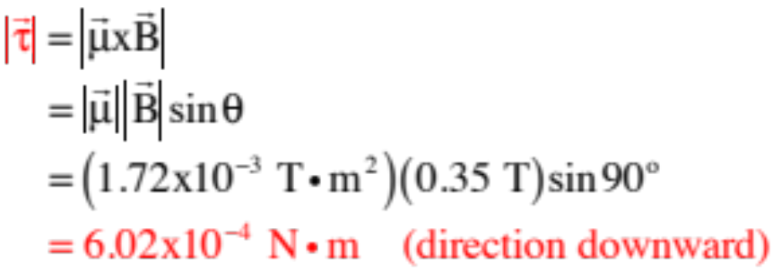


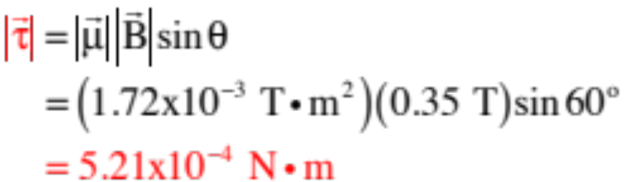
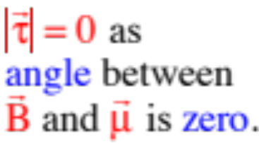
b.) If a magnetic field of 0.350 T is applied parallel to the plane of the loop, what is the magnitude of the torque acting on the loop?
c.) Calculate the magnitude of the torque on the coil when the 0.350 T B-fld makes an angle of with .
36.)
Notes:
a. µ=IA = 6.885e-5 Am² x 25 = 1.72e-3 Am²
b. Torque = µxB = 6.02e-4 Nm (Notice that A•m²•T = (C/S)•m²•(N/C•m/s) = N•m)
c. AT 0° there is no Torque. At 60°, 5.21e-4 Nm

Slide 37
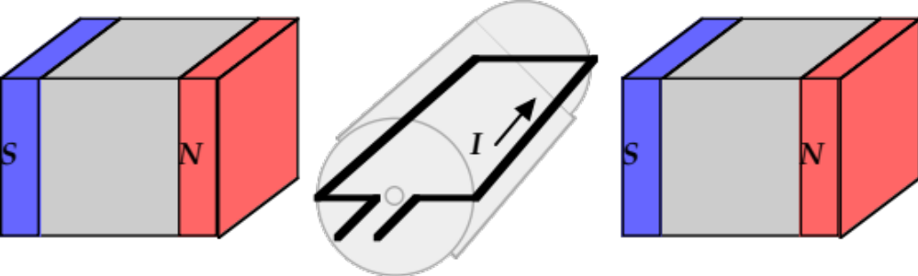
Electric Motors (courtesy of Mr. White)
Electric motors convert electrical energy to kinetic energy, and are created by placing a current-carrying loop in an external magnetic field. There are a number of different ways of doing this, but here is one common type:
Note from Fletch: So “current in” motivates rotation (hence a motor).
37.)

Slide 38
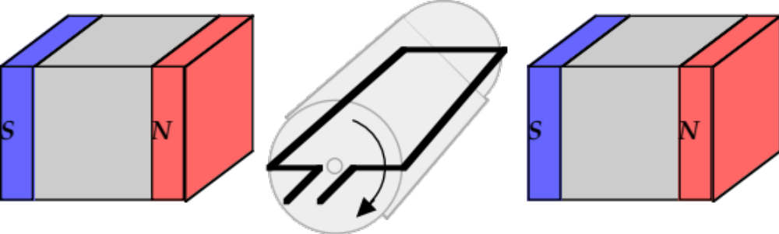
Electric Generators (courtesy of Mr. White)
Electric generators convert mechanical energy (work provided by an external source) to electrical energy. Motors and generators, in most cases, have the same physical structure. (Note from Fletch: In other words, as far as energy conversion goes, a motor is just a generator run “in reverse.”)
Note from Fletch: So rotation motivates a current (hence a generator).
38.)

Slide 39

Other Devices
A little more sophisticated version of a motor required one bit of information that would normally not be covered until next chapter.
It is charge in motion that generates magnetic fields. With current carrying coils, the generated magnetic fields are down the axis and through the face of the coil.
A handy trick to determine the direction of a current carrying wire’s B-fld is to lay your right hand on the coil with your fingers following the direction of current in the coil. The direction in which your extended right-thumb points identifies the direction of the coil’s B-fld.
direction of
B-fld
this end of
coil acts like
a north pole
Note that with the B-fld extending along the axis as it does, the coil’s ends look like north and south poles.
With that, consider the following:
39.)

Slide 40







Follow the current from the battery, through the brushes to the coil, then determine the B-fld due to the coil’s current (see below).
Fingers of right hand curl along line of current;
thumb identifies
direction of B-
field (with B-
field lines exiting this end, so it’s a North Pole)
40.)

Slide 41
Notice the attractions between the poles . . . these cause rotation . . .
41.)

Slide 42
More attractions, more rotation . . .
42.)

Slide 43
Brushes not in contact—current in coils about to change direction–momentum carries motion . . .
43.)

Slide 44
Notice the repulsion between the poles . . . still getting rotation . . .
44.)

Slide 45
Back to attraction . . .
This is a DC motor. . .
45.)

Slide 46



What is it?
What you are looking at here is the circuit for an old-fashioned door bell. See if you can follow through to see how the mechanism works (note the direction of the magnetic field in the pink horseshoe electromagnet, and the direction of the induced magnetic field in the yellow bar opposite the poles of the horseshoe magnetic, when the current flows).
46.)

Slide 47
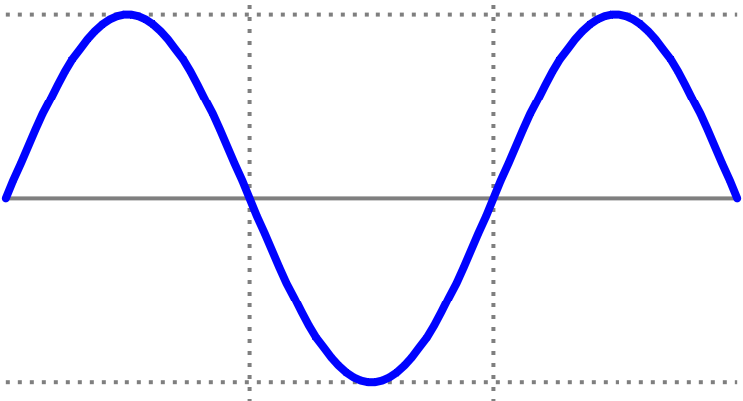
What is it?
This is the design for a loud speaker (actually, the coil and magnet are usually switched in real line). This is how it works:
a.) Let’s assume we want to project a 256 Hz (middle C) sound wave into the room. The signal would look like the sine wave shown below.
S
N
coil
cone (constrained
at the edges)
47.)

Slide 48

b.) During the first half of the cycle, let’s assume the direction of the time-varying current through the coil is directed as shown on the sketch. There are two things to note:
S
N
coil
i.) Being sinusoidal, the current will increase to a maximum, then will drop back down to zero whereupon the direction will change and the current will again increase to a maximum in the opposite direction, then proceed back to zero. This pattern will continue through time.
cone (constrained
at the edges)
48.)

Slide 49
ii.) With the current moving in the direction noted, the direction of the induced magnetic field in the coil (alternate right-hand rule) will leave the side of the coil closest to the permanent magnet a North Pole (see sketch).
c.) The north pole of the permanent magnet will interact with the induced north pole of the current carrying coil, and the net effect will be a repulsion experienced by both the coil AND the cone. As the cone is fixed at it’s outside edge, this will flex the cone outward with the amount of flex being dependent upon the size of the current at the given instant.
cone (flexes out)
S
N
N
coil
cone (constrained
at the edges)
d.) As the cone flexes outward, it will compress air into a high pressure region. That pressure ridge will travel away from the cone at approximately 330 m/s, or the speed of sound in air.
49.)

Slide 50
e.) As the current proceeds down toward zero, the cone will relax, pulling back.
f.) When the current direction changes, the direction of the induced magnetic field in the coil will change and the “pulling back” will proceed through equilibrium and into a flexing inward. The degree of flexing will, again, depend upon how much current to moving through the coil at a given instant.
cone (flexes in)
S
N
S
coil
g.) As the cone flexes inward, it will create a rarified region of air generating a low pressure region. That region will travel away from the cone at approximately 330 m/s, or the speed of sound in air.
cone (constrained
at the edges)
h.) This flexing outward, then inward, then outward will occur at the current frequency, or 256 Hz in our example, and the pressure variations will pass by your ear at a frequency of 256 Hz. That, in turn, will wiggle the little hairs in your ears creating electrical impulses that your brain will interpret as sound. Clever of nature, eh?
50.)

Slide 51


HALL EFFECT
An experiment to prove that negative charges moves through electrical circuits when current flows.
How normal current flows through the plate.
BROAD, THIN, METAL PLATE
51.)

Slide 52
HALL EFFECT
An experiment to prove that negative charges moves through electrical circuits when current flows.
How normal current flows through the plate.
BROAD, THIN, METAL PLATE
52.)

Slide 53

What happens when the plate is permeated by B-fld.
plate permeated by B-fld
53.)

Slide 54
. . . if POSITIVE charge is assumed to flow through circuit?
positive charge flow suggests upper side of plate will be high voltage side
positive charge flow
positive charge flow
54.)

Slide 55
. . . if NEGATIVE charge is assumed to flow through circuit?
negative charge flow suggests upper side of plate will be low voltage side
negative charge flow
negative charge flow
55.)

Slide 56

So back to the positive charge-flow assumption:
_
+
V
If there exists a predominance of positive charge on the upper side of the plate making that side of the plate higher voltage than the bottom side, then placing a voltmeter with its + and – terminals as positioned would produce a meter reading that was sensible (that is, the needle would swing in the appropriate direction).
B
R
V
In fact, if this experiment was done, the needle would swing in the wrong direction. In other words, the the meter is hooked up wrong. What are accumulating on the upper side of the plate are not positive charges, they are NEGATIVE charges.
In short, it is negative charge that flows through circuits.
56.)

Slide 57
3 Types of Magnetism
Ferromagnetism - material has a permanent “magnetic moment,” due to microscopic “domains” in which moments are aligned.
Paramagnetism - materials has a small magnetic susceptibility, that only becomes evident when placed in an external magnetic field.
Diamagnetism - material does not have permanent magnetic moments. In the presence of an external magnetic field, a weak magnetic moment is induced in a direction opposite to the external field.
57.)

