Slide 1
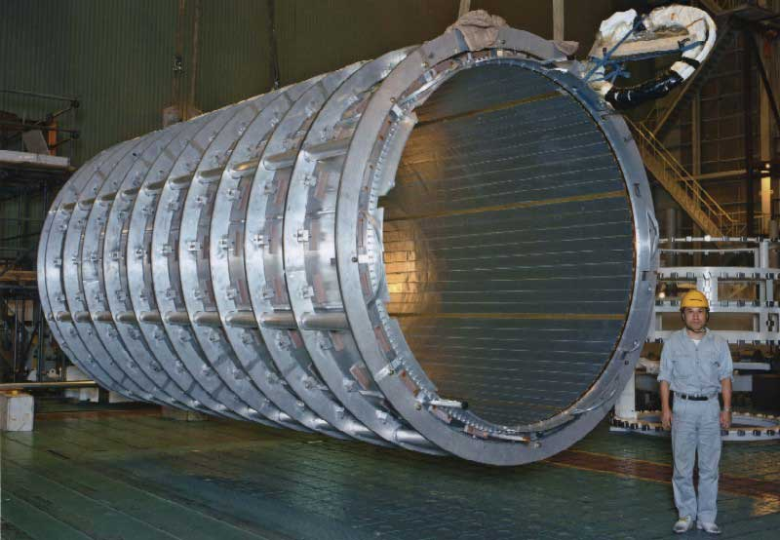
CHAPTER 30:
Sources of Magnetic Fields
Cern’s single-walled coil operates at 7600 amps and produces a 2.0 Tesla B-fld. http://atlas-magnet.web.cern.ch/atlas-magnet/info/project/ATLAS_Magnet_Leaflet-ds.pdf
Photo and info courtesy of Mr. White
1.)

Slide 2
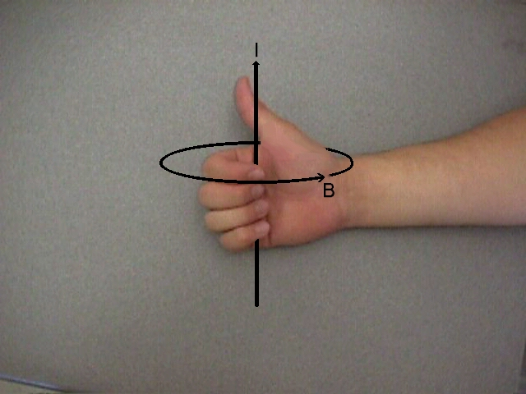


B-flds Produced by Charge in Motion
In 1820, Hans Christian Oersted, observed that a compass near a current-carrying wire will react. Conclusions: B-flds are produced by charge in motion, and B-flds circle around current carrying wires.
The sense of circulation can be deduced using what I call the right-thumb rule:
Grasp the wire with the right hand with the thumb in the direction of current. Your fingers will curl in the direction of the B-fld.
from side
B-fld into page
photo courtesy of Mr. White
from above
i
B-fld out of page
B-fld circles
current out
i
counterclockwise
of page
2.)

Slide 3
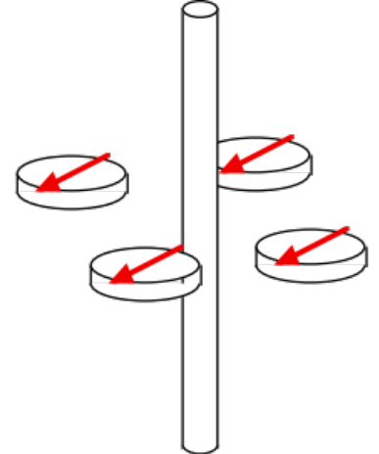
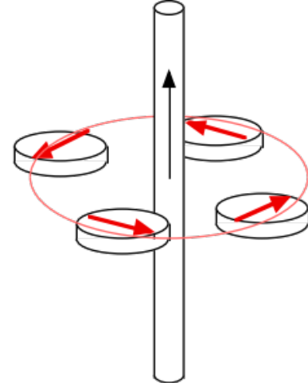
Oersted (1820) (courtesy of Mr. White)
define B-fld with compass
If the wire is grasped with the right hand, with the thumb in the direction of current flow, the fingers curl around the wire in the direction of the magnetic field.
The magnitude of B is the same everywhere on a circular path perpendicular to the wire and centered on it. Experiments reveal that B is proportional to I, and inversely proportional to the distance from the wire.
Obscure observation from Fletch: Notice that if the current-carrying wire is straight and you draw a vector from any point on the wire to a point of interest, the direction of the magnetic field at that point will be perpendicular to the plane defined by that vector and the direction of the current (treated like a vector).
B-fld
any vector from wire
vector defining current “i”
Plane of “any vector” and “i” is plane of page—B-fld is perpendicular to that
3.)

Slide 4
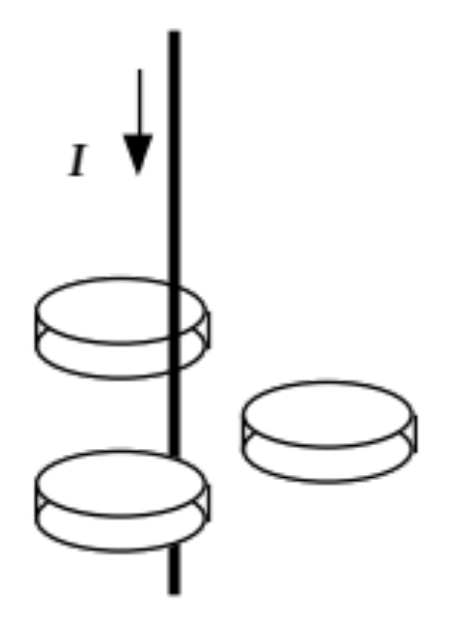
Example 1 (courtesy of Mr. White)
Predict the orientation of the compass needles.
4.)

Slide 5
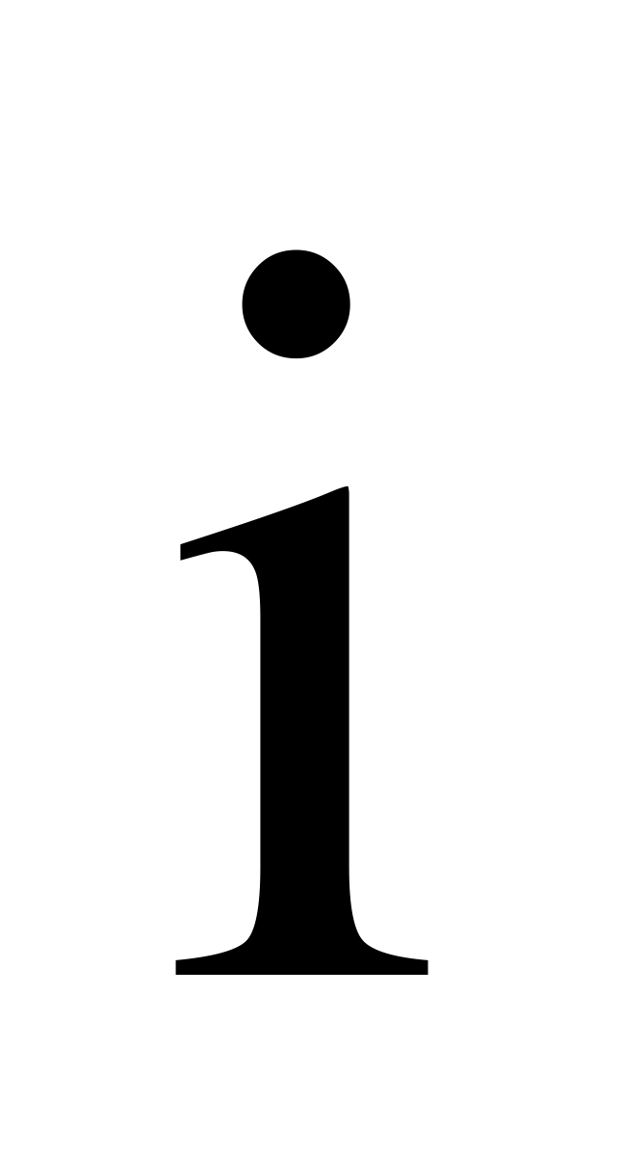
Example 1
Determine the direction and magnitude of the magnetic field at “x” if the wire carries current “i” and “x” is “r” units from the wire.
x
5.)

Slide 6
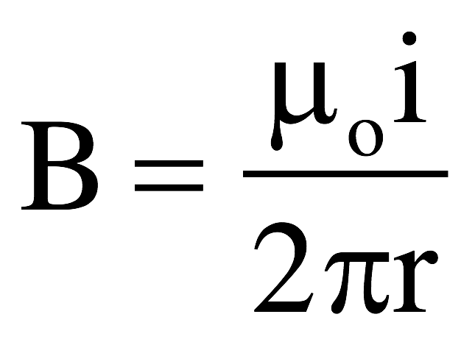
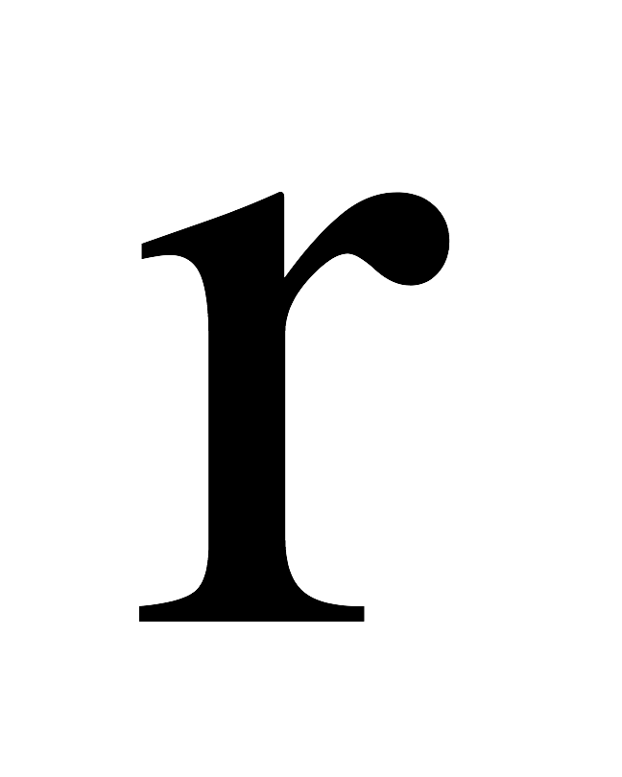
Solution
x
6.)

Slide 7

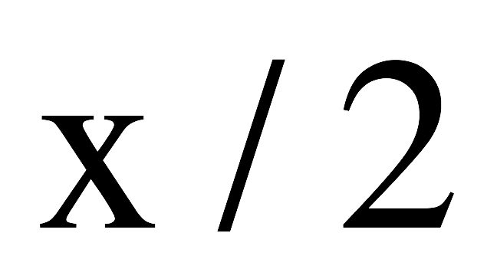
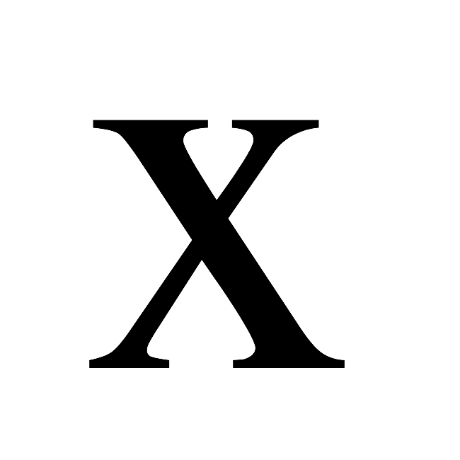
Example 2
Determine the direction and magnitude of the magnetic field at “p” if the left wire carries current “i,” the right wire carries current “2i” the wires are “x/2” units apart and “x” is “x” units from the 2i wire.
p
Where will the net magnetic field be zero?
7.)

Slide 8
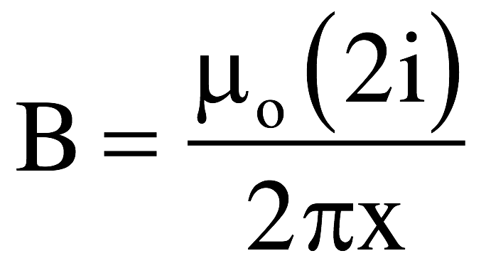
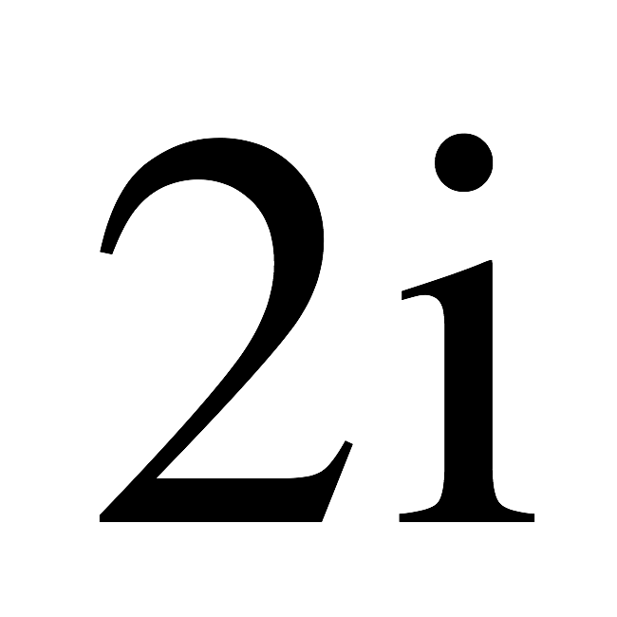
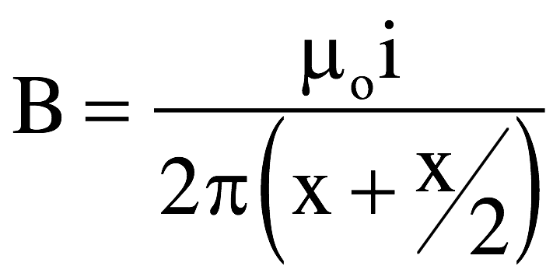
Determine the direction and magnitude of the magnetic field at “x” if the left wire carries current “i,” the right wire carries current “2i” the wires are “x/2” units apart and “x” is “x” units from the wire.
x
Where will the net magnetic field be zero?
To the left of the ”i” wire - the fields will be opposite in direction, and it’s farther from the 2i wire.
8.)

Slide 9
Determine the net magnetic field at the origin
9.)

Slide 10
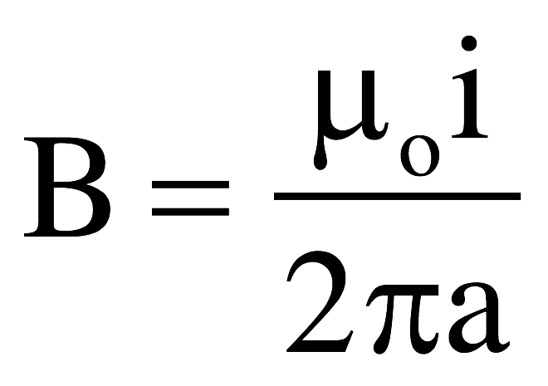

Determine the net magnetic field at the origin
19.48 on class Website is a good one to practice with!
10.)

Slide 11
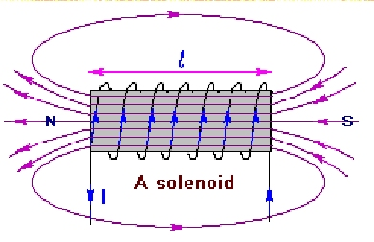
Solenoids
A long coil of wire with many loops (or turns) is called a solenoid.
The magnetic field inside the solenoid can be fairly large when current flows through the wire as each loop adds to the overall magnetic field strength.
The magnetic field within the solenoid is fairly uniform and runs in one direction, down the middle of the coils, resulting in the coil acting like a magnet with a north and south pole.
If a piece of iron is placed in the core of the loop, this becomes an electromagnet.
  Why iron? What happens?
11.)

Slide 12
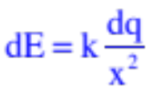




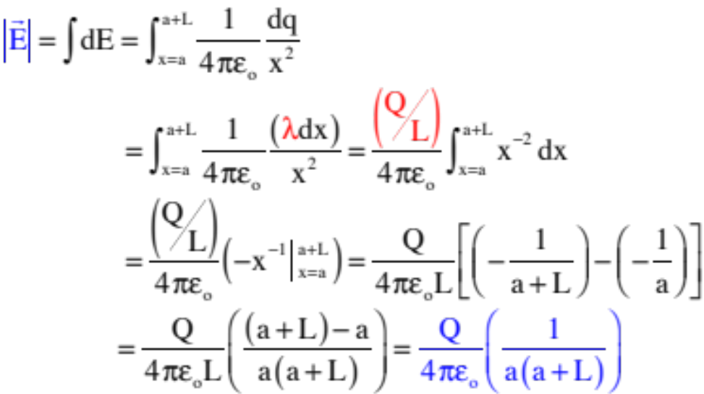
The Law of Biot-Savart
Coulomb’s Law observed that the electric field generated by a point charge was proportional to the magnitude of the field producing charge and inversely proportional to the square of the distance from the field producing charge and the point of interest.
Extending this, if you have an extended charge, the technique is to determine the magnitude of the E-fld for a differentially small piece of the charge dq, then integrate to get the net electric field.
12.)

Slide 13
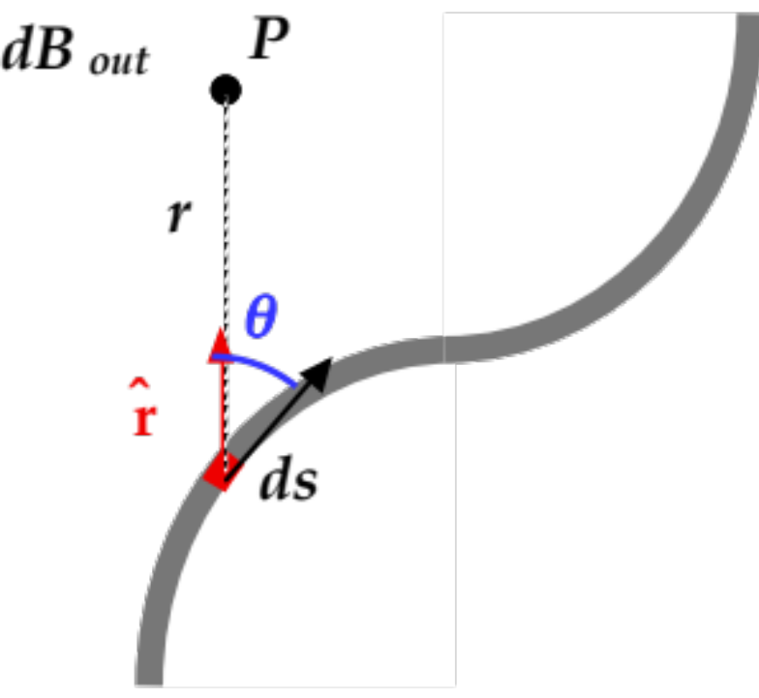
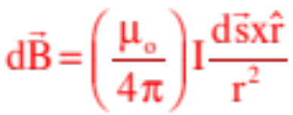

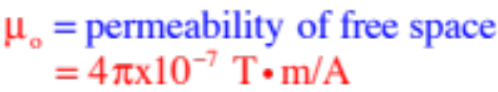


Biot-Savart does a similar thing for magnetic fields, with the exception that it incorporates the direction of the B-field into the calculation.
Specifically, it observes that the differential magnetic field dB at Point P due to the current in the differentially small section ds of wire is:
where:
graphic courtesy of Mr. White
Notice the cross product gives a direction that is perpendicular to the plane defined by and i at ds as advertised earlier.
13.)

Slide 14
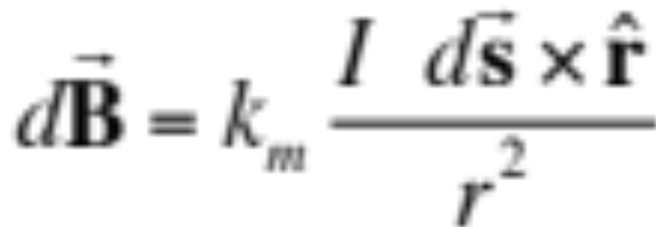
The Biot-Savart Law (courtesy of Mr. White)
determines direction of field
magnetic field at a point P perpendicular to segment of wire ds & perpendicular to unit vector r from ds to P.
element of wire
steady current in direction ds
k_{m}= 10⁻⁷ T•m/A
k_{m}= µ_{o} /4π , where
µ_{o} = permeability of free space
µ_{o} =4π x10⁻⁷
14)
Notes:
Review Coulomb’s Law leading to Electric Fields, and E=∫k•dq/r^2
Oersted figured out the orientation of the magnetic field due to a current-carrying wire, but what is it’s magnitude? What do we need to consider in calculating the magnetic field due to a current carrying wire?
Note that:
Point charge produces E field, current element produces B field.
E varies as inverse square of distance; B varies as inverse square of distance.
E field from point charge is radial;
B Field from current element is perpendicular to element and r

Slide 15




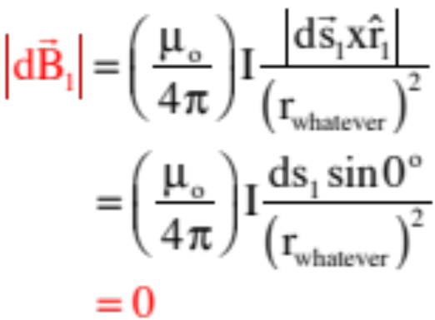
Example 2: (problem courtesy of Mr. White): Determine the magnitude and direction of the B-fld at the point O in the diagram. (Current I flows from top to bottom, radius of curvature = R.)
point O
To do this, you need to break the current paths into segments that either have the same r value or have a cross product that is zero.
Defining a differential length ds a the unit vector in one of the sections that moves directly toward or away from the point (see sketch),
the cross product that bit produces becomes:
15.)

Slide 16



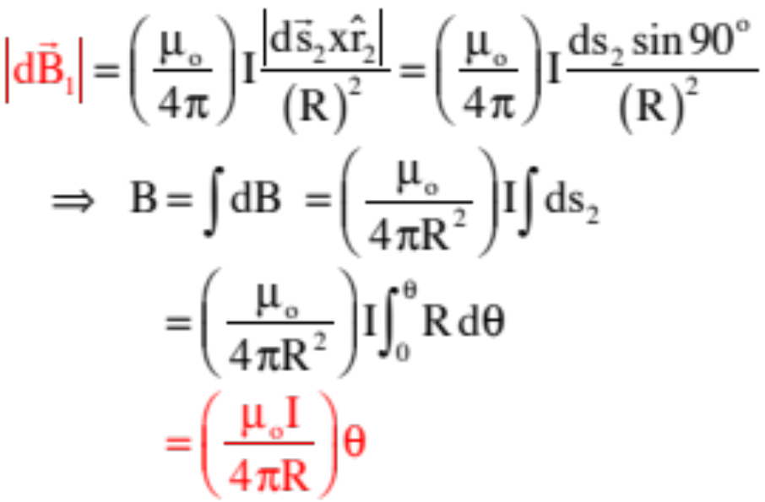


With no B-flds being generated at Point O due to the sections of wire that have current moving directly toward or away from the point, we turn to the only other section in the system:
Point O
Again, defining the differential length ds and the unit vector for the curved sections,
and noticing how ds is related to (see insert),
the cross product becomes:
How ds is related to R and .
point O
Also, crossing yields a direction INTO the page, which is exactly what the right-thumb rule would have given you!
16.)

Slide 17

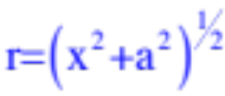

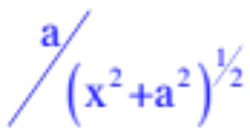
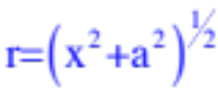


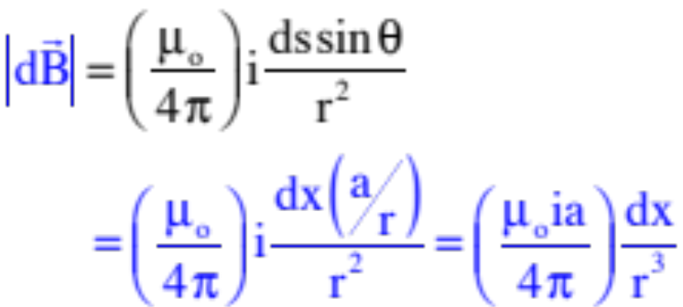



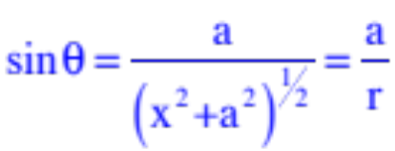
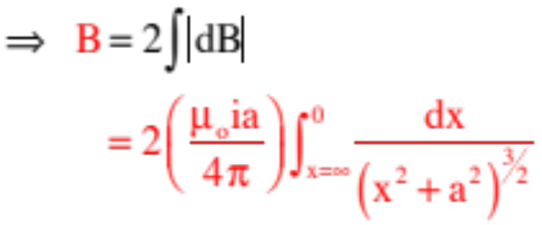
Example 3: Derive an expression for the B-fld generated by an infinitely long, current-carrying wire a distance a units from the wire.
Start by defining ds, and .
Define x.
point
Note that ds = dx and the general geometry. That is,
and
With that:
Double the sum of the differential B-flds from infinity to zero, we can write:
17.)

Slide 18
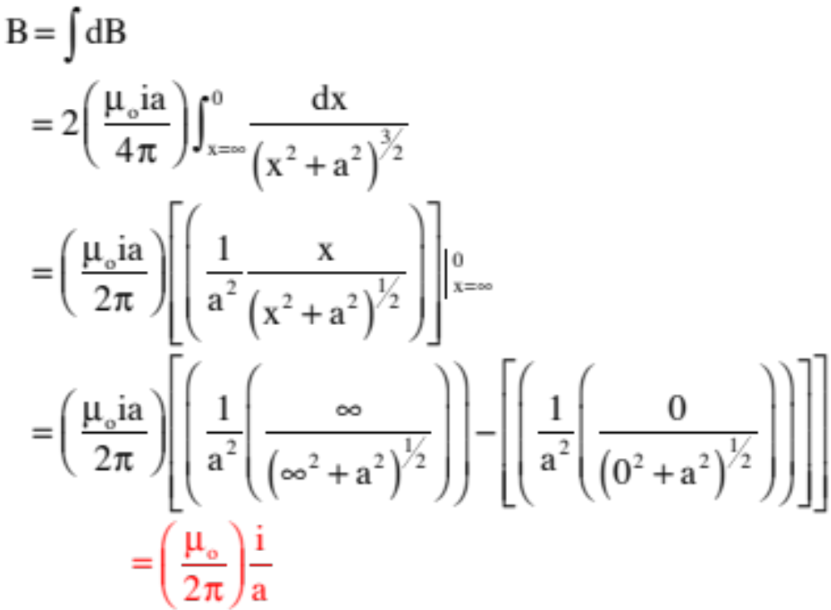



Solving:
And the cross product yields a B-fld direction OUT OF the page at the point.
18.)

Slide 19
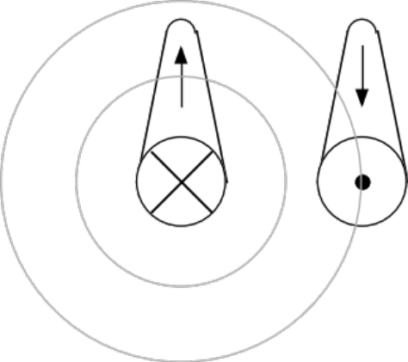




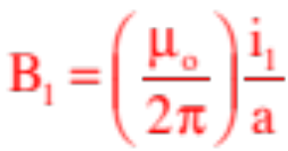
Magnetic Forces Between Wires
Example 4: Derive an expression for the magnitude and direction of force on a current-carrying wire bathed in the B-fld generated by a second current carrying wire a units away.
There is only one way to get the magnitude of the force, but there are TWO ways to get the direction. We’ll do it all.
graphic courtesy of Mr. White with slight modification
A more standard way to present a current coming into or out of the page;
For the magnitude: The direction of the magnetic field due to the left-side wire can be determined using the right-thumb rule and is as shown.
The magnitude of it’s B-fld is:
19.)

Slide 20
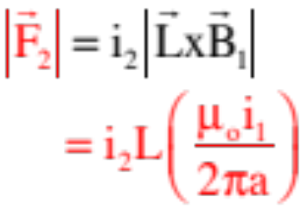





Because the force relationship between a current-carrying wire and the B-fld the wire is bathed in is known, we can write:
Now for the fun—finding the direction of the force on the right-hand wire: Start with the cross product.
is out of the page (in the direction of the right-hand wire’s current), and we’ve already determined the direction of the B-fld due to the left-hand wire in that region (it’s downward at the right-hand wire).
Executing yields a vector direction to the right, AWAY from the left wire.
20.)

Slide 21
But there’s a cooler way to do this which requires an interesting observation.
Consider two north poles juxtaposed against one another. You know from experience that these two magnets will repulse one another. Notice that the direction of the magnetic field
N
N
lines generated by the two in this case are parallelish.
If, on the other hand, the poles are opposites, their magnetic field lines will be anti-parallelish and the two magnetis will attract one another.
N
S
The rule: If the magnetic field lines between two field-producing objects are parallel to one another, the two objects will magnetically repulse one another. If they are anti-parallel, they will magnetically attract one another.
21.)

Slide 22

So going back to the direction of the force on the right-hand wire:
A quick determination (using the right-thumb rule) of the direction of the B-flds set up by the two wires in the region between the two wire
shows that their field lines are parallel between one another . . . which means the two wires will repulse one another. That means the force on the right-hand wire should be away from the left-hand wire, as determined using the mathy approach.
22.)

Slide 23


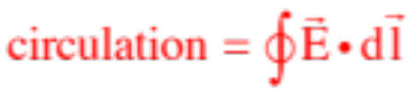




As a preamble: The circulation of a vector field around a closed path is defined as the summing of the dot products of that vector with all the differential lengths of the path around the circuit.
So if you had an electric field, for instance, and
and you did all the dot products around the path,
a closed path (defined in red),
the “circulation of E” would be:
So in this case, the dot product gives you the component of E along the line of dl, times dl, summed
over the entire closed path. And as some of these mini-dot products can be positive ( ) and some negative ( ), circulations can be zero or non-zero, depending upon the vector field involved.
23.)

Slide 24
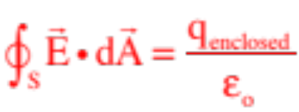



Ampere’s Law
(the magnetic counterpart to Gauss’s Law)
Think back to what Gauss’s Law did for you. Gauss observed that if you have a net charge in a closed surface, the straight-arrow electric field lines generated by the charge would either exit or enter the surface (depending upon whether the charge was positive or negative), creating an electric flux through the surface. That flux, he reasoned, was proportional to the charge enclosed. By the time the dust settled, he had posited Gauss’s Law, or:
imaginary Gaussian surface
Choose a reasonably symmetric surface, and voila, you have a useful mathematical tool for deriving electric field functions.
24.)

Slide 25

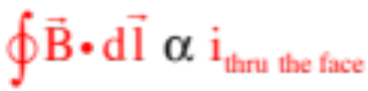

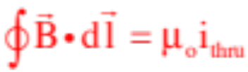

Magnetic fields set up by current-carrying wires are not “straight arrow vectors,” they are fields that circle around wires. So Ampere reasoned that if he defined a closed path around a wire and determine the circulation of the field around that path (this is a mathematical operation consisting of dotting the B-fld into a differential path length , then summing all those dot products around the closed path to get the “total circulation”), that sum would have to be proportional to the current passing through the face of the path. In other words,
The proportionality constant that makes this into an equality is the permeability of free space, or , making Ampere’s Law:
Note: The book uses as their differential path length, but they also use for their differential section of current in Biot-Savart. Using the same symbol for two different situations seems confusing, so I prefer when dealing with Amperian paths.
25.)

Slide 26






Example 5: Assume a current-carrying wire produces a B-fld, and the wire is far enough away so that the field lines generated by the wire look as shown to the right. If a small circular path is defined as shown, what is the circulation of the field around the path?
If we define a differentially small section along the path, we can execute the mathematical operation and end up with a positive dot product (the angle between the two vectors is less than ).
Define a second differentially small section along the path and we get a negative dot product (the angle between the two vectors is greater than ).
Bottom line: The net circulation will have positive parts and negative parts, and will ultimately sum to zero.
But we should have seen this coming. There is NO CURRENT PASSING THROUGH THE FACE OF THE PATH, so according to Ampere there should be NO NET CIRCULATION.
26.)

Slide 27




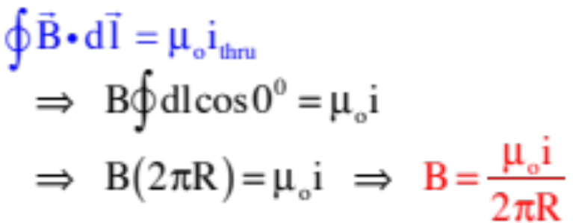


Example 6: A current carrying wire has current directed out of the page as shown. For the dotted path shown, is the net circulation equal to ?
YES, Ampere’s Law always works (just like Gauss’s Law always works, even when a geometry makes its integral impossible to solve).
The real question is whether using Ampere’s Law is a reasonable thing to try to do in this case . . . and the answer to that question is NO!
Why? Look at the symmetry.
The current through the face is easy—it’s just i, but the angle between and the B-fld evaluated at is different than the angle between and the B-fld evaluated at . That’s going to make the integral nasty.
Consider the problem exploiting symmetry:
is the same at every point on the path, so:
BAM! The B-fld for a current-carrying wire.
27.)

Slide 28
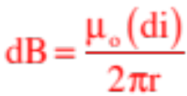








Example 7: Consider an infinite sheet of current with the current coming out of the page. Assume you know the current density j (the amount of current-per-unit-length) in the sheet. What is the net B-fld generated by the current R units away?
To get a feel for the power of Ampere’s Law, let’s assume we are looking at an infinite series of wires. How might we derive an expression for the magnetic field due to one current carrying wire, then extrapolate for the whole?
Consider the differential B-fld generated by our differential bit of current x units from the system’s origin.
28.)

Slide 29
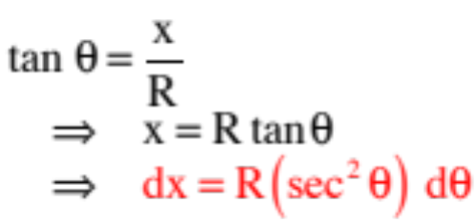
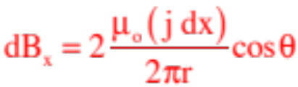


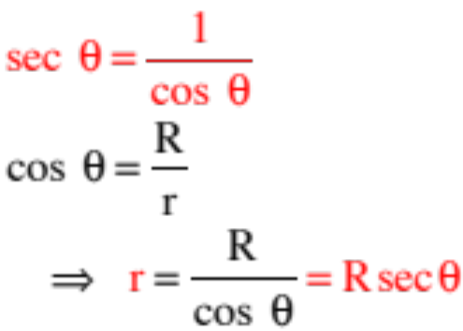

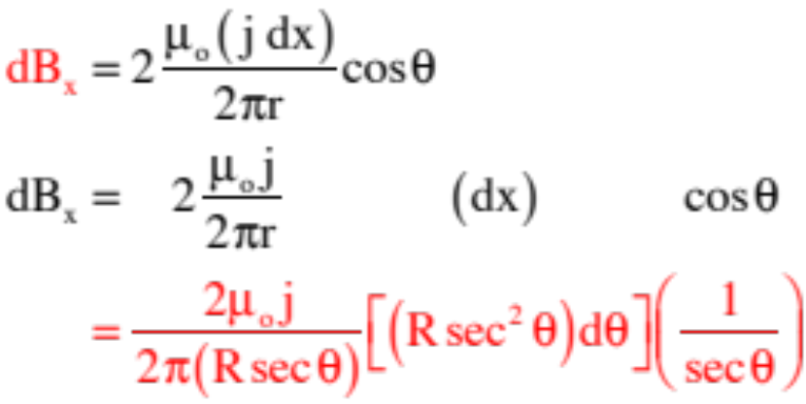
From symmetry, though, a second differential bit of current flow produces the additional field shown below, with the sum of the two fields producing a y-component that adds to zero.
Additional geometry yields:
So:
29.)

Slide 30
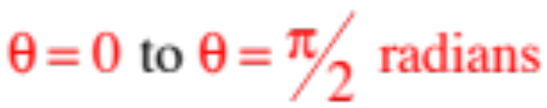
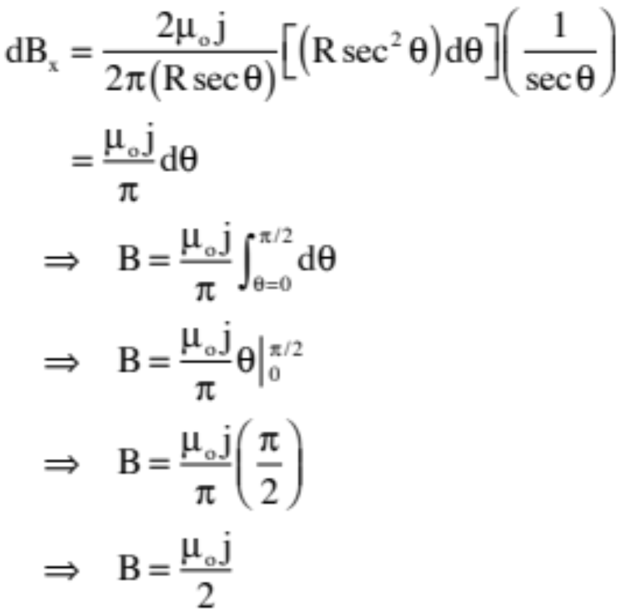


Simplifying, then summing (integrating) from , (we’ve already taken care of the other half in eliminating the y-component of the B-fld), we get:
30.)

Slide 31










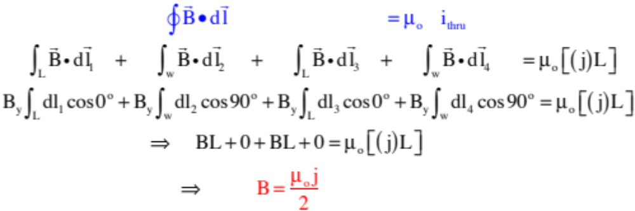

Constrast this with Ampere’s Law.
--Note that B is constant along the horizontal, in opposite directions on either side of the sheet.
Amperian path
--For Ampere’s Law, we need a path along which the magnitude of is either constant or such that the dot product of and is zero (a rectangle will do the job).
--The current thru the Amperian face is , where j is the number of wire per unit length, so:
. . . a lot easier!
31.)

Slide 32



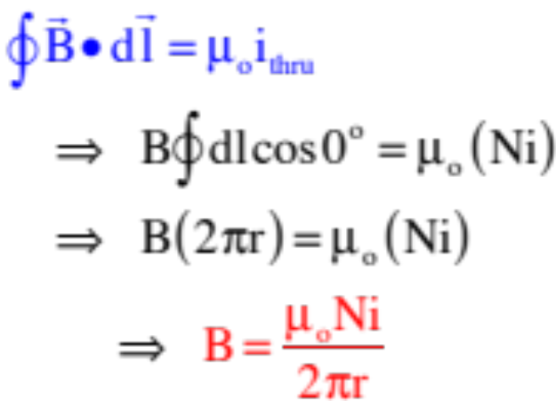
Example 8: Derive an expression for the B-fld inside an N-turn toroid (a coil with N winds that curves back on itself)
from above:
--Because the B-fld for a toroid circles along the toroid’s axis,
the Amperian path that is applicable here is a circle of radius r.
Amperian
path
--Noting that N wires pass through the Amperian path, the current through the face is Ni and we can write:
from the side:
--Notice that B varies with r.
232)

Slide 33
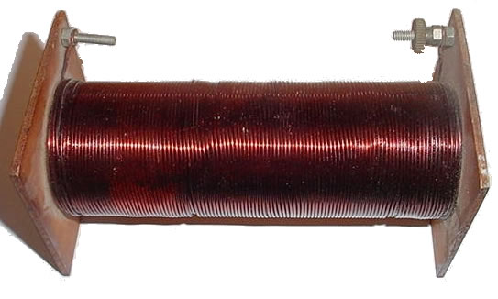
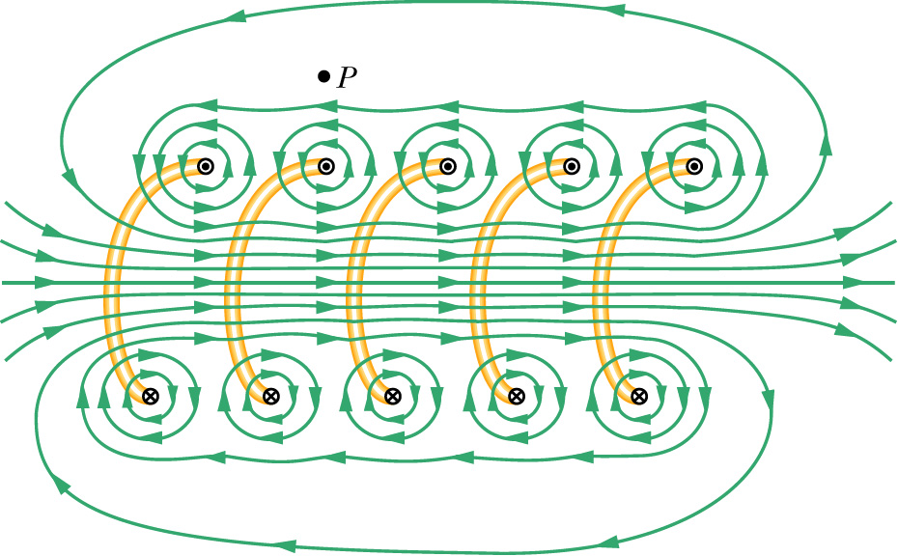
Solenoids
A solenoid, also referred to as a coil, is exactly that. A long wire tightly coiled helically. They are typically characterized by the number of winds per unit length n.
--Solenoids are typically tightly wound, but an spread out version (courtesy of Mr. White) allows us to see their microstructure.
--Between the winds the fields add to zero;
--Outside the winds the field is weak and drops to zero fairly quickly;
--Down the axis, the field is intense;
33.)

Slide 34

Trickery
There is still another right-hand rule that can be used to determine the direction of the magnetic field due to current through a coil. It’s easy (and fun!).
Lay your right-hand on the coil with your fingers pointing in the direction of the current.
The direction your thumb points is the direction of the B-fld down the axis of the coil.
34.)

Slide 35






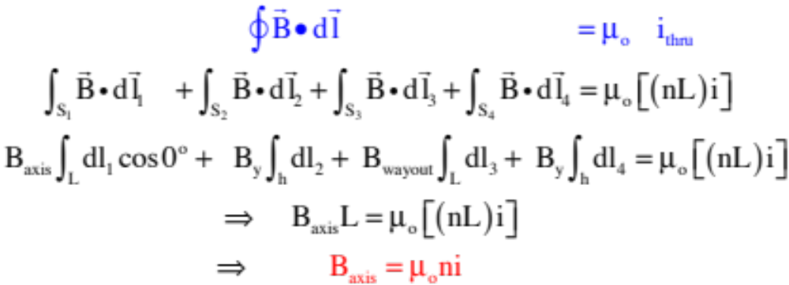

Example 9: Determine the B-fld down the axis of a current-carrying coil (a solenoid), where n is the number of turns per unit length in the coil (see cross-section).
We need a rectangular Amperian path. Why?
--The paths perpendicular to the coil will experience zero B-fld;
--The path outside the coil is far enough out so the B-fld is essentially zero;
(ignoring end effects)
--The path inside the coil experiences a non-zero B-fld.
The current through the face is:
where nL is the number of wires thru the face. So:
35.)

Slide 36

Deciding When to Use Ampere’s Law versus Biot Savart
Use Ampere’s Law when:
--You can define a path upon which the magnitude of B is constant over the entire path (this will normally be a circular path); or
--You can define a combination of paths some of which will have a magnitude of B that is constant over the section(s), some will have B equal to zero over the section(s) and/or some will have the evaluation of equal to zero over the section(s) . . . (these multiple paths are usually rectangular).
Use Biot Savart when:
--You can’t use Ampere’s Law. (In other words, Ampere’s Law should be your first choice.)
36.)

Slide 37


Electromagnetics
Because a coil sets up a magnetic field down its axis, as shown in the sketch, a tightly wound coil will act like a bar magnet in the sense that it will have one end that acts like a north pole and one end that acts like a south pole.
And because a ferromagnetic material (iron, steel, etc.) has within it magnetic domains that can align themselves to an external magnetic field, it is possible to make a very strong electromagnet by slipping a piece of iron (for instance) down the axis of a coil, then sending a current through the coil. That, in fact, is how electromagnets are made.
piece of iron
37.)

Slide 38



Subtleties—Magnetic Flux
In the section on Gauss’s Law, we started the discussion by defined electric flux in general through any simple surface as:
graphic courtesy of Mr. White
From this, Gauss extended the idea to how charge inside a closed surface was/is proportional to the electric flux through the surface, and Gauss’s Law was born as:
imaginary Gaussian sphere
38.)

Slide 39


At the time all of this was introduced, it was pointed out that the idea of flux can be applied to any vector field, which means we can define magnetic flux as:
B
Because magnetic field lines either circle current-carrying wires or are generated in pairs (a north and south pole together), the magnetic flux through a closed surface will always equal zero. In other words:
Although we will do a quick flux problem next, the full significance of magnetic flux won’t become evident until we get into induction and Faraday’s Law.
39.)

Slide 40












Example 10: Derive an expression for the magnetic flux through the face of the rectangular path shown due to the B-fld set up by the current-carrying wire (a very cool, classic problem).
The difficulty here is in the fact that the B-fld from the current carrying wire isn’t constant over the face of the area, as shows.
We have to determine the differential magnetic flux through a differentially small surface area where the B-fld
is evaluated constant, then sum all those over the entire face. Starting:
40.)

Slide 41



A Little Problem with Ampere’s Law
As stated, Ampere’s Law maintains that the circulation of B-fld around a closed path is proportional to the current that passes through the face of the path. Faraday noticed a bit of a twist to the situation that adds an unexpected wrinkle.
Consider the current carrying wire that leads to a capacitor as shown to the right. Notice also the path defined for use with Ampere’s Law.
capacitor
With the “face” of the path shown as green, the current through the “face” is the conventional current in the wire and we can write:
face
Amperian path
41.)

Slide 42
What Faraday noticed was that we don’t need to define the “face” of the path as previously shown but, rather, could identify it alternately as a billowing surface (the green) whose boundary is edged by the Amperian path.
capacitor
In that scenario, the path would still look like that shown in the sketch to the right.
The complication this generates is that we have an Amperian path—the same as before—and we have a surface we are associating with its “face,” but because the face passes between the plates of a capacitor, and because current does not
Amperian path
face
pass through a capacitor, there is no actual current through the face of our Amperian path. Yet common sense suggests that the magnetic field we determine using Ampere’s Law in the first setting shouldn’t disappear simply because we are using a different face, so how do we reconcile the problem?
42.)

Slide 43


Faraday’s solution was to claim that Ampere’s Law only works in the form you’ve seen if the electric field producing the current is constant. If the electric field is changing with time, an alternate version of Ampere’s Law must be used. That is where the displacement current comes in.
capacitor
The displacement current is defined as:
Amperian path
Does this make sense?
closed surface
To see we need to look at Gauss’s Law, and to do that we need to close the original circular face of the path to create a closed surface.
Having executed that operation, Gauss’s Law maintains that the net flux through that closed surface will be:
43.)

Slide 44




So . But in this case, is the charge on one plate of the capacitor. If we calculate the rate at which that charge is changing (the rate at which the capacitor is charging), we get the current in the circuit. In other words:
capacitor
Amperian path
Caps don’t have charge move through them, but the electrostatic repulsion between their plates creates the illusion that current is flowing through the cap. Faraday, apparently, deduced that that virtual current (my words, not his) was the displacement current needed for Ampere’s Law to work. In any case, the complete form of Ampere’s Law is:
where it’s YOUR CHOICE which term on the right you evaluate, depending upon the circumstances.
44.)

