Slide 1
The Island Series:
You have been kidnapped by a crazed physics nerd and left on an island with twenty-four hours to solve the following problem. Solve the problem and you get to leave. Don’t solve the problem and you don’t.
The problem: You have fifty-meters of wire, a powerful horseshoe magnet and a small light bulb (like the kind that goes into a flashlight). You are told there is a book on the island that will mysteriously open at exactly 11 PM, and will stay open for 5 seconds. In it are written 3-words. If you know what those words are when the helicopter arrives on the island the next day, you will be allowed to leave. There is no moon, so there will be no ambient light at 11 PM, and there are no vegetables or fruit on the island (you can’t make a battery, not that you could anyway—you’d need two different kinds of wire to make that work). How do you generate the light needed to read the book when it briefly opens at 11 PM?
1.)

Slide 2
Solution to Island Problem
Wind the wire into a coil, attach the coil to the light bulb, and repeatedly move the coil into and out-of the magnetic field as rapidly as you can.
The real question is, “Why does this work?”
2.)

Slide 3

CHAPTER 31-32:
Faraday’s Law and Inductance
photo courtesy of Mr. White
3.)

Slide 4
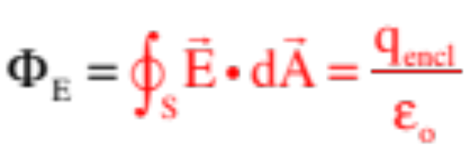
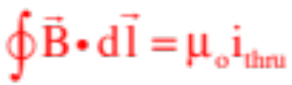
Electricity and Magnetism
At this point, we’ve come to find that the presence of charges generates an electric field and, according to Gauss, the relationship between those charges and that field is linked by what is called electric flux in the relationship:
We’ve also noted that magnetic fields are produced by charge in motion, and that current-carrying wires produce B-flds that circle the wire. With that, Ampere’s Law (ignoring that pesky displacement current term) relates the magnetic field produced by a current-carrying wire to the circulation of the wire’s B-fld by:
So the musical question is, if currents (and their associated electric fields) can produce B-flds, can B-flds produce currents?
4.)

Slide 5






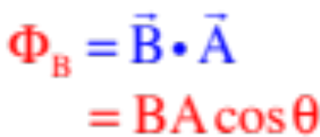

Magnetic Flux
If you’ll remember, when you have a surface in a vector field, a certain amount of the field will pass through the surface (we first talked about this with Gauss’s Law where we had electric field lines passing through a closed surface).
The idea of flux is a mathematical way to measure how much of the field passes through the surface.
Magnetic flux through a coil is shown to the right.
So let’s define an area vector whose magnitude is the area of the face of the coil and whose direction is perpendicularly out from the face.
Noting that the component of parallel to the face produces no flux and the component perpendicular to the face (along the line of ) does produce a flux we realize a dot product will do the desired math, so
with
and the units being , or Webers.
5.)

Slide 6






A Conventional Approach
Consider a loop moving through the magnetic field shown in the sketch.
--Initially, positive charge carriers, assumed mobile, will interact with the B-fld via and be forced upward toward the top of the loop. Having nowhere to go, they will accumulate leaving the bottom negative.
--The electric field they set up will produce a force that counteracts the magnetic force and the charges will come into equilibrium (i.e., ).
--At that point (and all of this will happen very quickly), we will have an
electric dipole with NO CONVENTIONAL CURRENT in the loop. This is the way the loop will stay as it moves through the B-fld.
6.)

Slide 7
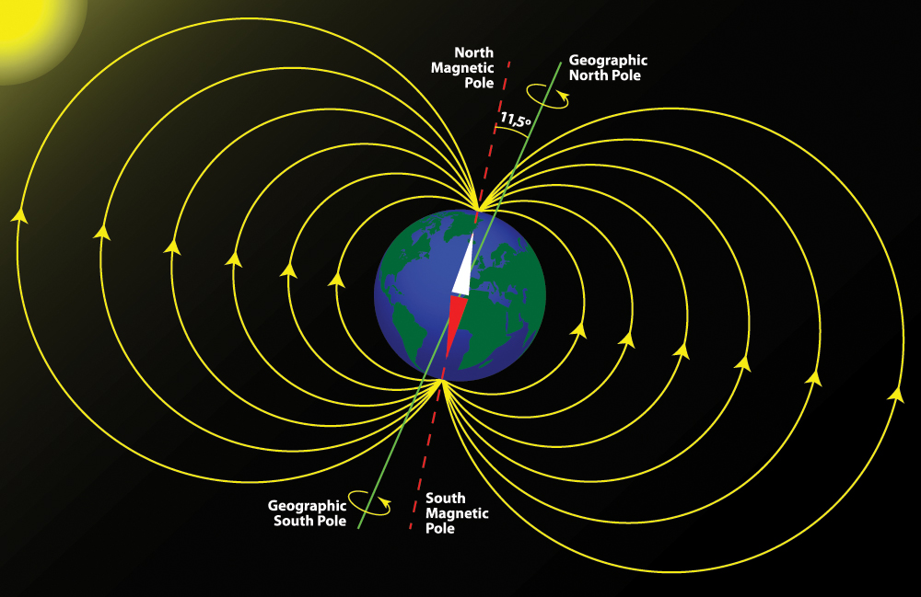
Exotic Aside—Example 1: An airplane flies from LA to Seattle and, due to its motion through the Earth’s magnetic field, undergoes a motional EMF. Noting that the earth’s B-fld points slightly downward as one flies north, which wingtip ends up positively charged, the left or the right? (courtesy of Mr. White)
Solution: The earth’s B-fld points slightly downward as one flies north. The cross product produces a leftward EMF, which means positive charge will move leftward.
7.)

Slide 8

Back at the ranch: Something interesting happen when part of the coil leaves the field.
--With the entire loop in the B-fld, all the positive charge carriers felt the same magnetic force upward. Consequence: charge accumulated at the top of the loop.
--But when the right side leaves the B-fld, there is no longer a magnetic force upward along the exiting path. That means the positive charges forced upward in the left section will
have some place to go—around the circuit and down the right side.
--In other words, what you end up with is a CONVENTIONAL CURRENT in the loop. This will persist as long as the loop is moving with part of itself in the B-fld while part is not.
8.)

Slide 9

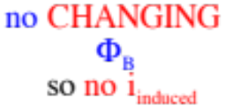

Faraday’s Law
The creation of a conventional current flow as the coil leaves the constant B-fld has been explained using what you already know from the Classical Theory of Magnetism. Faraday viewed it differently. His approach will allow us to analyze difficult situations that are not so easily untangled with the thinking we’ve just presented.
Faraday, who was not interested in the dipole, noticed that you only get an induced current when there is a
changing magnetic flux through the face of the coil. There could be a flux through the coil, but if it wasn’t/isn’t changing, no induced current.
9.)

Slide 10






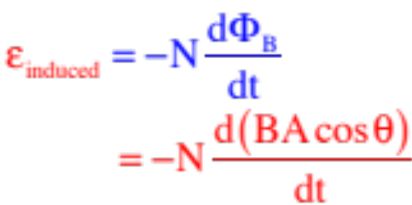
Remember back to our discussion of real-world power supplies. Internal to a power supply is a quality that generated an electric field and that, in turn, motivated charge to move. That motivating quality was quantified in what was called an electromotive force, or EMF (symbol ).
What Faraday deduced was that a changing magnetic flux through the face of a coil induces an
EMF that creates an E-fld that motivates charge to move in the form of an induced current. What’s more, how fast the EMF changes matters.
Mathematically, then, Faraday’s Law is:
Note: An EMF produced by motion in a B-fld is called a motional EMF.
10.)

Slide 11

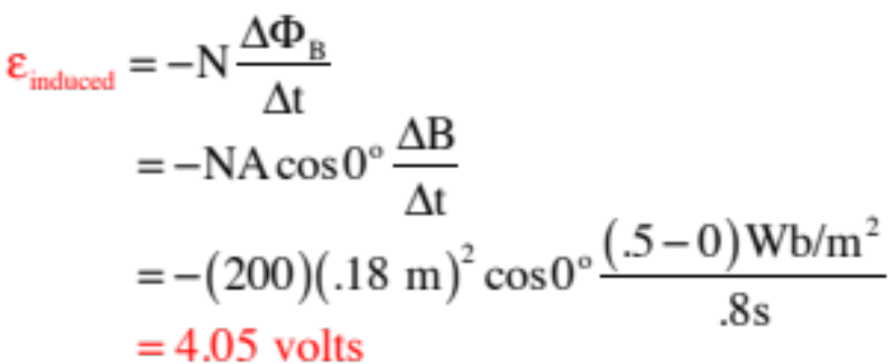

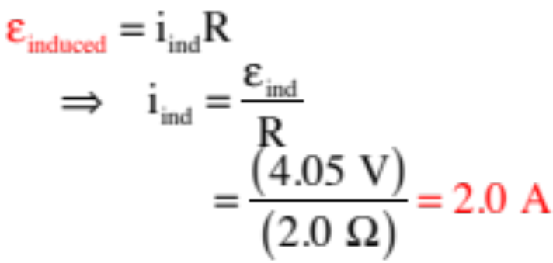
Example 2: A coil is wrapped with 200 turns of wire on the perimeter of a square frame of sides 18 cm. The total resistance of the coil is 2.0 ohms. A uniform B-fld is turned on perpendicular to the plane of the coil. (courtesy of Mr. White)
a.) If the field changes linearly from 0 to in a time of 0.80 sec, find the magnitude of the induced EMF in the coil while the field is changing.
With everything constant, we can use the version of Faraday and write:
b.) Find the magnitude of the current induced in the coil while the field is changing.
Ohm’s Law still work in these problems, so we can write:
11.)

Slide 12
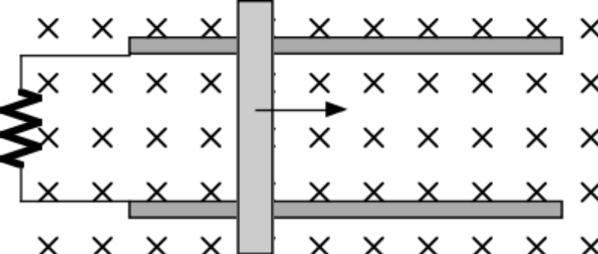

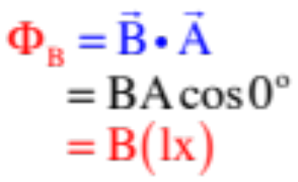
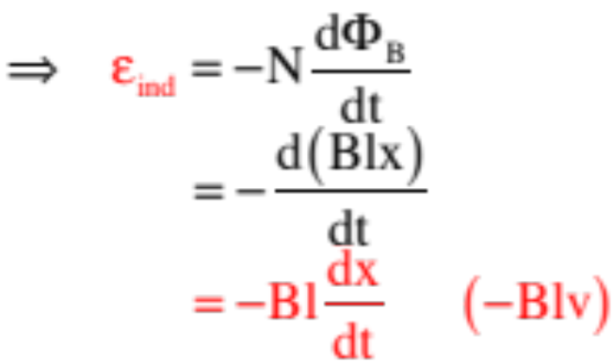
Example 3: A bar on frictionless rails is made to move with velocity v through a B-fld as shown in the sketch (you are looking down on the system).
R
B
a.) Derive an expression for the induced EMF in the “coil.”
x
graphic courtesy of Mr. White
The technique here is to write out a general expression for the magnetic flux, then take its derivative. Doing so yields:
12.)

Slide 13

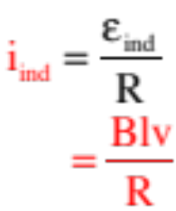
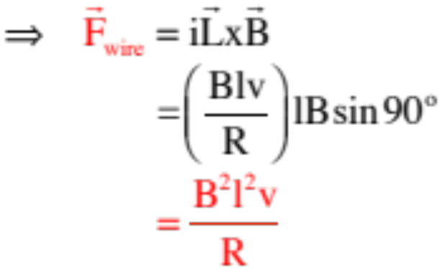

b.) In what direction is the induced current in the circuit?
R
B
There is a technique for determine the direction of an induced current in a coil due to a changing magnetic flux (it’s called Lenz’s Law), but we’ll talk about that later. For now, simply
x
graphic courtesy of Mr. White
using on the positive charges of the bar suggest the current is upward in the bar and counterclockwise in the circuit.
c.) Current in a B-fld will feel a force. If all of the resistance in the circuit is wrapped up in R, what will be the direction and magnitude of the force on the bar due to the current’s interaction with the B-fld?
Using , the force direction on the bar is to the left.
To evaluate , we need the current.
13.)

Slide 14
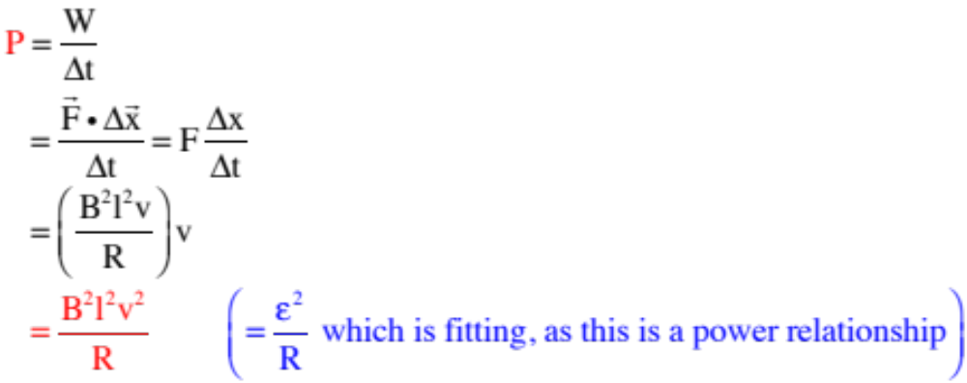
d.) A force must be provided to make the bar move with constant velocity v. How much power must that force provide to the system?
R
B
x
graphic courtesy of Mr. White
14.)

Slide 15

e.) The outside force motivating the bar to move with constant velocity is removed. If its velocity is just before the removal, what is the bar’s velocity as a function of time? Assume the rails are frictionless and the bar’s mass is m.
R
B
x
graphic courtesy of Mr. White
This is going to take some room, so its solution is shown on the next page.
15.)

Slide 16
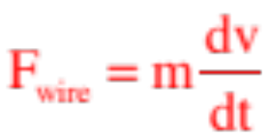
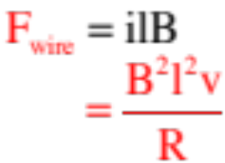
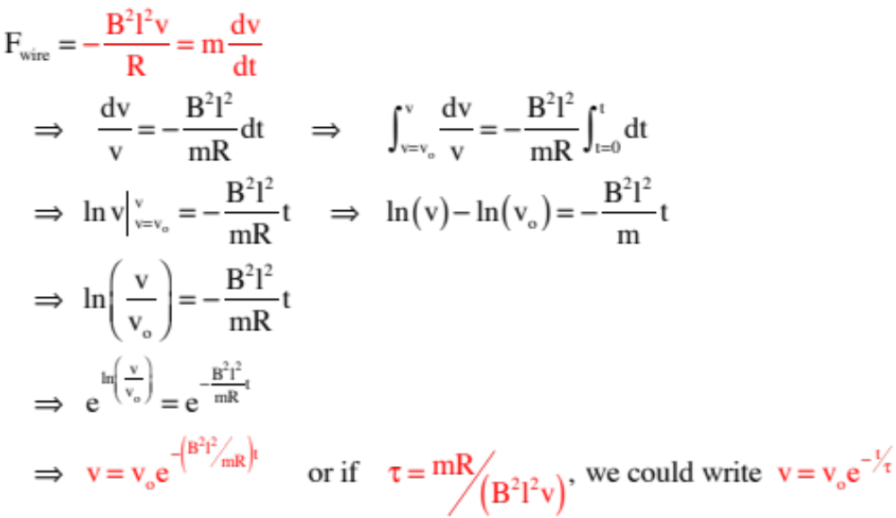
What do we know?
But we also know that:
That means we can write:
16.)

Slide 17
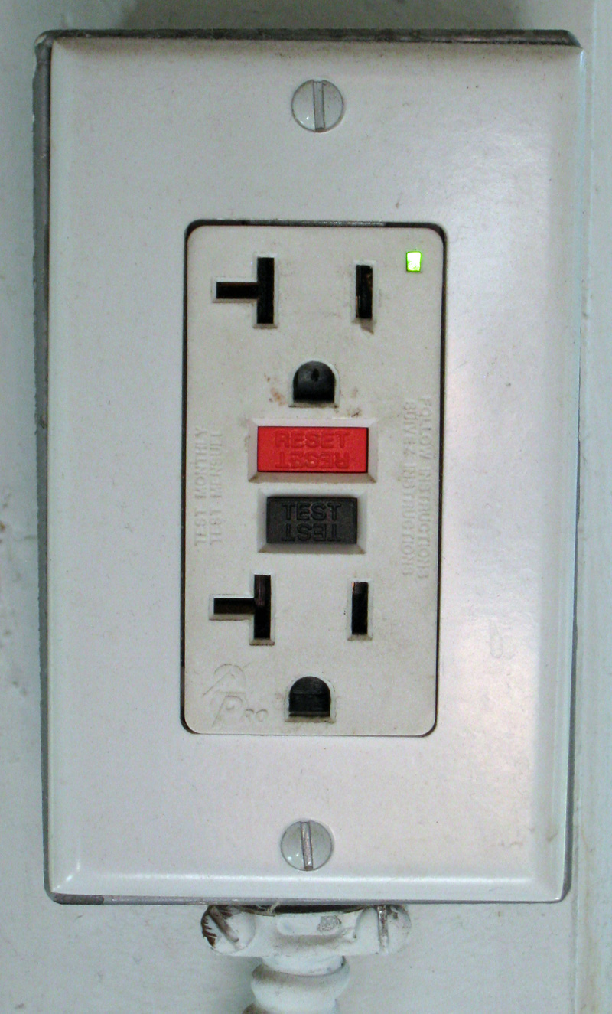
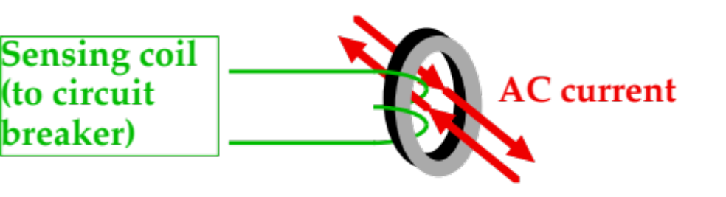
Real Life Application (courtesy of Mr. White)
Ground Fault Interrupter
No net current enclose by sending coil, so no magnetic field.
If there’s a ground fault (current going out but not back—this would be the case if you managed to electrocute yourself on the device by allowing current to flow to ground through you), a magnetic field is created, increasing flux, and inducing an emf that activates the circuit breaker.
17.)

Slide 18

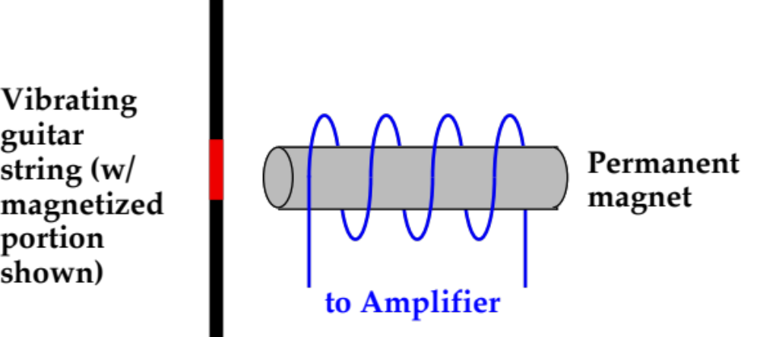
Real Life Application (courtesy of Mr. White)
Electric Guitar Pickup
Vibrating string produces a change in magnetic flux in the coil, which is transmitted as an emf to the amplifier.
18.)

Slide 19

Lenz’s Law
Although Faraday’s Law allows us to determine the magnitude of the induced EMF set up by a changing magnetic flux through the face of a coil and, by extension, the magnitude of the induced current through the coil, it says nothing about the direction of the induced current set up by the EMF. Lenz’s Law is designed to fill in that gap.
B
Lenz’s Law maintains that an induced EMF through a coil (or loop) will produce an induced current that will create its own induced magnetic flux, and that that induced magnetic flux will oppose the change of magnetic flux through the loop that started the process off in the first place.
A
graphic courtesy of Mr. White
Confused? That’s the statement of Lenz’s Law in the raw. Its message can be more economically unpacked with three easy steps.
19.)

Slide 20
The easy way:
1.) Identify the direction of the external B-fld.
B
2.) Identify whether the external magnetic flux is increasing or decreasing.
3a.) If the flux is INCREASING, the coil’s induced current will set up an induced magnetic field through the coil’s face that is OPPOSITE the direction of the external B-fld. Use the right-hand rule to determine the current direction that does this. (See note below.)
A
graphic courtesy of Mr. White
3b.) If the flux is DECREASING, the coil’s induced current will set up an induced magnetic field through
the coil’s face that is IN THE SAME DIRECTION AS the direction of the external B-fld. Use the right-hand rule to determine the current’s direction.
Note: Remember, the way you relate the direction of the magnetic field set up in a coil by a current through the coil is by laying your right hand on the coil with your fingers in the direction of the current. Your thumb will point in the direction of the B-fld down the axis. You will simply be using this technique backwards here (starting with the B-fld and figuring the current that produced it).
20.)

Slide 21


Try it on the figure to the right. Assume the field is diminishing.
1.) Identify the direction of the external B-fld.
B
to the right
2.) Identify whether the external magnetic flux is increasing or decreasing.
A
it’s decreasing
3.) As the flux is DECREASING, the coil’s induced current will set up an induced magnetic field through the coil’s face that is IN THE SAME DIRECTION as the external B-fld (as determined in #1).
graphic, heavily modified, courtesy of Mr. White
so the induced B-fld is to the right
How do you have to wrap my fingers (right hand) on the coil to get an induced B-fld to the right?
Wrapped them counterclockwise, so that’s the direction of the current.
21.)

Slide 22



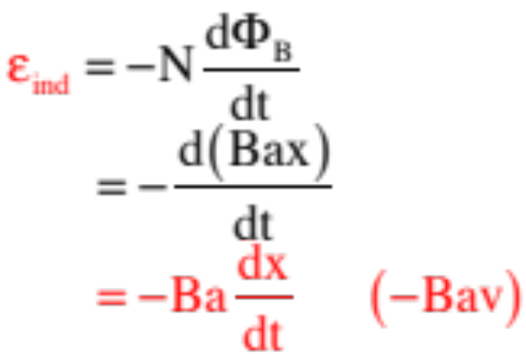
So Back to Motional EMFs
Example 4: A square coil of resistance R and sides of length a enters a region in which there is a constant B-fld. It is moving with constant velocity v as shown in the sketch:
a.) Is there a magnetic flux through the coil?
yes, magnetic field lines are piercing the face of the coil
b.) Is there an induced EMF set up in the coil (justify)? If so, what is its magnitude?
yes, the magnetic flux is CHANGING through the face of the coil
What was the technique to determine the EMF? Define the magnetic flux, then take it’s derivative! With N = 1:
22.)

Slide 23
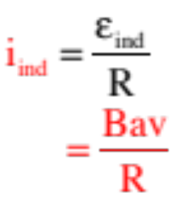


c.) What is the induced current in the coil?
d.) What is the direction of the current?
Lenz’s Law:
--external B-fld into the page;
--magnetic flux increasing,
--so induced B-fld OUT OF PAGE (opposite external field). Current has to
flow counterclockwise to achieve that.
i
e.) The induced current will interact with the external B-fld and feel a force. In what direction will be that net force?
The magnitude would be the magnitude of , which we could figure out, but all that was asked for was the direction, which is the direction of that cross product. The force on the two horizontal wires will cancel, but the force on the vertical wire in the B-fld will be to the left, as shown on the sketch.
23.)

Slide 24
The coil proceeds into the B-fld, fully immersing itself. At that point:
f.) Is there a magnetic flux through the coil?
yes, magnetic field lines are piercing the face of the coil
g.) Is there an induced EMF set up in the coil (justify)? If so, what is its magnitude?
Nope, the magnetic flux is NOT CHANGING through the face of the coil, so there is no induced EMF set up in the coil.
And that means there’s no induced current and no magnetic force acting to fight the motion of the coil as it moves through the field (there will be that dipole, but it won’t retard the motion).
24.)

Slide 25

The coil proceeds out of the B-fld, leaving it with time. At the point shown:
h.) Is there a magnetic flux through the coil?
yes, magnetic field lines are piercing the face of the coil
i.) Is there an induced EMF set up in the coil (justify)? If so, what is its magnitude?
yes, the magnetic flux is CHANGING through the face of the coil. We won’t do the calculation—it will be similar to what we did earlier—but we could.
j.) What is the direction of the induced current?
Lenz’s Law maintains clockwise (go through the steps for the practice).
e.) The direction of the induced force on the coil?
Says the vertical wire will feel a force to the left (again—do it!).
Huge observation: Induced currents will ALWAYS generate forces that fight what you are trying to do. Try to move the coil OUT OF THE FIELD—the induced force will fight you. Try to move the coil INTO THE FIELD—the induced force will fight you . . . they always fight the change.
25.)

Slide 26
Example 5: (courtesy of Mr. White) What direction is the current flow in this loop?
Procedure:
Determine direction of magnetic field
Determine whether flux in the area is increasing or decreasing in the direction of magnetic field
Use second RHR, with fingers pointing in opposite direction, to determine direction of current flow.
26.)

Slide 27
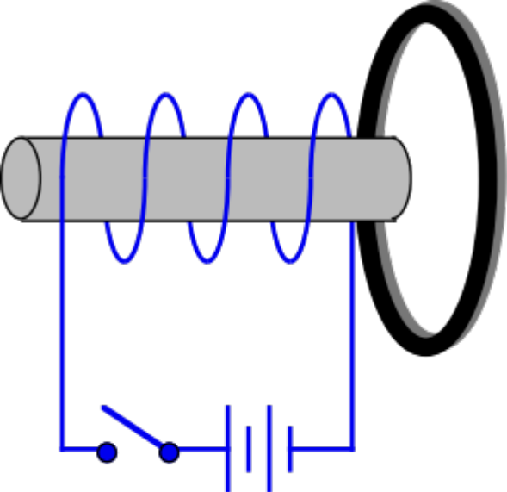

Example 6: (courtesy of Mr. White) For the circuit shown:
a.) Is there an induced current in the secondary coil when the switch is thrown? If so, in what direction will the current be?
Some very funky stuff happens in the primary coil when the switch is thrown, but what happens in the secondary is straightforward.
(graphic, modified, courtesy of Mr. White)
The battery-driven current in the primary coil generates a B-fld down the axis of the primary coil to the left.
As that B-fld is increasing, the induced B-fld due to induced current in the secondary coil will be OPPOSITE that direction, or to the right. The r.h.r. predicts an induced current in the secondary coil that is clockwise, as viewed from our perspective.
b.) Is there an induced current in the secondary coil after the switch has been closed for a long time? If so, in what direction will the current be?
Nope—once the battery-driven current in the primary coil gets to steady-state, the magnetic flux becomes constant and the induced EMF ceases.
27.)

Slide 28
c.) Is there an induced current in the secondary coil when the switch is opened after being closed for a long time? If so, in what direction will the current be?
The direction of the coil’s B-fld down the coil’s axis won’t changed, but now it will diminish to zero.
That means the induced EMF in the secondary coil will produce an induced B-fld that is in the SAME DIRECTION AS the
(graphic, modified, courtesy of Mr. White)
external field, or to the left. That will require a counterclockwise induced current.
28.)

Slide 29









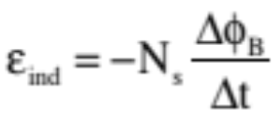
d.) What will the graph of the current in the second coil look like as a function of time?
29.)

Slide 30




Example 7: (modified from Mr. White)
a.) In what direction will the induced current flow in the loop of wire?
--The direction of the external B-fld is?
downward
--Is the flux increasing or decreasing?
it’s increasing
--So the induced B-fld is with or against the external field?
against
--Which means the induced current must be
using the modified right-hand trick to determine the direction of a current-carrying coil’s B-fld down its axis, you get into the page on the right . . .
30.)

Slide 31


b.) Will there be a force on the coil, and in what direction will it be if there is one? How about the magnet?
Yes, there will be. There are two ways to see the direction.
The hard way:
The magnet is producing an external B-fld. There is a current in the wire (it’s induced, but it’s nevertheless there). A current in a section of wire will feel a force equal to .
cross section of wire
Consider the section of wire at the far right side of the coil in the plane of the page (i.e., where the is. At that point, the “i” is into the page and B is as shown. The cross product yields a force as shown. A similar force is shown on the other side of the coil. Notice that the horizontal components will cancel leaving only downward vertical components. Translation: the coil will feel a force of repulsion that is DOWNWARD, while the magnet will feel an equal and opposite force UPWARD (Newton’s third law).
31.)

Slide 32


Easy way #1:
When the region between two B-fld producing structures has magnetic field lines that are parallel to one another (or parallelish),
the structures will be acting like like-poles and you will get repulsion. That’s the case in this situation, so the coil will be repulsed by the magnet and feel a force DOWNWARD.
Easy way #2:
IN ALL CASES, the induced magnetic field and current will set itself up in such a way as to OPPOSE WHATEVER CHANGE is occurring. In this case, you are trying to shove the magnet toward the coil (or the coil toward the magnet), so the induced force will fight you by generating a repulsive force between the entities . . . and the force on the coil will be DOWNWARD.
32.)

Slide 33
Example 8: (modified from Mr. White)
a.) In what direction will the induced current flow in the loop of wire?
b.) Will there be a force on the coil, and in what direction will it be if there is one? How about the magnet?
33.)

Slide 34
Example 9: (modified from Mr. White)
a.) In what direction will the induced current flow in the loop of wire?
b.) Will there be a force on the coil, and in what direction will it be if there is one? How about the magnet?
34.)

Slide 35
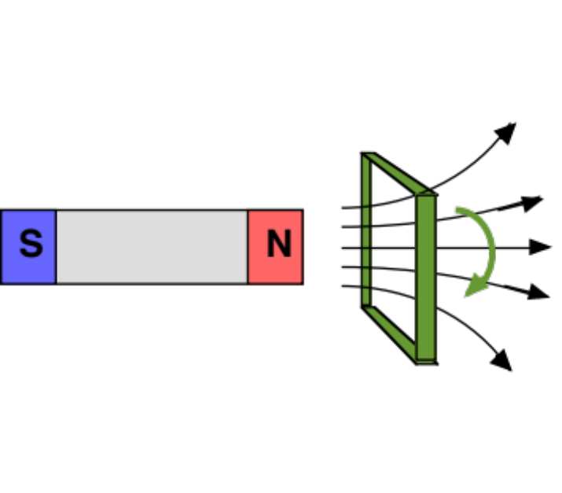
Example 10: (courtesy of Mr. White) In what direction will the induced current flow in a loop of wire shown?
35.)

Slide 36
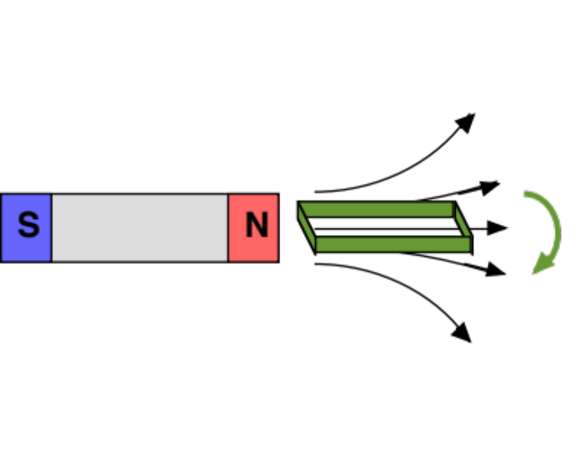
Example 11: (courtesy of Mr. White) In what direction will the induced current flow in a loop of wire shown?
36.)

Slide 37






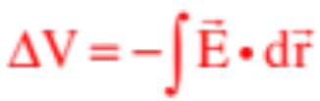
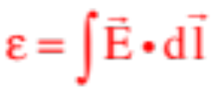
Electric Fields and Induced EMFs
Several chapters back, we deduced that static electric charge produces conservative force fields, and that the relationship between the electric potential difference between two points in the vicinity of such charge and the associated electric field set up by the charge (assuming everything is constant) is:
If the path of the E-fld varied, the relationship took the form:
New topic: We didn’t do this, but when we were discussing batteries a few chapters ago, we could have followed the following line of reason: The electric field set up in a circuit’s wires is generated by an EMF produced by a battery in the circuit. As is the case with all EMF’s, the relationship between the EMF and the electric field is . Because the battery’s EMF is produced by the separation of static charge between the battery’s terminals, the forces involved are conservative and potential energies (and electrical potentials) can be used to analyze the situation.
37.)

Slide 38
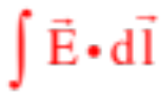



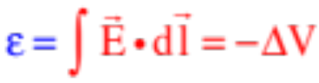
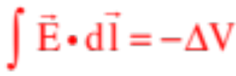
We would like to execute the integral around the circuit between the terminals. The problem is, if we traverse along the electric field, the voltage difference between the start and end points will be negative. That is:
The EMF is positive, so apparently,
which means:
or:
Which we expected in any case . . .
Again, we didn’t do any of this, but we could have.
38.)

Slide 39
Which brings us to our current situation. We are now talking about an EMF that generates an electric field that motivate charge to move due to a magnetic flux that is changing in time.
So what’s the problem? Consider a coil sitting in an increasing B-fld. Lenz’s Law says an induced current will be set up that fights the increase producing a current counterclockwise in our sketch.
i
We should be able to relate our induced EMF to the electric field that motivating the charge flow with the same relationship we used before, which is to say, with:
But where do we start, and where do we end? There are no terminals in this situation. The EMF just happens. It isn’t the consequence of static charge sitting, setting up an electric field as would be the case with the terminals of a battery. So what gives?
What gives is that EMF’s generated by changing B-flds do NOT generate conservative forces, so you cannot define a potential energy function for them!
39.)

Slide 40

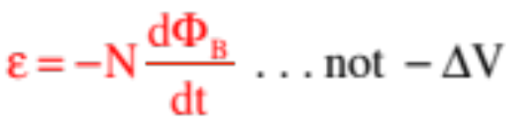
YIKES! So what do we do?
The problem is, we’ve kind of done things ass-backwards. We defined electrical potentials first, then we got around to realizing that the thing that really generates the electric fields that ultimately motivates charge to move is this mysterious quality called the electromotive force, or EMF, and that in batteries, effectively, the EMF is related to the voltage difference across the battery’s terminals.
i
If we had started by identifying the EMF, then noted that as a conservative forces, a battery’s terminals exhibited a voltage difference that is such that, when tracked in the direction of the E-fld motivating charge to move, is such that ,
then it would have been perfectly reasonable to say that when we have non-conser-vative forces, like what we are dealing with in Faraday situations, we should instead write:
40.)

Slide 41
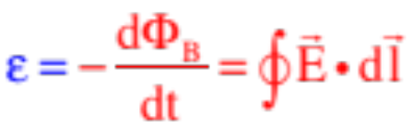


Bottom line: We can relate the electric field that motivates charge to move in a coil to the EMF produced by a changing magnetic flux that created it (i.e., the electric field) by the relationship:
Note 1: What the integral is doing is taking the circulation of the E-fld about the coil.
Note 2: There is a bit of a subtlety that is about to raise its ugly head that has to do with the direction of the area vector in a flux calculation. To whit:
It is your choice as to the area vector’s direction in a coil of wire (it is usually defined in the direction of the external B-fld), but once you’ve made that determination, the direction of the vector
used in
circulation calculations is formally defined as the direction the fingers of your right hand will curl when your thumb points in the direction of . For the example in the set-up shown above, that direction would be clockwise-ish.
41.)

Slide 42




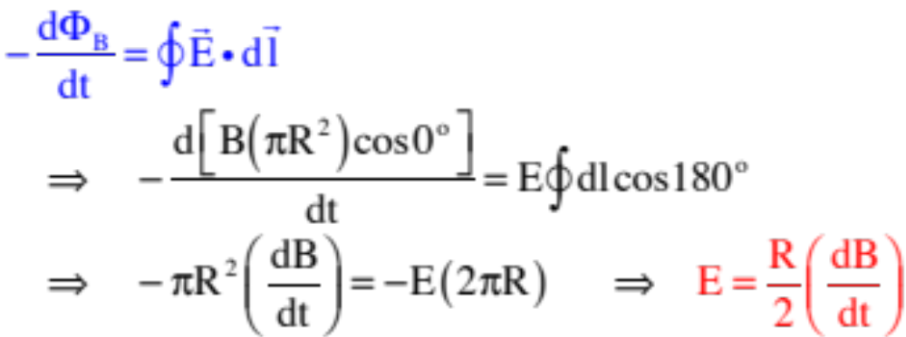
Example 12: For the situation shown
a.) Derive an expression for the magnitude of the E-fld should the B-fld increase.
Lenz’s Law maintains the induced B-fld be out of the page and the induced current, hence the induced E-fld, will be counterclockwise. With the area vector in the direction of the external magnetic field and appropriately defined (see previous slide for explanation, and see sketch for result), we can conclude:
The external B-fld is into the page, so the angle between that B-fld and the area vector will be ; the angle between and is , so we can write:
Notice: If the external B-fld was decreasing, dB/dt would be negative making E negative. That would tell us the E-fld was opposite originally assumed!
42.)

Slide 43
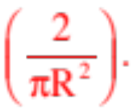
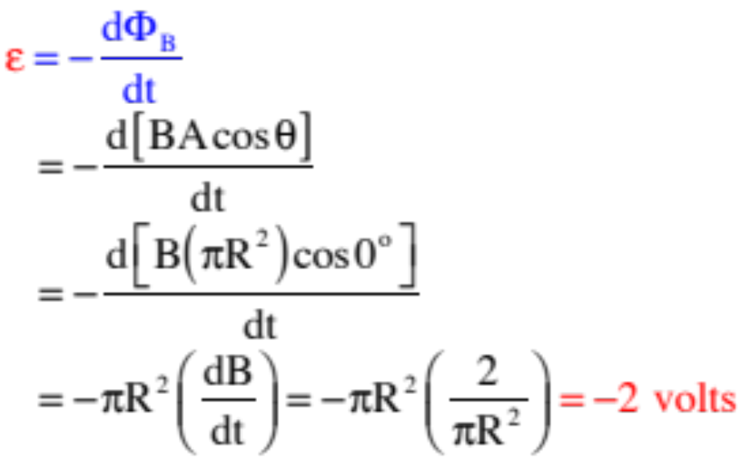
b.) Let’s assume that the magnetic field changes at a constant rate of
What is the induced EMF in this case?
If you are thinking, this should bring a serious question to mind! We will get to it shortly.
43.)

Slide 44


Subtleties About Faraday’s Law
1.) What would happen if the induced current and its associated induced B-fld and flux did NOT oppose the change of flux of the external field?
--Consider the following problem and see:
A coil is bathed in a magnetic field coming out of the page. Assume the B-fld is increasing.
Lenz’s Law maintains that the induced current is clockwise and the induced B-fld into the page. Let’s assume we think the opposite. What would this mean for our situation?
To begin with, the induced B-fld out of the page would add to the already increasing external B-fld producing an even larger, increasing magnetic flux. That would induce an even bigger EMF in the coil which would produce an even LARGER induced current which would produce a still LARGER induced B-fld to add to the external field . . . and the system would run away with itself. We would, in short, violate conservation of energy.
44.)

Slide 45


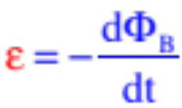
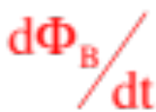
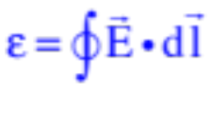
2.) We calculated an EMF value in Example 12b equal to -2 volts. What does that negative sign tell you . . . anything useful or interesting?
Having the units of of voltage (energy related), the negative sign has nothing to do with a vector direction. So what can we deduce from it?
--The external flux is positive as and are in the same direction. That means
will be negative only if is positive, which happens only if the flux is increasing.
Observation 1: A negative EMF means the external magnetic flux is INCREASING.
Observation 2: With the EMF negative, the circulation of the E-fld ( ) must be negative. With defined relative to , that means the direction of and must be opposite . This produces a current that produces a B-fld whose flux OPPOSES the change of external flux.
Bottom line: The negative sign ensures the math doesn’t predict a violation of the conservation of energy. Aside from that, it doesn’t tell you much that’s useful.
45.)

Slide 46

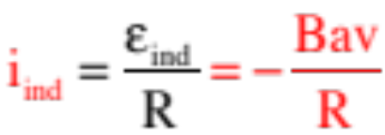
SO WHY have I taken six slides to delve into all of this?
You do a motional EMF problem and determine that the induced EMF in the coil being forced into the B-fld is:
You determine the induced current in the coil using Ohm’s Law and get:
If you are thoughtful, at this point, you think, “Until now, we’ve said that a negative sign in front of a current quantity means we’ve assumed the wrong direction of the current in the circuit. Is that what’s going on with this negative sign, and if so, does that mean we messed up with Lenz’s Law somehow?”
Not having a good answer, you calculate the force on the wire as it enters the field as:
The cross product yields a force away from the field, fighting the pulling of the coil into the B-fld (as expected), but when you put numbers in you get a magnitude that is negative (due to the negative current), so again, does that means we’ve determined a force direction that should have been opposite what was actually determined?
46.)

Slide 47

THIS IS THE PROBLEM people run into when trying to make sense out of the consequences of the negative sign in front of Faraday’s:
The following is the way out.
Faraday’s negative sign has one use and one use only. When incorporated into the math, with defined appropriately relative to (or ), it ensures that we predict an E-fld in the coil that produces a current that generates an induced B-fld whose flux does NOT violate conservation of energy. That is the ONLY reason the negative sign is there, and the only use it has.
Once you are passed the Faraday’s Law calculation and on to current calculations, the negative sign loses its meaning, which is to say, all you are interested in is how BIG (magnitude wise) the current is in the coil.
Put a little differently, if you are asked to do a Faraday’s Law calculation, you must include the negative sign. But once you go on to supplementary calculations, the negative sign can be ignored.
47.)

Slide 48
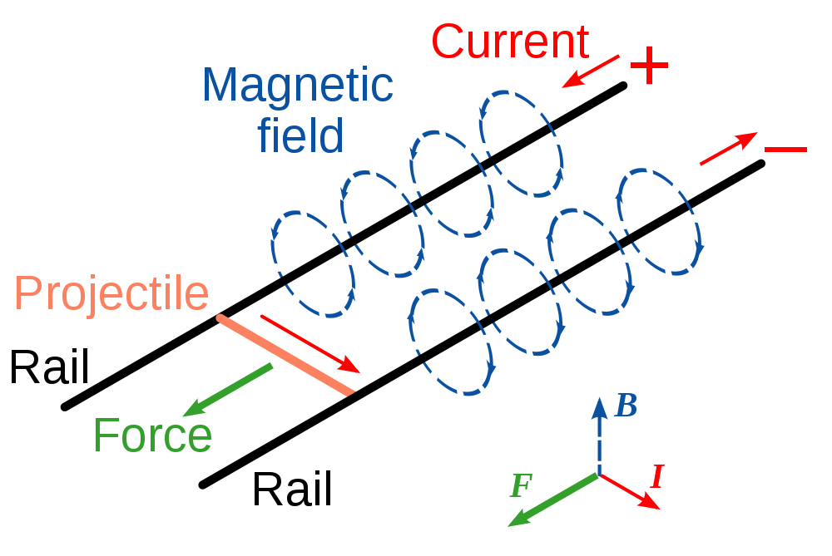
Example 13: (courtesy of Mr. White) Given the schematic diagram, explain how the “rail gun” works to accelerate a projectile. (Note that this is how they propel the Superman ride at Magic Mountain.)
Traced by User:Stannered from a PNG by en:User:DrBob, via Wikipedia
https://www.youtube.com/watch?v=eObepuHvYAw
48.)

Slide 49
Eddy Currents
Aluminum is NOTmagnetizable (it’s a metal, so you can get a current in it, but it doesn’t have magnetic domain like iron). So consider an aluminum disk rotating about its central axis that has a portion of its surface continuously passing through a B-fld directed into the page.
What is going to happen in this situation?
This is easiest to see by considering what will happen underneath a circle drawn on the disk if we think of the circle as being a coil of wire, and watch it over time.
--While away from the magnetic field, there will be no magnetic flux through the coil, so there will be no induced current in the coil.
--As it enters the magnetic field, there will be a change of magnetic flux and an induced current.
49.)

Slide 50

--The flux is increasing, so the induced current will be counterclockwise (producing an induced B-fld opposite the external field and out of the page).
--The induced current will interact with the external B-fld producing a force via that is upward, fighting the entrance of the “coil” into the external B-fld.
--Once completely into the B-fld, there will no longer be a changing magnetic flux, and the induced current and induced force will go away.
no current
--As it begins to exit the B-fld, there will again be a changing magnetic flux and the induced current and induced force, with this induced force again being directed upward (check it).
--And once out again and on its way, no changing flux and no force.
50.)

Slide 51
What’s really happening is not a single loop of wire moving into, then out of a B-fld but, rather, a continuous piece of metal moving through our B-fld.
The consequence is a permanent swirl of charge, called an eddy current, at the boundary of the B-fld.
These eddy currents constantly create a retarding force on the disk, hence the eddy current brake.
eddy currents
Large, heavy objects like trains use eddy current brakes for braking.
51.)

Slide 52


Example 14: What will happen when a magnet is dropped down an aluminum tube?
--Consider a loop below the position of the magnet at a given instant.
There is an increasing magnetic flux through it, so the induced current and its associated induced B-fld will set itself up how?
v
B
--Notice we find two north poles juxtaposed against one another due to the induced current. This will produce a magnetic force UPWARD on the magnet.
--Now consider a loop above the magnet at a given instant.
There is an decreasing magnetic flux through it, so the induced current and its associated induced B-fld will set itself up how?
(graphic, with considerable modification, courtesy of Mr. White)
--Notice we find one north poles and one south pole juxtaposed against one another. This will produce a magnetic force UPWARD on the magnet.
--Bottom line: It should take a long time for the magnet to free fall to the bottom of the tube!
52.)
Notes:
Aluminum foil passing through the poles of a magnet.
Cow magnet through copper tube

Slide 53
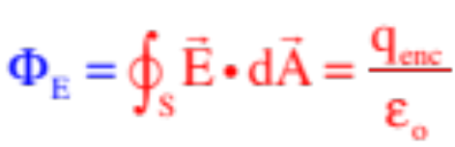
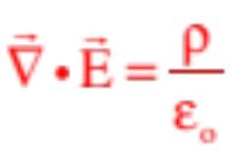
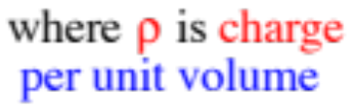
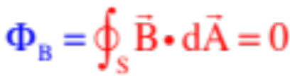

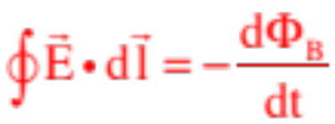
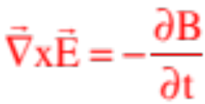
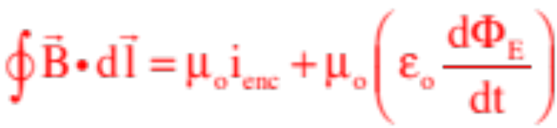
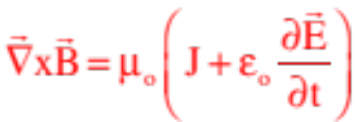
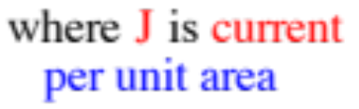
Maxwell’s Equations
Around 1862, James Clerk Maxwell compiled the four equations, known as Maxwell’s equations, that govern the world of electricity and magnetism. The equations come in two forms, the integral form you are familiar with and the derivative form used for boundary value problems. Both are shown below:
Integral form
Differential form
Gauss’s Law
Gauss’s Law for Magnetism
Faraday’s Law
Ampere’s Law
53.)

Slide 54



Inductance
Example 15: When this set-up (somewhat modified) was first presented, it was pointed out that, “Some very funky stuff happens in the primary coil when the switch is thrown.” What is that funkiness?
--As the current increases from zero to something, the B-fld down the coil’s axis increases.
--That increase of B-fld in turn produces an increasing magnetic flux.
--The increasing flux produces a back EMF that tries to force current to flow opposite the direction of the current generated by the battery (that is, a current that fights the change) and a B-fld opposing the battery’s B-fld.
--The net effect is that current in the coil is initially stymied, increasing only slowly with time.
54.)

Slide 55






The circuit symbol for a coil is shown in the circuit to the right. We need some way to quantify how “big” the coil is.
Using Faraday’s Law, we could identify the induced EMF generated in the coil due to the throwing of the switch. That would be:
Problem is, a coil in an electrical circuit is often encased in ceramic, so there is no easy way to measure the time rate of change of magnetic flux down its axis.
What was observed was that it is the change of current that actually induces the EMF, which means we could write:
To make this into an equality, we need a proportionality constant. In this case, the constant is called the inductance of the coil. Its symbol is L and its units are henrys. With that, Faraday’s Law becomes:
The units of inductance is henrys.
55.)

Slide 56



Observations
Notice that all of the parameters that characterize the size of the circuit elements have been proportionality constants linking two characteristics of an element.
The proportionality constant between the voltage across a resistor and the current through a resistor is the resistance R of a resistor.
The proportionality constant between the voltage across a capacitor and the charge on one plate is the capacitance C of a capacitor.
The proportionality constant between the induced EMF of a coil and the rate as which current changes in the coil is the inductance L of an inductor.
Note: A one-henry inductor is a huge inductor. They are more commonly found in the millihenry range.
56.)

Slide 57

Additional Observations
Coils are called by several names. The most common are:
Coils: Mundane, but to the point;
Solenoids: This term was used earlier;
Inductors: This is what coils are called when being used as a circuit element;
Chokes: This is slang used by electronics nerds in the 1950’s. You get extra points if you use terms like this in the presence of old people.
Minor Point: Because inductors are made of wire, inductors have resistor-like resistance associated with them. That means that when an inductor is placed in a circuit, you will often be told both its inductance L and it’s resistance .
Additional Note: The ”sub-L” in the expression is not referring to “load,” as is often the case with resistors. It is referring to the fact that the resistance is associated with internal resistance in the inductor L. Confusing, but that’s the case.
57.)

Slide 58






Example 16: Derive an expression for the inductance of a solenoid of length l, radius r and total number of turns N.
If we let n be the number of winds per unit length (i.e., N/l), and noting the volume of the coil is , we can write:
58.)
Notes:
Aluminum foil passing through the poles of a magnet.
Cow magnet through copper tube

Slide 59



Example 17: For the circuit to the right:
a.) What is the initial current in the circuit just after the switch is closed?
The back-EMF in the coil generated by the attempt of the battery to increase current in the coil (hence increase the B-fld down the coil’s axis) will fight the build-up of current in the system, so the initial current will be ZERO!
switch thrown at t = 0
b.) What is the current in the circuit after a long period of time?
Once the current goes steady-state, the inductor will no longer experience a CHANGING magnetic flux (there will be a magnetic flux, but it won’t be changing), and all of the voltage drops in the circuit will be due to resistor-like resistance. In other words:
59.)
Notes:
Aluminum foil passing through the poles of a magnet.
Cow magnet through copper tube

Slide 60


c.) Write a differential equation that characterizes the current as a function of time.
This is a Kirchoff’s Law problem. Summing the voltage changes around a closed path yields:
switch thrown at t = 0
d.) Solve the differential equation for the current as a function of time.
This is exactly the form of differential equations we ran into for a charging capacitor (see below),
complete with a solution that includes a natural log function and exponential solution (see next page for the gruesome details).
60.)
Notes:
Aluminum foil passing through the poles of a magnet.
Cow magnet through copper tube

Slide 61

61.)
Notes:
Aluminum foil passing through the poles of a magnet.
Cow magnet through copper tube

Slide 62


e.) What is the circuit’s time constant?
As was done with capacitors, the time constant is the inverse of the argument of the exponential in the current function. That means that for our inductor:
switch thrown at t = 0
Again, as before, after one time constant the current will be:
62.)
Notes:
Aluminum foil passing through the poles of a magnet.
Cow magnet through copper tube

Slide 63







f.) If current has been flowing for a long time, what happens when you open the switch?
An attempted drop in battery-current will instigate an attempted drop in B-fld down the axis of the coil. That will induce an EMF that fights the change, which in this case means it will force current to flow even longer than it normally would. Due to the symmetry of the situation, it will take one time constant for the current to drop 63% of its maximum.
switch opened after long time
graph of current function:
g.) The switch is closed, then after a long time it is opened. What will a graph of the current vs time look like for the system?
61.)
Notes:
Aluminum foil passing through the poles of a magnet.
Cow magnet through copper tube

Slide 64





Example 18: (problem courtesy of Mr. White) For the circuit to the right with the switch thrown at t = 0:
a.) What is the time constant for the circuit?
switch thrown at t = 0
b.) What is the current just after the switch is thrown?
zero
c.) What is the current at t = 2.0 milli-seconds?
64.)
Notes:
Aluminum foil passing through the poles of a magnet.
Cow magnet through copper tube

Slide 65


d.) What is the current after one time constant?
switch thrown at t = 0
e.) What is the current a long time after the switch is thrown?
65.)
Notes:
Aluminum foil passing through the poles of a magnet.
Cow magnet through copper tube

Slide 66





Energy in an Inductor
Think back. A capacitor stores its energy in the electric field that exists between its plates.
Not surprisingly, an inductor stores its energy in the magnetic field that exists down its axis. To see how much energy is stored in an inductor, consider the circuit shown to the right.
switch thrown at t = 0
Kirchoff’s Law yields:
Multiplying by the current yields:
Notice:
-- is the power provided by the battery;
-- is the power dissipated by the resistors in the circuit;
-- must be the power (i.e., the work the inductor does per unit time) dissipated by the inductor while in the circuit.
66.)

Slide 67




If the power dissipated by an inductor is
the power involved in storage must be
The relationships between power and work and work and potential energy are combine to produce:
switch thrown at t = 0
so:
67.)

Slide 68


The Production of AC
As one more nod to the use of Lenz’s Law, consider a coil that is spinning with constant angular velocity in a constant B-fld coming out of the page. To make the keeping track of things easier, I’ve made one side of the coil blue and one side red, and I’m making the side closest to you bigger.
We want to keep track of the induced current (or, more to point, which terminal is positive and which negative) as the coil rotates.
--At the point shown in the rotation, the loop’s external magnetic flux is entering a period of diminishing. The induced B-fld is out of the page. This happens due to an induced current that is c.c. That means the red end will act like a high voltage (+) source.
68.)

Slide 69
--As the loop continues to rotate (now the blue part is closest to you), the loop’s external magnetic flux continues to diminish so the induced current continues c.c. The red end continues to act like a high voltage (+) source.
--Once the loop has passed the quarter-turn point, it’s external magnetic flux begins to increase. The induced B-fld must be into the page, which means the induced current must now be clockwise. To effect that current, though, the red end CONTINUES to act like a high voltage (+) source.
69.)

Slide 70
--The loop reaches the point (halfway through the rotation), the external magnetic flux begins to enter a period of diminishing, so the induced B-fld orients into the page as the induced current goes c.c. Now the blue end acts like a high voltage (+) source.
--This is a BIG DEAL! The end-polarities have switched.
--The loop continues with the motion, mimicking the action of the first half cycle.
--This continues as every half-cycle, the polarity across the ends changes. We have just produced alternating current: AC!
70.)

Slide 71




AP Ideas (Induction) with Non-AP Math
The Transformer
To the right you see an iron yoke about which is wrapped two independent coils that are insulated from one another (see sketch). To whit:
--The left circuit, called the primary because it includes a power supply in it, has some number of winds in its coil.
--The right circuit, called the secondary because it includes a device you are transferring power to, has some number of winds in its coil.
71.)

Slide 72




At some time, the switch is thrown.
--Current in the primary coil experiences a back EMF, but it slowly builds generating a slowly escalating B-fld down its axis.
--The domains in the yoke snap into alignment telescoping that B-fld all around the yoke.
--As the B-fld increases,
an induced EMF is set up in the secondary coil producing an induced current in the secondary coil.
--The induced current in the secondary coil CONTINUES until the current in the primary has reached steady state whereupon the B-fld in the yoke ceases to change and there is no longer a changing magnetic flux through the secondary coil.
72.)

Slide 73


At some time, the switch is opened.
--As the current in the primary tries to drop, it (again) experiences an EMF which slows the diminishing as the B-fld down the axis erases.
--The domains in the yoke relax with the B-fld diminishing.
--As the B-fld decreases, an induced EMF is set up in the secondary coil opposite the original producing an induced current in the secondary coil.
--The induced current in the secondary coil WILL CEASE once the current in the primary has dropped to zero, as the B-fld in the yoke will cease to change at that point and there will no longer be a changing magnetic flux through the secondary coil.
73.)

Slide 74






A rudimentary graph of the proceedings from the closing to opening of the switch:
--The first graph animates the B-fld and magnetic flux down the axis of the primary coil;
--The second graph animates the EMF induced in the secondary coil when current in the primary changes.
74.)

Slide 75



What does the math suggest?
--Transformers transfer power from the primary coil to the secondary coil via a changing magnetic flux generated via a shared B-fld. That means we could write:
for the primary coil:
and for the secondary coil:
Taking the radio yields:
75.)

Slide 76


This ratio suggests that if you have more winds in the secondary coil, you will end up with a larger EMF in the secondary coil . . . You will have stepped the voltage up, so to speak.
This kind of transformer is called a step-up transformer. It’s characteristic is that:
You never get something for nothing, though. What is being transferred is power, and assuming ALL the power is transferred with no loss, we could write:
Translation: If the voltage goes up in a step-up transformer, the current provided to the secondary coil must go down.
NOTE: Using a transformer in a DC setting is nonsensical. The only time you get action in the secondary is when you change something in the primary. But using it with an AC source and ahhhhh, that’s when you get poetry.
76.)

Slide 77


Summary:
--Assuming you’re using AC, transformers allow you to transfer power from one part of an electrical circuit to another without electrically connecting the parts. It does it by utilizing two coils that are not electrically con- nected, but that share a common magnetic fld.
--Manipulating the winds ratio allows you to step-up the voltage or step-down the voltage from a source. This means that almost every electrical device you use has a transformer in it. (Example: the motherboard of a computer requires between 2 and 5 volts, but an AC wall socket is rated at 120 volts. The first thing your power cord runs into when it enters a computer is a transformer that steps the voltage down to a useable rating.)
--And FYI, the symbol for a transformer in a circuit is shown to the right (it’s supposed to signify two coil that aren’t connected to one another, coupled by a magnetic field signified by the three lines between the coils):
77.)

Slide 78




Example 19: You are off to Europe where the wall socket voltage is 240 volts. You want to take a hair dryer (bad idea as all the hotels will have them for free, buy you’re stubborn and want your favorite dryer).
a.) What kind of transformer are you going to want to take on the trip?
U.S. wall sockets are 120 volts, so you want a step-down transformer.
Huge minor point: What do we mean when we say the wall socket voltage is 120 volts AC?
An AC voltages across the terminals of a power supply means the voltage difference across the terminals varies in time and, in fact, actually changes polarity periodically. This is usually characterized as sine function:
78.)
Notes:
Aluminum foil passing through the poles of a magnet.
Cow magnet through copper tube

Slide 79

This motivates charge carriers in the circuit to jiggle back and forth in response to the alternating electric field set up by the alternating voltage across the terminals. This, in turn, means that the idea of a current (number of charge carriers passing a point per unit time) kind of loses its meaning. So what does the ammeter and voltmeter in an AC circuit read?
Without going into the math, the short answer is:
The AC ammeters in the circuit shown tells you how much DC current would be required to provide the same amount of power to the circuit as the AC source is providing.
It gives, in other words, the DC-equivalent current for the circuit.
Called the “root, mean, squared” value of the current (RMS, denoting how the value is derived using the current squared), this value equal to:
79.)
Notes:
Aluminum foil passing through the poles of a magnet.
Cow magnet through copper tube

Slide 80



A similar approach is used for voltage values, with
So when you plug a voltmeter into a wall socket and it reads 120 volts, that AC meter is giving you the RMS value for that source.
As a bit more minutia, that means the maximum voltage difference across the terminals of the wall socket is:
And as a wall socket’s frequency is 60 Hz, that means the voltage function for a wall socket is:
80.)
Notes:
Aluminum foil passing through the poles of a magnet.
Cow magnet through copper tube

Slide 81


Example 19: (So back at the ranch) You are off to Europe where the wall socket voltage is 240 volts. You want to take a hair dryer (bad idea as all the hotels will have them for free, buy you’re stubborn and want your favorite dryer).
b.) What kind of winds ratio will your transformer sport?
c.) If your dryer runs on 3 amps, how much current will be drawn from the French grid?
you’ll require 3 amps in the secondary, so:
81.)
Notes:
Aluminum foil passing through the poles of a magnet.
Cow magnet through copper tube

Slide 82


Example 20: How is AC power produced in hydroelectric power plants, and how is it transferred from the dam to the city?
coil
Water is run over the blades of a turbine whose shaft is attached to a coil that is bathed in a magnetic field. The coil is constrained to rotate at a fixed angular frequency (for the U.S., its 60 Hz; for Europe, it’s 50 Hz), so the EMF generated is:
shaft
B-fld
turbine
flowing water
It produces, in other words, periodic, alternating current that can be described with a sine function.
82.)
Notes:
Aluminum foil passing through the poles of a magnet.
Cow magnet through copper tube

Slide 83
The problem with energy transfer is energy loss to heat. Heat comes from high current, so the trick is to lower the current for transfer to the city.
The coil’s ends are connected via sliding contacts to terminals that are, them-selves, connected to a step-up transformer. This steps the voltage up (conse-quence: 50,000 volt high tension lines) and drops the current down close to zero.
As there are no toasters that can handle 50,000 volts, a step-down transformer is located in the city to drop the voltage down to 120 volts or 240 volts with appropriate rise in possible current.
to users
sliding contact
step-up
transformer
step-down
transformer
high voltage line to city
83.)
Notes:
Aluminum foil passing through the poles of a magnet.
Cow magnet through copper tube

Slide 84




RLC Circuits—Some Non-AP Stuff
You know how capacitors act in a circuit, and you know how inductors act in a circuit, so how do the two act together in a circuit?
In the circuit to the right, assume the capacitor is initially charged with polarity as shown. What will happen when the switch it thrown?
Initially, the cap tries to discharge. Problem is, the inductor responds to the increase in current by producing a back-EMF to fight the change of magnetic flux through its cross-section. The current in the circuit increases, but slowly.
84.)

Slide 85



As the cap continues to discharge, the current approaches steady state and the induced EMF disappears. The current continuing to flow.
What’s interesting is that as the cap’s charge diminishes, the current from the cap begins to fall off. The creates another changing magnetic flux through the coil, which produces an EMF that fights the decreasing current. EVEN AFTER ALL THE CHARGE ON THE CAP IS EXHAUSTED, CURRENT CONTINUES TO FLOW DUE TO THIS INDUCED EMF!!!
And as it does, that current begins to charge the capacitor up with its polarity reversed . . .
85.)

Slide 86



When the current stops, the cap is completely charged “going the other way.”
And with that, the cap will begin to discharge going the other way and the process will all over.
Bottom line: Current oscillates back and forth, dampening out due to the resistor-like resistance in the circuit, at a resonant frequency governed by the value of the cap and inductor.
86.)

Slide 87
87.)

Slide 88
88.)

Slide 89


AM Radio Circuit:
stuff
1.) A radio station takes it’s high frequency carrier wave provided to it by the FCC (say 980,000 Hz) and amplitude modulates that wave so its envelope matches a low frequency information wave (say, middle C at 256 Hz).
29.
89.)

Slide 90

2.) The antenna of a receiving set absorbs the signal.
antenna circuit
3.) Transferred to the RC tuning circuit via a transformer. Being an RC circuit, there will be only one frequency at which charge will want to oscillate. If the cap and inductor of that circuit produce a resonance frequency that matches the frequency of the station you want to listen to, that station’s signal will drive current in the tuning circuit and that signal will proliferate in that circuit. All others will dampen out.
tuner circuit
speaker circuit
90.)

