Slide 1

Cumulative Review from Gravitation to Faraday’s Law
0.)

Slide 2
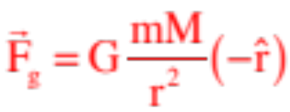
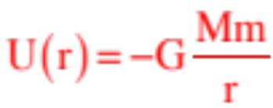
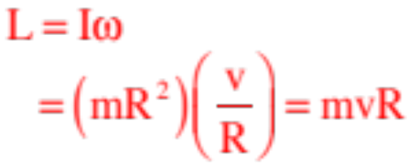
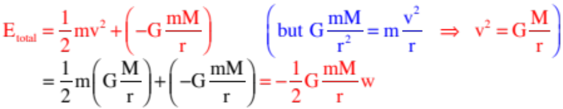
Gravitation
Gravitational force:
Gravitational potential energy:
Angular momentum (circular motion):
Total mechanical energy (circular motion):
1.)

Slide 3

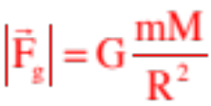
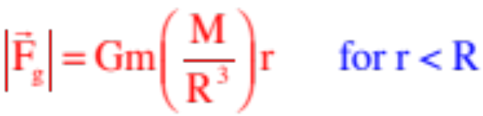

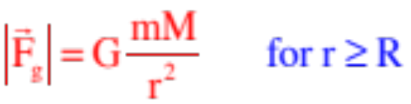
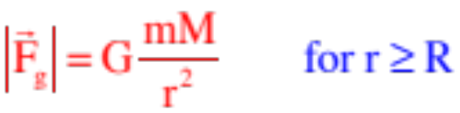
Graphs
Magnitude of force on particle due to a spherical shell:
Magnitude of force on particle due to a solid shell:
2.)

Slide 4
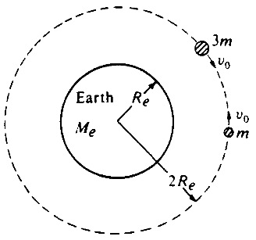
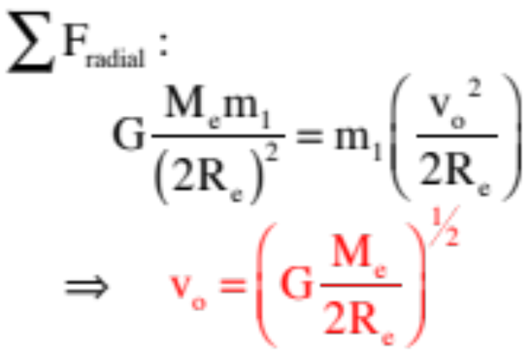
AP Example 7: Two satellites of masses m and 3m, respectively, are in the same circular orbit about the Earth's center, as shown in the diagram above. The Earth has mass M_{e} and radius R_{e}. In this orbit, which has a radius of 2R_{e}, the satellites initially move with the same orbital speed v_{o} but in opposite directions.
a.) Derive an expression for the orbital speed v_{o} of the satellites in terms of G, M_{e}, and R_{e}.
3.)
Notes:
1984M2.

Slide 5
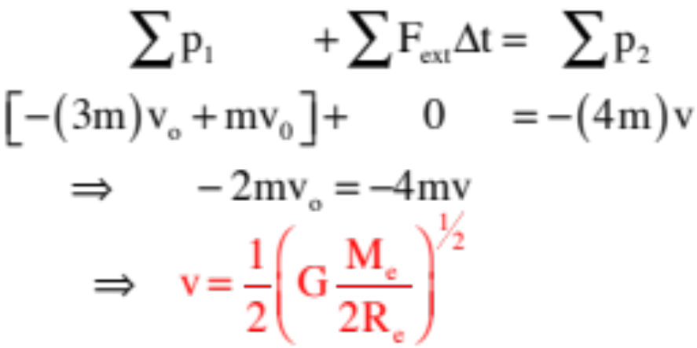
Using conservation of momentum:
where again, the negative sign suggests the final velocity is in the same direction as the original direction-of-motion of the 3m mass.
Clearly, the conservation of momentum is the easier way to go here, but both are educational.
4.)
Notes:
1984M2.

Slide 6
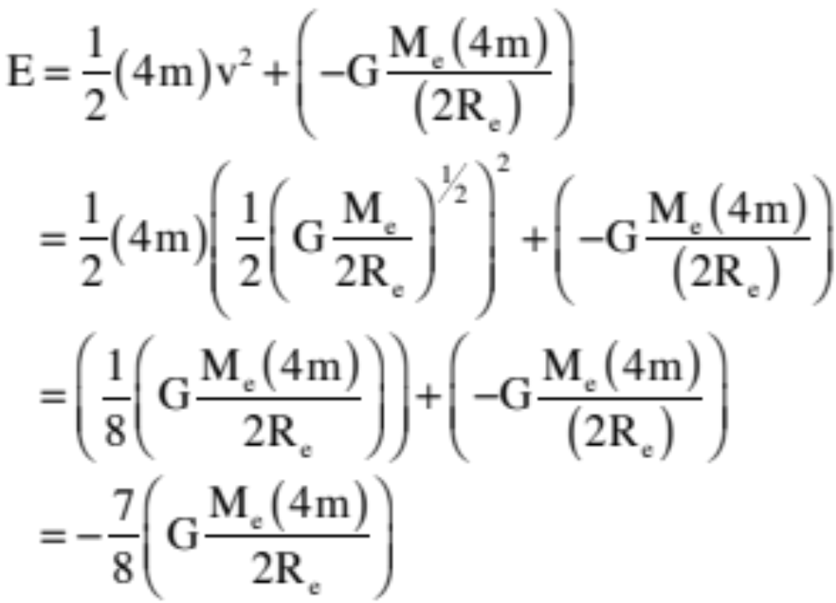
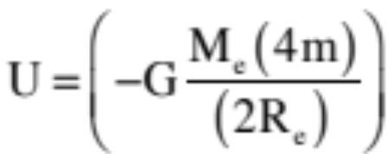
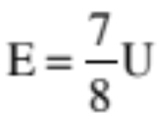
c.) Calculate the total mechanical energy of the system immediately after the collision in terms of G, m, M_{e}, and R_{e}.
As the gravitational potential energy is
apparently:
5.)
Notes:
1984M2.

Slide 7
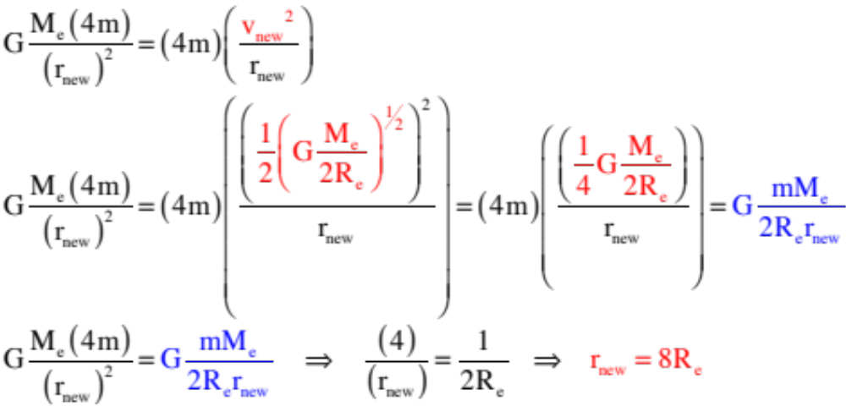
Note: For this new combo-satellite to carry the new velocity in a circular orbit, its new radius would have to be:
This wouldn’t happen, though, as the new motion would become elliptical looking something like:
6.)
Notes:
1984M2.

Slide 8
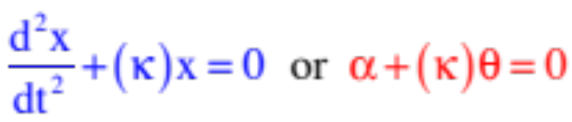


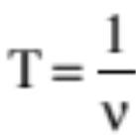

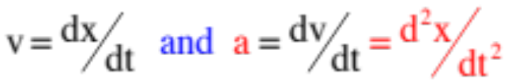


Relationships--Simple Harmonic Motion
Relationships always true:
characteristic equation for simple harmonic motion
angular frequency from characteristic equation
angular frequency and frequency related
period inversely related to frequency
position function for s.h.m.
velocity and acceleration functions
maximum velocity (happens at equilibrium)
maximum acceleration (happens at extremes)
7.)

Slide 9

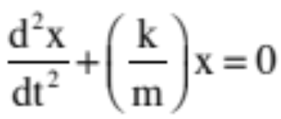
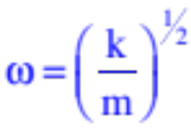
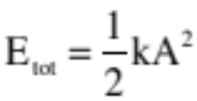
Summary of Relationships
For a spring:
for idea spring, Hooke’s Law
characteristic equation for simple harmonic motion
angular frequency from characteristic equation
total mechanical energy in system
The period and frequency of oscillation for a spring is constant no matter what the spring’s amplitude. How so? A larger displacement will require more distance traveled to execute a single cycle, but because force is a function of displacement, it will also generate a larger maximum force, so the period will stay the same no matter what!
8.)

Slide 10




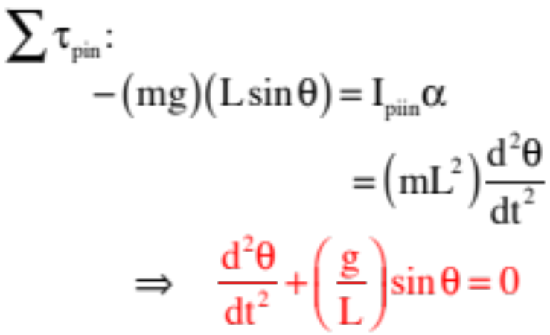





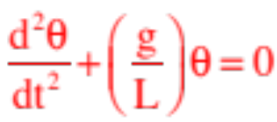
Example 2: A simple pendulum of length L is observed as shown to the right. What is its period of motion?
If we can show that this system’s N.S.L. expression conforms to simple harmonic motion, we have it. As the motion is rotational, we need to sum torques about the pivot point. The torque due to the tension is zero. Noting that r-perpendicular for gravity is , we can write:
This isn’t quite the right form, but if we take a small angle approximation, we find that for and we can write:
9.)

Slide 11
Electrostatics
10a.)

Slide 12


Grounding is the connecting of a structure to a reservoir of charge, often quite literally the ground, to electrically neutralize the structure.
circuit symbol
for ground
The symbol for ground in an electrical circuit is shown to the right.
Touching our polarized ball on the side opposite the rod (I’d like to thank Michelangelo for the hand) will “ground” that side, allowing free electrons to run from the hand to the ball, neutralizing that side of the ball.
electrons run
onto ball
from ground
Remove the hand and rod, and the electrons will redistribute themselves leaving you with a negatively charged ball.
This is called CHARGING BY INDUCTION (you are inducing a charge separation, then removing charge by grounding).
10.)

Slide 13











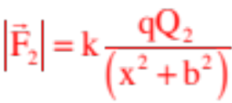

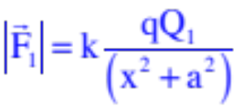
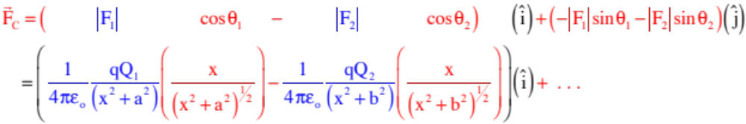
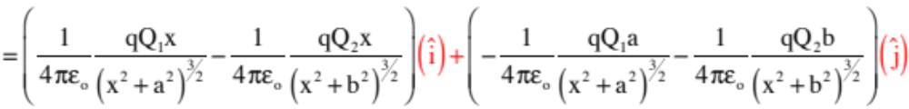
Putting it all together:
11.)

Slide 14
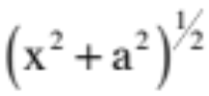




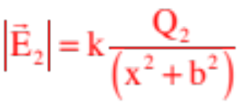
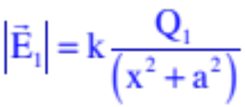
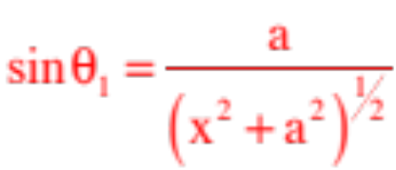
Example 7: Derive an expres-sion for the electric field at (x,0).
notice, no charge here,
just a point in space
This is very similar to Example 3 (and because the charge q was positive in that problem, the forces on it and the direction of the electric fields will even be the same). The difference? No need to include the test charge q, just work with E:
Defining the field directions and magnitudes,
then break into components:
You’d use the same trickery ( ) and finish the problem just like before.
12.)

Slide 15

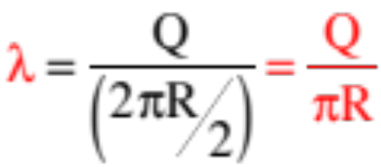

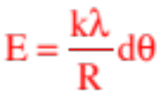





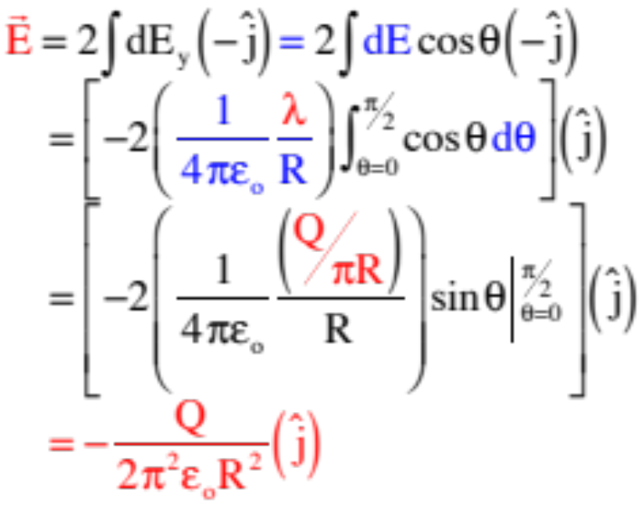




An additional bit of trickery is involved in exploiting the symmetry of the set-up. Notice there is a second dq on the right side at an angle that will produce a mirror-image differential electric field to our original bit of charge. The x-components of the two fields will add to zero, so all we really have to deal with is the y-component.
With the linear charge density as:
and E as:
we can write:
13.)

Slide 16
Summing over all of the differential hoops yields:
rewriting
14.)

Slide 17
Gauss’s Law
16a.)

Slide 18

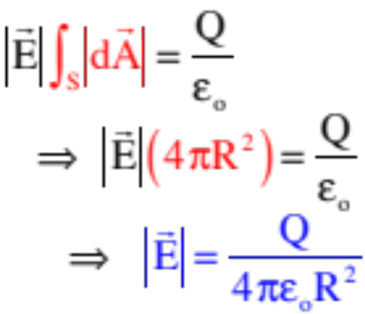
imaginary Gaussian surface
Herein lies the beauty of the method. Because every point on the surface is equidistant from the charge, the evaluation of the E at every differential surface dA WILL BE THE SAME, which is to say, IS A CONSTANT VALUE, and because it is a constant, we can pull it out of the integral. (Note that we couldn’t do that with the original Example 1 because each point was a different distance from Q.) With that, we can write:
That makes life wonderful, as now the only thing inside the integral is the differential surface area dA, and summing that over the surface simply yields the total surface area of the sphere ( ) . . . So we can further write
Look familiar? It should. It’s the same as the electric field function we derived for a point charge using Coulomb’s Law!
15.)

Slide 19

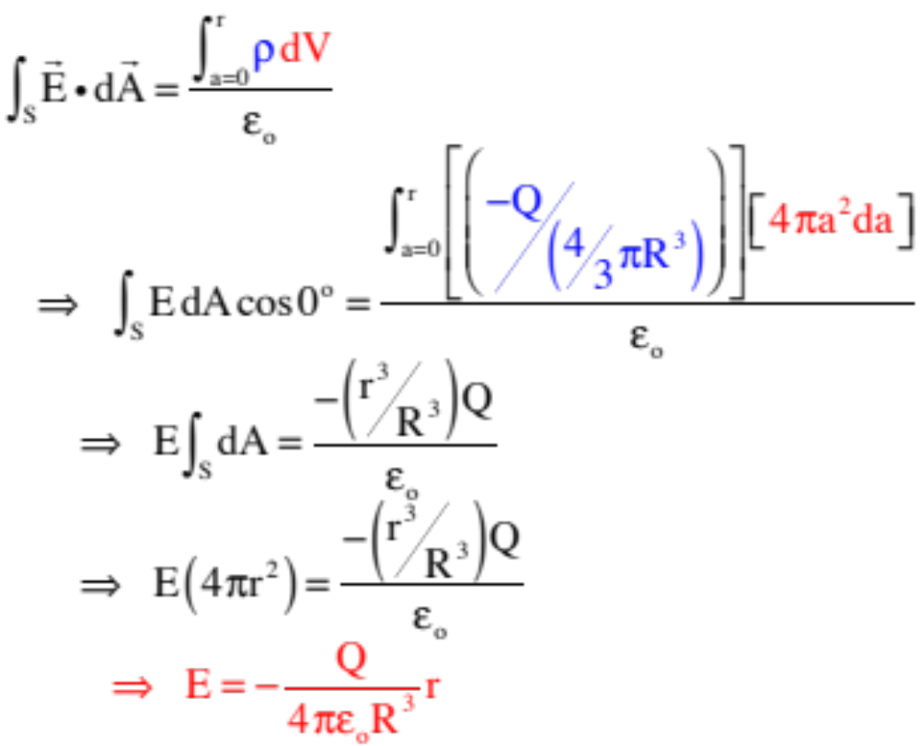

(con’t.—doing this with the density function . . . though either way would do here)
b.) for r<R:
Gaussian surface
Note that this is a linear E-field inside the sphere!
16.)

Slide 20

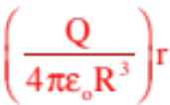
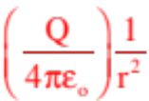


c.) What does the graph look like for electric field magnitude versus position?
17.)

Slide 21
This is easy. With all the charge on the surface, the charge enclosed inside the Gaussian surface is zero and:
b.) for r<R:
Gaussian surface
c.) What does the graph look like for E-field magnitude versus position?
Note that this suggests that E-fld functions are discontinuous . . .
18.)

Slide 22
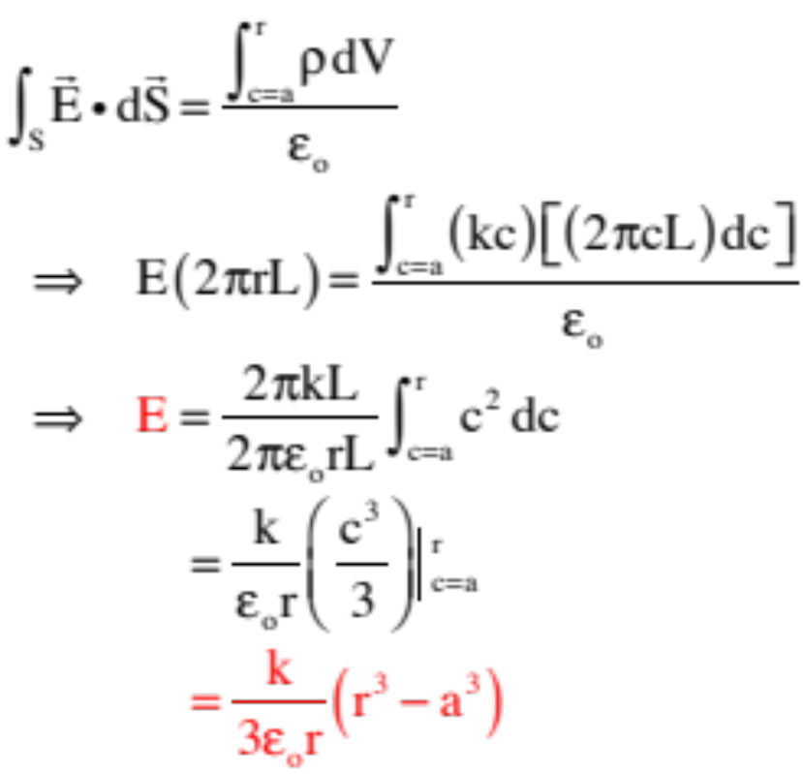




With that, Gauss’s Law becomes:
3-d view
Gaussian
surface
central axis
b.) Derive an electric field for r < a:
(It’s zero as no charge inside Gaussian surface.)
c.) Derive an electric field for r > b:
Same problem as Part a exception of the limits of the integration are different (you are now adding up ALL the charge inside the cylinder, so the limits go from c = a to c = b instead of c = a to c = the Gaussian radius r.)
19.)

Slide 23
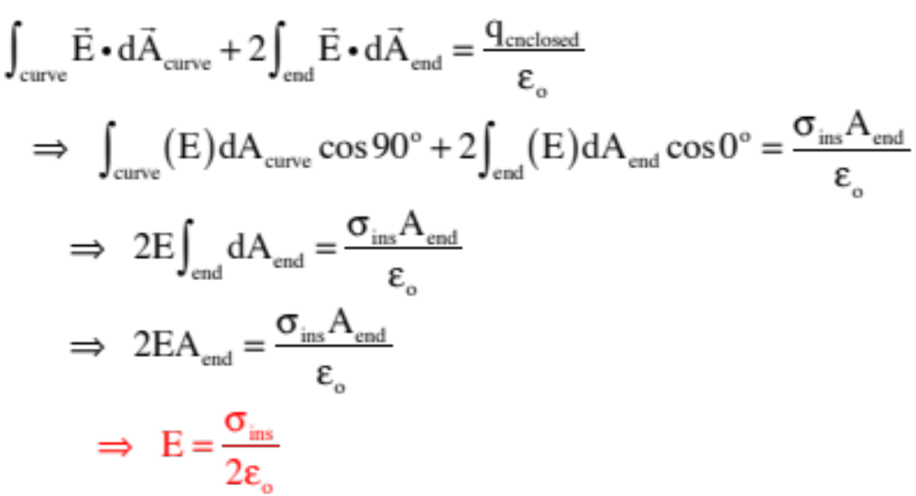





thin sheet
insulator
from side
20.)

Slide 24

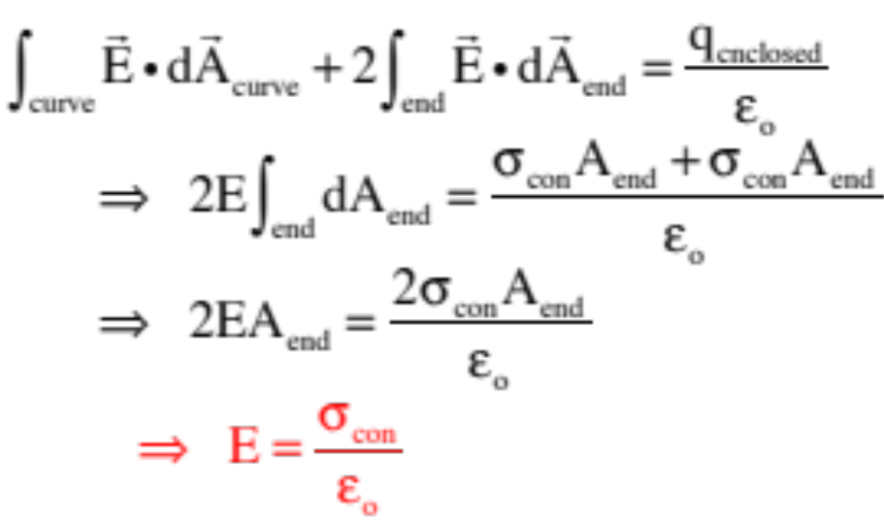
Example 11: Derive an expression for the electric field function for an “infinite” sheet of conducting material whose area charge density is a constant .
thin sheet
3-D view
thin sheet
conductor
from side
Here is where the difference in the charge configurations comes into play. We could use the same plug we used with the insulator, but there would be two surfaces upon which there was charge placed, each of which would have a charge density of . That means:
21.)

Slide 25
Example 16 - Faraday’s Ice Pail Experiment
Courtesy of Mr. White:
22.)

Slide 26
Electric Potentials
(energy considerations)
25a.)

Slide 27
An ELECTRICAL POTENTIAL FIELD, measuring the amount of potential energy per unit charge AVAILABLE at all points in the region of a field-producing charge, can be (and is) associated with any charge configuration.
electrical
disturbance
potential
field exists
An ELECTRICAL POTENTIAL FIELD exists wherever there is charge (and, for that matter, wherever there is an electric field). For the potential fields to exist, there doesn’t need to be present a secondary charge to feel the effect. And because voltage-flds tell us how much energy is available PER UNIT CHARGE at a point, the electrical potential field V is defined as:
Example 1: How much potential energy does a 2 C charge have at a point where the absolute electrical potential is ?
23.)

Slide 28
Work and Electrical-Potential (Voltage) Fields
Note: An absolute electrical potential field is a modified potential energy field.
Everything you can do with energy considerations, you can do with electrical potential functions:
Just as the work done on a body moving from one point to another in a conservative force field equals , we can use the definition of absolute electrical potential to write:
and
Apparently, if you know the voltage difference between two points, you know how much work per unit charge AND potential energy per unit charge the field has available between the two points.
Example 5: How much work does a field do on a moving 2 C charge if the potential difference between its beginning and end points is 7 volts?
24.)

Slide 29
Electrical Potential Difference and E-flds
Assuming we are dealing with a constant electric field and a straight-line path between two points in the field, we can use the definition of work ( ) with the manipulated definition of the electric field ( ) to extend out potential difference relationship ( ) into a very interesting proposition. Specifically:
two points in a
constant E-fld
And what might we glean from this bit of amusement?
25.)

Slide 30
c.) A positive charge Q=1C and mass m=1 kg moves naturally along the E-fld lines.
i.) Is the charge moving from higher electrical potential to lower, or lower electrical potential to higher?
This has nothing to do with the charge. Electric fields proceed from higher voltage to lower, so it’s doing the former.
ii.) Is the charge moving from higher potential energy to lower, or lower potential energy to higher?
This has EVERYTHING to do with the charge. POSITIVE CHARGES naturally move from higher to lower voltage along E-fld lines (being by definition the direction a positive charge would naturally accelerate), so it is moving from higher to lower potential energy.
iii.) If Q’s initial velocity was
at A, what is its velocity at B? (Note that the voltages have been put on the sketch.)
26.)

Slide 31
plates viewed
from side
e.) An electron accelerates between the plates. How fast is it moving if it started from rest?
Note that the electron (charge –e) would accelerate from the negative the positive plate, and that the potential energy of a charge sitting at a point whose potential is V is with the charge’s sign included, we can write:
low voltage
terminal
hi voltage
terminal
27.)

Slide 32
A Specific Case--The Electrical Potential Generated by a POINT CHARGE
Example 11: Derive a general expression for the electrical potential generated by a point charge Q?
Setting the zero point for the electrical potential to be where the electric field is zero (i.e., at infinity), and using the electric field function for a point charge as , we can write:
28.)

Slide 33
So How Are Electric Fields and
Electrical Potentials Related?
Remember back to the Energy chapter when we related a conservative force function to its potential energy function. We found that the spatial rate of change of potential energy equals the force associated with the potential energy field, or . There is an electrical analogue to this.
That is, the differential consequence of:
is
But if that is true, it must also be true that:
Except in Cartesian coordinates (assuming E is in the x-direction),
which can be expanded into multiple dimensions using the del operator as:
29.)

Slide 34
Example 12: Assume the charges are equal and opposite, and are placed symmetrically as shown.
a.) Is there an electric field at (x,0). If so, in what direction is it?
There will be an E-fld at (x,0). By inspection, its x-components will add to zero leaving it with only y-components.
b.) Is there an absolute electrical potential at (x,0). If so, in what direction is it?
TRICK QUESTION—electrical potentials don’t have directions as they are scalars. As for magnitude:
c.) Does this make sense?
Yes, if you understand how E-flds and voltage flds are related to one another.
30.)

Slide 35
Example 13 (A non-AP problem): Derive an expression for the electrical potential at the origin due to a rod with charge -Q uniformly distributed over its length L.
This extended charge distribution is something you’ve already seen. The solving technique is exactly as was before.
Define the differential electrical potential at the origin due to a differential bit of charge,
then sum that differential electrical potential over the entire rod. You’ll again need to define a linear charge density function
and note that . With that, we can write:
31.)

Slide 36
Example 15: A ring situated in the x-z plane (as shown) has –Q’s worth of charge on it.
a.) What is the direction of the E-fld at (x,0)?
From observation, it’s .
b.) Derive an expression or V at (x,0)?
these components are the same.
these components cancel out.
c.) Do the results from Parts a and b make sense together?
sure
32.)

Slide 37
c.) Sketch the graph for: E-fld vs position AND the electrical potential field vs. position.
Notice that whereas the E-fld functions is discontinuous, the V-fld function is CONTINUOUS!
33.)

Slide 38
SUMMARY—Conductors . . .
Electric Fields:
a.) Free charge on a conductor in a static setting stays on the conductor’s surface.
b.) Close to the surface of a conductor, the E-fld is perpendicular to the surface and has a magnitude .
c.) Inside a conductor, the E-fld is zero in a static charge situation (otherwise, electrons would migrate).
Electric Potentials:
a.) Free charge on a conductor will distribute itself so as to create a equipotential surface (the voltage will be the same at every point on the surface)..
b.) As the electric field inside a conductor is zero, the voltage field (the electrical potential field) inside a conductor will be CONSTANT.
34.)

Slide 39
Capacitance
38a.)

Slide 40
Furthermore, the charge Q on ONE PLATE will always be proportional to the magnitude of the voltage difference across the plates, with the proportionality constant being the cap’s capacitance. Mathematically, then:
Usually written in truncated form as:
this also means that the capacitance is defined as:
This, in turn, means the capacitance of a capacitor is a constant that tells you how much charge per volt the capacitor has the capacity to hold.
Its unit of coulombs per volt is given a special name—the farad.
It’s not uncommon to find capacitors in the range of: millifarad (mf = ), or microfarad (Mf or = ), or nanofarad (nf = ), or picofarad (pf = ).
35.)

Slide 41
Example 5: Derive an expression for the capacitance-per-unit-length of a coaxial cable of inside radius a and outside radius b.
1.) Assume charges (in this case, a linear charge density ):
2.) Noting that all the charge will migrate to the inside surfaces, use a Gaussian cylinder of length L and Gauss’s Law to derive an expression for the E-fld between plates.
3.) Derive an expression for the electrical potential difference ( ) between the plates:
36.)

Slide 42
Except
so
4.) Using the definition of capacitance:
37.)

Slide 43
So the parallel-plate capacitor derivation would look like:
with ,
That means:
and
38.)

Slide 44
DC Circuits
44a.)

Slide 45
Example 3: Current passes through a resistor? During some period of time, assume q’s worth of charge passes through the resistor. How much work is done on that charge?
Assume the voltage on either side of the resistor is and respectively. With that, we can write:
Example 4: How much power is being dissipated by the resistor in the previous problem?
Power is work per unit time, so:
In short:
This is generally true, but according to Ohm’s Law, we an write:
39.)

Slide 46
Characteristics of a Series Combinations
--Each element in a series combination is attached to its neighbor in one place only.
--Current is common to each element in a series combination.
--There are no nodes (junctions—places where current can slit up) internal to series combinations.
--The equivalent resistance for a series combination is:
--This means the equivalent resistance is larger than the largest resistor in the combination;
--This means that if you add a resistor to the combination, will increase and the current through the combination (for a given voltage) will decrease.
Example 3: What’s the equivalent resistance of a resistor in series?
40.)

Slide 47
Characteristics of a Parallel Combinations
--Each element in a series combination is attached to its neighbor in two place.
--Voltage is common to each element in a parallel combination.
--There are nodes (junctions—places where current can slit up) internal to parallel combinations.
--The equivalent resistance for a parallel combination is:
--This means the equivalent resistance is SMALLER than the smallest resistor in the combination;
--And, if you add a resistor to the combination, will decrease and the current through the combination (for a given voltage) will increase.
Example 3: What’s the equivalent resistance of three one-ohm resistors in parallel?
41.)

Slide 48
Example 6: The current from the battery is 3 amps. How much current goes through the upper branch of the parallel combination?
This is another use-your-head question.
If the upper branch has half the resistance of the lower branch, it should draw twice the current.
With 3 amps coming in, that means 2 amps should pass through the upper branch.
Note: AP questions often have easy, non-mathematical, use-your-head solutions like this. That is why I’m showing you screwball problems like this. We will get into a more formal approach for analyzing circuit problems shortly.
42.)

Slide 49
Some Definitions
A branch: A section of a circuit in which the current is the same everywhere.
Loop 3
branch
branch
--elements in series are a part of a single branch (look at sketch).
branch
Loop 1
Loop 2
--in the circuit to the right, there are three branches.
A node: A junction where current can split up or be added to.
--elements in parallel have nodes internal to the combination.
--in the circuit above, there are two nodes.
A loop: Any closed path inside a circuit.
--in a circuit, loops can be traverse in a clockwise or counterclockwise direction.
--in the circuit above, there are three loops.
43.)

Slide 50
Kirchoff’s Laws—the Formal Approach
With the definitions under your belt, Kirchoff’s Laws are simple (and you’ve been inadvertently using them in the seat-of-the-pants evaluations). They are:
Node A
Kirchoff’s First Law: The sum of the currents into a node equals the sum of the currents out of a node. Mathematically, this is written as:
Loop 1
Loop 2
Example from the circuit’s Node A:
Kirchoff’s Second Law: The sum of the voltage changes around a closed path (a loop) equals ZERO. Mathematically, this is written as:
Examples: starting at Node A:
Loop 1 traversing counterclockwise:
Loop 2 traversing clockwise:
Note: Current moves from hi to lo voltage, so traversing against the current through a resistor produces a that is positive; traversing with current makes it negative.
44.)

Slide 51











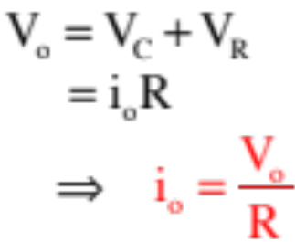

Capacitors—Charging Characteristics
Example 10: Consider a resistor, an uncharged capacitor, a switch and a power supply all hooked in series. Note also that when the switch is thrown, the voltage across “a” and “b” is equal to both the battery voltage and the sum of voltages across the resistor and capacitor. That is:
a.) At t = 0, the switch is closed. What initially happens in the circuit?
As the cap initially has no charge on its plates, it will provide no resistance to charge flow. That means no voltage drop
across the capacitor with all the voltage drop happen across the resistor . . . which means:
45.)

Slide 52
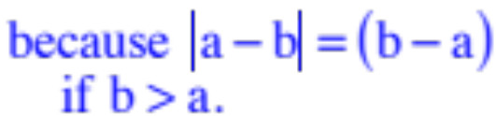
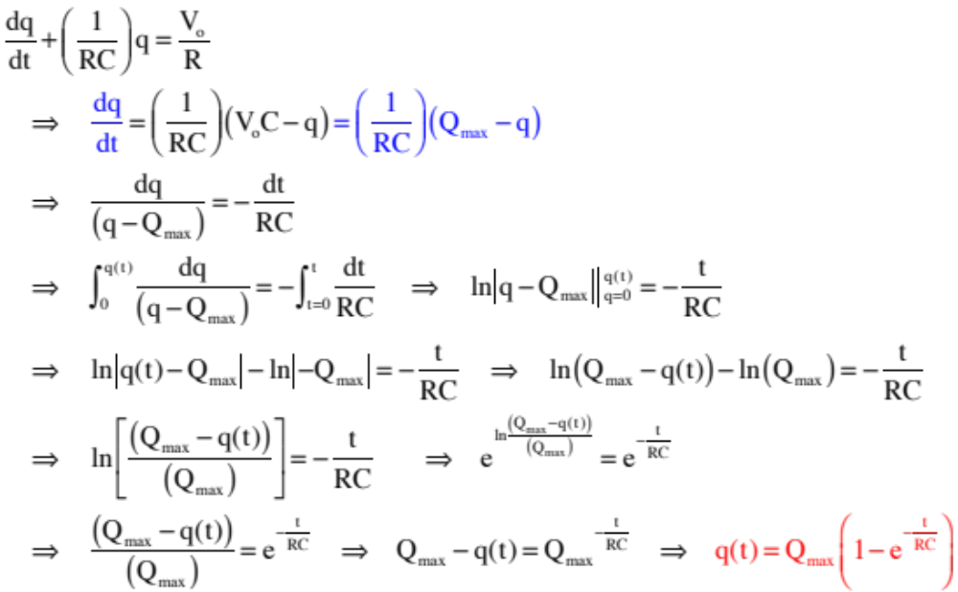
Solving:
46.)

Slide 53


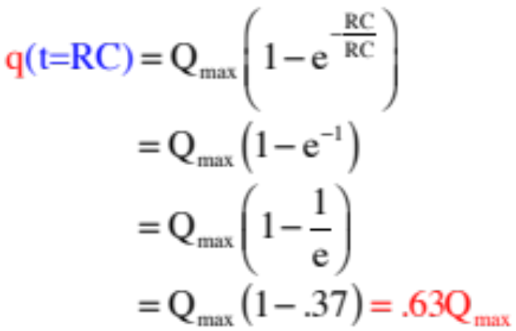







It would be nice to get a feel for how fast a capacitor/resistor combination will charge or discharge.
To that end, how much charge would the cap have accumulated after a time equal to RC?
This time is defined as one time constant . It is the amount of time it takes the capacitor to charge to 63% of its maximum. Two time constants will charge it to 87% of its maximum (try the calculation if you don’t believe me).
47.)

Slide 54

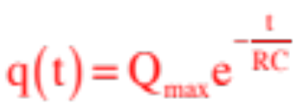
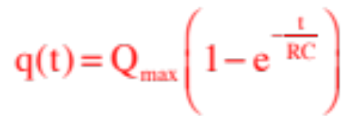

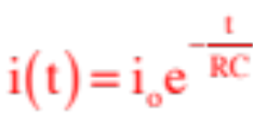
Summary of Graphs
Graphs of capacitor charging and discharging characteristics.
charge vs. time
(discharging)
charge vs. time
(charging)
current vs. time
(both charging and discharging)
48.)

Slide 55











Observations:
--The galvanometer-engineered ammeter consists of a galvanometer in parallel with (in this case) a resistor (that is, essentially a wire). As the equivalent resistance of a parallel combination is smaller than the smallest resistor in the combination, that means that the equivalent resistance of the ammeter is REALLY SMALL—exactly as expect.
--The galvanometer-engineered voltmeter consists of galvanometer and, in this case, an additional resistor in series. As the equivalent resistance of a series combination is larger than the largest resistor in the combination, that means that the equivalent resistance of the voltmeter is REALLY Big—again, exactly as expect.
49.)

Slide 56

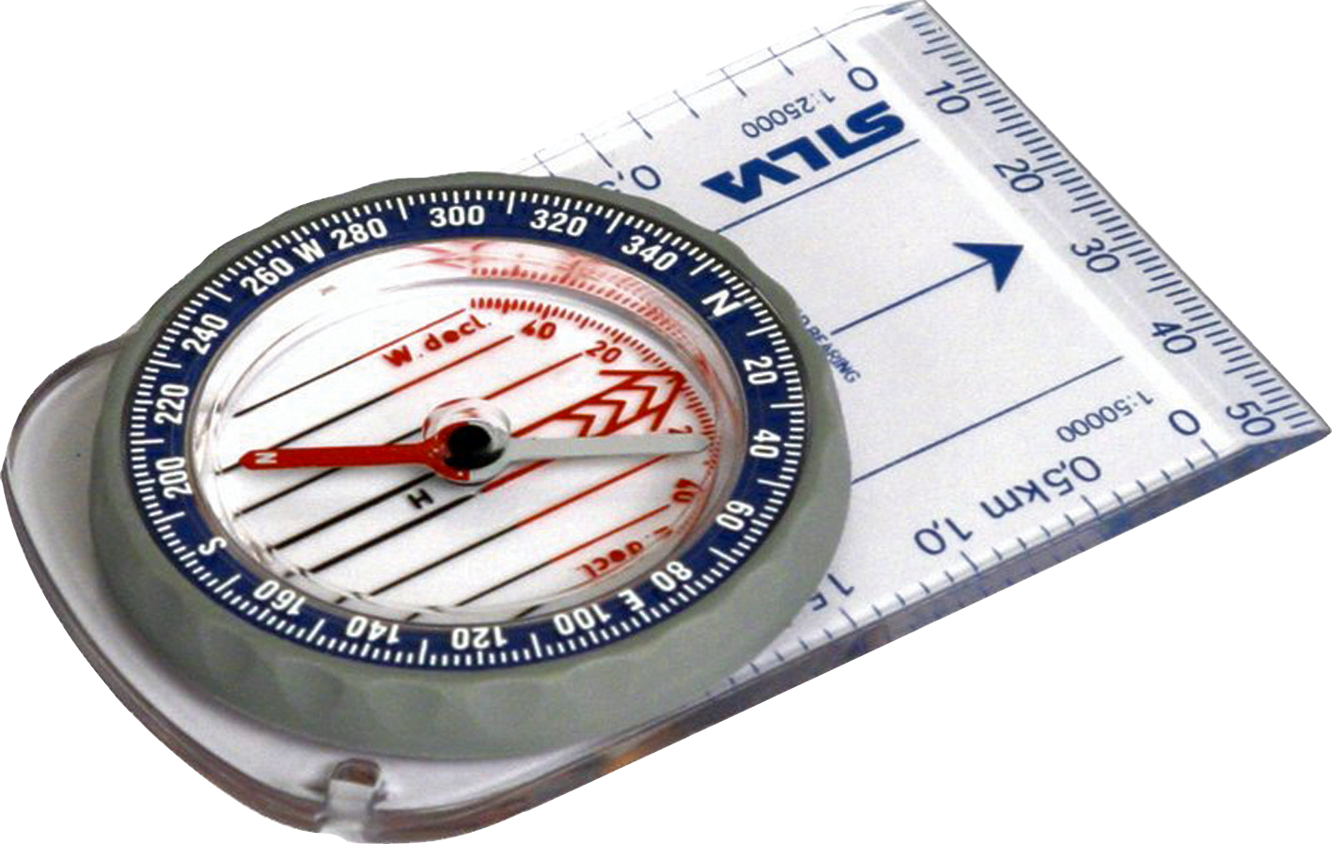
General Information
Electric Fields
Magnetic Fields
--magnetic fields (abbreviated as B-flds), with units of teslas in the MKS system, are NOT modified force fields (release a charge in a B-fld and it will just sit there);
--electric fields (abbreviated as E-flds), with units of newtons per coulomb or volt per meter, are modified force fields (release a charge in an E-fld and it will accelerate);
--magnetic forces do exist when a charge moves through a B-fld—they are centripetal and are governed by the relationship:
--electric fields are generated with the presence of charge;
--B-fields are generated by charge in motion;
--an electric field’s direction is defined as the direction a positive charge will accelerate if released in the field;
--a B-field’s direction is defined as the direction a compass points when placed in the field;
--electric field lines:
--magnetic field lines:
--go from positive to negative charge;
--go from north to south pole, or circle around current carrying wire;
--identify the E-fld’s direction in a region;
--are closer together where E-flds are more intense;
--identify the B-fld’s direction in a region;
--are closer together where B-flds are more intense;
50.)

Slide 57
Magnetic Fields
56a.)

Slide 58
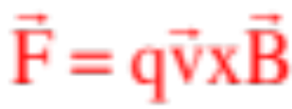





Magnetic Force
When charge moves through a magnetic field, it may or may not feel a force, depending upon its motion. If present, that force will be:
The magnitude is , where q is the size of the charge,
is the magnitude of the velocity vector, is the magnitude of the magnetic field and is the angle between the line of the two vectors.
The direction is determined using the right-hand rule.
sketch courtesy of Mr. White
51.)

Slide 59


Example 3: A charge q of mass m is moving with constant velocity v at right angles to a magnetic field B. (idea courtesy of Mr. White)
a.) What kind of motion will it execute?
Because magnetic forces are centripetal, the mass will follow a circular path.
b.) What is the radius of the motion’s path?
52.)

Slide 60




Example 5 (mass spectrometer): An unknown mass is volatalizes (made into a gas), had its molecules singly ionized (had one electron stripped away), accelerated through a
potential difference to give them velocity, and sent through a velocity trap made up of a 95,000 V/m E-fld and a .93 teslas B-fld. The molecules that make it through the trap move into a region in which there is only the B-fld.
a.) What is the velocity of the molecules that make it through the trap?
53.)

Slide 61

Other Devices
A little more sophisticated version of a motor required one bit of information that would normally not be covered until next chapter.
It is charge in motion that generates magnetic fields. With current carrying coils, the generated magnetic fields are down the axis and through the face of the coil.
A handy trick to determine the direction of a current carrying wire’s B-fld is to lay your right hand on the coil with your fingers following the direction of current in the coil. The direction in which your extended right-thumb points identifies the direction of the coil’s B-fld.
direction of
B-fld
this end of
coil acts like
a north pole
Note that with the B-fld extending along the axis as it does, the coil’s ends look like north and south poles.
With that, consider the following:
54.)

Slide 62


Oersted (1820) (courtesy of Mr. White)
define B-fld with compass
If the wire is grasped with the right hand, with the thumb in the direction of current flow, the fingers curl around the wire in the direction of the magnetic field.
The magnitude of B is the same everywhere on a circular path perpendicular to the wire and centered on it. Experiments reveal that B is proportional to I, and inversely proportional to the distance from the wire.
Obscure observation from Fletch: Notice that if the current-carrying wire is straight and you draw a vector from any point on the wire to a point of interest, the direction of the magnetic field at that point will be perpendicular to the plane defined by that vector and the direction of the current (treated like a vector).
B-fld
any vector from wire
vector defining current “i”
Plane of “any vector” and “i” is plane of page—B-fld is perpendicular to that
55.)

Slide 63






Biot-Savart does a similar thing for magnetic fields, with the exception that it incorporates the direction of the B-field into the calculation.
Specifically, it observes that the differential magnetic field dB at Point P due to the current in the differentially small section ds of wire is:
where:
graphic courtesy of Mr. White
Notice the cross product gives a direction that is perpendicular to the plane defined by and i at ds as advertised earlier.
56.)

Slide 64









With no B-flds being generated at Point O due to the sections of wire that have current moving directly toward or away from the point, we turn to the only other section in the system:
Point O
Again, defining the differential length ds and the unit vector for the curved sections,
and noticing how ds is related to (see insert),
the cross product becomes:
How ds is related to R and .
point O
Also, crossing yields a direction INTO the page, which is exactly what the right-thumb rule would have given you!
57.)

Slide 65







Because the force relationship between a current-carrying wire and the B-fld the wire is bathed in is known, we can write:
Now for the fun—finding the direction of the force on the right-hand wire: Start with the cross product.
is out of the page (in the direction of the right-hand wire’s current), and we’ve already determined the direction of the B-fld due to the left-hand wire in that region (it’s downward at the right-hand wire).
Executing yields a vector direction to the right, AWAY from the left wire.
58.)

Slide 66










Example 6: A current carrying wire has current directed out of the page as shown. For the dotted path shown, is the net circulation equal to ?
YES, Ampere’s Law always works (just like Gauss’s Law always works, even when a geometry makes its integral impossible to solve).
The real question is whether using Ampere’s Law is a reasonable thing to try to do in this case . . . and the answer to that question is NO!
Why? Look at the symmetry.
The current through the face is easy—it’s just i, but the angle between and the B-fld evaluated at is different than the angle between and the B-fld evaluated at . That’s going to make the integral nasty.
Consider the problem exploiting symmetry:
is the same at every point on the path, so:
BAM! The B-fld for a current-carrying wire.
59.)

Slide 67




Example 8: Derive an expression for the B-fld inside an N-turn toroid (a coil with N winds that curves back on itself)
from above:
--Because the B-fld for a toroid circles along the toroid’s axis,
the Amperian path that is applicable here is a circle of radius r.
Amperian
path
--Noting that N wires pass through the Amperian path, the current through the face is Ni and we can write:
from the side:
--Notice that B varies with r.
60.)

Slide 68

Trickery
There is still another right-hand rule that can be used to determine the direction of the magnetic field due to current through a coil. It’s easy (and fun!).
Lay your right-hand on the coil with your fingers pointing in the direction of the current.
The direction your thumb points is the direction of the B-fld down the axis of the coil.
61.)

Slide 69










Example 9: Determine the B-fld down the axis of a current-carrying coil (a solenoid), where n is the number of turns per unit length in the coil (see cross-section).
We need a rectangular Amperian path. Why?
--The paths perpendicular to the coil will experience zero B-fld;
--The path outside the coil is far enough out so the B-fld is essentially zero;
(ignoring end effects)
--The path inside the coil experiences a non-zero B-fld.
The current through the face is:
where nL is the number of wires thru the face. So:
62.)

Slide 70

Deciding When to Use Ampere’s Law versus Biot Savart
Use Ampere’s Law when:
--You can define a path upon which the magnitude of B is constant over the entire path (this will normally be a circular path); or
--You can define a combination of paths some of which will have a magnitude of B that is constant over the section(s), some will have B equal to zero over the section(s) and/or some will have the evaluation of equal to zero over the section(s) . . . (these multiple paths are usually rectangular).
Use Biot Savart when:
--You can’t use Ampere’s Law. (In other words, Ampere’s Law should be your first choice.)
63.)

Slide 71












Example 10: Derive an expression for the magnetic flux through the rectangular path shown due to the B-fld set up by the current-carrying wire (a very cool, classic problem).
The difficulty here is in the fact that the B-fld from the current carrying wire isn’t constant over the face of the area, as shows.
We have to determine the differential magnetic flux through a differentially small surface area where the B-fld
is evaluated constant, then sum all those over the entire face. Starting:
64.)

Slide 72





So . But in this case, is the charge on one plate of the capacitor. If we calculate the rate at which that charge is changing (the rate at which the capacitor is charging), we get the current in the circuit. In other words:
capacitor
Amperian path
Caps don’t have charge move through them, but the electrostatic repulsion between their plates creates the illusion that current is flowing through the cap. Faraday, apparently, deduced that that virtual current (my words, not his) was the displacement current needed for Ampere’s Law to work. In any case, the complete form of Ampere’s Law is:
where it’s YOUR CHOICE which term on the right you evaluate, depending upon the circumstances.
65.)

Slide 73
Faraday’s Law
72a.)

Slide 74





Faraday’s Law
The creation of a conventional current flow as the coil leaves the constant B-fld has been explained using what you already know from the Classical Theory of Magnetism. Faraday viewed it differently. His approach will allow us to analyze difficult situations that are not so easily untangled with the thinking we’ve just presented.
Faraday, who was not interested in the dipole, noticed that you only get an induced current when there is a
changing magnetic flux through the face of the coil. There could be a flux through the coil, but if it wasn’t/isn’t changing, no induced current.
66.)

Slide 75




Example 3: A bar on frictionless rails is made to move with velocity v through a B-fld as shown in the sketch (you are looking down on the system).
R
B
a.) Derive an expression for the induced EMF in the “coil.”
x
graphic courtesy of Mr. White
The technique here is to write out a general expression for the magnetic flux, then take its derivative. Doing so yields:
67.)

Slide 76

Lenz’s Law
Although Faraday’s Law allows us to determine the magnitude of the induced EMF set up by a changing magnetic flux through the face of a coil and, by extension, the magnitude of the induced current through the coil, it says nothing about the direction of the induced current set up by the EMF. Lenz’s Law is designed to fill in that gap.
B
Lenz’s Law maintains that an induced EMF through a coil (or loop) will produce an induced current that will create its own induced magnetic flux, and that that induced magnetic flux will oppose the change of magnetic flux through the loop that started the process off in the first place.
A
graphic courtesy of Mr. White
Confused? That’s the statement of Lenz’s Law in the raw. Its message can be more economically unpacked with three easy steps.
68.)

Slide 77





c.) What is the induced current in the coil?
d.) What is the direction of the current?
Lenz’s Law:
--external B-fld into the page;
--magnetic flux increasing,
--so induced B-fld OUT OF PAGE (opposite external field). Current has to
flow counterclockwise to achieve that.
i
e.) The induced current will interact with the external B-fld and feel a force. In what direction will be that net force?
The magnitude would be the magnitude of , which we could figure out, but all that was asked for was the direction, which is the direction of that cross product. The force on the two horizontal wires will cancel, but the force on the vertical wire in the B-fld will be to the left, as shown on the sketch.
69.)

Slide 78




c.) Is there an induced current in the secondary coil when the switch is opened after being closed for a long time? If so, in what direction will the current be?
The direction of the coil’s B-fld down the coil’s axis won’t changed, but now it will diminish to zero.
That means the induced EMF in the secondary coil will produce an induced B-fld that is in the SAME DIRECTION AS the
(graphic, modified, courtesy of Mr. White)
external field, or to the left. That will require a counterclockwise induced current.
70.)

Slide 79










d.) What will the graph of the current in the second coil look like as a function of time?
71.)

Slide 80






Example 12: For the situation shown
a.) Derive an expression for the magnitude of the E-fld should the B-fld increase.
Lenz’s Law maintains the induced current, hence the induced E-fld, will be counterclockwise. With the area vector in the direction of the external magnetic field and appropriately defined (see previous slide for explanation, and see sketch for result), we can conclude:
The external B-fld is into the page, so the angle between that B-fld and the area vector will be ; the angle between and is , so we can write:
Notice: If the external B-fld was decreasing, dB/dt would be negative making E negative. That would tell us the E-fld was opposite originally assumed!
72.)

Slide 81





Example 16: Derive an expression for the inductance of a solenoid of length l, radius r and total number of turns N.
If we let n be the number of winds per unit length (i.e., N/L), and noting the volume of the coil is , we can write:
73.)
Notes:
Aluminum foil passing through the poles of a magnet.
Cow magnet through copper tube

Slide 82









f.) If current has been flowing for a long time, what happens when you open the switch?
An attempted drop in battery-current will instigate an attempted drop in B-fld down the axis of the coil. That will induce an EMF that fights the change, which in this case means it will force current to flow even longer than it normally would. Due to the symmetry of the situation, it will take one time constant for the current to drop 63% of its maximum.
switch opened after long time
graph of current function:
g.) The switch is closed, then after a long time it is opened. What will a graph of the current vs time look like for the system?
74.)
Notes:
Aluminum foil passing through the poles of a magnet.
Cow magnet through copper tube

Slide 83



Knowing the power rating of an inductor, we can write:
switch thrown at t = 0
Note: The negative sign in the second line is due to the fact that the power stored in an inductor (versus the power dissipated by an inductor) will (using Faraday’s Law) be:
Continuing:
75.)

